Slide 1

USAID/South Sudan
New PEPFAR OVC/DREAMS Activity
Virtual USAID Pre-Application Conference
May 30, 2023

Slide 2

WELCOME
Thank you for your participation!
Please hold all questions until the end of the Presentation.
Copies of the Presentation and related materials will be made available on SAM.gov.

Slide 3
AGENDA
Introductions & Disclaimer (Contracting Officer)
Program Description Overview (Health Office)
Procurement Requirements Overview (Office of Acquisition & Assistance)
Break
SAM Registration
Q&A

Slide 4
INTRODUCTIONS
Introduction of the USAID/South Sudan Team
Introduction of Virtual Participants
Remarks from Health Office Team
Presentation of the Technical areas
Time for discussion, questions and answers

Slide 5
Disclaimer
Any points made in the following presentation, or any ensuing discussions, do not constitute any commitment on the part of USAID.
The following presentation is for your information only and all information provided is subject to change.
The Notice of Funding Opportunity (NOFO) and amendments, if any, is the official source of information.
USAID makes no guarantee that it will make any award(s) as the result of this NOFO.
Verbal Questions and Answers are not binding.

Slide 6
OVC/DREAMS Activity in South Sudan: Program Description
Background: Based on 2022 estimates, 7 percent of AGYW are infected with HIV every year compared to 5 percent of adolescent boys and young men. While in South Sudan, only about 60% of children on ART are having viral suppression nationwide.
Goal: To support children, adolescents, and families in the epidemic to improve HIV and health outcomes and reduce new HIV infections among AGYW

Slide 7
OVC/DREAMS Activity in South Sudan: Program Description
Objective 1: Vulnerable children are healthy, safe, stable and schooled
Increased capacity of families to support vulnerable children
Children and adolescents living with HIV receive comprehensive support to be retained on ART and virally suppressed
Children aged 10-14 have knowledge and skills about preventing HIV and sexual violence

Slide 8
Objective 2: Increased resilience of AGYW to HIV risks
Improved livelihoods and social assets among AGYW
Increased uptake of adolescent sexual and reproductive health and HIV services
Increased capacity of communities to address harmful social and gender norms affecting HIV risk among children and AGYW
OVC/DREAMS Activity in South Sudan: Program Description

Slide 9
OVC/DREAMS Activity in South Sudan: Program Description
Objective 3: Support USAID and PEPFAR localization and national capacity building goals.
Support the transition to and prime implementation and funding of capable local partners.

Slide 10
OVC/DREAMS Activity in South Sudan: Program Description
Target Populations For This Activity
Most vulnerable children aged 0-17
  Children and Adolescents living with HIV
  HIV exposed infants
  Children and adolescents living with an HIV+ caregiver, especially those who are not virally suppressed, or are at greatest risk of interruption in treatment
  Children who have experienced sexual and other abuse
  HIV+ adolescent girls who are pregnant or are mothers
  Most vulnerable Children of HIV+ female sex workers (FSWs)
Most vulnerable adolescent girls and young women aged 15-24

Slide 11
Major activities of the OVC component include:
Provide comprehensive, wrap-around services fomr children, adolescents, and families, to meet key benchmarks around health, safety, school, and household economic stability. This includes:
Ensuring access to HIV and other health services.
Supporting household economic stability through savings groups, income generating activities, and vocational training; and
Supporting children, especially girls, to remain and progress in school.
Improve clinical outcomes for C/ALHIV and HIV+ caregivers across the three 95s
Support primary prevention of HIV and violence for boys and girls ages 10-14.
Provide basic education support to eligible OVC
OVC/DREAMS Activity in South Sudan: Program Description

Slide 12
Major activities of the DREAMS component include:
Layered services for AGYW
ELA curriculum facilitated sessions
Assessed market for economic strengthening sessions
Economic strengthening sessions completed
Developed sustainability approaches
Conduct community norms change activities with AGYW and their communities, including male partners, around HIV awareness and violence prevention.
Collaborate with clinical partners to provide referrals to HIV testing services, PrEP, and post-GBV services, including PEP, sexually transmitted infections (STIs) screening, and FP services.
Coordinate with the OVC activity to ensure bi-directional referrals for eligible AGYW.

Slide 13
Cross-Cutting Approaches and Guiding Principles
Alignment with South Sudan’s Prevention priorities
Local Solutions to increase sustainability
Evidence-based approaches and solutions
Strategic collaboration and coordination
Child safeguarding
Promoting Gender Equity
Referrals and linkages
Layering of interventions

Slide 14
Applications: Eligibility, Requirements and Process Overview
Eligibility: unrestricted competition: open to all entities
Requirements: as stated in the NOFO
Process: multi-tiered review

Slide 15
Intended Award
Award Type: Cooperative Agreement
Award Period of Performance: 5 years
Award Amount: [$TBD]
Estimated Start and End Dates: 10/01/2023 to 09/30/2028
Applications must be submitted electronically no later than the closing date that will be indicated on the cover page of the NOFO. Late submissions will not be accepted. Hard copies are not required or accepted.

Slide 16
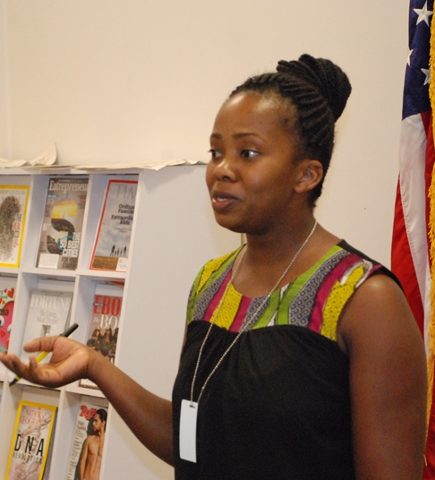
ELIGIBILITY REQUIREMENTS
WHO CAN APPLY?
Unrestricted Eligibility: any U.S. or non-U.S. organization, individual, non-profit, or for-profit entity

Slide 17
APPLICATION REQUIREMENTS
CAREFULLY READ THE ENTIRE NOTICE OF FUNDING OPPORTUNITY (NOFO).
Follow all instructions regarding the application format, content, timing and submission.
Failure to follow the instructions in the NOFO will be considered non-responsive and will result in rejection of the Application.
There will be a Question period. Submit in writing (by email) by the deadline indicated on the cover page. All answers will be provided in an Amendment that will be posted on SAM.gov.

Slide 18
PHASES PROCESS (4 Phases)
Phase 1 - Submission of Initial Application (Concept Paper)
Notification to Applicants Regarding Phase 1 Selection
3 Applicants will be selected to move on to Phase 2
Phase 2 – Concept Notes Review
Phase 3 - Oral Presentations
The applicant(s) with successful Concept notes will be invited to participate in Phase 3 of the solicitation process
Phase 4 - Co-Creation Process (Shared Responsibility, Collaboration, and Communication)
Phase 5- Full Application

Slide 19
APPLICATION DOs & DON’Ts
Review evaluation criteria: Study the evaluation criteria and their order of importance as listed in the solicitation. Typical evaluation criteria include technical expertise, staffing, experience and capabilities, and past performance.
Ask questions: The NOFO will include a point (or points) of contact. Only those individuals should be contacted about the solicitation; all questions should be submitted in writing.
Be aware of deadlines: Check dates and times, and take into account time zone differences. Information submitted past the deadline will likely not be accepted.
Follow instructions: The NOFO will include specific requirements and instructions for preparing your response. We recommend that organizations create a checklist of key items and mark them off as they are completed. If you do not follow the requirements exactly, your submission may be disqualified.

Slide 20
APPLICATION DOs & DON’Ts (cont.)
Understand USAID: It is important to demonstrate that your organization has an understanding of USAID’s operations. Review the Agency’s program cycle, and read relevant Country Development Cooperation Strategies.
Demonstrate ability to perform: Past performance information is a key factor for predicting successful performance. Your organization needs to provide information about your relevant recent past performance. If your organization is new to doing business with USAID or the U.S. Government, you can submit performance information from other work.
Explain how your proposed costs are competitive: We are responsible for achieving the best value in our awards. Solicitations usually request that cost proposals also outline a narrative describing, in detail, how your costs were developed.
Demonstrate financial and organizational responsibility: USAID makes a responsibility determination based on financial and organizational standing. We use the Federal Awardee Performance and Integrity Information System (FAPIIS) as one resource to verify this information, or the USAID Agreement or Contracting Officer may conduct a formal pre-award survey of your organization.

Slide 21
APPLICATION RESOURCES
Visit www.WorkwithUSAID.org for useful resources to assist you with the Application preparation and process.
  Pre-Engagement Assessment
  Effectively Responding to USAID Funding Opportunities
  Writing Your USAID Proposal
  Indirect Cost Rate Guide for Non-Profit Organizations
  Resource Library

Slide 22
UNIQUE ENTITY IDENTIFIER (UEI)
SAM.GOV REGISTRATION
To be eligible to apply for U.S. federal awards (grants or contracts), entities need to obtain the following registrations:
A non-U.S.-based organization must obtain a free NATO Commercial and Government Entity (NCAGE) code.
All organizations seeking federal funding must register in the System for Award Management (SAM), the official mechanism for potential partners to register to do business with the U.S. Government.
A U.S.-based organization needs a free CAGE code. This is generated when you apply for SAM, a process that can take 4+ hours.
Through SAM, all organizations will be assigned a 12-character alphanumeric Unique Entity Identifier (UEI).
Be sure to use your exact organization name for all registrations. Any variation may cause issues.

Slide 23
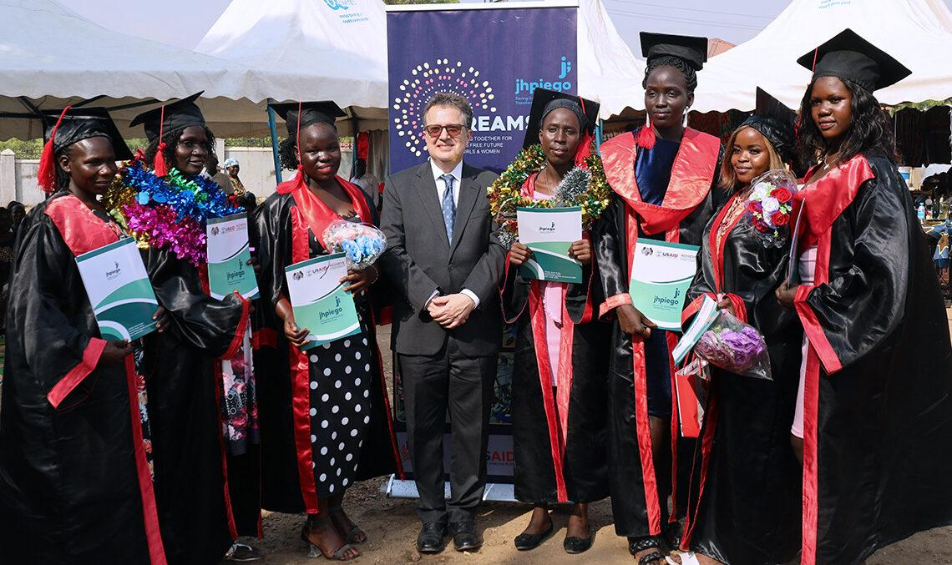
Shukran/Thank you!

