Slide 1
Performance Evaluation for USAID/West Africa/Regional Health Office AmplifyPF Regional Project: Phase 1
December 19, 2022
Martha Silva and Janna Wisniewski
With assistance from Abdou Louché Ado (Niger)

Slide 2


Session agenda
Overview of Evaluation Phase 1
Findings by research question
  Qualitative data
  Desk review
Implications for Evaluation Phase 2

Slide 3
Executive summary
The purpose of Phase 1 was to collect preliminary data and develop learning to inform the extent and methodology of the second phase of the evaluation.
Interviews and a desk review of project documents and data were conducted.
Findings related to cross-cutting contextual factors, the youth approach, institutionalization, partnerships between USAID and MOHs, the added value of the project, and the degree to which AmplifyPF met its objectives were presented.
The evaluation team suggested focal areas of Phase 2 of the evaluation.

Slide 4
Acronyms
AMPLIFYPF - Amplify Family Planning and Sexual and Reproductive Health project
CHW - Community Health Worker
CTAR - Comité Technique d’Appui au RIA (Technical Support Committee)
CYP - Couple-Years Protection
FP - Family Planning
DHIS2 - District Health Information Software 2
DQA - Data Quality Assessment
HIP - High Impact Practice
ILN - Integrated Learning Network

Slide 5
Acronyms
IP - Implementing Partner
ISBC - Identification Systématique des Besoins des Clients
LOP- Length of Project (target)
MoH - Ministry of Health
PAB - Plan d’Action Budgetisé
PPE - Personal Protective Equipment
PPFP - Post-Partum Family Planning
TOR - Terms of Reference
WABA - West Africa Breakthrough Action

Slide 6
Goal and objectives of AmplifyPF
Goal: Mobilize partners to expand access to and utilization of quality FP services in four selected West African countries
Objective 1 | Strengthen and institutionalize a system for adapting and replicating key family planning high impact practices
Objective 2 | Engage and leverage domestic donors and West African communities and resources to build sustainability and scale of selected high impact practices
Objective 3 | Institutionalize a sustainable and self-regulating system of service quality assurance and monitoring
Objective 4 | Collaborate and coordinate with other USAID FP/RH partners working on commodity security, demand creation, policy, learning, and related health systems

Slide 7
Aims of the evaluation
Overall: Collect data and develop recommendations that will inform the design of a new activity
Phase 1: Collect preliminary data and develop learning to inform the extent and methodology of the second phase of the evaluation

Slide 8
Phase 1 research questions
1. What cross-cutting contextual factors positively or negatively influenced family planning programming, implementation and achievement of results across the four countries?
2. How effective was AmplifyPF in addressing the gaps in sexual and reproductive health knowledge, behaviors, access to and uptake of services among youth?
3. How and to what extent have AmplifyPF’s interventions been institutionalized at national, district, and community levels?
4. What were the successes and challenges of the partnership between AmplifyPF and the USAID Missions and Ministries of Health?
5. What was AmplifyPF’s added value to the USAID Missions and government stakeholders in health programming?
6. How do Missions and Ministries of Health (MoH) want to be engaged in the future, based on lessons from the partnership?
7. To what extent did the project achieve its overall objectives in delivering desired/planned results?

Slide 9
Methods and data sources
Key informant interviews (n=11)
 | Regional | Togo | Burkina Faso | Niger | RCI | Total
AmplifyPF | 3 (m) | 1 (f) |  |  |  | 4
USAID Mission |  |  | 1 (m) |  | 1 (f) | 2
MoH FP |  | 1 (m) |  |  |  | 1
District lead |  | 1 (m) |  | 1 (f) |  | 2
Youth Ambassadors |  |  | 1 (f) | 1 (m) |  | 2

Slide 10
Methods and data sources
Desk review
AmplifyPF baseline data
AmplifyPF performance management plan
AmplifyPF midpoint review
AmplifyPF quarterly, annual, and COVID reports
Demographic and health surveys
Performance Monitoring for Action surveys
FP2030 report from Track20
Other partners’ reports (e.g., Breakthrough RESEARCH)

Slide 11
1. What cross-cutting contextual factors positively or negatively influenced family planning programming, implementation and achievement of results across the four countries?

Slide 12
Positive influences on programming and implementation
Flexibility
The ability to pivot as a cooperative agreement
  Shift in perspective from coordination project to service delivery project
  ILN accreditation changed to facility accreditation
  The project pivoted to equipping facilities once they realized that basic equipment was missing
  Offering a core package of service quality intervention while retaining focus on the ILN
Data Quality Assurance
Although DQA was extremely challenging (from gaining access to DHIS2 data, to aligning indicator definitions across countries, to improving timelines and completion of data), improvements in DQA in intervention districts have been equally extremely motivating

Slide 13
Positive influences on programming and implementation (2)
Close collaboration at multiple levels (regional partners [notably West African Breakthrough Action], national, district, and health facility)
  Coordination mechanisms with regional and national USAID implementing partners, with AmplifyFP as secretariat
  Integration of AmplifyFP into local implementation plans (Niger)
  Comité Technique d'Appui aux RIA (CTAR) as an innovation— importance of identifying the right people to be part of CTAR
  Site walkthroughs increased engagement and problem solving

Slide 14
Ongoing challenges identified
Lack of a clear long term sustainability strategy for some aspects of the project, particularly upstream human resource preparedness for HIPs
Commodity stockouts at the health facility level
High MoH staff turnover and other human resource shortages
Loaded workplans threatening the accomplishment of project activities in timely fashion
Intensification of project activities
Completing the process of providing medical and technical equipment to health facilities
Rapid setting up phase of new activities in AmplifyPF’s portfolio following an increase in project funding’s envelope

Slide 15
Negative influences on programming and implementation (1)
USAID's internal structure, communication, and staff turnover
  Coordination and communication between regional office and country mission was insufficient, leaving the IP to mediate
    We are asked to present a project in a country…and we find ourselves in a conflict situation...with the USAID health team. You see that's not comfortable, and we've been through that. (Amplify 3)
    [AmplifyPF] do the work planning without our involvement that much…sometimes they share the work plan with us for our review. But I think that we should frankly, we should be more involved." (USAID Country)
  Change of regional team—one team designed the project with one vision in mind, another arrived with a different vision
Notes:
ORIGINAL QUOTE
On nous demande d'aller présenter un projet dans un pays. On va vous présenter et on se trouve dans une situation conflictuelle... avec l'équipe santé de l'USAID. Tu vois que ça, c'est pas confortable et on a vécu ça.

Slide 16
Negative influences on programming and implementation (2)
Perceptions of a top-down approach within country-level planning and lack of flexibility when developing workplans
  But the project comes with the ToR. It's true that there is a sharing of ToR, either in hard (copy). That's what's been happening lately. At the beginning, it was by mail... and I can give my amendment, I can say no, that I propose that we put such amount, etc. But [now] it comes with an approved ToR which must be executed. That is a point that needs to be improved, I think. (Niamey district head)
Notes:
ORIGINAL QUOTE
Mais le projet vient avec le TdR. C'est vrai qu'il y a un partage de TdR, soit en hard. C'est ce qui se passe ces derniers temps. Au début, c'était par mail ... et je peux donner mon amendement, je peux dire non ça je propose qu'on mette tel montant, etc.. Mais c'est pas fini, ça vient avec un TDR approuvé ou il faut exécuter. Ça, c'est un point qu'il faut améliorer je pense.

Slide 17
Negative influences on programming and implementation (4)
CTAR membership and district staff turnover
Côte d'Ivoire: Less historical focus/investment in FP, and not having a full Mission meant that the necessary staff/experience was not there from the beginning

Slide 18
Negative influences on programming and implementation (3)
COVID-19 pandemic. No USAID mechanism to procure PPE, which was at odds with AmplifyPF's request and advocacy that health services remain open
The coup d'état and insecurity in Burkina Faso meant that the project had to shift to working only with the private sector in that country
However, both COVID-19 and insecurity led to innovations:
  With this insecurity they developed virtual monitoring, and we really love that because we can use that for the other project that we are supporting, where they go with the camera, even with COVID, because with COVID sometimes you cannot travel. So, the plan is a virtual monitoring we did with the healthcare facilities. And then they go there with the camera. We see they interview, you know, the nurse, the interview, the one taking care of the drugs. And they can show all the drugs that are in the room. We can see that in the camera, and we can do some monitoring like this." (Burkina Mission)

Slide 19
2. How effective was AmplifyPF in addressing the gaps in sexual and reproductive health knowledge, behaviors, access to and uptake of services among youth?

Slide 20
Positive aspects of youth approach (1)
Respondents agree that the Youth Champion approach has been very successful; project targets have been exceeded (>200%)
The approach is viewed as empowering to youth rather than something designed by adults and handed to them
Youth benefit from practical, engaging training
In Togo, youth contributed to implementing activities in PAB (plan d’action budgetisé)
  The primary objective of this project for young people is to strengthen their leadership and their visibility. (Youth 2 – Burkina Faso)
Notes:
ORIGINAL QUOTE
L'objectif principal d'abord de ce projet pour jeunes, c'est de renforcer leur leadership et leur visibilité.

Slide 21
Positive aspects of youth approach (2)
Both males and females are Young Champions
Youth use creative approaches for demand creation
  Social media literacy classes
  Produce content on multiple social media channels
  Referral coupons with follow-up
  Film showings and discussions
  Parental engagement
Young Champions conduct their own evaluations of their activities and report close collaboration with AmplifyPF staff

Slide 22
Challenges in implementing the youth approach
Coordination among youth groups needs to improve
Difficulty managing the action plan
Implementation budget is necessary to gain legitimacy
Youth informants were concerned that program coverage was not more extensive; youth were being missed
In Togo, services are still not set up to serve young people well
  Opening hours not set outside of school hours
  Youth are not well-received

Slide 23
3. How and to what extent have AmplifyPF’s interventions been institutionalized at national, district, and community levels?

Slide 24
Sustainable district-level interventions (project-wide)
Identification Systématique des Besoins des Clients (ISBC) - strong agreement that this is simple, low-cost, and successful enough to be scaled up and sustained
CTAR: Varied perspectives on potential for sustainability, dependent on local context
Youth Champion initiative: Young people are excited and invested
Community engagement/Site walkthroughs: Respondents felt well-prepared to continue

Slide 25
Cross-cutting issues for sustainability (1)
Incorporating activities within the MoH budget is key to sustainability but has yet to be broadly achieved
Sustainability of basic equipment and infrastructure in question
  What happens when the equipment Amplify has provided breaks or goes missing? (Amplify3)
Lack of buy-in from the state to invest, when even basic equipment is missing. Rather, facilities wait for the project to fund equipment
  So when we talk about sustainability... So, people know what to do, they know how to do it. They can even organize themselves to do so. But do states work in the sense that they are interested in sustainability? I do not believe. (Amplify3)
Important to note that one informant stated that cost-sharing has been strong in Year 4.
Notes:
ORIGINAL QUOTE
Donc quand on parle de pérennisation, il faut vraiment... C'est très beau. Nous tous, on parle de pérennisation, on parle de pérenisation. Donc les gens ont ce qu'il faut faire, ils savent le faire. Ils peuvent même s'organiser pour le faire. Mais est ce que les ethno-Etats travaillent dans le sens où ils sont intéressés par la pérennisation? Je ne crois pas.

Slide 26
Cross-cutting issues for sustainability (2)
Data quality assurance: development of SOPs
  In Niamey, the district head feels she is not ready to continue the data quality assurance without AmplifyPF

Slide 27
Burkina Faso (1)
Task-sharing
  Guidelines have been developed to train CHWs to provide FP services
  Plans for continued training of new CHW (yet untested)
  Insufficient capacity for supervision
  There is substantial resistance for task sharing among clinicians. Informants expressed a need to show that it is safe and advocate for evidence-based programming.

Slide 28
Burkina Faso (2)
Post-partum family planning
  Less progress than that seen in task-sharing. There is a need for greater emphasis on provider behavior change (e.g., respectful care).
  Postpartum family planning. There is a long way to go. Postpartum, post-abortion. There's a long way to go. I don't think the project is doing that much like they are doing in the task shifting (Burkina Mission)

Slide 29
Côte d'Ivoire
Task-sharing
  Although policies are in place, behavior change is slow due to the medicalized nature of the health care system
Historical under-investment in family planning thought to have slowed institutionalization of HIPs

Slide 30
Niger
Task-sharing
  Perception of lower effort and lower performance compared to PPFP
  A major challenge is that Niamey district does not hire midwives, rather they are unpaid volunteers
Post-partum family planning
  Identification Systématique des Besoins des Clients (ISBC) has revolutionized their practice and is sustainable due to its simplicity

Slide 31
Togo (1)
Task-sharing
  Documented SoPs and regulations provide clarity for roles and responsibilities
  Sustained pre-clinical and clinical training is harder to solve but the structure to supervise (once per quarter) already exists, with or without external support
  There is substantial resistance to task sharing among clinicians. Informants expressed a need to show that it's safe and advocate for evidence-based programming

Slide 32
Togo (2)
Post-partum family planning
  It’s clear and there is no turning back (Togo MoH)
  But there are several challenges, including continued training and supervision
  Pre-service training in PPFP is not yet widespread
Notes:
ORIGINAL QUOTE
C'est clair et il n'y a pas de retour en arrière possible

Slide 33
4. What were the successes and challenges of the partnership between AmplifyPF and the USAID Missions and Ministries of Health?

Slide 34
Successes in partnerships
AmplifyPF came in with an innovative approach that required working towards buy-in, and MoHs have embraced and adopted
In Togo, long-standing relationships are leveraged and parties understand each other well (Amplify and MoH)
  I consider that all the partners who are in the country, they are there to support us in implementing our action plans, that we call on to solve our problems. And the minimum that we can do is to be available to work with them and their partners together, to pose our problems clearly. Say what is available, what is left, what we expect from them, and it is also up to them to tell us the conditions under which they can support us. (Togo MoH)
Notes:
ORIGINAL QUOTE
Je considère que tous les partenaires qui sont dans le pays, qu'on avait des partenaires mais sont là pour nous accompagner à mettre en œuvre nos plans d'action que nous appelons à résoudre nos problèmes. Et le minimum que nous puissions faire, c'est d'être disponible pour travailler avec, avec eux et ses partenaires ensemble, poser nos problèmes clairement. Dire ce qui est disponible, ce qui reste, que nous attendons d'eux et à eux aussi de nous dire les conditions dans lesquelles ils peuvent nous appuyer

Slide 35
Challenges in partnerships
Overall, very positive feedback in partnership, despite "growing pains" in early engagement
Niger: Discomfort expressed about changes in reference and workplans with less opportunity than expected to influence these changes
Burkina Faso: Staffing challenges made it difficult to be as engaged as they would have liked

Slide 36
5. What was AmplifyPF’s added value to the USAID Missions and government stakeholders in health programming?

Slide 37
Added value to districts
Improved district level performance—districts gained notoriety / recognition
ILN approach mobilizing funding for health facilities is innovative and making a difference (Burkina Mission)
Site walkthrough activity building capacity of the communities and staff to sustain engagement (Burkina Mission)
  …and there are some who have never visited a peripheral structure, and seeing what they saw, they put their hand in their pocket and they filled some gaps (Niger district head)
Notes:
ORIGINAL QUOTE
…et il y en a qui n'ont jamais visité une structure périphérique et vu ce qu'ils ont vu, ils ont mis la main de la poche et ils ont paqueté dans certains compléments de gap

Slide 38
Added value to countries
Harmonized indicator definitions
Improved data availability and quality

Slide 39
6. How do Missions and Ministries of Health want to be engaged in the future, based on lessons from the partnership?

Slide 40
Stakeholder recommendations (1)
Mission involvement in regional project development
  Who should lead? Should they come from where the money originates or where the project is implemented?
We are the one leading and then they have the input because it is in the country. We know the context, We know the background. We have much knowledge of the country more than the other people, I would say. (USAID Country)
Several informants urged engagement with MoH so they do not feel that a project is being imposed upon them
More support for implementing partner in advocating for changes/inclusions in DHIS2 (Amplify2 requested that USAID be more involved)

Slide 41
Stakeholder recommendations (2)
Engage with district leaders during development stage, not just when plans are finalized
Engage political leaders
  There must, therefore, be in the first place this commitment there that we see from our political leaders who are very, very listened to. There has to be direction. Maybe they need to be oriented, they need to engage. Not only spoken commitment, but, and they can build the health centers. (Niamey district head)
Agree to cover entire districts/entire regions
Increase investment in PBC—infrastructure and training are not enough
Increase transparency when communicating decisions about what is retained and excluded from the work plan (Togo).

Slide 42
Stakeholder recommendations (3)
Integrate Youth Champions into MoH strategy and formalize their roles (much like CHWs)
  We have community workers who are personnel who are directly attached to the Ministry of Health. If we can also do the same thing with the Young Champions, I think it would be a very good thing because for the moment, they are solely dependent on the project. So, if there was a possibility of also being able to institutionalize this step for young people who are directly attached to the Ministry, a bit like community workers, that could be a very good thing. (Amplify2)
Continue integration of service delivery and social and behavior change funded partners such as AmplifyPF and WABA
Multiple community stakeholders and donors expect to see the results of their investments. Create social/community accountability scoreboards to help visualize their investments in aggregate.

Slide 43
7. To what extent did the project achieve its overall objectives in delivering desired/planned results?

Slide 44
Goal: Mobilize partners to expand access to and utilization of quality FP services in four selected West African countries
 | Baseline (n) | Percentage of target achieved |  |  |  | % LOP target achieved
 | Baseline | Y1 | Y2 | Y3 | Y4 | LOP target
Number of Couple-Years Protection (CYP) achieved in AmplifyPF intervention districts | 129,268 | 53.0 | 102.0 | 130.0 | 128.4 | 91.8
Number of new users of modern FP methods in AmplifyPF intervention districts | 36,946 | 45.9 | 91.5 | 96.8 | 98.7 | 71.5
Number of clients’ who received an FP method from the ILNs facilities during the reporting period (new and continuing) | 241,367 | 43.6 | 76.7 | 96.6 | 100.6 | 69.2
Percent of women who deliver in a facility and initiate or leave with a modern contraceptive method prior to discharge (Immediate Post-Partum FP) | Unavailable at project level | 144.6 | 76.2 | 144.6 | 161.6 | Unavailable at project level
Percent of postabortion care clients who left the facility with a contraceptive method | Unavailable at project level | 64.3 | 115.3 | 144.1 | 104.7 | Unavailable at project level
Source: AmplifyPF routine data
Notes: Baseline data represents the initial eight ILNs. Percentage of Length of Project (LOP) achieved shows progress as of September 2022.
Colors: Green (100% or above); Orange (90.0%- 99.9%); Pink: (less than 90.0%)

Slide 45
Stakeholder perspectives (1)
CYP and CPR improvements were attributed to AmplifyPF by national and district stakeholders
Improved functionality of CTAR—coordination groups existed in Togo but were not functional
Data quality
  Today, if you compare the quality of data in the districts covered by Amplify to other health districts that do not have this possibility, you will see the difference (Amplify3)
  Niger has requested data quality assurance technical assistance in non-implementation districts. (Amplify 2)
Notes:
ORIGINAL QUOTE
Qu'aujourd'hui, si vous comparez la qualité des données dans les districts couverts par Amplify aux autres districts sanitaires qui n'ont pas cette possibilité là, vous allez voir la différence

Slide 46
Stakeholder perspectives (2)
  Several districts that are not part of FP partners are asking us to share with them our various indicators, how did we get there? (Niger district head)
  We have been able to advocate with other projects who have seen that this practice actually, This approach is really promising. And so, these projects are committed to replicating that. (Amplify3)
  When they really do comparisons between districts, they realize that districts covered by Amplify really are different from other districts. I think it's a very good testimonial that really demonstrates that our passage was really able to create an impact that is quite visible. (Amplify2)
Notes:
ORIGINAL QUOTES
Plusieurs districts qui ne font pas partie de partenaires de la PF nous sollicite pour partager avec eux nos différents indicateurs comment en est-on arrivé? (Niger district head)
Nous avons pu faire le plaidoyer auprès d'autres projets qui ont vu que cette pratique en fait, cette approche là est vraiment porteuse. Et donc ces projets là se sont engagés à répliquer cela. (Amplify3)
Lorsqu'ils font des comparaisons vraiment entre les districts, ils se rendent compte que vraiment des districts couverts par Amplify vraiment sont différents des autres districts. Je pense que c'est un très bon c’est un témoignage qui démontre à suffisance vraiment, que notre passage a pu vraiment créer un impact qui est assez visible. (Amplify2)

Slide 47
Attribution of impact
DHIS2 data: Longitudinal data is not publicly available
Demographic and Health Survey data: Too infrequent
PMA2020: Too infrequent; recent years not yet available
FP2030 by Track20: Annual, but not disaggregated by district
Project-specific data sets: Very targeted but often several years old

Slide 49
Goal: Mobilize partners to expand access to and utilization of quality FP services in four selected West African countries
Burkina Faso | 2010 | 2014 | 2018 | 2021
Total fertility rate | 6.0 | 5.5 | 5.2 | 4.4
Women aged 15-19 who have ever been pregnant | - | - | - | 20.1
Modern method (married WRA) | 15.0 | - | - | 31.5
Modern method (unmarried, SA WRA) | 58.7 | - | - | 59.4
Unmet need for family planning (married WRA) | 37.2 | - | - | 15.5
Unmet need for family planning (unmarried SA WRA) | - | - | - | 30.0
Niger | 2012
Total fertility rate | 7.6
Women aged 15-19 who have ever been pregnant | 40.4
Modern method (married WRA) | 12.2
Modern method (unmarried, SA WRA) | 39.9
Unmet need for family planning (married WRA) | 16
Unmet need for family planning (unmarried SA WRA) | -
Côte d'Ivoire | 2012 | 2021
Total fertility rate | 5.0 | 4.3
Women aged 15-19 who have ever been pregnant | 29.6 | 22.7
Modern method (married WRA) | 12.5 | 17.9
Modern method (unmarried, SA WRA) | 30.2 | 42.6
Unmet need for family planning (married WRA) | 13.7 | 22.3
Unmet need for family planning (unmarried SA WRA) | 22.2 | 32.6
Togo | 2014 | 2017
Total fertility rate | 4.8 | 4.4
Women aged 15-19 who have ever been pregnant | 16.5
Modern method (married WRA) | 17.3
Modern method (unmarried, SA WRA) | 38.4
Unmet need for family planning (married WRA) | 33.6
Unmet need for family planning (unmarried SA WRA) | -
Source: Demographic and Health Surveys and Malaria Indicator Cluster Surveys

Slide 50
Goal: Mobilize partners to expand access to and utilization of quality FP services in four selected West African countries
Source: PMA2020. Data are from all women of reproductive age.

Slide 51
Goal: Mobilize partners to expand access to and utilization of quality FP services in four selected West African countries
Source: PMA2020. Data are from all women of reproductive age.

Slide 52
Goal: Mobilize partners to expand access to and utilization of quality FP services in four selected West African countries
AmplifyPF
AmplifyPF
Source: FP2030 by Track20

Slide 53
Goal: Mobilize partners to expand access to and utilization of quality FP services in four selected West African countries
AmplifyPF
AmplifyPF
Source: FP2030 by Track20

Slide 54
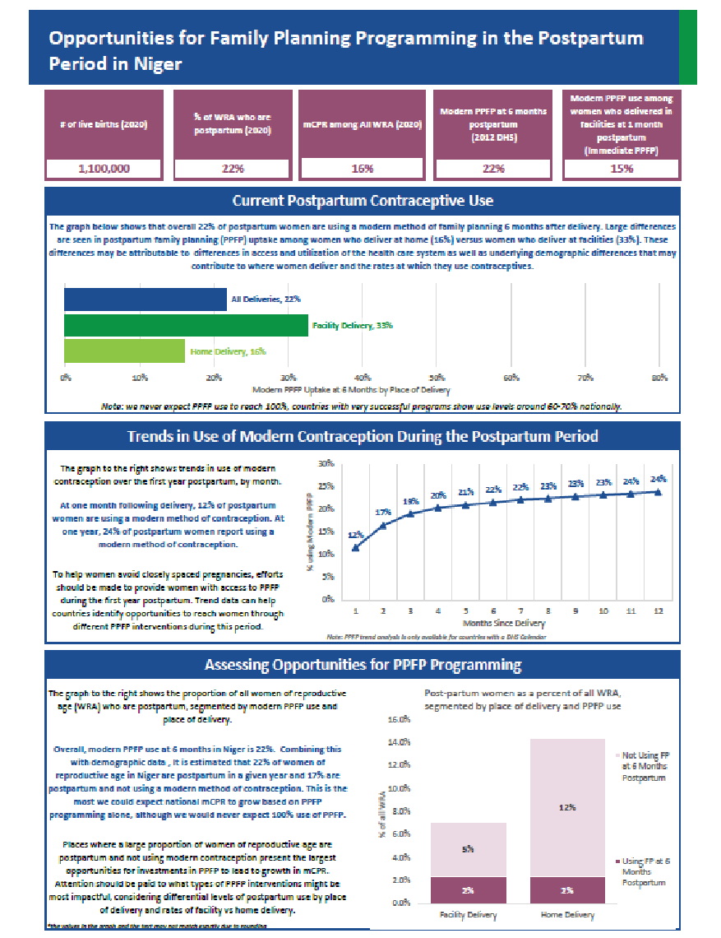
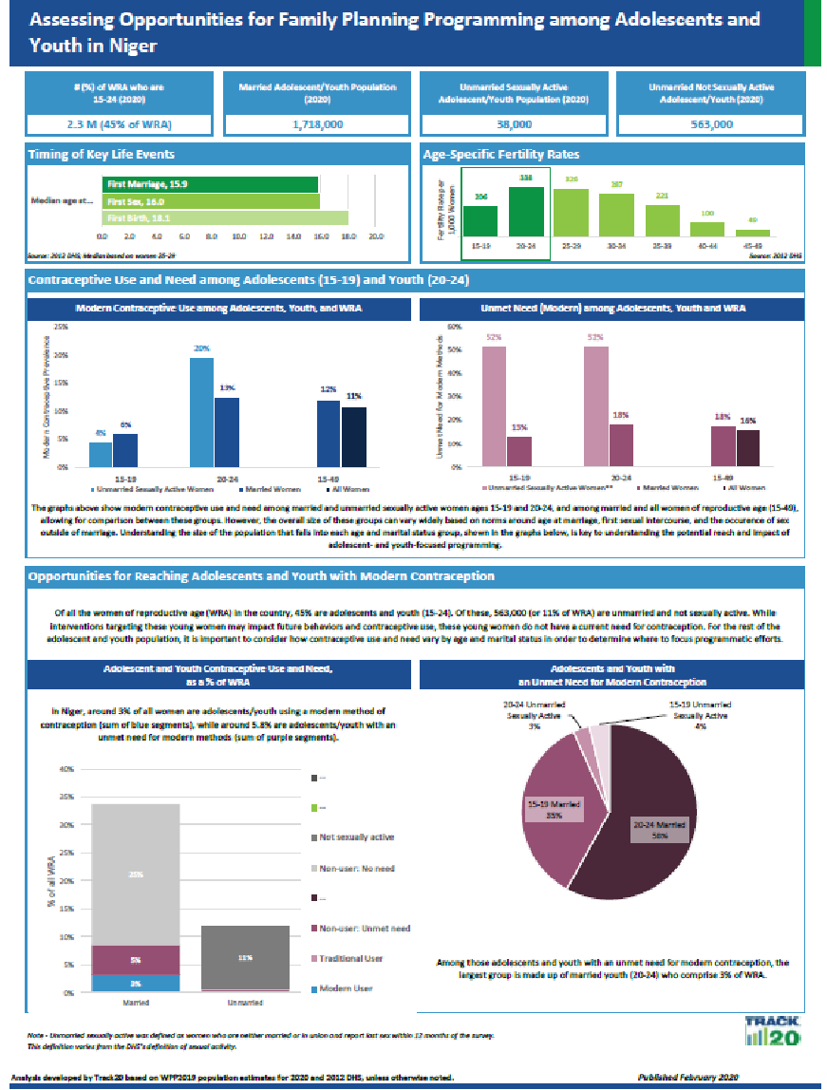
Source: FP2030 by Track20

Slide 55
Objective 1: Strengthen and institutionalize a system for adaptation and replication of key family planning high impact practices
IR 1.1: Integrated Learning Centers (ILNs) established in four target countries
 | Percentage of target achieved
 | Y1 | Y2 | Y3 | Y4
Number of functioning ILNs in target countries (direct) | 62.5 | 100.0 | 100.0 | 100.0
Source: AmplifyPF routine data

Slide 56
Objective 1: Strengthen and institutionalize a system for adaptation and replication of key family planning high impact practices
IR 1.2: ILNs serve as adaptive learning incubators for implementing HIPs
 | Percentage of target achieved
 | Y1 | Y2 | Y3 | Y4
Percent of USG-assisted service delivery sites providing family planning counseling and/or services | 100.0 | 102.7 | 100.0 | 400.0
Number of USG-assisted CHWs providing FP information, referrals, and/or services during the year | 0.0 | 174.3 | 152.4 | 148.5
Percent of Quality Improvement Teams established or supported by AmplifyPF that resolved at least one of the issues they identified and addressed | No QIT established with AmplifyPF support during these years. |  |  | 143.8
Average stock out rate of contraceptive commodities at FP service delivery points | Not reported | 27/28 meet or exceed | 22/28 meet or exceed | Data issue
Number of adolescents and young people reached by sensitization activities supported by AmplifyPF | N/A | 0.0 | 131.2 | 448.1
Source: AmplifyPF routine data

Slide 57
Objective 1: Strengthen and institutionalize a system for adaptation and replication of key family planning high impact practices
IR 1.3: Country-level HIP focus groups established to support ILN model and HIP replication
Support the establishment and operation of the committees in charge of HIP scale-up | Q1Y4: Niger Q2Y4: Niger and Togo Q4Y4: Planned for all countries
Support the review of HIP implementation | Q1Y4: Togo Q2Y4: Burkina Faso
Monitoring of AmplifyPF activities implemented by USAID RHO | Q1Y4: Burkina Faso and Togo Q2Y4: Côte d'Ivoire
Strengthen the capacities of country teams in team building, procurement procedures, change management and brief communication | Q4Y4: Planned for regional level
Source: AmplifyPF quarterly reports

Slide 58
Objective 1: Strengthen and institutionalize a system for adaptation and replication of key family planning high impact practices
IR 1.4: System of strategic adaptation established in collaboration with key partners to replicate HIPs outside of direct ILNs
 | Percentage of target achieved
 | Y1 | Y2 | Y3 | Y4
Number of policies or guidelines developed or changed with USG assistance to improve access to and use of family planning and reproductive health services | N/A | 480.0 | 200.0 | 144.4
Source: AmplifyPF routine data

Slide 59
Objective 2: Engage and leverage domestic donors and West African communities and resources to build sustainability and scale of selected HIPs
IR 2.1: Country-level scale up of HIPs activities institutionalized
Support the revision, multiplication and dissemination of normative documents related to HIPs as needed | Q1Y4: Côte d'Ivoire, Niger, Togo Q2Y4: Niger and Togo Q3Y4: Côte d'Ivoire and Niger
Support the establishment and operation of committees in charge of scale-up of HIPs | Q4Y4: Planned for all countries
Strengthen the capacities of country teams in team building, procurement procedures, change management and brief communication | Q4Y4: Planned for regional level
Source: AmplifyPF quarterly reports

Slide 60
Objective 2: Engage and leverage domestic donors and West African communities and resources to build sustainability and scale of selected HIPs
IR 2.2: Regional-level scale up of HIPs activities institutionalized
 | Percentage of target achieved
 | Y1 | Y2 | Y3 | Y4
Number of institutions/initiatives met during regional collaboration, learning, and dissemination events leveraged | 0.0 | 280.0 | 240.0 | 110.0
Source: AmplifyPF routine data

Slide 61
Objective 2: Engage and leverage domestic donors and West African communities and resources to build sustainability and scale of selected HIPs
IR 2.3: Existing networks of USG-funded and non-USG funded programs leveraged
Exchanges with platform projects | Q1Y4: Burkina Faso and Niger Q2Y4: Côte d'Ivoire and Niger Q3Y4: Côte d'Ivoire and Niger
Coordination meeting and joint planning with other USAID projects | Q1Y4: All four countries Q2Y4: All four countries Q3Y4: Burkina Faso, Niger, Togo
Momentum Country and Global Leadership (MCGL) co-creation workshop | Q2Y4: Togo
Prepared supply plans for reproductive health products including contraceptives | Q2Y2: Regional level
Source: AmplifyPF quarterly reports

Slide 62
Objective 2: Engage and leverage domestic donors and West African communities and resources to build sustainability and scale of selected HIPs
IR 2.4: Private sector resources/municipalities leveraged and mobilized
Strengthen the capacity of ILN municipal leaders to mobilize internal and external resources to support ILNs and develop a resource mobilization plan | Q1Y4: Côte d'Ivoire and Togo Q2Y4: Burkina Faso, Côte d'Ivoire, Niger Q3Y4: Togo
Monitoring of resource mobilization in ILNs | Q1Y4: Regional level Q2Y4: Burkina Faso, Niger, Togo Q3Y4: Côte d'Ivoire, Niger, Togo
Source: AmplifyPF quarterly reports

Slide 63
Objective 3: Institutionalize a sustainable and self-regulating system of service quality assurance and monitoring
 | Percentage of target achieved
 | Y1 | Y2 | Y3 | Y4
Percent of USAID-assisted service sites in the ILNs assessed deemed quality competent based on an assessment, according to national, international, or other defined standards/tool (as defined by the HCG) | N/A | 0.0 | 31.7 | 142.9
Source: AmplifyPF routine data

Slide 64
Objective 3: Institutionalize a sustainable and self-regulating system of service quality assurance and monitoring
IR 3.1: National level quality control authority established
Train AmplifyPF country teams and Ministry of Health staff in charge of data on DQA | Q1Y4: Côte d'Ivoire Q2Y4: Burkina Faso and Niger Q3Y4: Togo
Develop client exit interview questionnaire to measure quality of care and client satisfaction | Q1–2Y4: Regional level
Provide technical and financial support for conducting DQAs at AmplifyPF sites | Q1Y4: Côte d'Ivoire and Togo Q2–3Y4: All four countries
Monitor the quality of HIP implementation (including data quality via DQA) | Q1Y4:All four countries Q2Y4:All four countries Q3Y4: Côte d'Ivoire, Niger, Togo
Source: AmplifyPF quarterly reports

Slide 65
Objective 3: Institutionalize a sustainable and self-regulating system of service quality assurance and monitoring
IR 3.2: QA tools for facility and ILN level monitoring of HIP implementation developed
Compile and share results of self-assessments with country teams | Q1Y4: Côte d'Ivoire, Niger, Togo Q2Y4: Niger and Togo Q3Y4: Niger and Togo
Establish additional quality improvement teams | Q1Y4: All four countries Q2Y4: Burkina Faso and Niger Q3Y4: Niger
Coaching of QITs in collaboration with WABA | Q1Y4: Niger and Togo Q2Y4: Burkina Faso, Niger, Togo Q3Y4: Niger
Support the implementation of quarterly self-assessments | Q1Y4: Côte d'Ivoire, Niger, Togo Q2Y4: Togo

Slide 66
Objective 3: Institutionalize a sustainable and self-regulating system of service quality assurance and monitoring
IR 3.3: Regional level QA accreditation body established
 | Percentage of target achieved
 | Y1 | Y2 | Y3 | Y4
Number of ILNs accredited | 0.0 | 0.0 | 0.0 | 0.0
Source: AmplifyPF routine data

Slide 67
Objective 4: Collaborate and coordinate with other USAID FP/RH partners working on commodity security, demand creation, policy, learning, and related health systems
IR 4.1: USG project support coordinated to achieve Amplify-FP goals at national and regional levels
 | Percentage of target achieved
 | Y1 | Y2 | Y3 | Y4
Cumulative number of institutions/initiatives active/working in the RH/FP met in all four countries (in-person) | 0.0 | 86.7 | 164.7 | 55.0
Cumulative number of institutions/initiatives active/working in the RH/FP met in all four countries (virtual) | 0.0 | 25.0 | 200.0 | 53.3
Source: AmplifyPF routine data

Slide 68
Objective 4: Collaborate and coordinate with other USAID FP/RH partners working on commodity security, demand creation, policy, learning, and related health systems
IR 4.2: Regional FP/RH forums convened
 | Percentage of target achieved
 | Y1 | Y2 | Y3 | Y4
Number of regular, documented forums for information sharing and discussion held or supported by the project, including with USG-funded projects | 350.0 | 75.0 | 162.5 | 25.0
Source: AmplifyPF routine data

