Slide 1
CDC-RFA-PS19-1909
National Harm Reduction Technical Assistance and Syringe Services Program (SSP) Monitoring and Evaluation Funding Opportunity
Informational Conference Call
May 9, 2019
National Center for HIV/AIDS, Viral Hepatitis, STD, and TB Prevention

Slide 2
Welcome and opening remarks
Michelle Van Handle, MPH
Associate Director
Program and Performance Improvement Office
National Center for HIV/AIDS, Viral Hepatitis, STD, and TB Prevention

Slide 3
Welcome to the Conference Call
Thank you for your participation
Logistical Details
  This call is being recorded
  Please hold all questions until the end of the call
  Please mute your phone
Roll Call

Slide 4
Conference Call Purpose and Objectives
Purpose
  To present an overview of the National Harm Reduction Technical Assistance and Syringe Services Program (SSP) Monitoring and Evaluation Funding Opportunity (NOFO) to inform and prepare prospective applicants to develop a strong application
Roadmap for today
  Describe NOFO details
  Provide clarification on eligibility requirements
  Discuss technical assistance and resources available to applicants
  Describe details of the procurement and grants process
  Q & A

Slide 5
Introduction and overview

Slide 6
Program Summary
This three year program will
  Strengthen the capacity and improve the performance of harm reduction programs throughout the United States
  Implement a monitoring and evaluation of syringe services programs.
  Help prevent infectious disease resulting from injection drug use; and
  Improve health outcomes for people who inject drugs

Slide 7
Long Term Outcomes
Improved health outcomes of persons who inject drugs
Reduced incidence of infectious disease resulting from injection drug use
Reduced injection drug use and other high risk substance use

Slide 8
Primary activities
This three-year NOFO is composed of two demonstration projects, and two components:
  technical assistance
  monitoring and evaluation
Activities will include:
  Providing technical assistance to SSPs,
  Developing a national training network; and
  Implementing a SSP monitoring and evaluation program.

Slide 9
Components and Demonstration Projects
Component 1: Harm Reduction Technical Assistance
Component 2:
SSP Monitoring and Evaluation
Demonstration Project 1a:
Patient Navigation at SSPs
Demonstration Project 2a:
IDU Surveillance

Slide 10
Component 1: Harm Reduction Technical Assistance
Activities | Short and Intermediate Term Outcomes
Activity 1: Develop a national network that provides harm reduction technical assistance responsive to the needs of states and local jurisdictions | Strengthened capacity of jurisdictions to implement comprehensive SSPs to prevent the infectious disease consequences of injection drug use (IDU) Improved sustainability of SSPs Improved linkage to medication-assisted treatment from SSPs Improved screening and linkage to care for infectious disease at SSPs
Activity 2: Create toolkit to support the implementation of SSPs in urban, suburban and rural areas

Slide 11
Recipient awarded to complete activities under Component 1 must complete activities under demonstration project 1a

Slide 12
Demonstration Project 1a: Patient Navigation Program at SSPs
Activities | Short and Intermediate Term Outcomes
Activity 1: Develop patient navigation program at 8 SSPs to link clients to medication-assisted treatment (MAT) and to care and treatment for infectious disease | Strengthened connections from SSP to other community programs Strengthened capacity of SSPs to support PWID seeking access to MAT and other infectious disease care Increased use of MAT by PWID Increased access to care and treatment for infectious disease resulting from IDU for PWID
Activity 2: Develop guidance on best practices for patient navigation

Slide 13
Component 2: Monitoring and Evaluation of SSPs
Activities | Short and Intermediate Term Outcomes
Activity 1: Work with SSPs to improve program data collection and reporting for local monitoring and evaluation | Improved implementation of SSPs Improved capacity of CDC and partners to monitor SSP services and program needs in the US Improved capacity of CDC to support and sustain SSPs Improved capacity of SSPs to measure their local impact
Activity 2: Develop and implement a national monitoring and evaluation program for SSPs
Activity 3: Develop national standardized metrics for monitoring SSPs

Slide 14
Recipient awarded to complete activities under Component 2 must complete activities under demonstration project 2a

Slide 15
Demonstration Project 2a: Injection drug use surveillance
Activities | Short and Intermediate Term Outcomes
Activity 1: Develop a survey instrument to collect individual-level data from SSP clients and their peers | Strengthened capacity of SSPs to describe and meet the needs of their client population Strengthened capacity of SSPs to understand local drug use trends Establishment of a national surveillance system to identify new and emerging issues impacting PWID and other persons who use drugs
Activity 2: Work with SSPs nationwide to use a data collection platform to capture client-level program data
Activity 3: Develop and implement a survey of SSP clients and their drug-using peers in a select sub-sample of SSPs

Slide 16
Funding
Total funding for 3-year program $6,925,000
Year one is funded at $4,975,000
Component 1 [Technical assistance] funded at $850,000/annually
Component 2 [SSP Monitoring and evaluation] at $125,000/annually
The demonstration projects are funded in year one for a total of $4,000,000
  Demo project 1a [patient navigation at SSPs]: $1,000,000
  Demo project 2a [IDU surveillance]: $3,000,000

Slide 17
Q&A
Q: Are the demonstration projects optional?
A: No, the demonstration projects are not optional.
Component 1 – Funded organizations also must conduct activities for component 1a in year one.
Component 2 – Funded organizations also must conduct activities for component 2a in year one.
Separate budgets must be submitted for components and demonstration projects.
Q: How long are the demonstration projects funded for?
A: Currently, resources are only available in year 1 for these activities.

Slide 18
For which component(s) should my organization apply?
Organizations may apply for component 1, 2, or both, but must submit a separate work plan and budget for each component.
Organizations applying to component 1 (Technical Assistance), must conduct activities for demonstration project 1a (Patient Navigation from SSPs).
Organizations wishing to apply for component 2 (SSP Monitoring and Evaluation), must conduct activities for demonstration project 2a (IDU Surveillance).
No more than 2 organizations will be funded under this cooperative agreement

Slide 19
Q&A
Q: The logic model states a long-term outcome is to reduce the infectious disease consequences of the opioid epidemic. Does this mean we can focus on reducing infections such as endocarditis, MRSA or STDs, or should we focus on hepatitis C and HIV?
A: Components 1 & 2 are funded by Congressional appropriation authorizing activities that address hepatitis B and C and HIV.
Demonstration project 1a and 2a are funded under a different budget activity. Work under these activities allows funding to be used to address the infectious disease consequences of opioid use and overdose to advance the understanding the of the opioid overdose epidemic.

Slide 20
Strategies and activities

Slide 21
Strategies and activities: Component 1
Technical Assistance
Recipient will collaboratively develop and deliver a national comprehensive technical assistance program to increase harm reduction knowledge, skills and competencies of staff supporting existing SSPs and to local health departments or community based organizations wishing to develop and implement SSPs.
Develop a system for SSPs nationwide to request TA
Develop a national training network for SSPs
Creation of a harm reduction technical assistance toolkit

Slide 22
Strategies and activities: Component 1
Technical Assistance
Training curricula, materials and toolkit must cover, among other topics:
  Providing comprehensive services
  Teaching cultural competency for working people who inject drugs
  Providing linkage to care and building community health systems
  Building local champions and stakeholder support
  Addressing syringe disposal in communities
  Delivering services in rural and suburban areas
  Educating stakeholders and policy makers on evidence-based practices
  Working with law enforcement.

Slide 23
Strategies and activities: Demonstration Project 1a
Patient Navigation
Successful recipient will pilot a 1-year program providing patient navigators at 8 SSPs
Navigators will link clients with opioid use disorder to MAT, and to programs offering care and treatment for infectious disease associated with injection drug use, including viral hepatitis and HIV.

Slide 24
Strategies and activities: Demonstration Project 1a
Patient Navigation
Determine metrics to be collected in patient navigation program
Identify 8 SSPs that will participate in this demo project.
  All participating SSPs must be located in areas where accessing MAT is possible, with support from a patient navigator.
  Participating SSPs must not have a patient navigation program already in place, but should have the capacity to start one quickly once resources have been made available.
  Co-located where “Increasing use of medication assisted treatment to address opioid use among patients with bacterial and fungal infections related to injection drug use” (NCEZID) being funded by CDC in selected sites
  Develop guidance on replicating successes in other locations

Slide 25
Strategies and activities: Component 2
SSP Monitoring and Evaluation
The recipient will develop and implement a monitoring and evaluation program for SSPs
  Develop guidance on monitoring and evaluation for SSPs
  Provide data coordination: work with sites to conduct data cleaning, conduct data reconciliation, and identifying errors.
    Combine and analyze data sets and provide combined data set to CDC.
Monitor and track SSPs in the U.S., including openings and closings, locations, and services offered

Slide 26
Strategies and activities: Component 2
SSP Monitoring and Evaluation
Support local program evaluation/outcome monitoring at SSPs nationwide.
  Biannually, work with SSPs to gather information from SSP clients, focusing on how the local program succeeds in meeting the needs of their clients, measuring client satisfaction, and gaps in services.
Work with SSPs to collect summarized data from individual organizations and produce an annual national SSP report

Slide 27
Strategies and activities: Component 2a
Injection Drug Use Surveillance
Develop and pilot a survey that collects information on substance use and injection use trends and risk behaviors
  Using customizable technology solution designed to capture self-reported client data from individuals engaging with SSPs
Collect in-depth information from a subset of SSP clients and their drug-using peers on their drug use practices, experiences with overdose, infectious disease and bacterial infections
Share results of survey via SSP report

Slide 28
Q&A
Q: Is the expectation that a funded recipient will work with all SSPs in the United States?
A: The target goal is to work with at least 80% of SSPs (as identified by the North American Syringe Exchange Network: https://www.nasen.org/map/) in the United States in urban, suburban and rural areas

Slide 29
Q&A
Q: A second activity under demonstration project 2a (IDU Surveillance) is the implementation of survey system in 50 SSP and 250 of their drug-using peers. May we budget funds for incentives to ensure participation in this survey?
A: Yes, applicants may budget in survey incentives. Applicants will be required to prepare a detailed budget as part of the application consistent with instructions in the funding opportunity announcement and application instructions.

Slide 30
CDC Activities

Slide 31
Work with Recipient Programs
Support Activities
Support Staff & Programmatic Trainings
Provide Technical Assistance & Guidance
Assist in Conducting Monitoring & Evaluation Activities
Provide Current Information, Surveillance Data & Recommendations
Provide Standardized Data Collection Forms & Templates
Perform Yearly Evaluations & Provide Feedback to Grantees

Slide 32
Collaboration Expectations
Recipients will be required to routinely exchange information and work closely with other recipients under this NOFO, and, as directed, other groups funded by CDC to conduct related activities.

Slide 33
Who can apply? Who will be awarded?
Unrestricted eligibility
Recipients must have a minimum 5 years history of establishing, building, and/or maintaining working partnerships to facilitate ongoing development and delivery of their respective services (i.e., technical assistance, and/or SSP monitoring and evaluation).
Recipients must have demonstrated capacity to reach SSPs nationwide, which includes urban, suburban and rural areas
Recipients are expected to have subject matter expertise in harm reduction and SSPs

Slide 34
Who can apply? Who will be awarded?
Successful applicant will:
  Describe an overall approach consistent with the Approach and Purpose of the NOFO to conduct activities required for the selected component
  Demonstrate coordination and collaboration with harm reduction organizations, local health departments and community-based organizations
  Demonstrate a quality, comprehensive plan that has the potential to meet the outcomes described in this NOFO’s logic model
  Demonstrate that the proposed use of funds is an efficient and effective way to implement the strategies and activities and attain the period of performance outcomes. (up to 7 points)
Strong applications include an SSP engagement and communications strategy and describes how applicant will develop programs associated with selected component

Slide 35

Timeline
Funding announcement publication: May 1, 2019
Informational call May 9, 2019
Letters of Intent due: May 24, 2019
Applications due: June 26, 2019
Notice of Award: September 2
(Notice of award is an estimate and subject to change)

Slide 36
Letters of Intent
Letters of intent must be sent via U.S. express mail, delivery service, or email by May 24th
Please send to:
Harm Reduction NOFO
Centers for Disease Control, NCHHSTP
1600 Clifton Rd, MS 8-06
harmreduction@cdc.gov

Slide 37
Q&A
Q: Are letters of intent mandatory?
A: No, letters of intent are not required, but appreciated. When we have a sense of how many applicants to expect, we can better prepare for the review process.
Q: What should we include in the letter of intent?
A: Please include any other organizations expected to be collaborating on this project; the component(s) to which you will be applying; and indication that organization has the current capacity to work with SSPs nationwide.

Slide 38
Application and Submission Information
Application Deadline: June 26, 2019 11:59 p.m. EST
CDC Assurances and Certifications
Project Abstract (maximum of 1 page)
  Summary of the proposed activity suitable for dissemination
Project Narrative (maximum of 20 pages)
  This includes the work plan
  Activities to be conducted over the entire project period
  12 point font, 1-inch margins, number all pages
  Content beyond the specified page number will not be reviewed
Application Appendices
Funding Restrictions
Electronic Submission
  www.grants.gov
  Validation process may take up to two (2) business days

Slide 39
Application Review Information
Review and Selection Process
  Initially reviewed for completeness by OGS
  Eligible applicants jointly reviewed for responsiveness by NCHHSTP and OGS
  Technical Structured Review conducted by NCHHSTP
Scoring Criteria
  Approach (30 points)
  Evaluation and Performance Measurement (25 points)
  Organizational Capacity to Implement the Approach (45 points)
  Budget and Budget Narrative (reviewed but not scored)

Slide 40
Award Administration Information
Award Notices
  Receipt of a Notice of Grant Award from OGS
  The Notice of Grant Award will be signed by an authorized GMO and the recipient can retrieve the notice of award from GrantSolutions
  All grantees are subject to the DUNS and CCR requirements in GrantSolutions
Administrative and National Policy Requirements
  45 Code of Federal Regulations (CFR) Part 75, uniform administrative requirements cost principals and audit requirements for HHS awards
Reporting to CDC
  Annual Performance Report (no later than 120 days before end of budget period and serves as yearly noncompeting continuation application)
  Quantitative indicator data (quarterly each budget year)
  Final Performance and Federal Financial Reports (due 90 days after the end of the project period)

Slide 41
Agency Contacts
Programmatic Technical Assistance
  Contact: Alice Asher
  Telephone: (404) 718-8284
  Email: harmreduction@cdc.gov
Financial, Grants Management, or Budget Assistance
  Grants Management Specialist: Rhonda Perry Colbert
  Telephone: (770) 488-2848
  Email: hvx1@cdc.gov
Submission Difficulties Assistance
  Grants.gov Contact Center Phone: 1-800-518-4726
  Email: support@grants.gov
Submission Questions
  Technical Information and Management Section (TIMS)
  Telephone: (770) 488-2700
  Email: ogstims@cdc.gov

Slide 42
Q&A
Q: Can resources from this NOFO be used to support implementation of services in SSPs?
A: Yes, however, SSPs receiving federal funds must be located in a jurisdiction that has received a determination of need concurrence from CDC

Slide 43
Consolidated Appropriations Act, 2016 (P.L. 114-115) Permits use of federal funds to support SSPs
Modifies the restriction on use of federal funds for SSPs
Still prohibits use of federal funds for sterile needles or syringes for the injection of drugs
Allows for federal funds to be used for other components of SSPs based on evidence of a demonstrated need by the health department and in consultation with CDC
  “Experiencing, or at risk for, increases in hepatitis infection or an HIV outbreak due to injection drug use”
SSPs receiving TA or support to conduct other activities under this NOFO must be in a jurisdiction with a DON

Slide 44
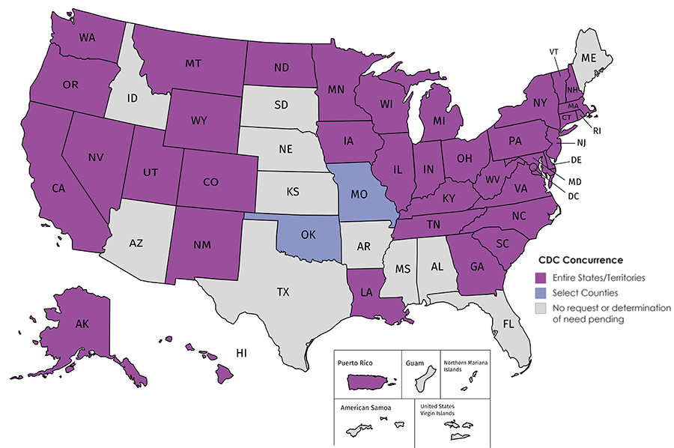
Does this jurisdiction have a DON in place?
https://www.cdc.gov/hiv/risk/ssps-jurisdictions.html
Updated 4/26/19

Slide 45
What can federal funds be used for?
Staff
Supplies (e.g., alcohol pads, sterile water, cotton)
Testing kits for viral hepatitis and HIV
Syringe disposal services
Navigation services to ensure linkage to services
Communication, outreach and educational materials
Planning and evaluation activities
Use of federal funds must be in alignment with objectives and associated activities for each component. Please contact CDC with any questions about how federal funds may be used.

Slide 46
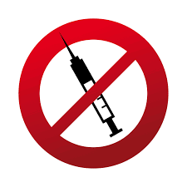
Federal funds cannot be used for:
Needles and syringes
Other devices solely used for illegal drug injection (e.g., cookers)
Other non-federal funds (including tribal, state and private) may be used for purchase of these supplies

Slide 47
Thank you for your interest!
For more information, please visit: https://www.cdc.gov/nchhstp/funding/announcements/ps19-1909/index.html
Questions?
Please email harmreduction@cdc.gov

