Slide 1
CDC-RFA-OT18-1802: Strengthening Public Health Systems and Services Through National Partnerships to Improve and Protect the Nation's Health
Partnership Support Unit
Office for State, Tribal, Local and Territorial Support (OSTLTS)
Centers for Disease Control and Prevention (CDC)
Informational Conference Call
February 20 & 22, 2018

Slide 2
Agenda
Introductions
Program Overview
NOFO Requirements
Application Review and Selection Process
Pre-Application Information
NOFO Resources
Q&A

Slide 3
Introductions
OSTLTS Partnership Support Unit

Slide 4
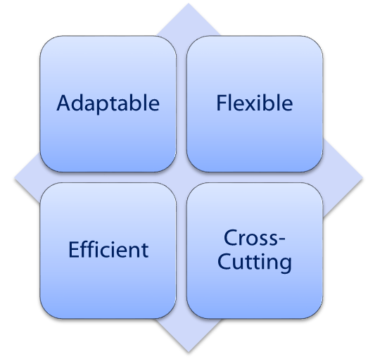
Office for State, Tribal, Local and Territorial Support
OSTLTS advances the US public health agency and system performance, capacity, agility, and resilience
  Technical assistance to State, Tribal, Local and Territorial Health Departments
  Partnerships to improve health systems
  Internal CDC coordination and support
  Performance improvement
  Capacity building

Slide 5
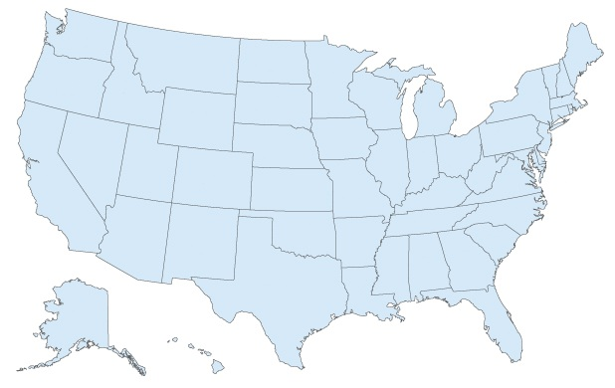

Partnership Support Unit
Partnership Support Unit (PSU) activities are designed to advance the mission and goals of CDC and OSTLTS.

Slide 6
Capacity-Building Assistance (CBA) Program Overview
CDC-RFA-OT18-1802

Slide 7
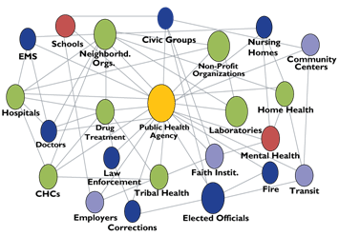
Background
Call for transformation of the US public health system
Represents a complex and broad range of agencies, organizations, and individuals
Emphasis to address challenges of governmental public health agencies
  Underfunding, fragmentation, and lack of cross-cutting capabilities

Slide 8
Relevant Work
Building Capacity of the Public Health System to Improve Population Health through National, Nonprofit Organizations (CDC-RFA-OT13-1302) is a five-year cooperative agreement ending June 30, 2018.
Since July 2013, CDC has awarded 25 national nonprofit organizations to strengthen the public health system through capacity-building assistance (CBA).

Slide 9
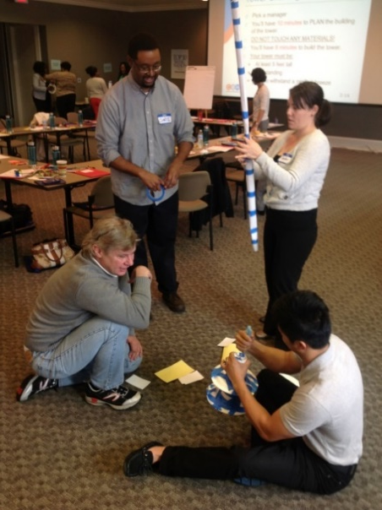
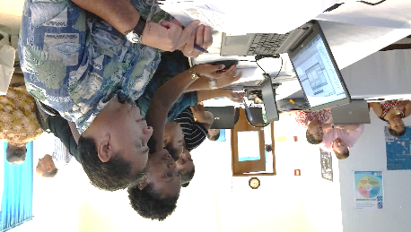
CBA
Funding
Information sharing
Resource development
Technical assistance
Technology transfer
Training

Slide 10
Purposes
To strengthen the nation’s public health infrastructure, ensure a competent, current, and connected public health system, and improve delivery of essential public health services through capacity-building assistance.
Deliver CBA
Strengthen
the nation’s
public health infrastructure
Ensure a competent, current and connected public health system
Improve delivery of essential public health services

Slide 11
CBA Providers
The goal is to fund organizations that have the
  Capability
  Expertise
  Resources
  National reach
  History of providing CBA

Slide 12
Target Population Categories
Each application must address CBA needs for one of three target population categories:
  A) Governmental Public Health Departments
  B) Workforce Segments Across Governmental Public Health Departments
  C) Nongovernmental Public Health Components

Slide 13
Logic Model
Strategies | Outcomes
 | Short-Term | Intermediate | Long-Term
Public Health Systems Infrastructure | Improved operational capacity to evaluate, manage, and improve public health systems | Increased capability of public health systems to achieve nationally established standards | Current, competent, connected public health system Improved delivery of essential public health services Improved public health outcomes related to national objectives
Leadership and Workforce | Improved leadership capacity to identify and prioritize public health needs Strengthened core and discipline-specific public health competencies among the workforce to improve job performance | Increased leadership decision-making to address public health needs strategically and systematically Strengthened capability of the public health workforce to deliver essential public health services
Data and Information Systems | Improved capacity of data and information systems to conduct public health monitoring and surveillance | Increased capability to use data to inform decision-making and support evidence-based practices and policies
Communication and Information Technology | Improved communication and information technology capacity to inform the public effectively and efficiently | Strengthened capability to use communication and information technology to affect health decisions and actions
Partnerships | Improved capacity to establish and maintain partnerships within and across sectors to create a shared vision of health | Strengthened capability to respond to public health priorities collaboratively and strategically
Laws and Policies | Increased capacity to evaluate laws and policies to affect health | Strengthened capability to systematically apply and use laws and policies to improve health
Programs and Services | Improved capacity to identify, prioritize, and customize relevant programs and services to address public health needs | Increased capability to implement evidence-based/informed public health programs, policies and services to address public health needs

Slide 14
CBA Program Strategies
Program strategies include activities to improve
Public Health Systems Infrastructure - operational capacity such as policies and plans, administration and management, and quality improvement
Leadership and Workforce - leadership and workforce competencies, recruitment and retention
Data and Information Systems - the collection, management, interpretation, and dissemination of data to guide decision making
Communication and Information Technology - the use of communication and information technology to affect health decisions and actions
Partnerships - the establishment and maintenance of results-driven partnerships
Laws and Policies - the ability to interpret and inform laws and policies that affect health
Programs and Services - identification of best practices and the implementation of evidence-based/informed programs and services

Slide 15
CBA Program Outcomes
The CBA efforts performed under this program should work toward the short-term and intermediate outcomes in the logic model.
Recipients are expected to achieve the selected CBA program outcomes and report any additional outcomes accomplished.
Capacity-Building Assistance
Leadership and Workforce
Data and Information Systems
Communication and Information Technology
Partnerships
Programs and Services
Improved Public Health Capacities and Capabilities
Laws and Policies
Public Health Systems Infrastructure

Slide 16
Two-Part Funding Strategy
This NOFO is structured to provide funding to recipients using two competitions.
Funding Strategy 1: Initial Funding
  Responsive applications are objectively reviewed
  Initial funding may be awarded by OSTLTS or other CDC Centers, Institutes, or Offices (CIO)
Funding Strategy 2: CIO Project Plans
  Recipients of Funding Strategy 1 awards are eligible to apply for additional funding
  CDC will publish and compete CIO project plans according to target population categories
  Proposals submitted in response to the CIO project plans are reviewed

Slide 17
NOFO Requirements
CDC-RFA-OT18-1802

Slide 18
Eligibility
State, county, city, territorial, or township governments
Public and state-controlled institutions of higher education
Native American tribal governments
Native American tribal organizations
Nonprofit organizations
Private institutions of higher education
Community-based organizations
Faith-based organizations
Applicants that meet the eligibility criteria must also meet responsiveness criteria to advance to objective review.

Slide 19
Responsiveness
Provide evidence of having a public health charge or mission
  Statement of an entity’s organized efforts to promote and protect the health of people and the communities where they learn, live, play, and work.
  Reflected in documents such as the applicant’s articles of incorporation, bylaws, signed board resolutions, or mission statement.
Non-responsive applications will not advance to objective review.

Slide 20
Target Populations
Categories A and B address the CBA needs of target populations within governmental public health departments.
Category A: Governmental Public Health Departments – Meets the priority organizational-level CBA needs of one of the following health department types: state, tribal, local, or territorial.
Category B: Workforce Segments across Governmental Public Health Departments – Meets the priority CBA needs of one workforce segment across two or more health department types: state, tribal, local, and territorial.

Slide 21
Target Populations, cont.
Category C addresses the CBA needs of target populations outside of governmental public health departments.
Category C: Nongovernmental Public Health Components – Meets the priority CBA needs of one type of nongovernmental component of the public health system.
  CBA activities conducted for this category must also leverage the organization’s expertise and networks to benefit a governmental health department type or workforce segment.

Slide 22
Organizational Capacity
Demonstrate ability to execute the CBA program strategies, implement activities, and achieve expected outcomes by describing
  Current and recent programs
  Staffing and partnerships
  Procurement activities
  Relationship with target population
    Category C - Relationship with governmental health departments
  Affiliate organizations, if applicable
  Current CDC CBA funding, if applicable

Slide 23
Evaluation and Performance Measurement
The NOFO proposes examples to demonstrate the types of measures that will show progress toward achieving program outcomes.
  Process measures track the implementation of strategies and activities
  Outcome measures determine progress in achieving outcomes
Measures should clearly align with the strategies and outcomes, as defined in the NOFO and represented in the logic model.

Slide 24
Work Plan
Develop a CBA work plan that provides a high-level plan for the five-year period of performance and a detailed plan for the first year.
Five-Year Overview (narrative)
  Intended outcomes for the period of performance
  Intended strategies, activities, and outputs to be achieved by the end of the five-year performance period
  Administration and assessment processes to ensure successful implementation and quality assurance

Slide 25
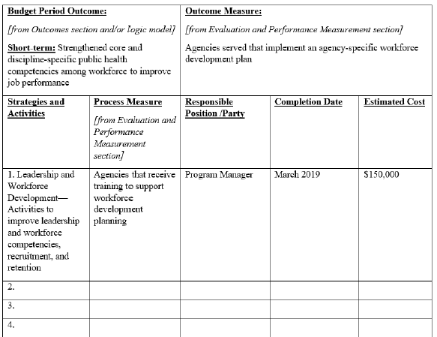
Work Plan, cont.
One-Year Detailed Work Plan (table)
  Applicants are required to use the table for first year activities
  Table must be completed for the budget period outcomes
  If an activity leads to multiple outcomes, it should be described under each outcome measure

Slide 26
Documentation Requirements
Applicants must submit the following information
Project Abstract
Project Narrative
  Background, Approach, Evaluation and Performance Measurement Plan, Organizational Capacity of Applicants to Implement the Approach, and Work Plan
Budget Narrative
CDC Assurances and Certifications
Table of Contents for Entire Submission
Resumes/CVs
Letters of Support
Organizational Charts
Indirect Cost Rate, if applicable
Proof of Public Health Mission
Proof of National Scope of Work

Slide 27
Other Requirements
Address all evaluation criteria
Submit all acceptable attachments in PDF file format
Submit no more than two stand-alone applications
  Each application must identify a distinct target population
Submit applications to Grants.gov by March 29, 2018, 11:59 pm (ET)

Slide 28
Letter of Intent
Submit via email attachment to OSTLTSPartnersNOFO@cdc.gov by February 27, 2018, 11:59 pm (ET).
  Copy Ralph Robinson, Grants Management Officer, RRobinson6@cdc.gov
The letter of intent is strongly encouraged and enables CDC to plan NOFO activities accordingly.

Slide 29
Application Review and Selection Process
CDC-RFA-OT18-1802

Slide 30
Review and Selection Process
Phase I – Eligibility and responsiveness
Phase II (Funding Strategy 1) – Objective review of responsive applications
Phase III – CDC funding priority and preferences
Phase IV (Funding Strategy 2) – Review of responsive work plans
  Objective or Technical Review
  CDC funding preferences

Slide 31
Evaluation and Scoring Criteria
Approach (25 points)
Evaluation and Performance Measurement (15 points)
Applicant’s Organizational Capacity to Implement the Approach (60 points)
Budget (reviewed, not scored)
Follow the scoring criteria for your selected target population category.

Slide 32
CDC Funding Priority
National Scope (15 points)
  Added to the final score of applications that demonstrate national scope.
  This funding priority aligns with the CBA program intent to fund activities that build capacities and capabilities across multiple jurisdictions.
Evidence of national scope must be submitted to receive additional 15 points.

Slide 33
CDC Funding Preferences
Preference will be given to applications that
  Avoid duplication of CBA services to the same target populations
  Ensure CBA services are provided to target populations not served by higher ranking applications
  Ensure CBA services are provided to target populations not duplicated in other CDC funding mechanisms

Slide 34
Key Dates
Letter of Intent: February 27, 2018, 11:59 pm (ET)
  Identify number of application submissions (up to two)
Application Deadline: March 29, 2018, 11:59 pm (ET)
Award Announcements
  Funding Strategy 1: May 2018
  Funding Strategy 2: September 2018

Slide 35
Pre-Application Information
CDC-RFA-OT18-1802

Slide 36
Pre-Application Submission
Register NOW with Grants.gov
Sign up to receive notifications for CDC-RFA-OT18-1802
Become familiar with the Grants.gov website
Ensure your organization has the following readily available and current:
  Data Universal Numbering System (DUNS) number
  Employer Identification Number (EIN)
  System for Award Management Registration
  Central Contractor Registration number
  Bank account information

Slide 37
NOFO Resources
CDC-RFA-OT18-1802

Slide 38
Resources
NOFO Webpage: https://www.cdc.gov/stltpublichealth/partnerships/capacity-building-assistance-OT18-1802.html
NOFO Mailbox: OSTLTSPartnersNOFO@cdc.gov
Grants.gov Support: Call 1-800-518-4726 or email support@grants.gov

Slide 39
Q&A Discussion

Slide 40
Thank You!

