Slide 1

USFS Eastern Region
Cohesive Fire Strategy
2022 Request for Applications
U.S. Forest Service
Eastern Region State and Private Forestry
Fire & Aviation Management, Cooperative Fire Program

Slide 2
Welcome & Overview
National Cohesive Strategy
2022 Cohesive Fire Strategy RFA
Wildfire Risk Reduction (WRR)
Wildfire Preparedness (WP)
Cross‐Boundary Wildfire Hazard Mitigation on Non‐Federal Lands
Grants.gov

Slide 3
National Cohesive Strategy
Restore & Maintain Landscapes
  Landscapes across all jurisdictions are resilient to fire related disturbances in accordance with management objectives.
Fire Adapted Communities
  Human populations and infrastructure can withstand a wildfire without loss of life or property.
Wildfire Response
  All jurisdictions participate in making and implementing safe, effective, efficient risk-based wildfire management decisions.

Slide 4
Northeast Regional Action Plan Implementation Actions
Use of Prescribed Fire for Multiple Benefits
Restore Fire Adapted Ecosystems
Mitigate “Event” Created Hazardous Fuels
Support Local Fire Adapted Communities
Treat Hazardous Fuels in the WUI
Promote Prevention Programs
Improve Wildland Fire Management Efficiency
Increase Initial Response Capacity
Improved Shared Response Capacity
Developed by the Northeast Regional Strategy Committee and stakeholders to identify the most important actions to progress on.

Slide 5
Wildfire Risk Reduction Component
Target: Goals 1 and 2 of the Cohesive Strategy
Restore and Maintain Landscapes
Fire Adapted Communities
Meet one or more Regional options 1-6
    Use of Prescribed Fire for Multiple Benefits
    Restore Fire Dependent Ecosystems
    Mitigate “Event” Created Fuels
    Support Local Fire Adaptation by Communities
    Treat Hazardous Fuels in the WUI
    Promote Prevention Programs

Slide 6
Wildfire Preparedness Component
Target: Goal 3 of the Cohesive Strategy
Response to Wildfire
Meet one or more Regional options 7-9
    Improve organizational efficiency/effectiveness of wildland fire community
    Increase local IA response capacity
    Develop extended attack and long-duration response capacity

Slide 7
Cross-Boundary Mitigation
Target: Goals 1 and 2 of the Cohesive Strategy
Restore and Maintain Landscapes
Fire Adapted Communities
Meet one or more Regional options
    Use of Prescribed Fire for Multiple Benefits
    Restore Fire Dependent Ecosystems
    Mitigate “Event” Created Fuels
    Support Local Fire Adaptation by Communities
    Treat Hazardous Fuels in the WUI
    Promote Prevention Programs

Slide 8
Eligibility
Cross-Boundary Mitigation | Wildfire Risk Reduction (WRR) Component | Wildfire Preparedness (WP) Component
State Forestry Agencies Local government Nonprofits Tribes National Forests (applying on behalf of adjacent non-Federal landowners) Private landowners and associations | State Forestry Agencies Forest Fire Compacts Groups of States Tribes Nonprofit organizations Academic Institutions | Forest Fire Compacts Groups of States Wildfire Training Academies Tribes Fire Science Exchanges
“For Profit” organizations are not eligible for this funding opportunity

Slide 9
Funding Limits
Wildfire Risk Reduction (WRR) | Wildfire Preparedness (WP)
$25,000 to $300,000 in Federal funds
Equipment: No more than 25% of Federal funds requested
Maximum amount awarded to any one State (State Cap) cannot exceed 15 % of the total FY funds allocated for this RFA
$25,000 to $100,000 in Federal funds
Equipment: No more than 25% of Federal funds requested

Slide 10
Funding Limits
Cross-Boundary Mitigation Projects
No Funding Limit
No State Cap
Match not required, but beneficial in scoring criteria
No limit for Cross-Boundary Mitigation applications, though total available is $1.5M

Slide 11
Examples of Activities
Wildfire Risk Reduction (WRR)
Use of Prescribed Fire
Use of Mechanical Fuel Reduction
Vegetation Management
Use of small diameter wood
Defensible Space
CWPPs or equivalent
Fuel Breaks & Fire Breaks
Dry Hydrants that support a Fire Adapted Community
Fire Mngmt Planning in fire adapted landscapes w/ FAC’s
Slash Removal
Brochures, PSA’s
Property Assessments
Prescribed Fire or fire adapted communities related training
Exercises that support FAC’s
I&E, Firewise, RSG, FAC & Fire Prevention Programs
Wx station upgrades that support a FAC
Notes:
Non qualifying:
Research and development projects
Capital improvements
Economic development projects

Slide 12
Examples of Activities
Wildfire Preparedness (WP)
Leadership development
Higher level wildfire/Rx fire training (300 level and above)
Fire/Rx training academies
Aviation/UAS training and support
Develop opportunities for firefighters to attain IMT qualifications
Wildfire Investigation and Law Enforcement
Risk based Rx/wildfire response training and exercises
Coordination of State resources over a broad area
Purchase of supplies, radios, and firefighting tools is limited to support a specific project
Notes:
Non qualifying:
Research and development projects
Capital improvements
Economic development projects

Slide 13
Cross-Boundary Mitigation
Criteria & Examples
Project must benefit resources on Federal Land
  State Forester and Forest Supervisor Support (completed project form)
  Treat priority areas within State Forest Action Plans, Risk Assessments, CWPP’s, etc.
  Reduce chance of fire starting and affecting federal land (prevention)
  Treat hazardous fuels where fire transmission could affect NF system land
  Treat hazardous fuels and improve ecological conditions within watersheds with NFS lands
Notes:
Non qualifying:
Research and development projects
Capital improvements
Economic development projects

Slide 14
Cross-Boundary Mitigation
Criteria & Examples
Examples:
  Hazardous fuels reduction activities (fuel breaks, Rx burning, timber harvest)
  Development and implementation of CWPP or equivalent
  Technical assistance (silvicultural prescriptions, burn plan development)
  Training or monitoring activities on non-federal lands that benefit resources on federal land
Notes:
Non qualifying:
Research and development projects
Capital improvements
Economic development projects

Slide 15
NFPORS Forms are Required for WRR/WP
Mandatory for all SFA, VFA, and WRR/WP Grant applications
For questions on NFPORS please contact your Coop Fire staff
Please Report Accurately-the acres treated are part of the region’s accomplishment target

Slide 16
Ranking Criteria
Address Northeast Regional Action Plan's Options (40 pts)
Engage in partnerships and collaboration (20 pts)
Explain project effectiveness and efficiency (20 pts)
Demonstrate a Wildfire Risk Focus (10 pts for WRR/WP; 20 pts for Cross-boundary)
Share Knowledge / Technical Transfer (10 pts only for WRR/WP)

Slide 17
Again in FY 2022 – Grants.gov
Submit all applications through Grants.gov
  Search for grant opportunity:
  USDA-FS-2022-COHESIVE-STRATEGY
  Application deadline is 5:00 pm ET on January 14, 2022
  Grants.gov provides 24/7 support:
  1-800-518-4726 or support@grants.gov

Slide 18
Preparing to Apply
FY 2022 guidance document has details on how to register and apply online through Grants.gov.
Before working in Grants.gov you will need:
    Employer Identification Number (~5 weeks)
    System for Award Management (SAM) registration (~2 weeks)
      Generates the Unique Entity Identifier (replaces DUNS)
    Grants.gov account with Authorized Organization Representative (AOR) role (same day)
One lead agency/grant applicant will submit an application in Grants.gov for all other contributors to the project.
Only Grants.gov users with the AOR role for the applying entity are eligible to submit applications to Grants.gov.

Slide 19
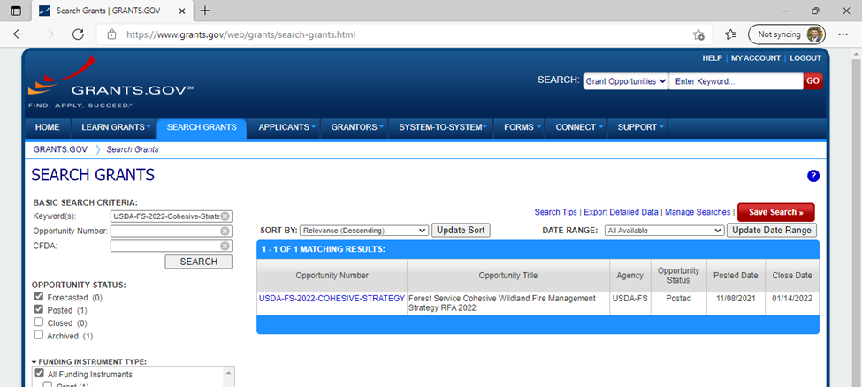
How to Apply: Search Grants
Search for Opportunity
USDA-FS-2022-COHESIVE-STRATEGY
Notes:
Enter the opportunity ID at the top, as a keyword or opportunity number.

Slide 20
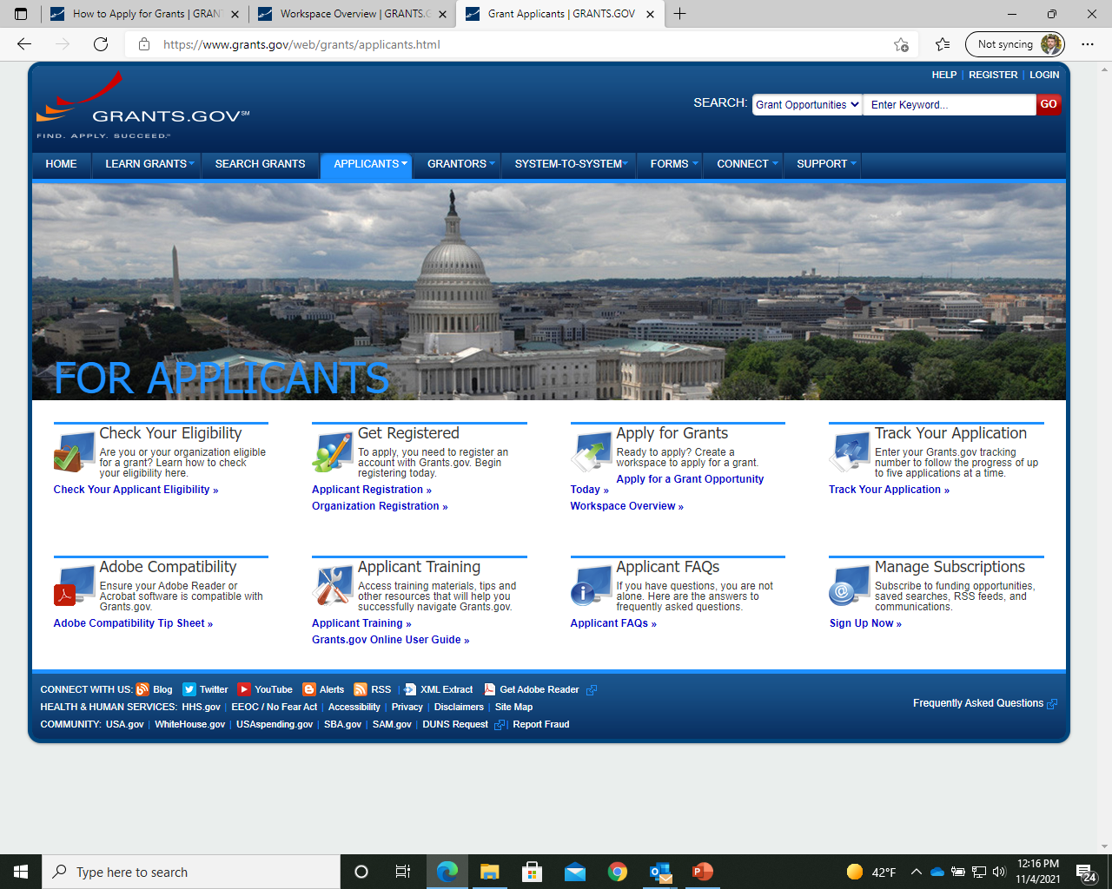
1-800-518-4726 and email at support@grants.gov

Slide 21
Reminders
Submit a separate letter of support from the State Forester or appropriate designated authority (NJ – State Firewarden or NY – Director of Forest Protection) for approving activities for WRR/WP
Submit your Project Proposal Form with State Forester and Forest Supervisor signature for Cross-Boundary projects
Include a current NFPORS form for WRR/WP
Link Project Proposal to NCS Goals/Regional Options and State Forest Action Plans
At least 100% match of requested Federal funds is required for WRR/WP
Provide an electronic shape file for fuels/land treatment for Cross-Boundary projects
Submit application and documents through Grants.gov
Proposals due by 5:00 pm ET on January 14, 2022
Include all required items

Slide 22
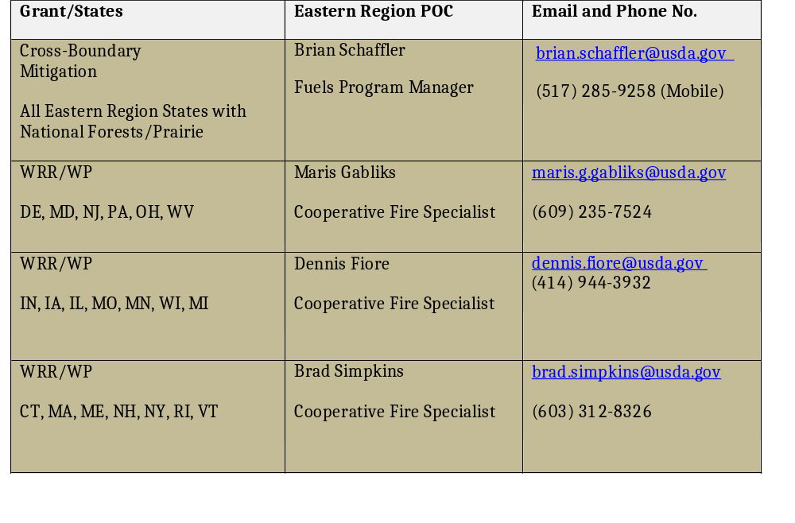

Slide 23
Questions?
Thank you for your participation
U.S. Forest Service
Eastern Region State and Private Forestry
Fire & Aviation Management, Cooperative Fire Program

