Slide 1
U.S. ARMY COMBAT CAPABILITIES
DEVELOPMENT COMMAND
CHEMICAL BIOLOGICAL CENTER
MSI HBCU STEM Funding Opportunity Announcement (FOA)
18 July 2024
DEVCOM CBC | Ms. Debra Thedford, associate director, strategic initiatives GROUP and Patricia Congdon, Lead Acquisition Management specialist, G-8
APPROVED FOR PUBLIC RELEASE: DISTRIBUTION UNLIMITED
Notes:
Welcome and introductions.

Slide 2


msi and hbcu STEM history
01
Authorization
  10 U.S.C. 4144 Research and Education Programs and Activities: historical black colleges and universities and minority serving institutions of higher education
Created by the U.S. Army Combat Capabilities Development Command Chemical Biological Center (DEVCOM CBC) in 2015 to:
  Increase participation of MSIs and HBCUs in Defense and National Security programs
  Facilitate recruitment from a largely untapped pool of science and engineering talent and facilitate capacity building
Cooperative Agreement W911SR-14-2-0001 which expires 31 December 2024
  Facilitate participation of MSIs and HBCUs which generally lack experience or administrative infrastructure to address FAR requirements
  Authorization for basic (6.1) and applied (6.2) research and advanced technology development (6.3)
  Direct or competitive funding to universities and industry
02
03

Slide 3
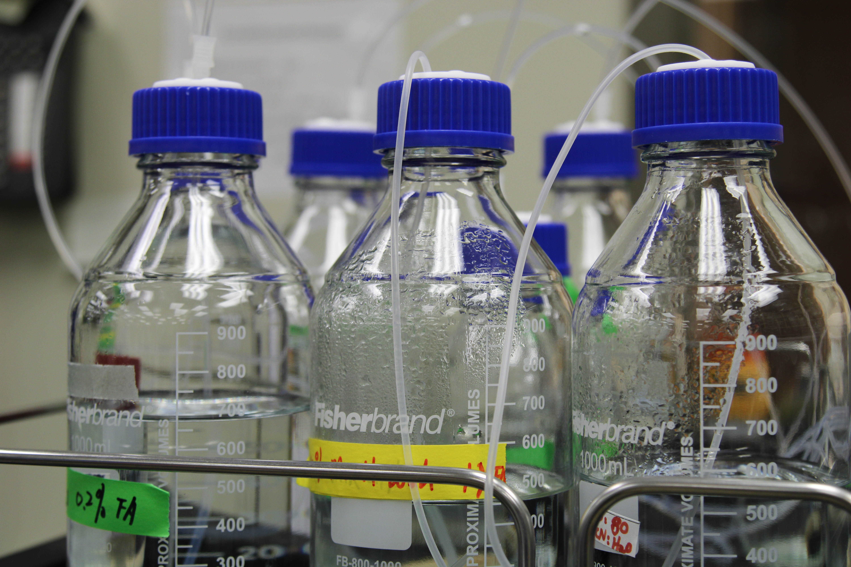
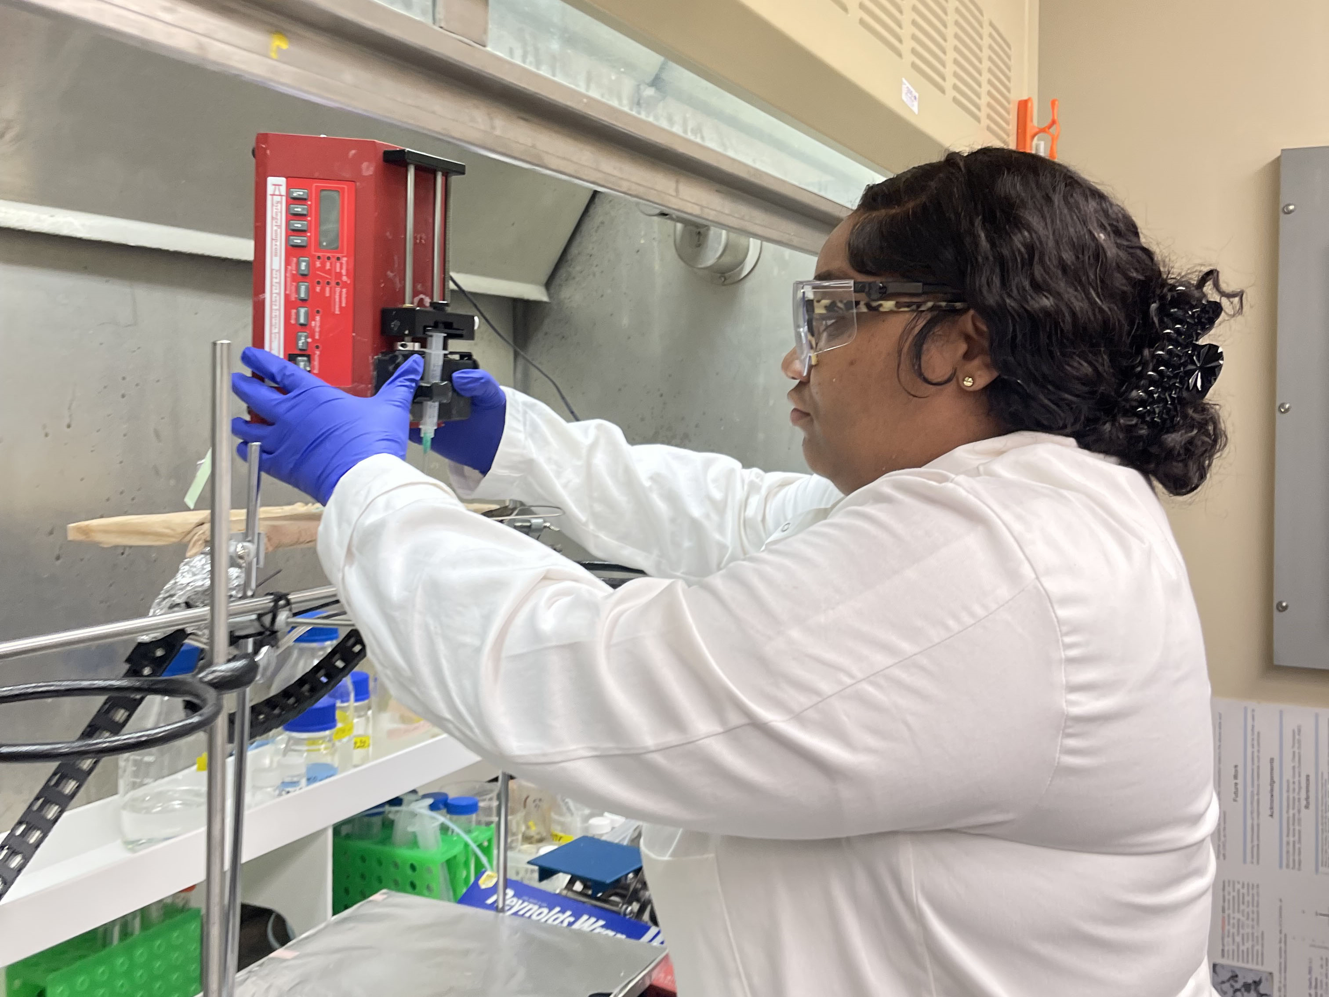
MsI HBCU STEM Objectives
      Enhance the research and educational capabilities of such institutions in areas of importance to national defense.
      Encourage the participation of such institutions in the research, development, testing and evaluation (RDT&E) programs and activities.
      Increase the number of graduates from such institutions engaged in disciplines important to the national security functions of the Department of Defense.
      Encourage research and educational collaborations between such institutions and other institutions of higher education, Federal Government organizations, and the defense industry.
      Provide a unified voice to effectively articulate the strategically important role of the MSIs and HBCUs in Government science, technology, engineering and mathematics (STEM) initiatives and technology base.
      Effectively develop critical technology that can be transitioned to weapons systems and commercial applications.
      Maximize the collaborative capabilities of the Government and MSIs and HBCUs; and improve research facilities of the MSIs and HBCUs.
Notes:
Dual Categorized Universities
California State University – Northridge (HSI) (AANAPISI)
California State University – Sacramento (HSI) (AANAPISI)
The City College of New York (HSI) (AANAPISI)
Rutgers, The State University of New Jersey (AANAPISI & HSI)
Southern Adventist University (ANNAPISI/HSI)
University of Illinois at Chicago (HSI) (AANAPISI)
University of Nevada - Las Vegas (HSI) (AANAPISI)

Slide 4
Key Requirements
Consortium Responsibilities
  Implement comprehensive plan for meeting the objective of 10 U.S.C. 4144 to establish a method to baseline and measure the success of the program
  Establish membership of the consortium from among eligible MSIs and HBCUs. This will also include identifying leaders from industry and other academia to serve as mentors for the membership.
        Grow membership
        Maintain and update the Consortium Member Agreements
  Establish and maintain a web presence that is current and relevant for use by the public, prospective Consortium Members, existing Consortium Members, and the Government.

Slide 5
Key Requirements (Cont’d)
  Provide the vision and guidance to grow the capacity of the MSIs and HBCUs through collaboration, partnering and numerous other capacity building methods to allow the universities, colleges, and students to become major contributors of Defense research
  Publicize requirements for White Papers, Research Project Proposals
  Review White Papers and Proposals for completeness and responsiveness to posted solicitations
  Proper use of all allocated funds and accountability through Generally Accepted Accounting Principles (GAAP)

Slide 6
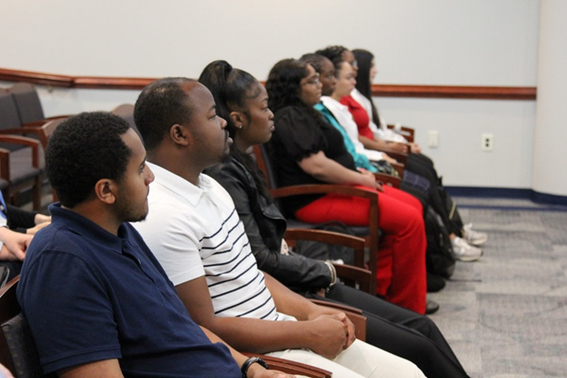
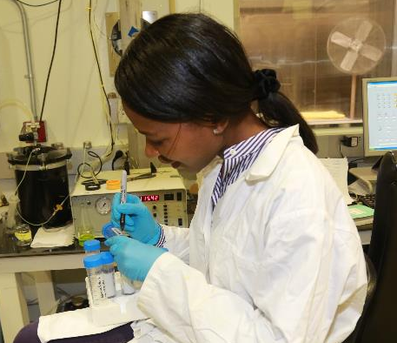
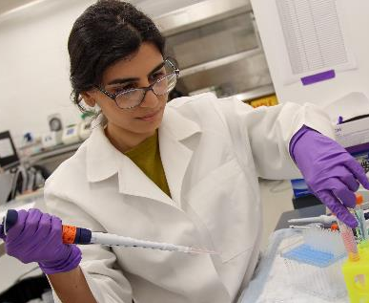
Reporting Requirements
Consortium Deliverables
  Monthly Status Reports
  Website
  Annual MSI and HBCU STEM Consortium Program Annual Report
  Consortium Membership List
Individual Research Effort Deliverables
  Quarterly and Annual Technical Status Report
  Quarterly and Annual Financial Status Report
  Final Technical and Financial Reports per Research Effort.

Slide 7
EVALuation CRITERIA
Technical
  Evaluation will focus on applicant’s approach, experience and qualifications to assess the likelihood that the offeror can successfully perform the requirements described in the FOA.
Management
  Evaluation will focus on the applicant’s methodology and mechanisms of the proposed comprehensive management plan to ensure that it provides for adequate oversight and management of the MSI and HBCU STEM Consortium.

Slide 8
EVALuation CRITERIA (Cont’d)
Past Performance
  Evaluation will focus on the applicant’s past performance on related cooperative agreements to include successful performance of requirements, quality and timeliness of delivery of services, effective management of consortium members, cost management, proactive management and customer satisfaction.
  An applicant without any applicable past experience will receive a neutral rating.
Credentials
  This factor will focus on the applicant’s credentials, as an organization (reputation or recognition in the area of STEM research) as well as the credentials of the specific individuals proposed. Credentials include, but are not limited to, personnel on board, ability to recruit qualified personnel, and reputation within the STEM outreach and education community.

Slide 9
Notes:
This concludes the presentation, any questions?

