Slide 1


Minority Serving Institution Partnership Program
Overview

Slide 2

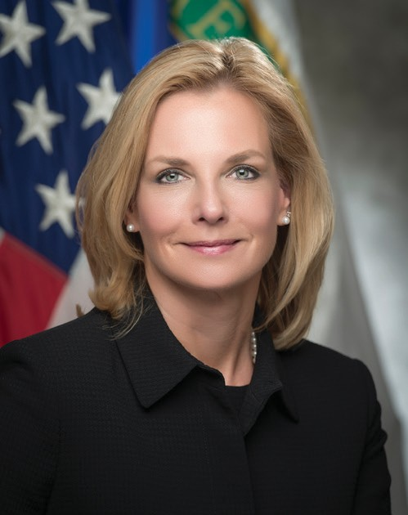

“Strengthening Our Nation Through Nuclear Security”
Nuclear Security Enterprise (NSE):
DOE/NNSA, National Laboratories, Production Plants and Sites around the country work together to maintain and enhance nuclear security
Lisa E. Gordon-Hagerty
Under Secretary for
Nuclear Security and
NNSA Administrator

Slide 3
NNSA Equities with Education
NSE Recruitment
Future Talent Pipeline Development
STEM Pipeline Retention
Upskilling/ Reskilling
Learning and Development
Educational Opportunities
Internships Fellowships, Scholarships
Strategic Partnerships
R&D

Slide 4
NNSA Minority Serving
Institution Partnership Program
Background:
  Administered by DOE/NNSA Management and Budget,
  Implemented through consortia-based grants consisting of participants from selected MSIs and NNSA production facilities and laboratories
Purpose:
  Designed to build a sustainable pipeline between DOE’s sites/labs and MSIs in STEM disciplines, and bring a heightened awareness of NNSA plants and laboratories to MSIs with a common interest in STEM research fields.
    Capacity Building: Research and infrastructure
    Student Enrichment and Development: Exposure to academic and professional experiences, promote successful internship opportunities for students to transition to the NSE STEM workforce
    Collaborative Research/Tech Transfer: Access to world-class resources and research opportunities
Value to the National Security Enterprise:
  Links students’ academic pursuits with professional work and research conducted by national laboratory/site partners.
  Exposes students to technology and research housed at national laboratory/site partners.
  Provides students with internship opportunities at DOE/NNSA national laboratories/plants that are aligned with their academic disciplines.
  Prepares students to make significant and immediate contributions to the DOE/NNSA STEM workforce upon graduation
  Since 2015, 466 internships at NNSA plant and lab partners through consortia.

Slide 5
NNSA Minority Serving
Institution Partnership Program
Mission:
Create and foster a sustainable STEM-pipeline that prepares a diverse workforce of world class talent through strategic partnerships between Minority Serving Institutions and the DOE/NNSA Enterprise.
Vision:
Drive a diverse, highly educated, and agile STEM workforce prepared for the future of the DOE/NNSA Enterprise.
Crucial Success Factors:
Strengthen and expand MSI STEM educational and/or research capacity in DOE/NNSA mission areas.
Target collaborations between MSIs and the DOE/NNSA enterprise that increase interactions to provide MSIs direct access to DOE/NNSA STEM resources.
Grow the number of minority (MSIPP) students who graduate with STEM degrees.
Grow the number of minority (MSIPP) graduates and post-doctoral students hired in to DOE/NNSA STEM workforce.

Slide 6
Consortia
Advanced Manufacturing Network
(AMFN)
Additive Manufacturing Post Processing Partnership
(AMP3)
Consortium for High Energy Density Science
(CfHEDS)
Consortium on Nuclear Security Technologies
(CONNECT)
Partnership for Research and Education Consortium in Ceramics and Polymers
(PRE-CCAP)
Consortium Enabling Cybersecurity Opportunities and Research
(CECOR)
Consortium for Integrating Energy Systems in Engineering and Science Education
(CIESESE)
Energy Sciences: Experimental and Modeling
(ESEM)
Partnership for Proactive Cybersecurity Training
(PACT)
Pipeline Development of Skilled Workforce in STEM through Advanced Manufacturing
(STEAM)

Slide 7
Consortia
School | Consortium
Allen University | CECOR
American Indian Higher Education Consortium | AMFN
Bay Mills Community College | AMFN
Benedict College | CECOR
Bowie State | CECOR
Cankdeska Cikana Community College | AMFN
Claflin University | CECOR
Clark Atlanta University | CECOR
Denmark Technical College | CECOR
Florida A&M University | CfHEDS
Florida International University | PRE-CCAP
Howard University | AMP3, PACT
Inter American University of Puerto Rico - San German | ESEM
Miami Dade College | CIESESE
Morehouse College | CfHEDS, ESEM
Morgan State University | AMP3
Morris College | CECOR
Navajo Technical University | AMFN, PACT
Norfolk State University | CECOR
North Carolina A&T State University | STEAM, CECOR
Prairie View A&M University | ESEM
Salish Kootenai College | AMFN
South Carolina State University | CECOR
Southern University of New Orleans | STEAM
St. Mary's University | CONNECT
Tennessee State University | PRE-CCAP, STEAM, ESEM
Turtle Mountain Community College | AMFN
Universidad Del Turabo | CIESESE
University of Arizona | PACT
University of California Merced | CfHEDS
University of Nevada at Las Vegas | CONNECT
University of New Mexico | CIESESE
University of Puerto Rico | CIESESE
University of Texas at El Paso | CIESESE, PRE-CCAP
University of Texas at San Antonio | CONNECT
University of the District of Columbia | AMP3
University of the Virgin Islands | CECOR
Virginia State University | STEAM
Voorhees College | CECOR
Site | Consortium
Argonne National Laboratory | CONNECT, PACT
Kansas City Plant | AMFN, AMP3, PRE-CCAP, STEAM
Lawrence Livermore National Laboratory | CECOR, STEAM
Los Alamos National Laboratory | AMP3, CONNECT, ESEM, PRE-CCAP, STEAM
National Energy Technology Laboratory | CIESESE
Oak Ridge National Laboratory | AMP3, STEAM
Pacific Northwest National Laboratory | ESEM
Sandia National Laboratory | AMFN, CECOR, CIESESE
Y-12 Plant | AMP3, STEAM

Slide 8
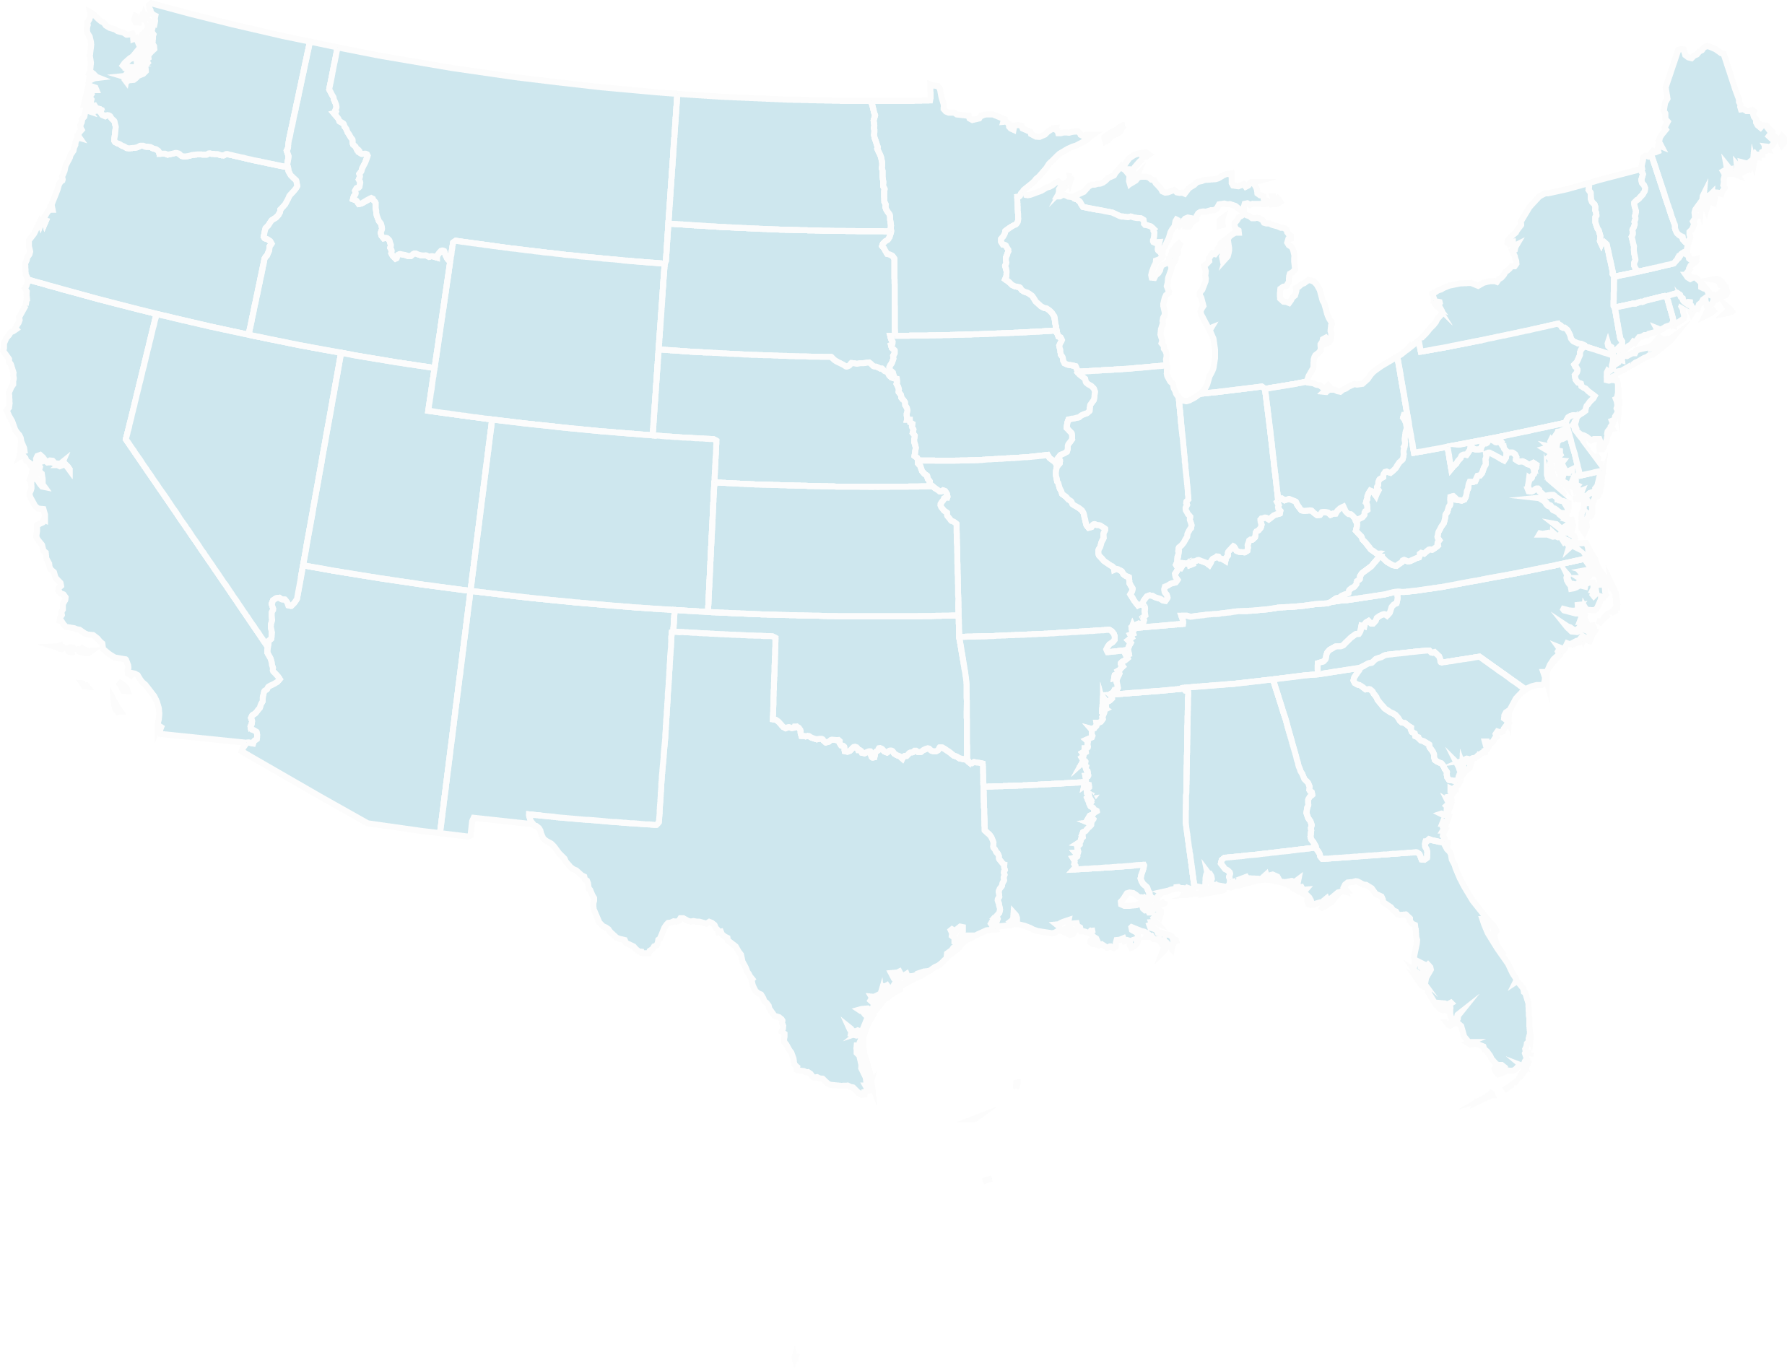
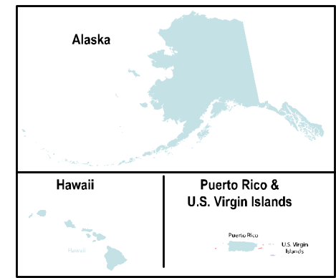
Consortia
SKC
TMCC
PNNL
CCCC
BMCC
ANL
NETL
BSU, MSU
LLNL
HU, UDC
College/University
UC Merced
KCP
VSU
AIHEC
Lab/Plant/Site
NSU
UNLV
NCA&T
NTU
TSU
ORNL, Y-12
UNM
Pantex
BC, AU
LANL, SNL
SCSU, CU, DTC, MC
CAU, MC
VC
UA
UTEP
FAMU
PVU
SUNO
Alaska
UTSA, St.MU
FIU, MD
Hawaii
Puerto Rico &
U.S. Virgin Islands
Puerto Rico
IAUPR- San German, Universidad Del Turabo, UPR
U.S. Virgin Islands
UVI

Slide 9
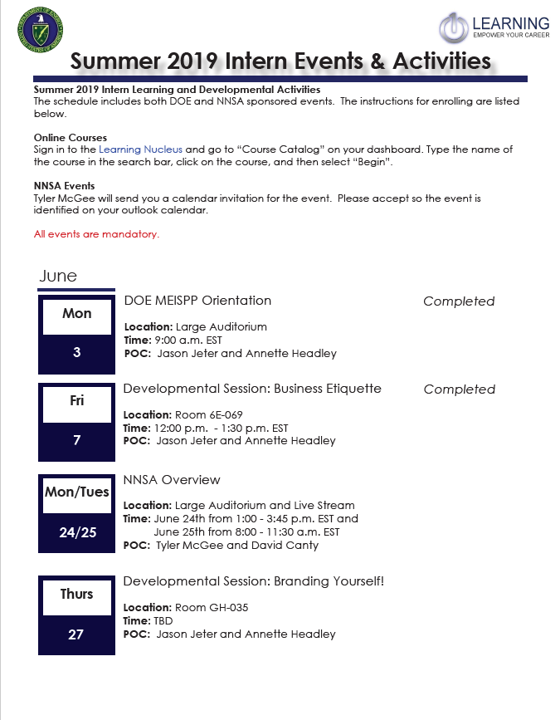
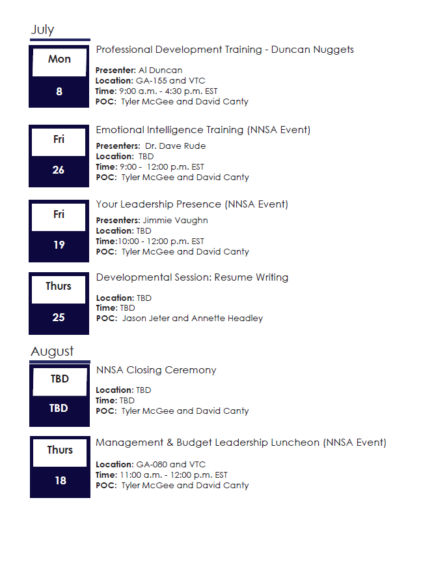
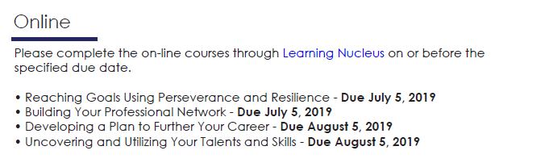
Direct Internships through MEISPP
Minority Educational Institution Student Partnership Program Interns
Training and Development Opportunities
2017
21
2018
24
2019
22
Notes:
Historical Data from previous years and an example of the training schedule

Slide 10
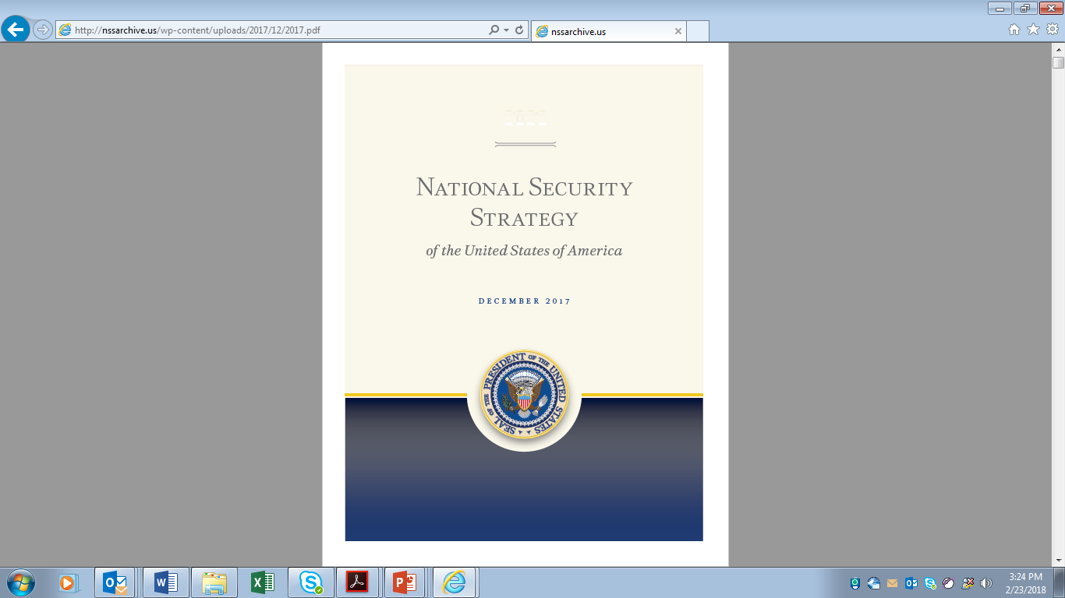

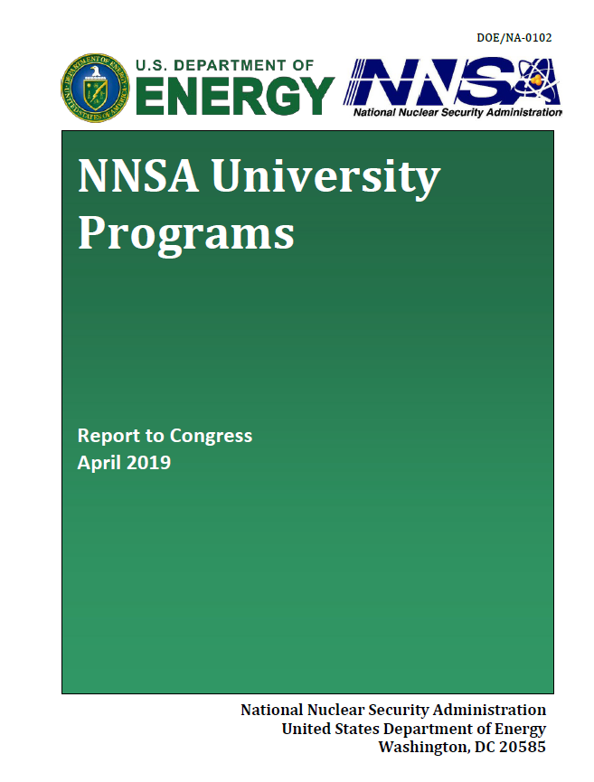
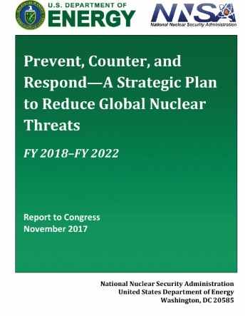
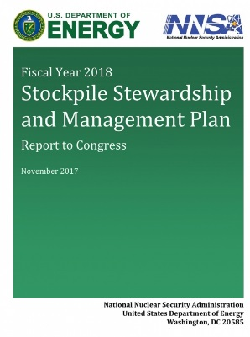
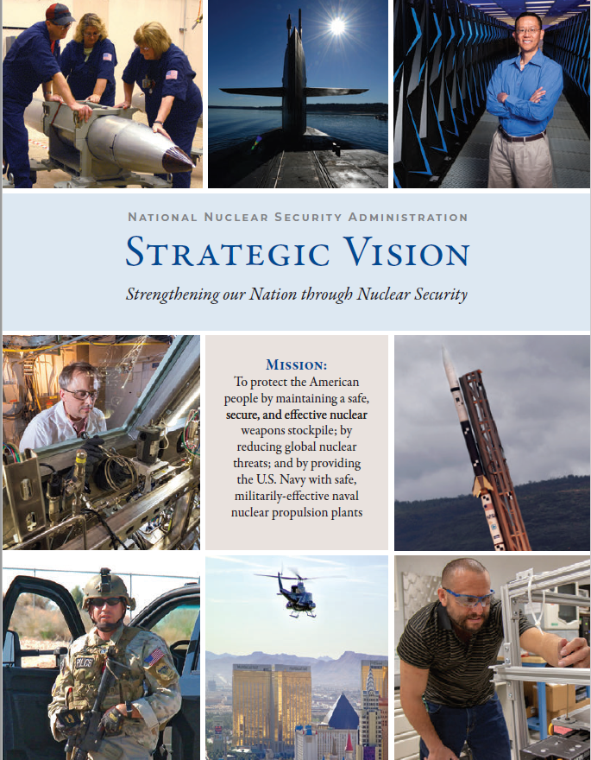
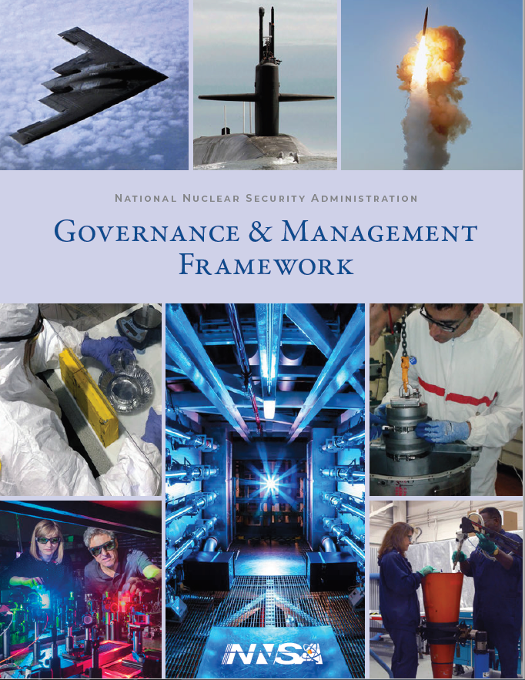
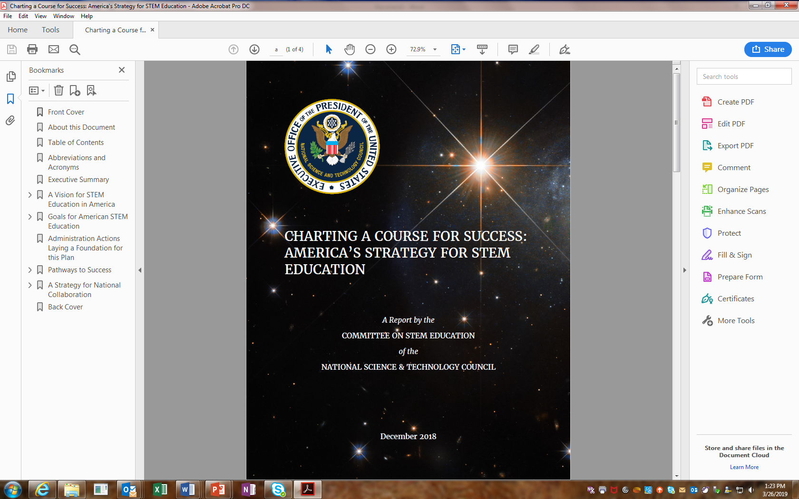
Guiding Principles
  Through alliance with university partners, NNSA is better positioned to:
  Maintain a safe, secure, and effective nuclear weapons stockpile
  Prevent, counter, and respond to global nuclear threats
  Conduct leading-edge scientific research
  Recruit, retain, and develop a diverse and expert workforce
  Protect the safety and security of sites, employees, and public
  Advance the Secretary of Energy’s STEM initiatives

Slide 11

Guiding Principles
DOE/NNSA Prevent, Counter, and Respond
“The scientific and technical capabilities and highly-skilled workforce of the nuclear security enterprise support DOE/NNSA’s nonproliferation, counterterrorism, counterproliferation, and emergency response programs in executing their critical national security missions.”
President’s Management Agenda
Cross-Agency Priority Goal #8 - Results-oriented accountability for grants
“Federal agencies will maximize the value of grant funding by applying a risk-based, data-driven framework that balances compliance requirements with demonstrating successful results for the American taxpayer.”
National Security Strategy - Pillar #2
Lead in Research, Technology, Invention, and Innovation.
" We will encourage scientists in government, academia, and the private sector to achieve advancements across the full spectrum of discovery, from incremental improvements to game-changing breakthroughs. We will nurture a healthy innovation economy that collaborates with allies and partners, improves STEM education, draws on an advanced technical workforce, and invests in early-stage research and development (R&D).”
White House Inclusive Diversity Initiatives
Historically Black Colleges and Universities (https://sites.ed.gov/whhbcu/)
American Indian and Alaska Native Education (https://sites.ed.gov/whiaiane/)
Educational Excellence for Hispanics (https://sites.ed.gov/hispanic-initiative/)
America’s Strategy for STEM Education (https://www.whitehouse.gov/wp-content/uploads/2018/12/STEM-Education-Strategic-Plan-2018.pdf)
6

Slide 12
Federal Government STEM Education Five Year Strategic Plan
GOALS FOR AMERICAN STEM EDUCATION Build strong foundations for STEM literacy Increase diversity, equity, and inclusion in STEM Prepare the STEM workforce for the future
Pathways | Objectives
Develop and enrich strategic partnerships | Foster STEM ecosystems that unite communities
 | Increase work-based learning and training through education-employer partnerships
 | Blend successful practices across the learning landscape
Engage students where disciplines converge | Advance innovation and entrepreneurship in education
 | Encourage transdisciplinary learning
Build computational literacy | Make computational thinking an integral element of education
 | Expand digital platforms for teaching and learning

Slide 13
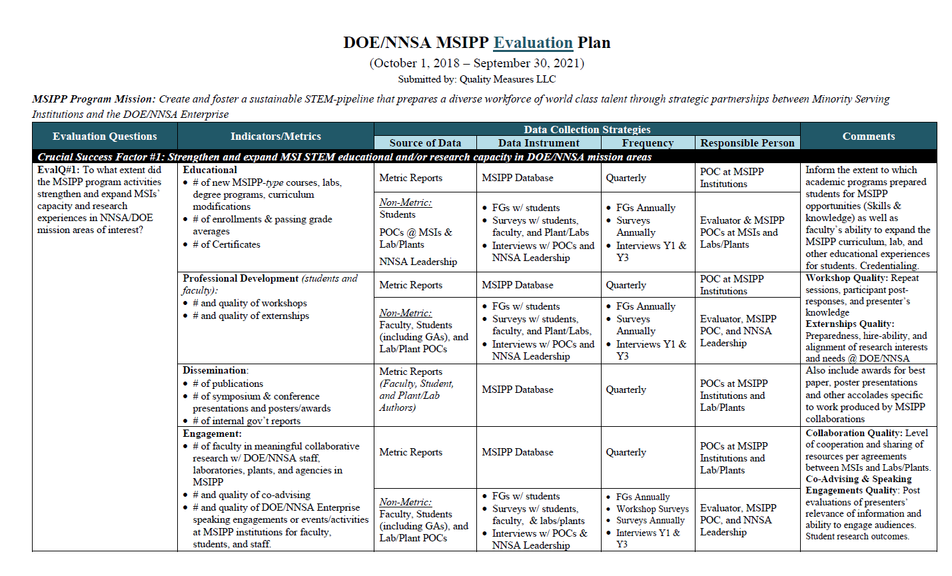
Evaluation

Slide 14
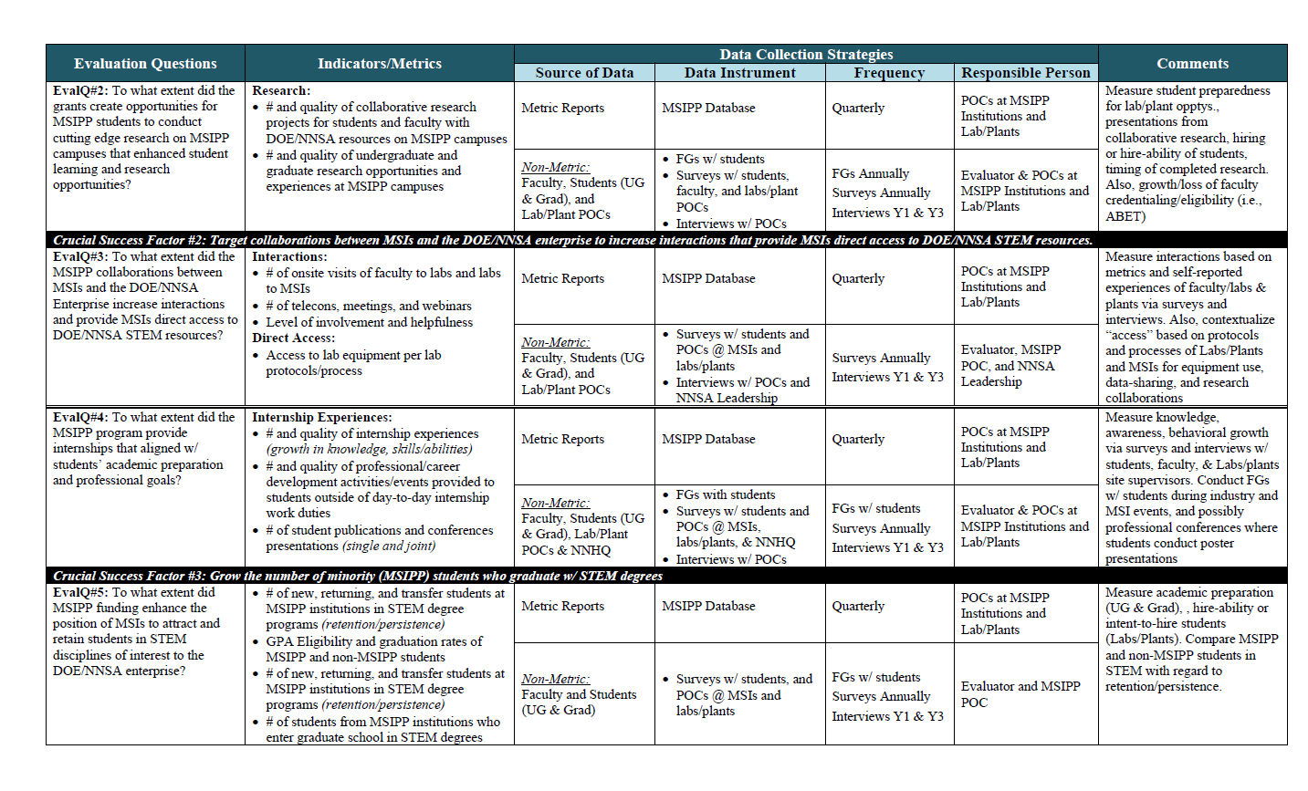
Evaluation

Slide 15
Evaluation

Slide 16
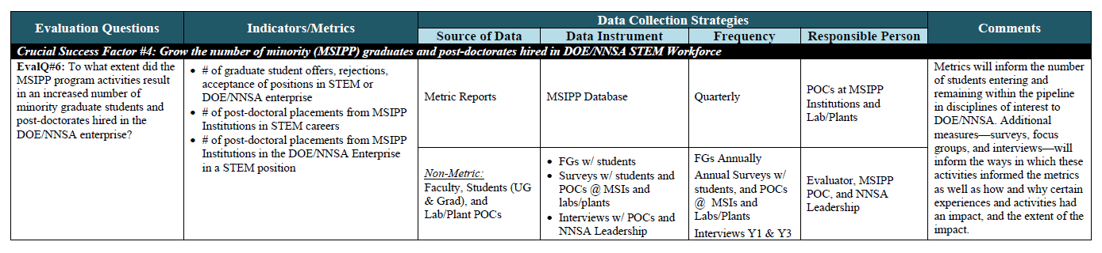
Evaluation

Slide 17
Important Items to Remember
Read the FOA in its Entirety
Ask Questions Early Through FedConnect
Apply Early To Make Sure You Identify Mistakes or Missing Information Early – NOTE: Corrections Can Be Made to an Application Before the FOA Closes
Confirm Application Requirements – Use the Checklists on Page 34-37 Under Sub-Section E. Summary of Required Forms and Files
Use Mandatory Forms Identified as Mandatory – Don’t Assume Mandatory Is Optional
Do Not Use Previously Used FOA Budget Justification Form and Other Previously Used Forms (Travel, Equipment, Materials & Supplies)
Update Information in the System for Award Management (SAM) – Instructions Discussed on Page 33 Under Sub-Section C. 12. List of Assurances and Certifications
Verify Sub-recipient Information (Mandatory Forms & SAM Assurances and Certifications)
Submit New Application Proposals (No Previously Used Application Proposals with Previous FOA Numbers)
We Wish You Much Success In Submitting Complete and Accurate Applications!

Slide 18
Questions
NNSA Program Manager:
David Canty
David.Canty@nnsa.doe.gov
NNSA Grants Officer:
Patricia Parrish
Patricia.Parrish@nnsa.doe.gov

