Slide 1
Webinar: Notice of Funding Opportunity for the Terrorism Prevention and Counterterrorism Research Center of Excellence
August 6, 2019
Jeffrey Brownsweiger
Program Manager
Office of University Programs
Science and Technology Directorate

Slide 2
Webinar Information
Acronyms:
  COE = Center of Excellence
  NOFO = Notice of Funding Opportunity
  HSE = Homeland Security Enterprise
  TPCR = Terrorism Prevention and Counterterrorism Prevention (TPCR)
  OUP = Office of University Programs
Two funding opportunities for the TPCR COE:
  Center Lead - for applicants who want to submit a proposal for Center Lead Center Lead
  Center Partner - for applicants who want to submit a proposal for a single research project
This webinar is being recorded and will be posted on grants.gov.
Please submit any questions in the Chat Box.
  Questions will be answered at the end of the webinar.
  Questions/answers will be posted on grants.gov.
Questions about specific research themes, topics or questions will not be addressed during this webinar.

Slide 3
Agenda
Overview of the Office of University Programs (OUP)
The DHS Centers of Excellence (COEs)
  OUP’s expectations of a DHS COE
  What does a COE do?
  Establishing a new COE
  Benefits of being a DHS COE
  Who can apply?
  Clarification about funding
Review Process
Tips to consider when applying as a Center Lead/Partner
Q&A

Slide 4
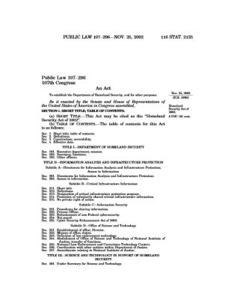
Congressional Direction
Homeland Security Act 2002
  The Under Secretary for Science and Technology shall have the responsibility for:
    “[establishing] … a coordinated, university-based system to enhance the Nation’s homeland security”
    “supporting United States leadership in science and technology”
    “merit review of research and development projects … and the dissemination of research conducted or sponsored by the Department”

Slide 5
Office of University Programs
The Office of University Program (OUP) streamlines access to the expertise of the Nation’s colleges and universities to address pressing homeland security needs:
  OUP makes it easy to tap into the intellectual power of America’s universities for homeland security research, development and education.
  DHS Components can access academic expertise to answer research questions, deliver technical solutions, and build a highly specialized workforce.
  OUP Program Managers provide individualized service to DHS Components and assist with finding needed R&D capabilities within OUP’s network of over 200 partner institutions.
  OUP offers established vehicles through which DHS Components and other partners can access the research and expertise found at the S&T Centers of Excellence.

Slide 6
OUP Functions
OUP establishes and manages Centers of Excellence, Minority Serving Institution Programs, and Workforce and Professional Development Initiatives, including:
  Managing competitions and merit reviews
  Managing COE projects for DHS Components
  Establishing competed vehicles to provide access to COEs
  Establishing and managing academic-related vehicles
  Providing fellowship vehicles
  Matching Components with needed capabilities within the COE network
  Creating opportunities for the homeland security enterprise to interact with researchers

Slide 7
What are Expectations for COEs?
COEs are funded through cooperative agreements, which enable and require substantial Federal agency involvement.
Applicants for COEs should expect to:
  Dedicate substantial time and resources to OUP and DHS.
  Perform research management oversight.
  Adapt to evolving homeland security challenges and priorities.
  Identify and partner with leading researchers in relevant disciplines.
  Develop sustained relationships with homeland security stakeholders.
  Collaborate with other COEs and be actively engaged in the COE community.
  Plan in advance for transition of research results to users and industry partners.

Slide 8
OUP Thrust Areas
Centers of Excellence:
  The Centers of Excellence (COEs) develop innovative, customer-driven homeland security science and technology solutions and train the next generation of homeland security experts.
    Each new university-based COE is a consortium competitively-awarded for a ten year term
    Network of ten COEs and more than 200 partners
Minority Serving Institutions:
  The OUP Minority Serving Institutions (MSI) Programs diversify the academic institutions involved in the homeland security mission and train dedicated professionals who can sustain the homeland security and technology workforce.
    Scientific Leadership Awards – institutional awards to support the development of homeland security science and engineering teaching initiatives
    Summer Research Team Program – grants supporting summer research collaborations that engage early career faculty and students with the COEs

Slide 9
Workforce and Professional Development Initiatives
Workforce Development
  Create skilled university graduates and prepare them for the workforce through internships, fellowships and post-graduate opportunities.
  Activities include supporting students financially, providing students with experiential learning opportunities, and developing course content at the COEs and MSIs
Professional Development
  Increase utilization of COE developed courses and training materials by current DHS science and engineering professionals.
  Activities include developing continuing education science and engineering courses, seminars and certificates for DHS employees

Slide 10









Current DHS Centers of Excellence

Slide 11
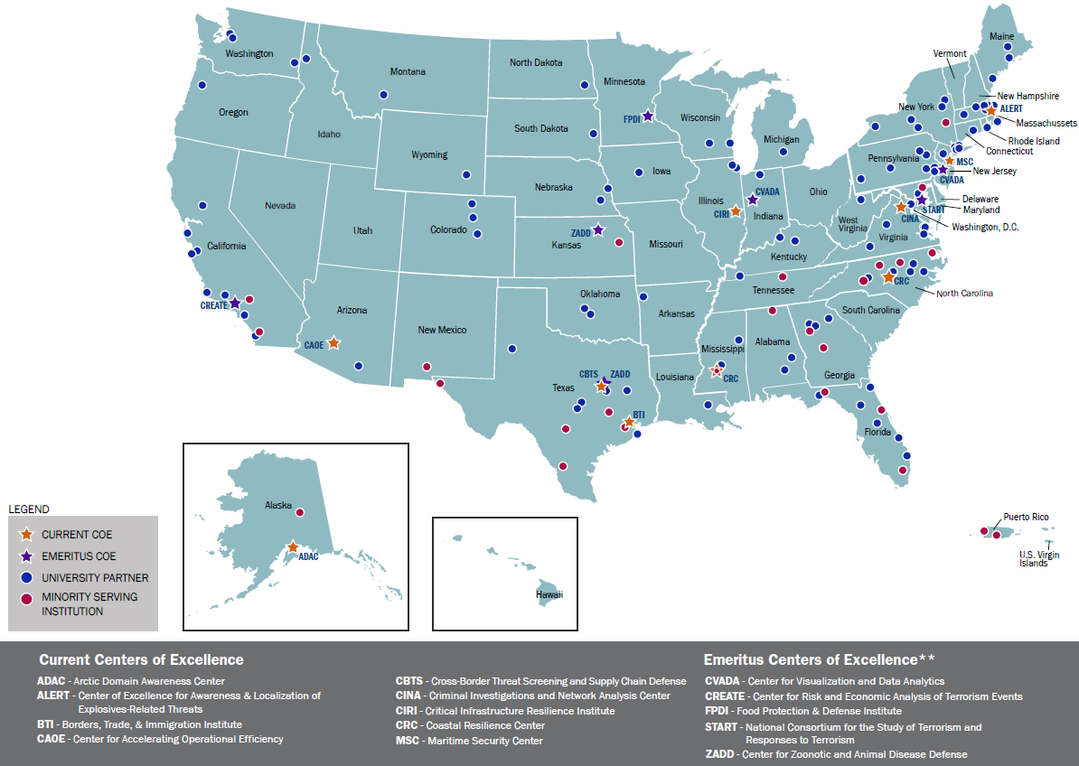
Current and Emeritus COE Network

Slide 12

COE Topic Alignment to DHS Missions

Slide 13
COE Review Process
S&T uses a three-phased full and open competition designed to identify high potential applicants
Develop Funding Opportunity
Notice of Funding Opportunity posted on www.grants.gov
Selection:
  Final selection may include projects from either the center lead or partner applications
  Negotiations with COE Leads
  10 year award to COE
External Scientific Review
Internal Mission Relevance Review
Site Visits to COE Lead Finalists
New COE Kickoff
1
2
3
4
5
6
7
Site Visits to COE Lead Finalists
Internal Mission Relevance Review
DHS stakeholders develop research questions for funding opportunity
OUP Process
NOTE: Not all proposed projects in a COE Lead application are likely to be selected.
Customer Involvement

Slide 14
How Are COE Topics Identified?
S&T has established a thorough and rigorous process to examine the topics which are to be designated as a Centers of Excellence. This four-month evaluation framework consists of two phases, throughout which S&T determines how a proposed COE topic satisfies the following:
Phase 1: Strategic Assessment
  It must be a priority for Congress, the Administration, DHS Leadership, DHS Components, and/or First Responders.
  The topic must serve a significant DHS mission and continue to be a DHS priority in the future.
  It must address a real knowledge gap.
  Phase 2: Topic Refinement
  It must be a uniquely DHS problem with no other agencies’ research programs sufficiently addressing it.
  A COE must be able to make a significant contribution with available resources and academic constraints.
DHS Mission Areas
Law
DHS Mission Relevance
DHS Need
Market Research
Stakeholder Priority
Ability to Contribute
COE TOPIC

Slide 15
Establishing a new COE:
Evaluation Process and COE Selection
Funding Opportunity Announcement is posted on www.grants.gov
Evaluation Process
  External panel scientific review and recommendations
  Internal panel DHS relevancy review and priority selections
  Site visits with DHS subject matter experts to Lead Institution finalists to assess management
Selection
  Selection of new COE Leads and Partners
  Negotiations with COE Leads, including COE subcontracting and approval process
  10-year award to COE
NOTE: Not all proposed projects in a COE Lead application are likely to be selected.

Slide 16
Establishing a New COE:
Post-Award Standup
Initial Work Plan for Year 1
  OUP-facilitated Work Plan Development Workshop.
      After Year 1, research projects may be refined, developed or evaluated through:
  Workshops with stakeholders and end users to identify new gaps and research needs.
  Advisory committees – OUP will establish a Board of Directors to provide guidance to OUP.
Biennial Reviews – OUP will conduct a formal review every 2 years with a SME review committee to evaluate the research, and reallocate resources as necessary.

Slide 17
Why Should You Apply?
Being a COE Lead or Partner is a unique opportunity to:
Work on real homeland security challenges.
Develop solutions to make the nation safer, more secure, and resilient against terrorism.
Work closely with a combination of:
  homeland security operational personnel including local, state, and other federal agencies
  scientific subject matter experts
  industry and nonprofit organizations
Foster and enable high-level, inter-agency and public-private partnerships and collaboration.

Slide 18
Who Can Apply?
Any accredited U.S. institution of higher education
Applicants should NOT submit a proposal for the same research project to more than one of the TPCR NOFOs, either Center Lead or Partner.
Center Lead
  Only one application for Center Lead will be accepted from any single university
Center Partner
  Any Principal Investigator (PI) at an accredited U.S. institution of higher education can apply in partnership with other subcontractors or performers.
  A PI can only submit one project per proposal.
  A PI may submit more than 1 proposal for separate projects.
  PIs who are partners under a Center Lead application may not submit the same project proposal under the Partner FOA.

Slide 19
Clarification about Funding
~$3.5 million/year is available for the selected Center Lead and Partner applications.
DHS awards the ~$3.5 million/year award to the Center Lead.
DHS may allocate substantial funds to support Partner applications.
DHS reserves the right to select projects submitted to the Center Lead and/or the Partner FOAs and combine them to create the research and workforce development portfolio for the new Center.
Selected Partner projects become part of the Center Lead portfolio and are funded through the ~$3.5 million/year award to the Center Lead institution.
The Center Lead administers funding to all DHS-selected projects, including funding Partner projects that have been incorporated into the newly formed Center.

Slide 20
Tips for Applying
Read the entire NOFO.
Develop a diverse but integrated multi-institutional, multidisciplinary team.
Structure projects to be measurable and managed using technical and programmatic milestones.
Plan for transitioning research results or technologies
Create a matrix – did you address everything?
Review the checklist.
A separate Partner NOFO is available for applicants interested only in submitting proposals for individual projects.
Notes:
TP: Carefully read the FOA. It is complicated and we ask a lot of Center Lead applicants. Please be responsive.

Slide 21
Overall Review Process
Competition Dates:
  Posting of Funding Opportunity Announcement: July 10, 2019
  Submission of Proposals by Closing Date: September 13, 2019
Three-tiered Review:
Scientific Quality Review (External Review): Anticipated October 2019
    Focus on the research quality and influence, the education program, and the appropriateness of the costs.
DHS Relevancy Review (Internal DHS SMEs): Anticipated November 2019
    Focus on the mission relevance of the proposed research, education and outreach programs and the applicant’s demonstrated capabilities.
Site Visit Review: Anticipated December 2019

