Slide 1
Information Session Open House
Dr. Sara Hogan
Office of Storage & Transportation
May 26, 2026

Slide 2
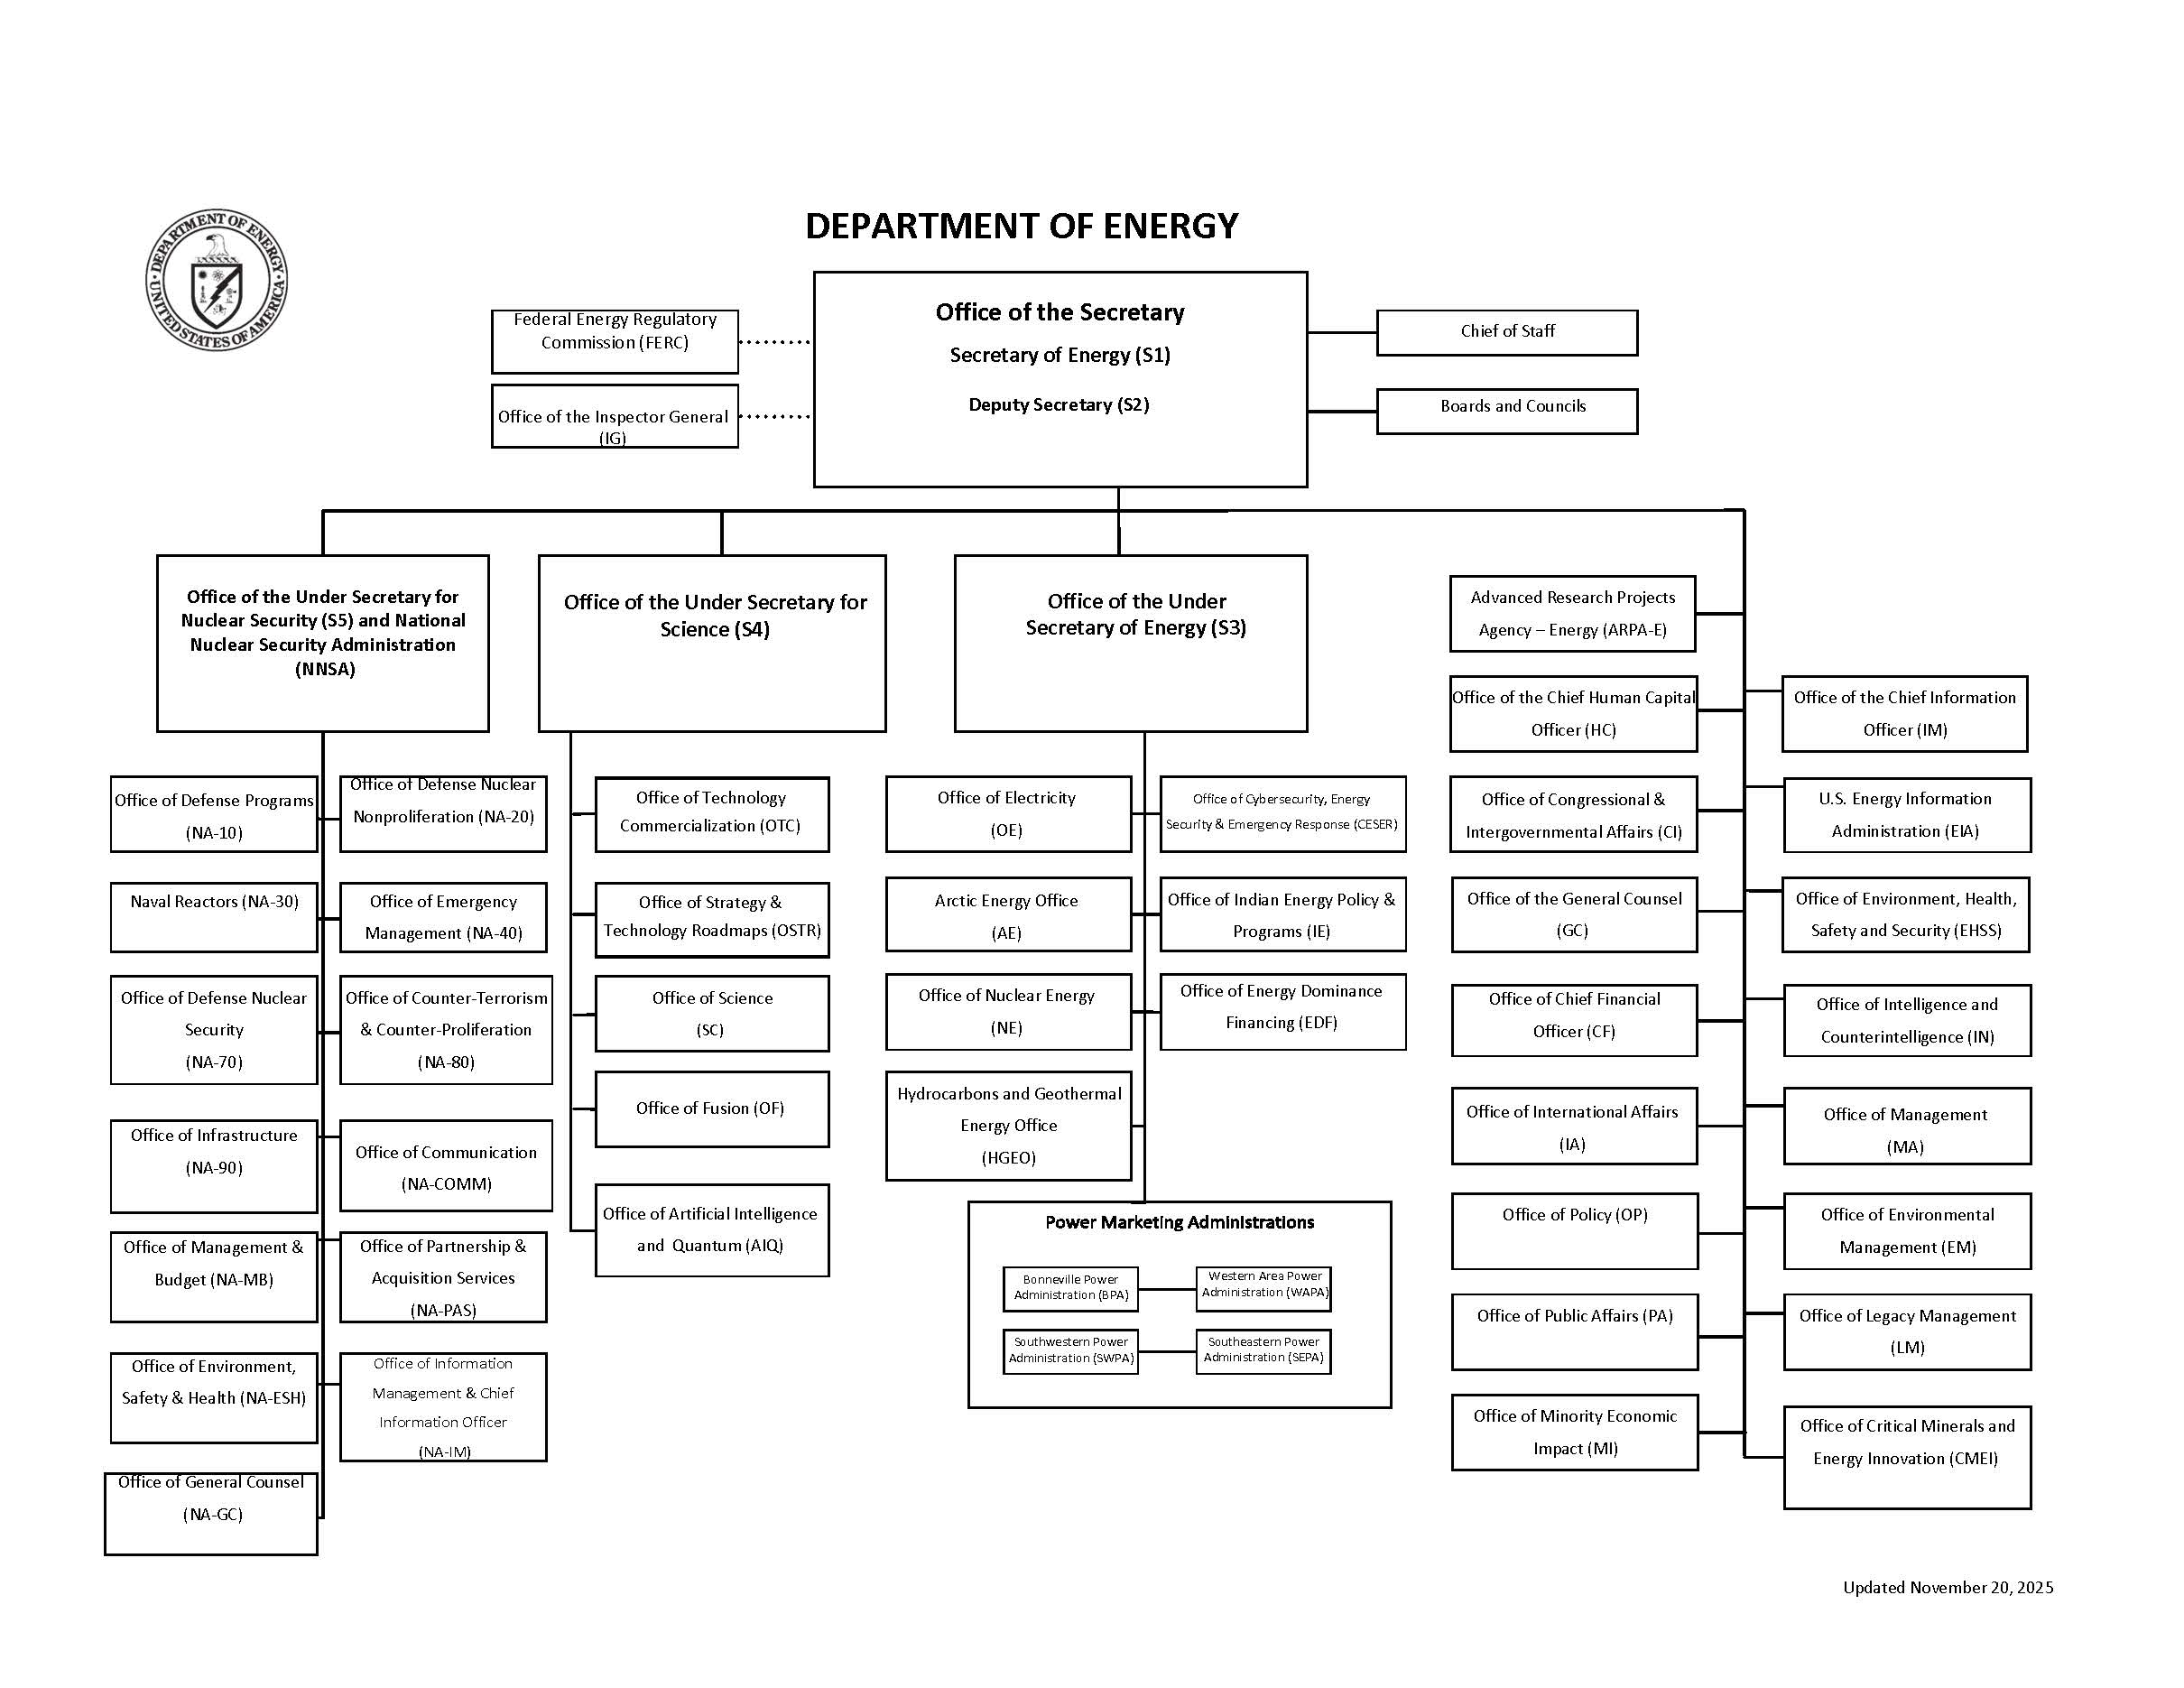

Slide 3

Office of Spent Fuel & High-Level Waste Disposition
Mission: Develop and implement a plan for the safe and secure long-term management of the Nation’s used nuclear fuel (UNF) and high-level radioactive waste (HLW)

Slide 4
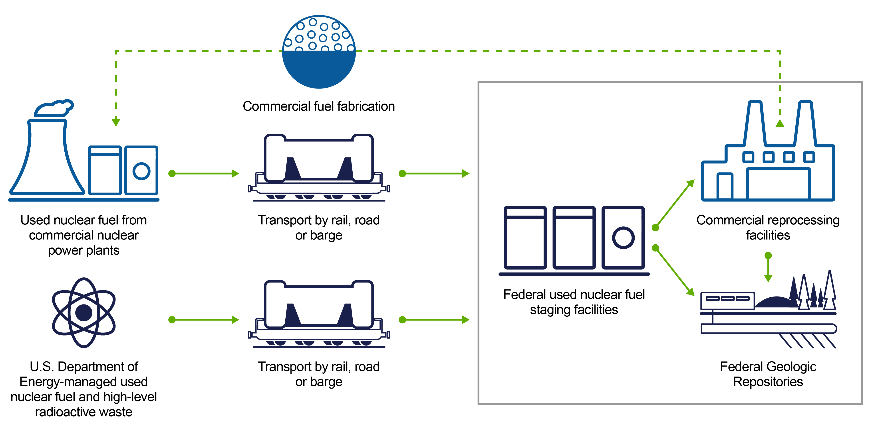
Integrated Waste Management System for UNF & HLW

Slide 5

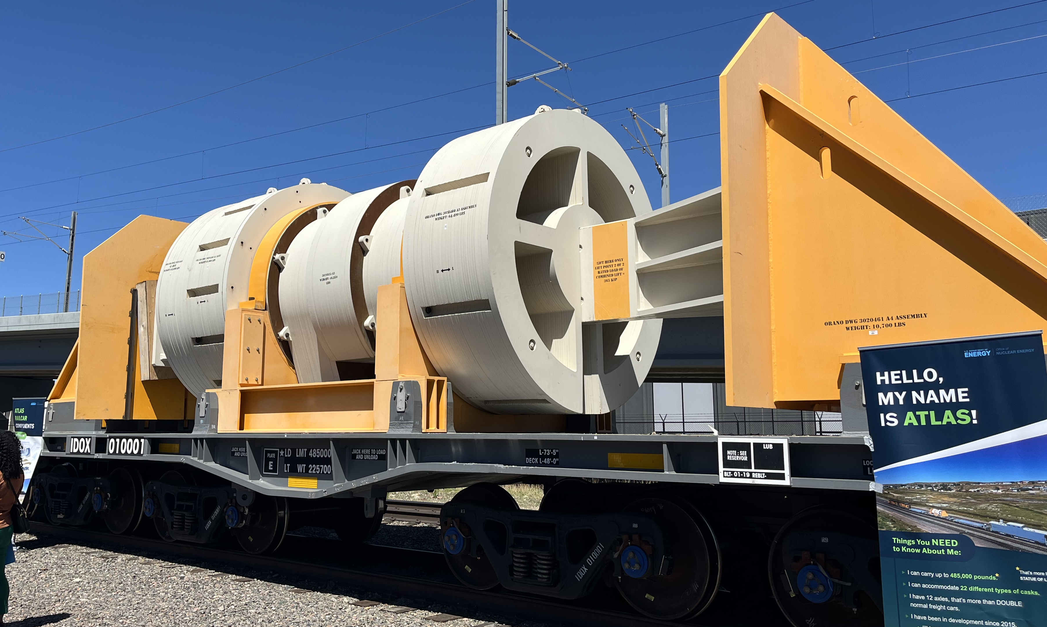
Tribal Engagement
National Transportation Stakeholders Forum (NTSF) Ad Hoc Working Groups:
  Section 180(c)
  High Burnup Research Cask (HBURC) Shipment
Transportation Core Group
  March 18-19, 2025, Washington, DC
  August 20-21, 2025, Crystal City, VA
  March 24-25, 2026, Charlottesville, VA

Slide 6
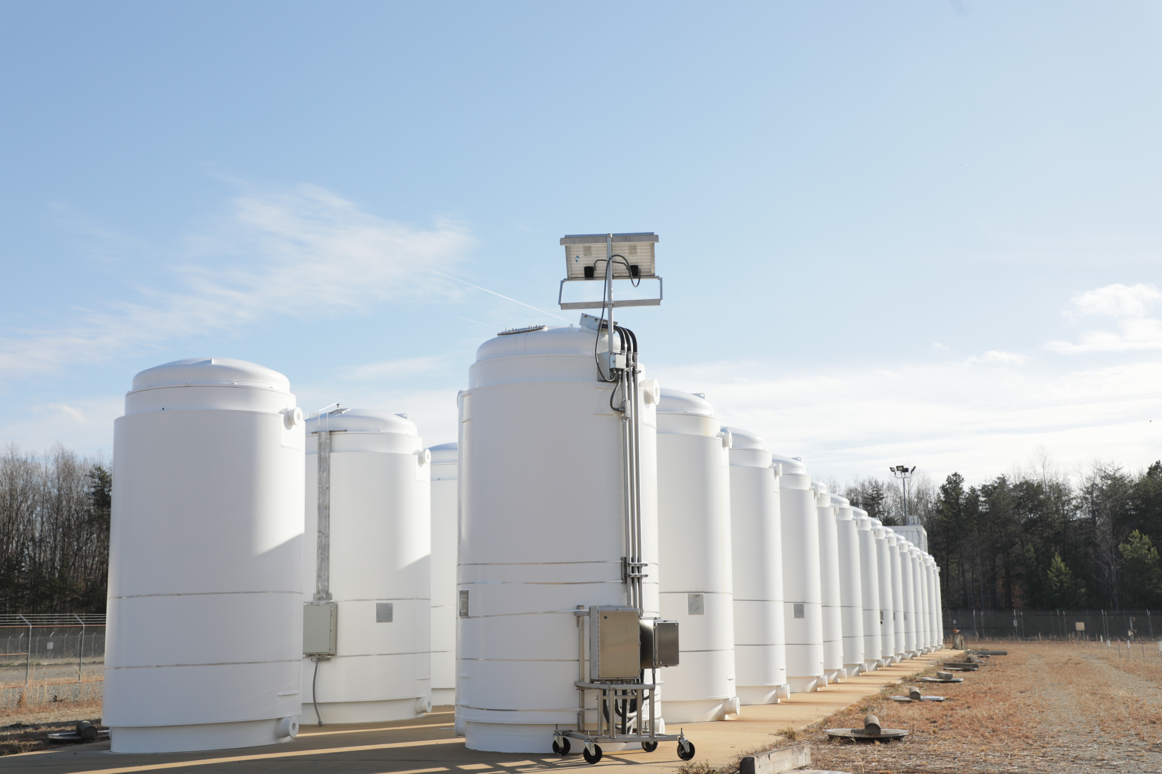
What is the High Burnup Research Cask Project?
Research project started in 2013 as a collaboration between the U.S. Department of Energy (DOE) and the Electric Power Research Institute (EPRI)
High burnup UNF stays in reactors longer to produce electricity
Monitoring characteristics of high burnup UNF in one dry cask at the North Anna Power Station near Mineral, Virginia
Project will provide data to support safe storage of UNF for DOE’s future Federal UNF staging facility(ies), and for a majority of currently operating U.S. nuclear power plants
Notes:
There are many casks in this photo, but only the cask on the front right is part of this research project.

Slide 7
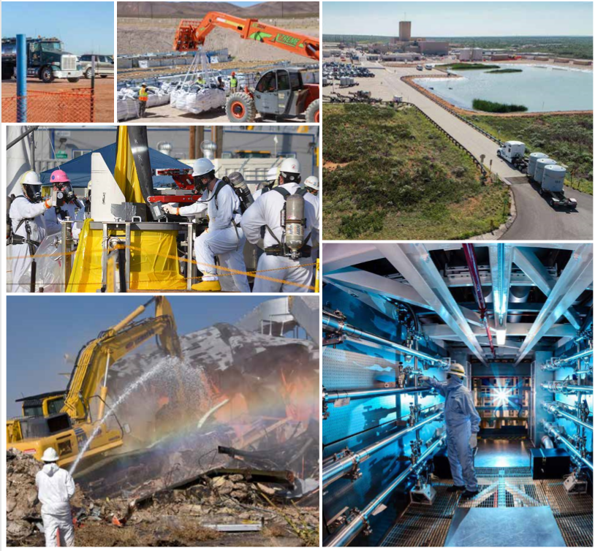
Office of Environmental Management’s Mission
To complete the safe cleanup of the environmental legacy brought about from decades of nuclear weapons development and government-sponsored nuclear energy research.
The Office of Environmental Management (EM)’s priority is to ensure the safety and health of the public and EM's workforce while continuing to protect the environment.

Slide 8
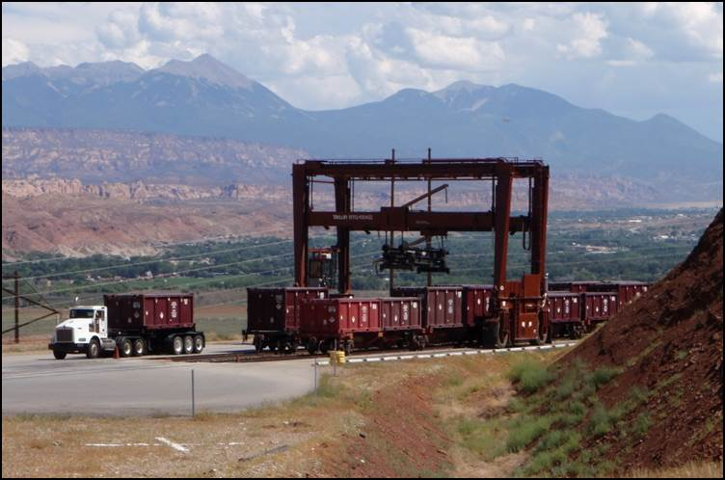
Office of Packaging and Transportation Mission
The Office of Packaging and Transportation (OPT) protects people and the environment by ensuring safe, compliant and efficient packaging and transportation of materials.
OPT achieves this mission by conducting packaging and transportation assessments and oversight; assisting field sites; and developing and managing policies, guidance and tools in accordance with DOE requirements and government regulations.

Slide 9
Project Background
The purpose of the award is to help facilitate engagement among Federally recognized Tribes with DOE’s offices of Environmental Management (DOE-EM) and Nuclear Energy (DOE-NE) for planning and coordination of DOE transportation of UNF, HLW, and other radioactive materials
DOE transportation of radioactive materials will occur/occurs on public land
DOE engages with Tribes on radioactive materials transportation largely through the Tribal Radioactive Materials Transportation Committee (TRMTC)
  TRMTC engages in their own activities, engages with DOE alongside State Regional Groups, and participates in NTSF

Slide 10
Work Scope – Cooperative Agreement
Performance Period October 1, 2026 – September 30, 2031
One awardee will be selected
Activities of the award must be within DOE’s scope and deliverables. Within that scope, specific activities are directed by the information needs and interests of the Tribal members
In addition to specific tasks and deliverables, work scope may include but is not limited to:
implementing efforts to complete the policy and procedures for a DOE emergency response training and technical assistance funding program for UNF shipments
addressing outstanding questions related to a rail, highway, or waterway-based UNF transportation system
sharing information on DOE development of specialty railcars
assisting in developing general plans and procedures for DOE UNF shipping campaigns, including providing regional or Tribe-specific data and information
supporting Tribal participation in meetings and technical conferences

Slide 11
Desired Experience
Subject matter expertise in radioactive materials and waste, radioactive materials transportation, emergency response training
Experience working with Tribes
Experience with project management and budgeting
Ability to plan meetings and travel
Access to knowledge on current events in industry and the Federal government
Efficient communication skills
Ability to work with diverse teams
Experience with Federal contracts
Ability to maintain a website

Slide 12

TRMTC Executive Committee Members
Richard Arnold (Pahrump Paiute Tribe/ Consolidated Group of Tribes Organizations)
Adam Duran (Pueblo of Pojoaque)
Jimmy-John Thompson (Timbisha Shoshone Tribe)

