Slide 1
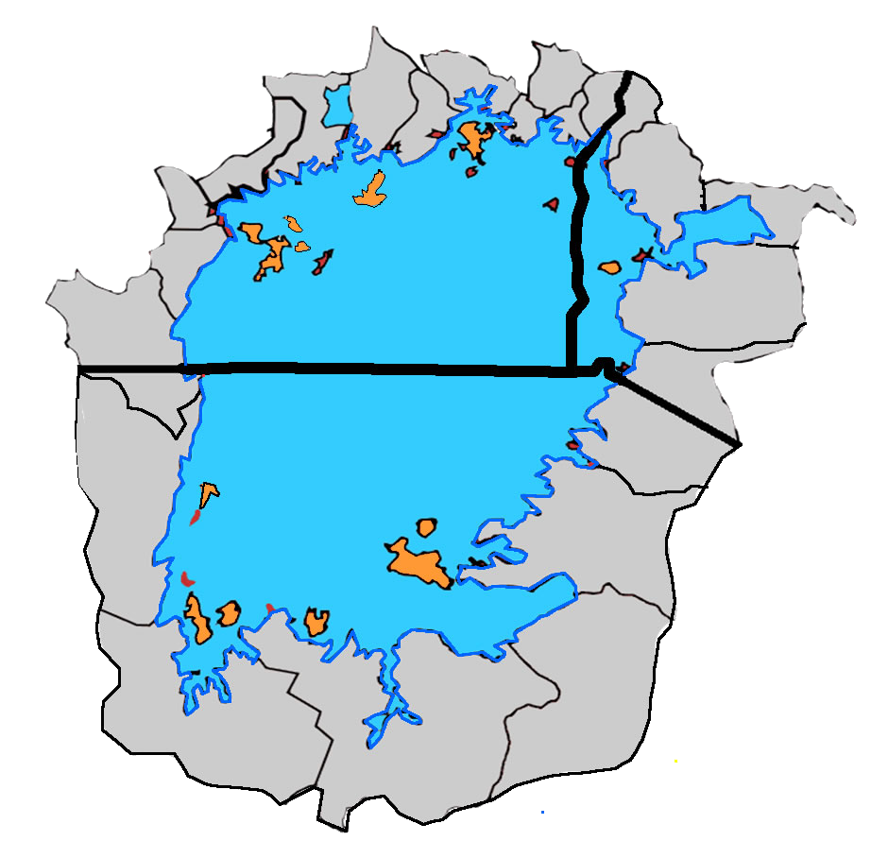
Lake Victoria Region: HIV Prevalence and Population Mobility Patterns
Jinja
Namayingo
(9.0%)
Siaya (21.0%)
4.9%
Kenya
5.9%
Buikwe (9.0%)
4.9%
5.9%
Uganda
Mpigi (12.0%)
Entebbe
13
9
Kisumu
Masaka (12.0%)
3
2
4.5%
1
Kisumu (16.3%)
8
4
5
Kasensero
Migori
10
11
Homa Bay (20.7%)
Misenyi (7.0%)
Migori (13.3%)
No | Island | Surface Area (Km Sq) | Distance from the shore line (Km)
1 | Mfangano, Kenya | 65 | 16.81
2 | Ndere, Kenya | 4.07 | 1.28
3 | Rusinga, Kenya | 44.94 | 4.81
4 | Remba, Kenya | 2.24 | 27.96
5 | Ringiti, Kenya | 2.01 | 24.89
6 | Ukerewe, Tanzania | 527.96 | 27.37
7 | Mwanza, Tanzania | 3.24 | 1.56
8 | Bugala, Uganda | 282.83 | 28.52
9 | Damba, Uganda | 33.82 | 13.53
10 | Migingo, Kenya | 0.069 | 17.7
11 | Usingo, Kenya | 0.74 | 17.13
12 | Maisome, Tanzania | 126.95 | 10.45
13 | Buvuma, Uganda | 219.59 | 14.15
Bukoba
Bukoba (6.0%)
Rorya (6.0%)
6
12
Mwanza
7
Legend
Above national HIV prevalence
4.5%
Tanzania
Inland Town
Lake County/District
Lake Victoria
National Boundary
County/District Boundary
Movement between islands
Movement between islands and Lake shores
Movement to rest of the world
Notes:
There are more than 3000 islands many of which are uninhabited.

Slide 2
Populations of selected islands and surrounding towns
Reference | Country | Towns | Population
Census 2009 | Kenya | Siaya | 22,586
 |  | Kisumu | 388,311
 |  | Migori | 53,100
 |  | Homa Bay | 58,936
Census 2014 | Uganda | Kampala | 1,507,114
 |  | Entebbe | 365,857
 |  | Jinja | 76,057
Census 2012 | Tanzania | Mwanza | 351,607
 |  | Musoma | 134,327
 |  | Bukoba | 128,796
Reference | Country | Islands | Population
2007 census | Tanzania | Ukerewe | 150,000
https://en.wikipedia.org/wiki/Kalangala_District | Uganda | Kalangala | 63,000
https://fortuneofafrica.com/ug/ssese-islands/ | Uganda | Ssese | 35,000
https://globalhealthcenter.umn.edu/global-partnerships/east-africa-network/mfangano | Kenya | Mfangano | 30,000
https://www.ncbi.nlm.nih.gov/pubmed/27185811 | Kenya | Rusinga | 25,000
2011 census | Uganda | Buvuma | 20,000
2007 census | Tanzania | Ukara | 16,000
https://www.youtube.com/watch?v=6UnHtAR9Pb8 | Kenya | Remba | 11,000
https://www.cfpc.ca/ProjectAssets/Templates/Resource.aspx?id=5084 | Kenya | Ringiti | 6,000

Slide 3
Summary
Lake Victoria is the largest lake in Africa, with a surface area of 68,800 km2, and a catchment area of 193,000 km2.
The lake contains over 3,000 islands* (inhabited and uninhabited), and has a highly indented shoreline estimated to be about 3,460 km long.
The visual displays mobility from the Lake Victoria islands to the lake shores and the rest of East Africa.
Reference
Kenya:
  Kenya HIV estimates report 2018 (NACC and NASCOP)
  https://nacc.or.ke/wp-content/uploads/2018/12/HIV-estimates-report-Kenya-20182.pdf
  http://siteresources.worldbank.org/INTAFRICA/Resources/2579941335471959878/Kenya_County_Fact_Sheets_Dec2011.pdf
Tanzania:
  Tanzania HIV Impact Survey (THIS) 2016-2017
  https://phia.icap.columbia.edu/wp-content/uploads/2017/11/Tanzania_SummarySheet_A4.English.v19.pdf
  https://www.nbs.go.tz/nbs/takwimu/census2012/Tanzania_Total_Population_by_District-Regions-2016_2017r.pdf
Uganda:
  Uganda Population-Based HIV Impact Assessment UPHIA 2016–2017
  https://phia.icap.columbia.edu/wp-content/uploads/2018/07/3430%E2%80%A2PHIA-Uganda-SS_NEW.v14.pdf
https://www.ubos.org/onlinefiles/uploads/ubos/NPHC/NPHC%202014%20FINAL%20RESULTS%20REPORT.pdf
  * Africa Facts - https://africa-facts.org/lake-victoria-facts/

