Slide 1
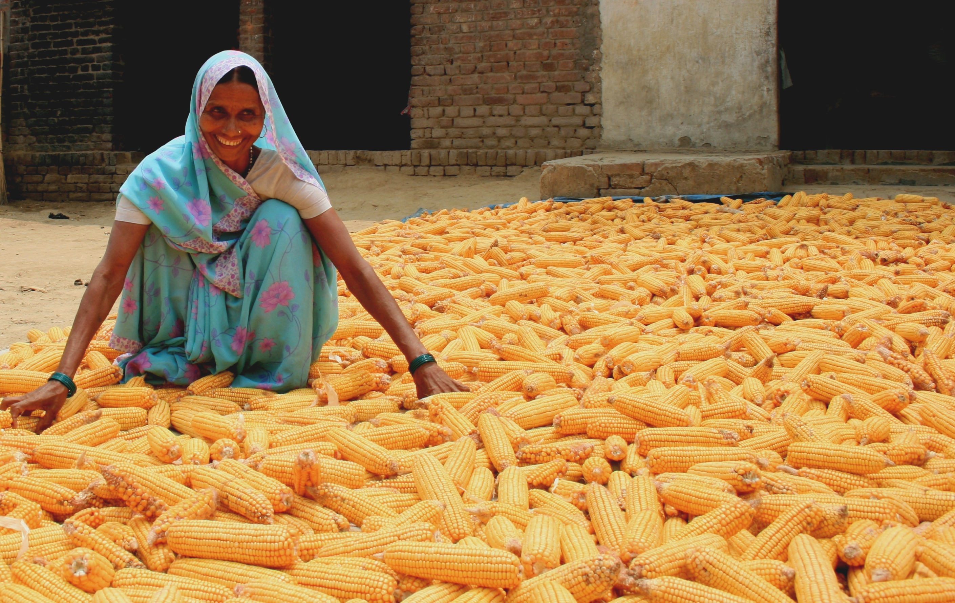
GLOBAL FOOD SECURITY STRATEGY (GFSS)
INDIA – AG TECH CHALLENGE Broad Agency Announcement
BAA-ROAA-GFSS-2018

Slide 2
Objectives
To provide information about what is a Broad Agency Announcement (BAA) for AG-Tech Challenge.
To provide an overview about Food Security Strategic Partnerships developed by USAID/ INDIA.

Slide 3
What is a BAA?
BAAs may be used by agencies to fulfill R&D requirements for scientific study and experimentation directed toward advancing the state-of-the-art or increasing knowledge or understanding rather than focusing on a specific system or hardware solution. The BAA technique will only be used when meaningful proposals with varying technical/scientific approaches can be reasonably anticipated.
BAAs are open for anyone to participate -- including the private sector, public sector, non-governmental, for-profit, non-profit, and educational institutions -- whether you are new to USAID, or a long-standing partner.

Slide 4
Stage 1 – Posting Announcement/Receiving EOIs
The BAA is posted to both FedBizOpps and Grants.gov.
Expressions of Interest (EOI) are received.
If your expression of interest is not accepted, you will receive correspondence stating that and you will not move on to Stage 2.
For Expressions of Interest which are deemed to have merit, USAID will issue an invitation to collaborate to the potential partner.

Slide 5
Stage 2 – Co-Creation/Design
Together, USAID and the potential partner(s) will collaborate on a Concept Paper.
The Concept Paper, generally 5-10 pages, will further detail and explain the project as initially provided in the Expression of Interest.
This process calls for working together with organizations that may or may not be new to you.
All potential partners may not move forward to Stage 3.

Slide 6
Stage 3 – Peer and Scientific Review
Concept Papers developed during Stage 2 will be reviewed by the Peer and Scientific Review Board.
The Board will review Concept Papers and recommend considered Apparently Successful Partners to the CO/AO.
All potential partners may not move forward to Stage 4. Evaluations are typically done on a green/amber/red light basis.

Slide 7
Stage 4 – Award
The CO/AO will review the Peer and Scientific Review Board’s recommendations, and will make a determination whether the respondent is an Apparently Successful Partner.
The CO/AO may also make or narrow down the anticipated instrument type to facilitate project design.
CO/AO will engage in final review, negotiation, and determinations of instrument type, responsibility, cost reasonableness, etc., and will craft an award instrument with the Apparently Successful Partner.

Slide 8
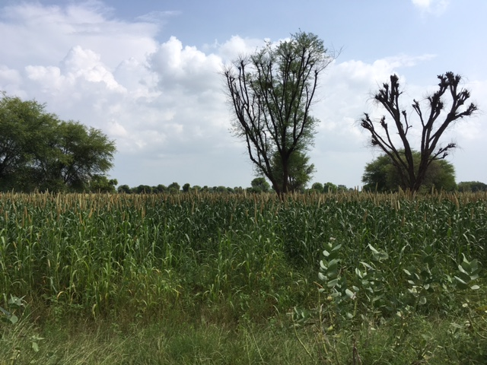

Strategic Partnerships for Agricultural Development in Asia
USAID/ India: Food Security Office

Slide 9

FOOD SECURITY OFFICE: Strategic Vision
Adapt and diffuse proven Indian agricultural technologies/ processes to overcome developmental challenges like low agricultural productivity and chronic poverty
Deepen and strengthen U.S. relationships with non-traditional donors and global leaders to produce lasting change in global food and nutrition security
Special attention to women, the extreme poor, small-scale producers, youth, marginalized communities, and small and medium enterprises
Support programs that capitalize on India’s expertise through public-private partnerships, in the deployment of best practices, technology/ innovation transfers, capacity building, and harmonization of regional markets to reduce food and nutrition insecurity.
Leverage local resources, local capacity building, diversify partner base, graduate from assistance, and promote
aid effectiveness

Slide 10
USAID projects aim to
Enhance Production
Improve agricultural productivity through access to technologies; diversification in livestock, poultry, fisheries, crops and farm mechanization
Expand Markets
Expand agricultural markets and trade through a value chains approach, improving post-harvest management, promoting small and medium enterprises, and facilitating regional trade and market access
Improve Nutrition
Build Resilience
Improve the nutritional status of women and children through access to diverse foods, informed nutrition-related behaviors, and service delivery
Build climate resilient food systems following an integrated approach to improve water and resource use in crop production, risk reduction through crop/weather based advisory services, and insurance products

Slide 11
Impact of Partnerships in FY 2016 -17
Partnerships: Establish and nurture long-term partnerships and alliances between U.S., Indian, and respective host country governments, including agricultural research and education institutions, private sector, and civil society organizations. These partnerships reflect the transformation of the USAID-India relationship from a traditional donor-recipient approach to a peer-to-peer partnership whereby India and USAID jointly collaborate to solve global development challenges.
65, 000 farmers applied improved technologies and management practices across 27,063 hectares of land
26 new public-private partnerships were facilitated to develop, transfer and scale up innovation
39,000 individuals have received USG supported short term agricultural sector productivity or food security training, of which more than 15,000 are women
$ 2.4 million in new private sector investments in the agriculture sector or food chain leveraged by Feed the Future implementation

Slide 12
Collaborations to Promote Food and Nutrition Security
Support programs that capitalize on India’s expertise, often through public-private partnerships, in the deployment of best practices, innovation transfers, and harmonization of regional markets to reduce food and nutrition insecurity.
High replicability of India’s ability to develop and deploy cost-effective development solutions to other developing countries in South and South East Asia, including members of the South Asian Association for Regional Cooperation (SAARC), etc.
  Indian agricultural innovations: technologies, products, services, best practices, business model, market competitiveness for development impact shared with focus Feed The Future (FTF) countries
  Capacity Building : leverage Indian expertise and institutions to enhance human and institutional capacity
  Resilient Systems: enhance agricultural resilience by promoting technologies that enable farmers cope with variability in rainfall variability, heat shocks, pest and diseases, change in cropping patter, etc.

Slide 13
Cross-cutting themes
Youth Development
Gender Equality
&
Female Empowerment
Equitable & Inclusive Growth
Science, technology and Innovation
Information & Communication Technologies (ICT)
Market Linkages
Applied Research

Slide 14
Examples of partnerships that USAID/FSO in India is implementing around the world
Agricultural supply chain development project in Nepal
Dairy production project in Kenya
Small-scale agricultural mechanization in Kenya
Institutional and individual capacity building in 17 countries (Asia/Africa)

Slide 15
Broad Agency Announcement (BAA): BAA-ROAA-GFSS-2018
USAID/ India is seeking Expressions of Interest (EOI) through BAA-ROAA-GFSS-2018 . Please login to www.fbo.gov and www.grants.gov for details regarding the BAA.
Agricultural sectors for consideration under BAA by applicants:
Seeds and Fertilizers
Fisheries and feed technologies
Nutrition-sensitive agriculture/aquaculture
Post-harvest processing and cold storage technologies,
Precision agriculture and sustainable agriculture technologies
Small-holder mechanization and finance
Business process innovations
Livestock and dairy production
Deadline to submit Expressions of Interest (EoI) is January 31, 2018

Slide 16

Please submit your questions to indiarco@usaid.gov by Jan. 17, 2018 till 5:00 pm IST

