Slide 1

Registration Steps for DUNS, NCAGE and SAM
U.S. Embassy in Tbilisi

Slide 2
Step 1 – Obtain a DUNS Number
Step 2- Request NCAGE Code
Step 3- Register in SAM

Slide 3
STEP 1 – Obtain a DUNS Number
DUNS number (Data Universal Numbering System )is a 9 digit number obtained from DUN and Bradstreet on the website: http://fedgov.dnb.com/webform/index.jsp
If you don’t know if you have a DUNS Number, search on the following website:
http://fedgov.dnb.com/webform/CCRSearch.do

Slide 4
Step 2- Request NCAGE Code
Foreign registrants in SAM must have a NATO Commercial and Governmental Entity (NCAGE) Code assigned. If your organization does not already have an NCAGE assigned, for non-NATO countries you can obtain one using the form at this link:
https://eportal.nspa.nato.int/ac135public/

Slide 5
To request an NCAGE, connect to the non-NATO NCAGE tool at https://eportal.nspa.nato.int/ac135public/
When you get to that Web site, click on the "CAGE/NCAGE Code Request" tab and follow the instructions.
  The first screen you will come to will allow you to check to see if an NCAGE is already assigned to the company that you require an NCAGE for. If your search does not find an existing NCAGE, click on the tab called "Request New CAGE" at the bottom of the search results screen. Follow the instructions provided on the Web site.
  After you submit your request, you will automatically receive:
    1) a request confirmation/validation e-mail message and
    2) a second e-mail message once the CAGE request is processed (assignment of the code or reject of the request).

Slide 6
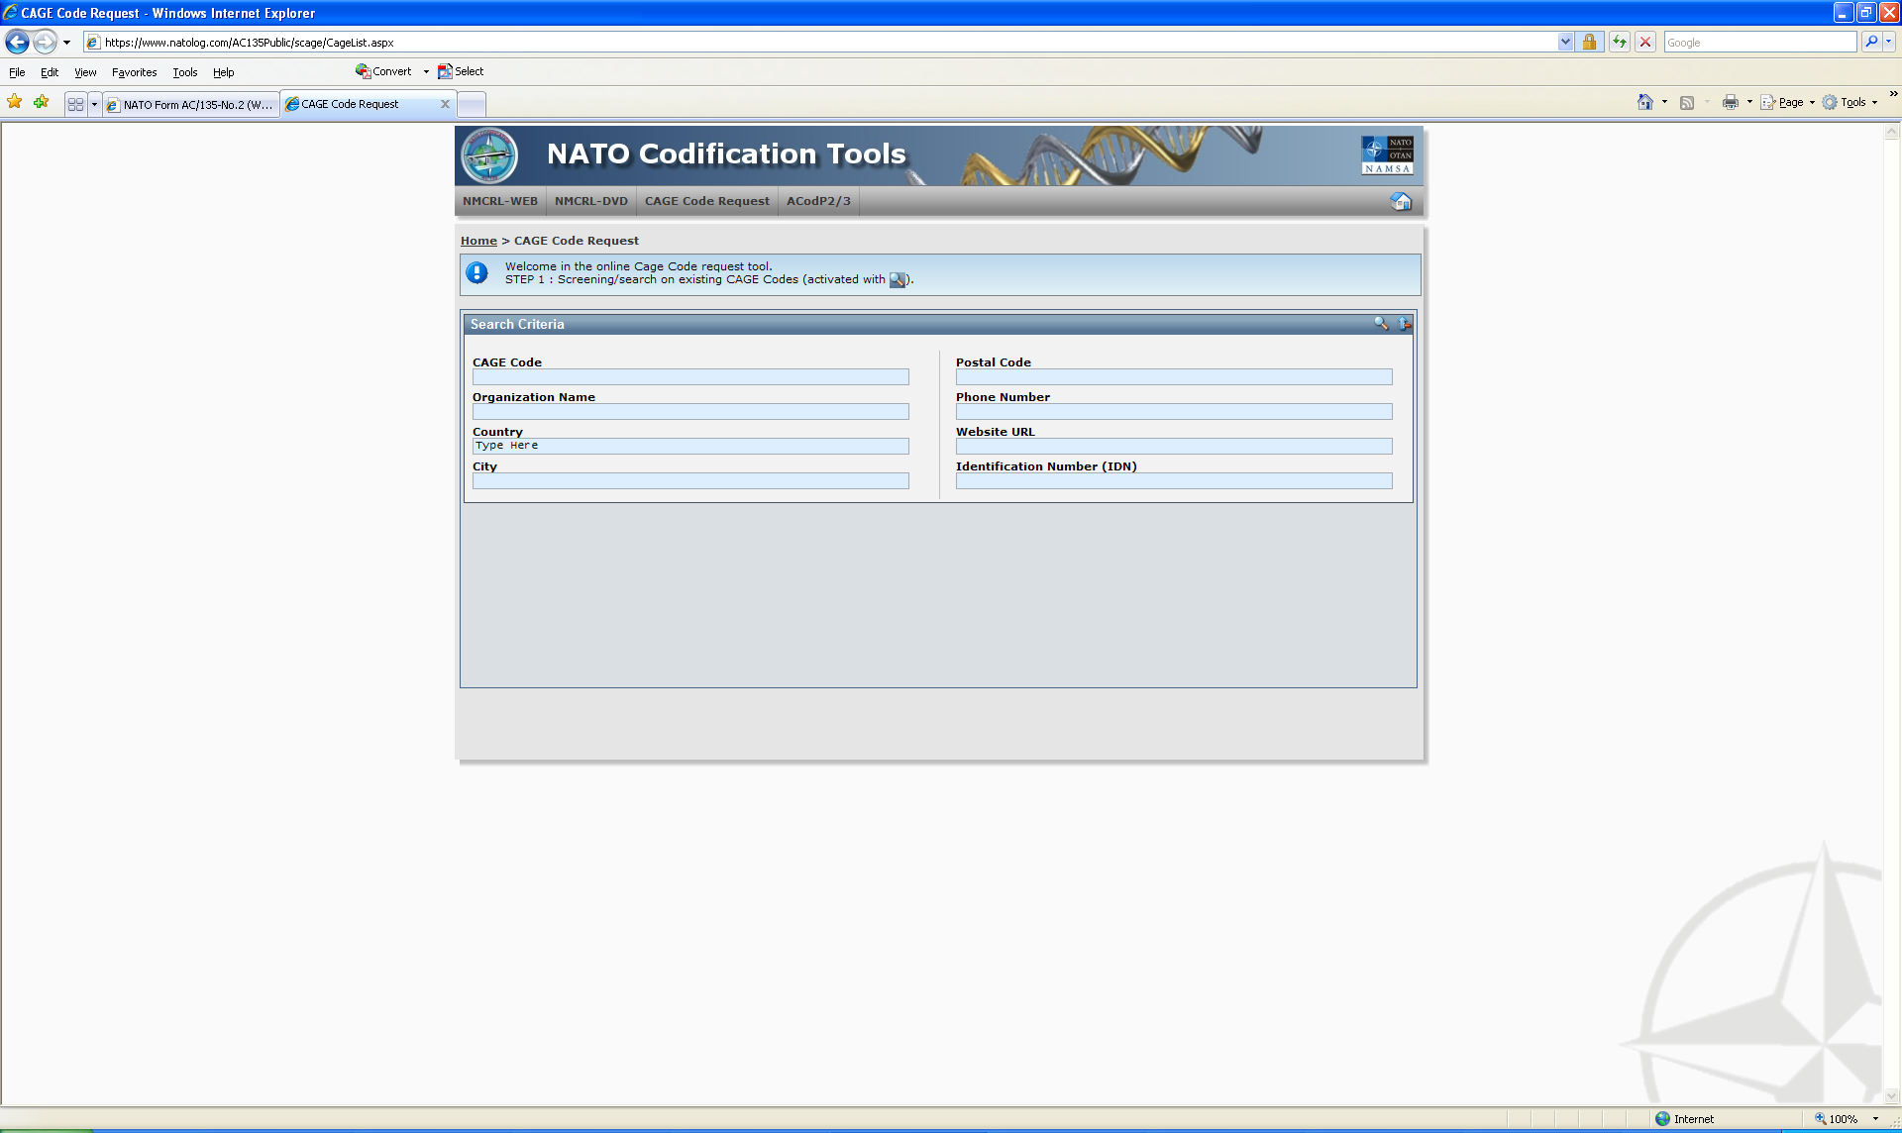

Slide 7
Business Identification Number Cross- Reference System (BINCS)
Prior to registering in SAM, insure that your newly assigned NCAGE is listed on the Business Identification Number Cross- Reference System (BINCS) at http://www.logisticsinformationservice.dla.mil/BINCS/begin_search.aspx If the assigned NCAGE is not listed in BINCS call the Customer Interaction Center at: 269-961-7766 or 1-877-352-2255 or send a message to dlacontactcenter@dla.mil.

Slide 8
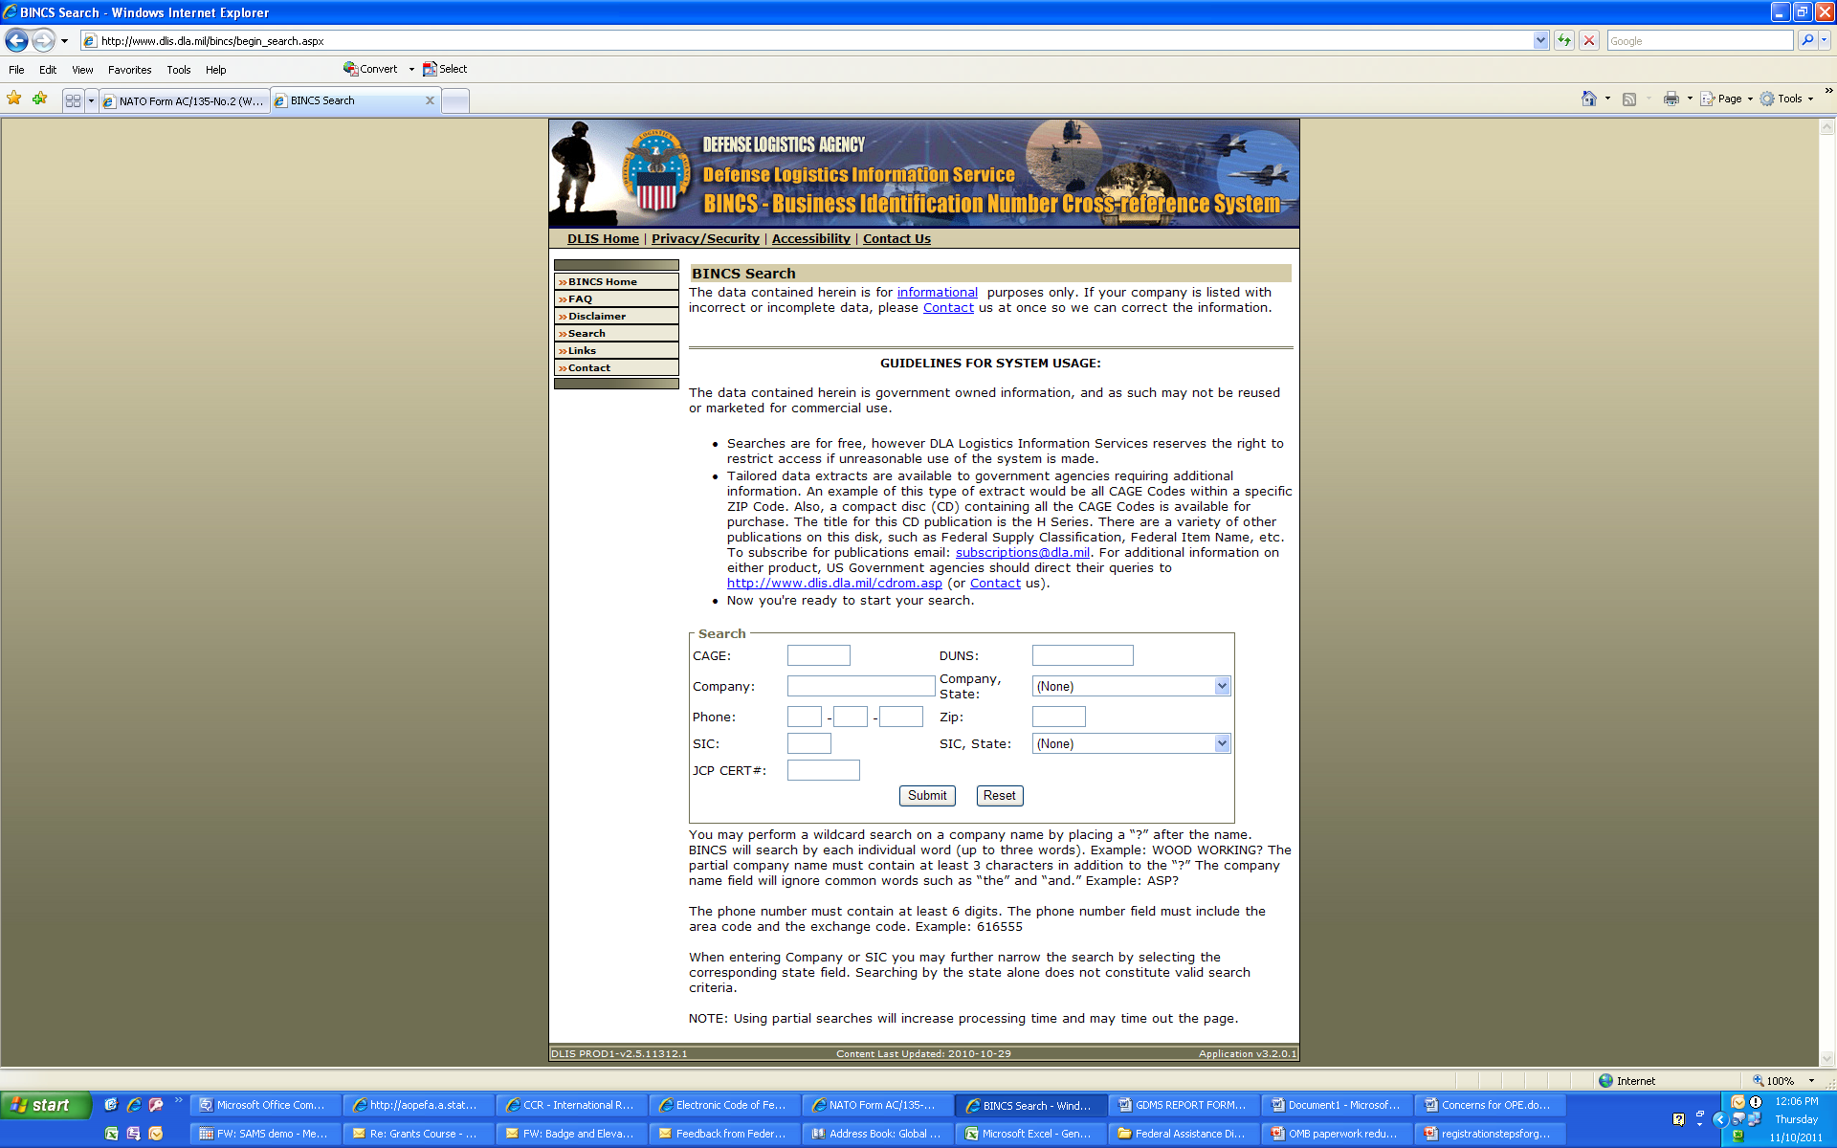

Slide 9
Step 3- Register in SAM
If you are not already registered with the Central Contractor Registration (CCR), you will need to do so.
www.Sam.gov
Registration requires a DUNS Number, NCAGE code and financial and management information about your organization.
There are helpful User Guides under “Help” tab

Slide 10
Registration in SAM
1. Go to www.sam.gov
2. Create a Personal Account and Login
3. Click “Register New Entity” under “Manage Entity” on your “My SAM” page
4. Select your type of Entity
5. Select “No” to “Do you wish to bid on contracts?”
6. Select “Yes” to “Do you want to be eligible for grants and other federal assistance?”

Slide 11
Registration in SAM
7. Complete “Core Data”
Validate your DUNS information
Enter Business Information (Foreign organizations don’t need to provide TIN.)
Enter CAGE code if you have one. If not, one will be assigned to you after your registration is completed. Foreign registrants must enter NCAGE code.
Enter General Information (business types, organization structure, etc)
Financial Information (Electronic Funds Transfer (EFT )Information)
Executive Compensation
Proceedings Details
8. Complete “Points of Contact”
9. Your entity registration will become active after 3-5 days when the IRS validates your TIN information.

