Slide 1


FY 2024
Basic Needs for Postsecondary Students Program
ALN (CFDA): 84.116N
Pre-Application Webinar
Stacey Slijepcevic, Director-Hispanic-Serving institutions Division
Njeri Clark, Competition Manager

Slide 2
Welcome!

Slide 3

Note: The Federal Register is the official guide for submitting your grant application! https://www.federalregister.gov/

Slide 4
Agenda
Basic Needs Program Purpose
FY 2024 Competition At A Glance
Eligibility
Priorities
Allowable and Unallowable Activities
Selection Criteria
Performance Measures
Reporting Requirements
GEPA 427 Form
Evidence Form
Planning and Submitting Your Grant Application
Resources
Final tips
Q&A

Slide 5
Purpose of the program
The Basic Needs for Postsecondary Students Program provides grants to eligible institutions of higher education (IHEs), or a consortia or system of such institutions, to advance systemic and sustainable solutions to student basic needs insecurity through support programs that address the basic needs of students and to report on practices that improve outcomes for students.

Slide 6
FY 2024 Competition At A Glance
Application available in Federal Register: June 4, 2024
Application deadline: August 5, 2024
Estimated available funds: $9,583,334
Maximum award: $900,000 Average award: $750,000
Performance period: 36 months
-Start date: TBD
Estimated number of awards: 12
Priorities
2 Absolute Priorities
2 Competitive Preference Priorities
Unrestricted indirect cost rate
2 Invitational Priorities

Slide 7
Eligibility
Eligible Applicants
1. Community colleges
2. Two- and four-year public and private Historically Black colleges and universities
3. Tribal Colleges and Universities
4. Minority-serving institutions
5. A consortium or system of eligible institutions
Note: The list of institutions designated as eligible for FY 2024 under titles III and V of the HEA is available at https://www2.ed.gov/about/offices/list/ope/idues/eligibility.html
Confirm your eligibility early!
.

Slide 8
FY 2024 PROGRAM PRIORITIES
The Notice Inviting Applications (NIA) published in the Federal Register contains two absolute priorities, two competitive preference priorities, and two invitational priorities.

Slide 9
Absolute Priority 1
Strengthening Cross-Agency Coordination and Community Engagement to Advance Systemic Change
Meeting absolute priority criteria is REQUIRED. We consider only applications that meet this priority:
Projects that are designed to take a systemic evidence-based approach to improving outcomes for underserved students in one or more of the following priority areas:
(a) Coordinating efforts with Federal, State, or local agencies, or community-based organizations, that support students, to address two or more of the following:
(1) Food assistance.
(2) Housing.
(3) Transportation.
(4) Health, including physical health, mental health, and behavioral health and trauma.
(5) Child care.
(6) Technology.
(b) Conducting community needs and asset mapping to identify existing programs and initiatives that can be leveraged, and new programs and initiatives that need to be developed and implemented, to advance systemic change.
(c) Establishing cross-agency partnerships, or community-based partnerships with local nonprofit organizations, businesses, philanthropic organizations, or others, to meet family well-being needs.

Slide 10
Absolute Priority 2
Promoting Equity in Student Access to Educational Resources and Opportunities
Meeting absolute priority criteria is REQUIRED. We consider only applications that meet this priority:
Under this priority, an application must demonstrate that the project will be implemented by one or more of the following entities:
(1) Community colleges (as defined in the NIA).
(2) Historically Black colleges and universities (as defined in the NIA).
(3) Tribal Colleges and Universities (as defined in the NIA).
(4) Minority-serving institutions (as defined in the NIA).

Slide 11
Competitive Preference Priority 1
Meeting Student Social, Emotional, and Academic Needs (up to 7 points)
Addressing competitive priority preferences is optional.
Projects that are designed to improve students' social, emotional, academic, and career development, with a focus on underserved students through creating a positive, inclusive, and identity-safe climate at IHEs through one or both of the following activities:
(1) Fostering a sense of belonging and inclusion for underserved students. (up to 3 points)
(2) Implementing evidence-based practices for advancing student success for underserved students. (up to 4 points)

Slide 12
Competitive Preference Priority 2
Increasing Postsecondary Education Access, Affordability, Completion, and Post-Enrollment Success (up to 3 points)
Addressing competitive priority preferences is optional.
Projects that are designed to increase postsecondary access, affordability, completion, and success for underserved students by establishing a system of high-quality data collection and analysis, such as data on persistence, retention, completion, and post-college outcomes, for transparency, accountability, and institutional improvement.

Slide 13
Invitational Priority 1
Leveraging Public Benefit Programs
Under this priority, we are particularly interested in projects that include one or more of the following activities:
(a) Establishing processes to automatically identify and conduct outreach to students who may be eligible for public benefit programs in accordance with recent Federal guidance.
(b) Conducting ongoing and timely surveys and assessments of student basic needs security, including surveys of student needs conducted upon enrollment.
(c) Providing referrals and case management to students to enroll in local, State, and Federal public benefit programs.
(d) Coordinating and collaborating with government and community-based organizations and providing direct services such as temporary housing, secure sleeping arrangements, free or subsidized food, and access to child care.
Applications that meet invitational priorities do not receive a competitive or absolute preference over other applications.

Slide 14
Invitational Priority 2
Developing a Campus-Wide Strategy to Address Student Mental Health Needs
Applications that meet invitational priorities do not receive a competitive or absolute preference over other applications.
Under this priority, we are particularly interested in projects that are designed to develop a campus-wide strategy to address student mental health needs. This includes creating inclusive campuses, increasing the availability of supportive and treatment services and access to additional staff, and implementing best practices, such as auditing existing campus mental health supports for effectiveness; identifying gaps and taking steps to tailor interventions to better meet the needs of vulnerable populations; implementing skill-training interventions; conducting routine screenings for depression, suicide risk, and anxiety; and investing in suicide means restriction.

Slide 15

Examples of Supports and Services
1. housing voucher application assistance and other services to secure temporary housing for students
2. free or subsidized food
3. access to child care
4. transportation subsidies
5. access to technology
6. access to physical, mental, and behavioral health services
7. outreach to students to encourage participation in basic needs programs and services
8. assistance to eligible students to apply for and enroll in public assistance programs or coordinate and collaborate with government and/or community-based organizations
9. other basic needs to eligible students

Slide 16
Examples of Unallowable Activities
Construction
Tuition assistance, including the purchase of books
Purchase of students’ work supplies such as work boots, uniforms, etc.
Other activities outside the scope and intent of the Basic Needs Program
Subgrants

Slide 17
Selection Criteria
Selection Criteria | Maximum Points
a. Need for the Project | 10
b. Quality of the Project Design | 30
c. Quality of Project Services | 25
d. Quality of Project Personnel | 10
e. Quality of the Management Plan | 10
f. Quality of the Project Evaluation | 15
Total Maximum Score for Selection Criteria | 100
Competitive Preference Priority 1 | 7
Competitive Preference Priority 2 | 3
Total Possible Score Per Application | 110

Slide 18
Selection Criterion
a. Need for the project (up to 10 points)
The Secretary considers the need for the proposed project. In determining the need for the proposed project, the Secretary considers the following factors:
(1) The magnitude of the need for the services to be provided or the activities to be carried out by the proposed project. (up to 5 points)
(2) The extent to which specific gaps or weaknesses in services, infrastructure, or opportunities have been identified and will be addressed by the proposed project, including the nature and magnitude of those gaps or weaknesses. (up to 5 points)

Slide 19
Questions to Consider- Need for the Project
How big is the problem to be addressed and what are the specific issues?
How do the proposed activities address the purpose of the basic needs program , the gaps and weaknesses at your institution, and the target population?

Slide 20
Selection Criterion
b. Quality of the project design (up to 30 points)
The Secretary considers the quality of the design of the proposed project. In determining the quality of the design of the proposed project, the Secretary considers the following factors:
(1) The extent to which the proposed project will integrate with or build on similar or related efforts to improve relevant outcomes (as defined in this notice), using existing funding streams from other programs or policies supported by community, State, and Federal resources. (up to 10 points)
(2) The extent to which the proposed project demonstrates a rationale (as defined in this notice). (up to 15 points)
(3) The extent to which the design of the proposed project is appropriate to, and will successfully address, the needs of the target population or other identified needs. (up to 5 points)

Slide 21
Questions to Consider – Project design
Have you evaluated existing programs and resources within your institution, the community, and state and local agencies?
What are the intended outcomes of the project and how will your plan be presented using a Logic Model?
Have you cited research or evaluation findings that suggest your project is likely to improve relevant outcomes for the target population?

Slide 22
Selection Criterion
c. Quality of project services (up to 25 points)
The Secretary considers the quality of the services to be provided by the proposed project.
(1) In determining the quality of the services to be provided by the proposed project, the Secretary considers the quality and sufficiency of strategies for ensuring equal access and treatment for eligible project participants who are members of groups that have traditionally been underrepresented based on race, color, national origin, gender, age, or disability. (up to 5 points)
(2) In addition, the Secretary considers the following factors:
(i) The likely impact of the services to be provided by the proposed project on the intended recipients of those services. (up to 5 points)
(ii) The extent to which the services to be provided by the proposed project involve the collaboration of appropriate partners for maximizing the effectiveness of project services. (up to 15 points)

Slide 23
Questions to Consider –
Project Services
How will you ensure that underrepresented students have equal access to project services?
What long term outcomes (impacts) are expected as a result of the project?
What partners are appropriate to achieve maximum results?

Slide 24
Selection Criterion
d. Quality of project personnel (up to 10 points)
The Secretary considers the quality of the personnel who will carry out the proposed project.
(1) In determining the quality of project personnel, the Secretary considers the extent to which the applicant encourages applications for employment from persons who are members of groups that have traditionally been underrepresented based on race, color, national origin, gender, age, or disability. (up to 3 points)
(2) In addition, the Secretary considers the
qualifications, including relevant training and experience, of key project personnel. (up to 7 points)
Note: For the selection criterion “Quality of personnel,” applicants are encouraged to include in their application that they are committed to paying their staff a living wage for the local area and providing benefits.

Slide 25
Questions to Consider – Project Personnel
What will be your hiring strategies and policies?
Does the proposed project director have experience working with the target population, managing similar projects, and budgeting?
What is the appropriate level of effort or time commitment for the Project Director and other key staff?
Are the position descriptions and proposed qualifications for those to be hired sufficient for the grant project?

Slide 26
Selection Criterion
e. Quality of the management plan (up to 10 points)
The Secretary considers the quality of the management plan for the proposed project. In determining the quality of the management plan for the proposed project, the Secretary considers the adequacy of the management plan to achieve the objectives of the proposed project on time and within budget, including clearly defined responsibilities, timelines, and milestones for accomplishing project tasks.

Slide 27
Questions to Consider – Management plan
How will the proposed project be managed and who will manage the various components?
What is your implementation plan, including the project budget, milestones and timelines?
Have you considered an organization chart for the project?

Slide 28
Selection Criterion
f. Quality of the Project Evaluation (up to 15 points)
The Secretary considers the quality of the evaluation to be conducted of the proposed project. In determining the quality of the evaluation, the Secretary considers the following factors:
(1) The extent to which the methods of evaluation are thorough, feasible, and appropriate to the goals, objectives, and outcomes of the proposed project. (up to 5 points)
(2) The extent to which the methods of evaluation include the use of objective performance measures that are clearly related to the intended outcomes of the project and will produce quantitative and qualitative data to the extent possible. (up to 5 points)
(3) The extent to which the methods of evaluation will, if well implemented, produce promising evidence (as defined in this notice) about the project's effectiveness (up to 5 points).

Slide 29
Questions to Consider – Project Evaluation
What methods of evaluation will be used to measure progress and are they clearly aligned to the objectives and intended outcomes of the project?
Do the project’s performance measures inform the evaluation methods?
What type of data will be produced from your evaluation and how will you utilize this data?
If implemented successfully, will at least one component of your project produce evidence of effectiveness?

Slide 30
Output vs. Outcome
Can you distinguish the outputs from outcomes?
1140 students participated in food voucher program. {Output}
Retention of students who participated in the program increased by 7% in the year after the voucher program was implemented. {Outcome}
125 freshmen students participated (attended three or more sessions) in mental health student conferences. {Output}
Retention rates for freshmen students increased by 15% between academic years 2025 and 2026. {Outcome}

Slide 31
Performance Measures
For purposes of Department reporting under 34 CFR 75.110, the Department will use the following performance measures to evaluate the success of the Basic Needs for Postsecondary Students Program:
(1) The percentage of low-income students at the grantee institution served by any direct student service supported by the grant.
(2) The annual persistence rate at the grantee institution for all students who are served by any direct student service supported by the grant.
(3) By the end of the grant period, the rate of degree or certificate completion at the grantee institution for all students served by any direct student service supported by the grant.
(4) The level of basic needs insecurity among all students served by any direct student service supported by the grant, measured before and after implementation of the grant.
Note: For purpose of the performance measures, the term “low- income student” means a student—
(a) Who is eligible to receive a Federal Pell Grant for the award year for which the determination is made; or
(b) Who would otherwise be eligible to receive a Federal Pell Grant for the award year for which the determination is made, except that the student fails to meet the requirements of section 484(a)(5) of the HEA, 20 U.S.C. 1091(a)(5), because the student is in the United States for a temporary purpose.

Slide 32
Reporting Requirements
If you receive a multiyear award, you must submit an annual performance report that provides the most current performance and financial expenditure information as directed by the Secretary under 34 CFR 75.118.
At the end of your project period, you must submit a final performance report, including financial information, as directed by the Secretary.
If you apply for a grant under this competition, you must ensure that you have in place the necessary processes and systems to comply with the reporting requirements in 2 CFR part 170 should you receive funding under the competition.

Slide 33
General Overview of GEPA Section 427
Purpose: To ensure equitable access to, and participation in, Federally-assisted programs for all beneficiaries.
Section 427 highlights, but is not limited to, 6 barriers that can impede equitable access or participation:
An applicant must determine and define:
1. The participants and community to serve
2. The local circumstances
3. Barriers that may inhibit participation
1. Gender
2. Race
3. National origin
4. Color
5. Disability
6. Age

Slide 34

GEPA Section 427 Standard Form Changes
Original Form
Updated Form
One overall general requirement
Flexibility to determine and define the barriers to “equitable access” and “equitable participation”
Discretion in how to describe plans to address the identified barriers
Description may be provided in a separate narrative or in connection with related topics in the application
Applicants respond to four questions with specificity
Flexibility to determine and define the barriers to “equitable access” and “equitable participation”
A timeline for meeting targeted milestones for removing identified barriers
Notes:
The Section 427 standard form, created in 1995, consisted of one overall requirement allowing an applicant to define and determine its barriers. Each applicant had discretion with addressing barriers identified and either provided an overall general narrative or in connection with related topics in the application.
ED updated the Section 427 form by requiring responses to four questions. Each applicant still maintains flexibility in determining and defining barriers, but the questions prompt responses to be focused on equity and specific questions in addition to a timeline to meet targeted milestones for removing the identified barriers.

Slide 35
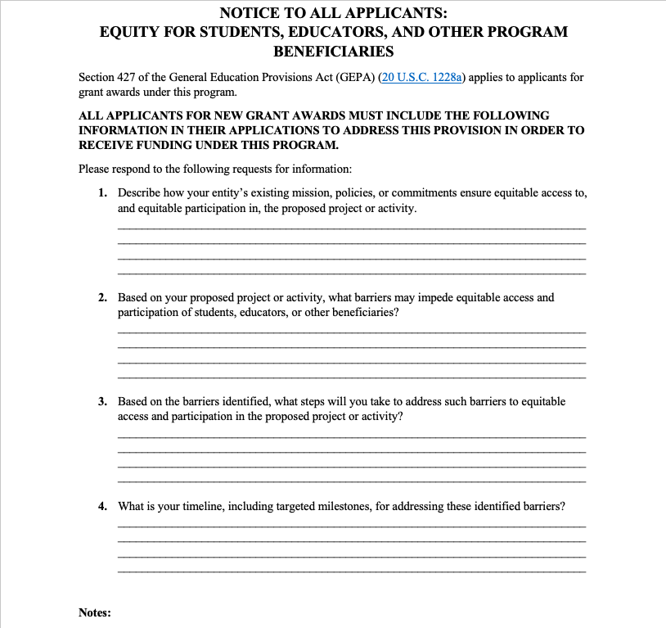
Updated GEPA Form Has Four Questions
Applicants must respond to each question on the standard form and submit the form with its grant application package or State plan.
For Grants.gov application submissions:
The updated form is integrated into Grants.gov and no longer needs to be uploaded as PDF.
The form is electronic and each text box response allows 4,000 characters.
An error message is received if a response is missing and the form can not be saved. (see next slide)
Notes:
The Section 427 standard form is required to be completed and submitted with an applicant’s grant application package or State plan submission. Each text box allows 4,000 characters, so ensure if copying from another document that all content copied properly. Applicants that have already undertaken steps to address barriers must provide an explanation or description of the steps already taken in response to each question, as appropriate. Applicants that believe no barriers exist must provide an explanation or description to each question, as appropriate, which confirms this position and satisfies GEPA Section 427 requirement.
A link to the one-page instructions are included in the application package for how to complete GEPA Section 427 standard form.

Slide 36
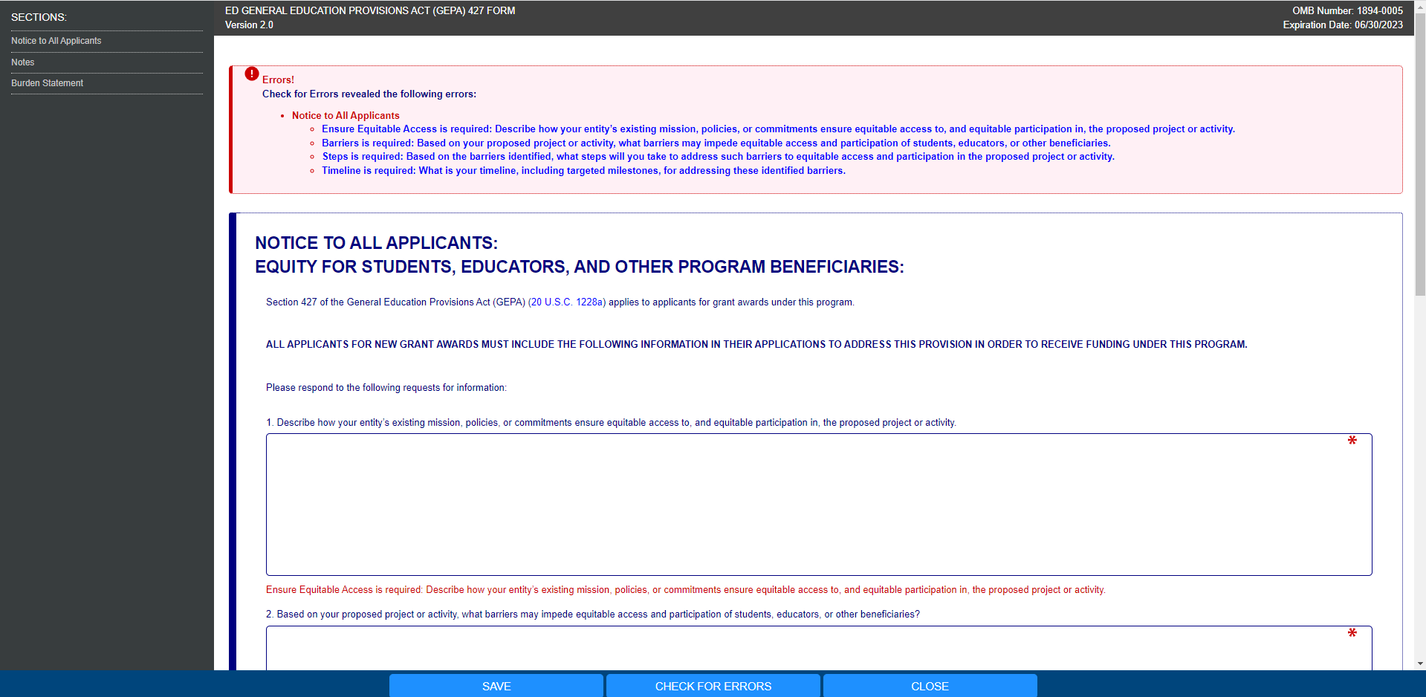
Sample Error Message
Notes:
If you do not respond to a question, you will receive an error message, and be unable to submit the form until all responses have been recorded.

Slide 37
GEPA Form Instructions
Applicants may identify any barriers that may impede equitable access and participation in the proposed project or activity, including, but not limited to, barriers based on economic disadvantage, gender, race, ethnicity, color, national origin, disability, age, language, migrant status, rural status, homeless status or housing insecurity, pregnancy, parenting or caregiving status, and sexual orientation.
Applicants are not required to have mission statements or policies that align with equity in order to submit an application.
Applicants may have already included some or all this required information in the narrative sections of their applications or their State Plans. In responding to this requirement, for each question, applicants may provide a cross-reference to the section(s) and page number(s) in their applications or State Plans that includes the information responsive to that question on this form or may restate that information on this form.
Notes:
READ SLIDE

Slide 38
GEPA Form Instructions (continued)
Applicants must respond to each question using the associated text box. Each text box allows approximately 4000 characters; therefore, if copying and pasting into the text box from another document be sure to check that everything copied.
Applicants should use the “check for errors” button before they save the form. Applicants will receive an error message if any response is missing and will not be able to submit the application due to the missing information.
Applicants that have already undertaken steps to address barriers must still provide an explanation and/or description of the steps already taken in each text box, as appropriate, to satisfy the GEPA Section 427 requirement.
Applicants that believe no barriers exist must still provide an explanation and/or description to each question to validate that perception, as appropriate, to satisfy the GEPA Section 427 requirement.
Notes:
READ SLIDE

Slide 39
Sample Grant Program
Grant Program Goal: To provide grants to alternative high schools, non-profit organizations, and combinations of those institutions to provide academics and other support services to prepare low-income, first-generation college students, and other underrepresented students for a college education.
ED Strong Interest In: Ensuring low-income students, first-generation college students, students who are English learners, students with disabilities, homeless students, students who are in foster care, and other disconnected students, receive the necessary support to assist them in successfully pursuing a college education.
The slides that follow provide a sample response to each question on the new Section 427 form from a fictitious organization applying for federal funds under the above grant parameters.
Notes:
Over the next several slides, we will look at a Sample Grant Program and the Sample Responses provided by the applicant.

Slide 40
Question One – Sample Response
Describe how your entity’s existing mission, policies, or commitments ensure equitable access to, and equitable participation in, the proposed project or activity.
Our organization has a contract with the city to operate a non-traditional high school in the local YMCA. As a non-traditional high school, we will open earlier and remain open longer than a regular high school and be open seven days a week to work with students living on their own, students that are homeless, and students expelled from a regular high school. One of the goals of our organization is to ensure homeless and other non-traditional students are able to obtain high school diplomas.
Notes:
READ SLIDE

Slide 41
Question 2 – Sample Response
Based on your proposed project or activity, what barriers may impede equitable access and participation of students, educators, or other beneficiaries?
Based on the population that is currently served, our organization has identified homelessness status or housing insecurity, pregnancy, and language as potential barriers.
Notes:
READ SLIDE

Slide 42
Question 3 – Response Example
Based on the barriers identified, what steps will you take to address such barriers to equitable access and participation in the proposed project or activity?
We intend to offer core subjects of varying levels of math, reading, and science, several times throughout the day and evening, in small group settings so that registered students are able to attend classes needed to graduate. Daily attendance will be required although not at any set time. Multilingual counselors will be on site at various times to regularly engage with each student. A mobile health truck will be onsite bi-weekly to address health and safety issues.
Notes:
READ SLIDE

Slide 43
Question 4 – Response Example
What is your timeline, including targeted milestones, for addressing these identified barriers?
Extensive outreach through posters and flyers posted at local community organizations and shops, support from the YMCA patrons, mobile health van team, and our counseling staff conducting daily foot patrols within a specific perimeter and in the hangout areas of targeted youth in order to share information and recruit targeted population.
The target population assigned through the system, such as juvenile courts, will also assist in the identification and recruitment of the individuals who will be served.
Register five percent (50 students) of the target population (as documented by local standard statistical references), for core classes within 180 days of the opening of the school year.
Notes:
READ SLIDE

Slide 44
GEPA Section 427 Resources
PDF version of Section 427 form and instructions GEPA 427 - Form Instructions for Application Package (ed.gov)
Computer-based training, Ensuring Equitable Opportunities Under the GEPA Section 427
GEPA Section 427 form Frequently Asked Questions (FAQs)
The Department of Education Equity Action Plan at ED.gov/equity
Comments or concerns regarding the status of your individual form may be addressed to Njeri Clark at Njeri.Clark@ed.gov.
Notes:
The Department has developed resources to familiarize you with the updated GEPA Section 427 Form. We highly encourage you to take the computer-based training. Links to these resources are also located in the application booklet.

Slide 45
Evidence Form
-In this competition, you are asked to propose to implement a project component (or strategy) that meets the Demonstrates a Rationale standard and to design a project evaluation that could meet the Promising Evidence standard.
-Both elements should be addressed in the project narrative.
-In addition, applicants addressing the Demonstrates a Rationale selection factor under the Quality of the Project Design selection criterion should complete the Evidence Form to show how the project “Demonstrates a Rationale.”
-As defined in the NIA, “demonstrates a rationale” means a key project component included in the project’s logic model is informed by research or evaluation findings that suggest the project component is likely to improve relevant outcomes.
-You demonstrate your rationale by creating a logic model for your project. The logic model should include a project component that is informed by research.
-If your project meets the demonstrates a rationale standard, then on the Evidence Form, you should mark “Demonstrates a Rationale.”

Slide 46
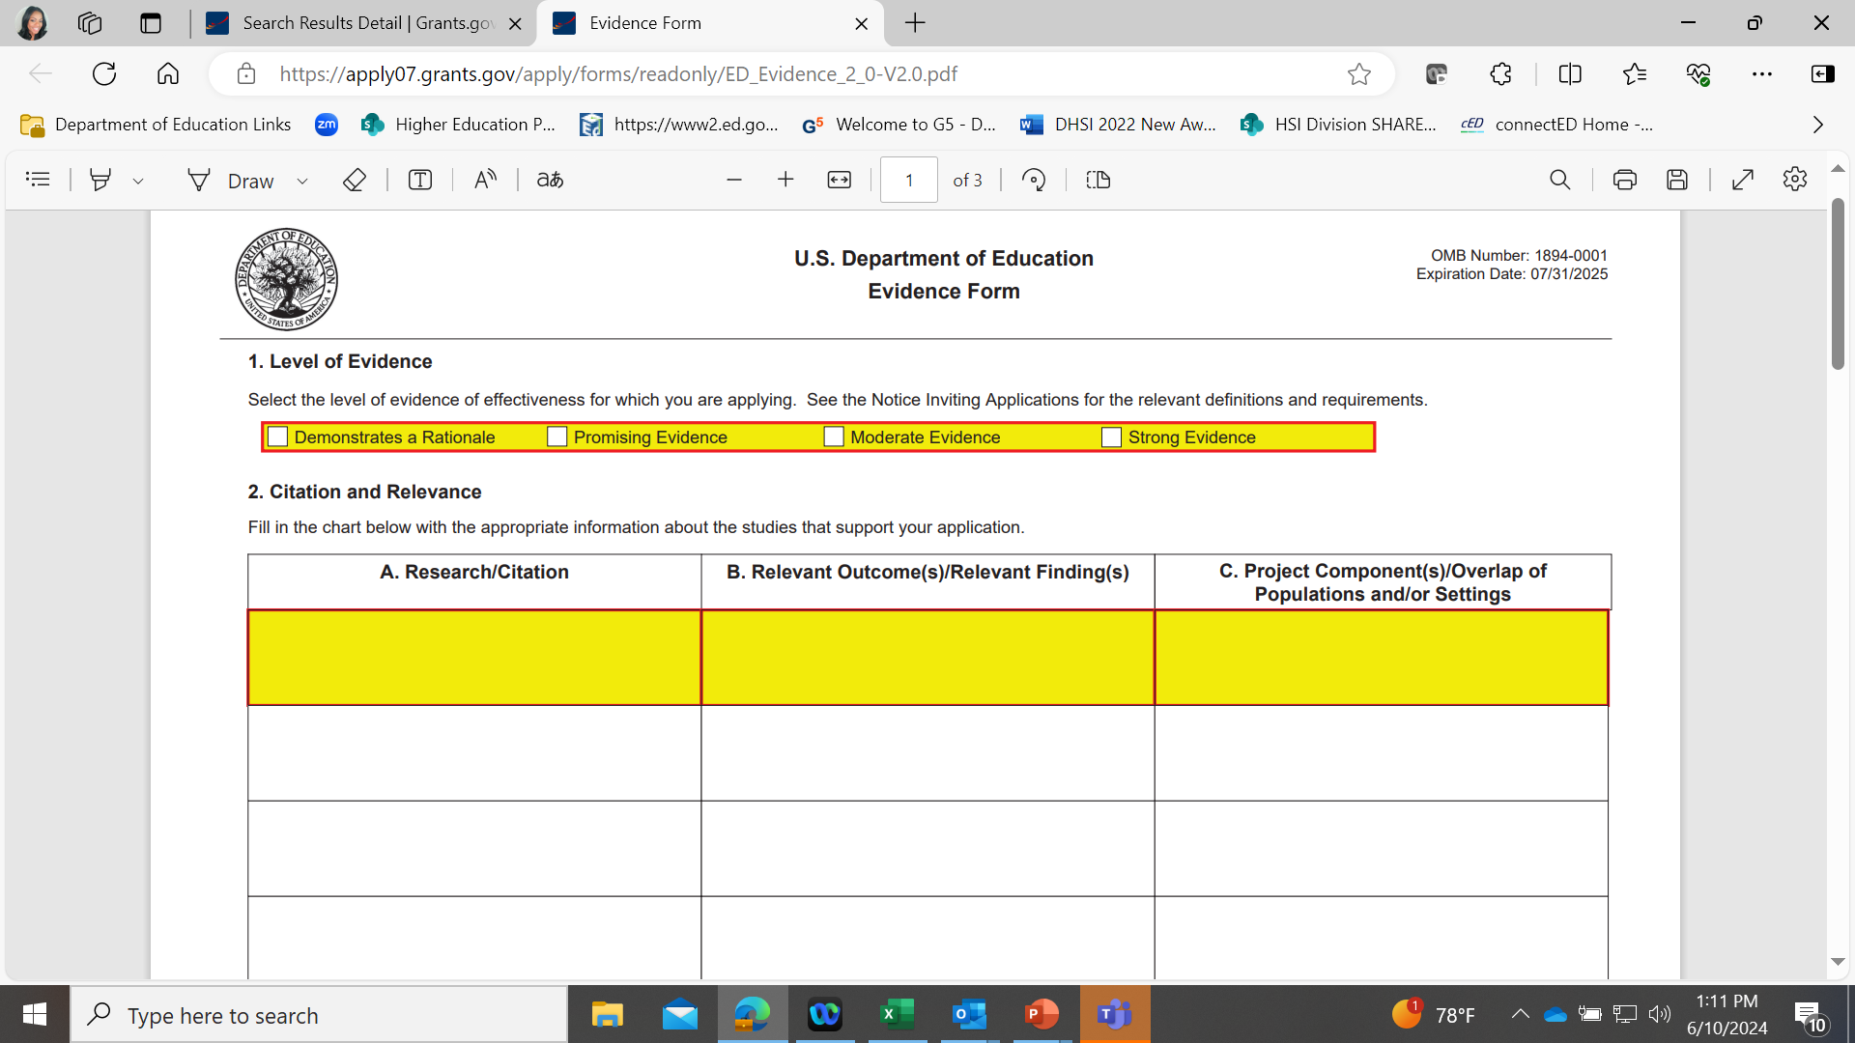

Slide 47
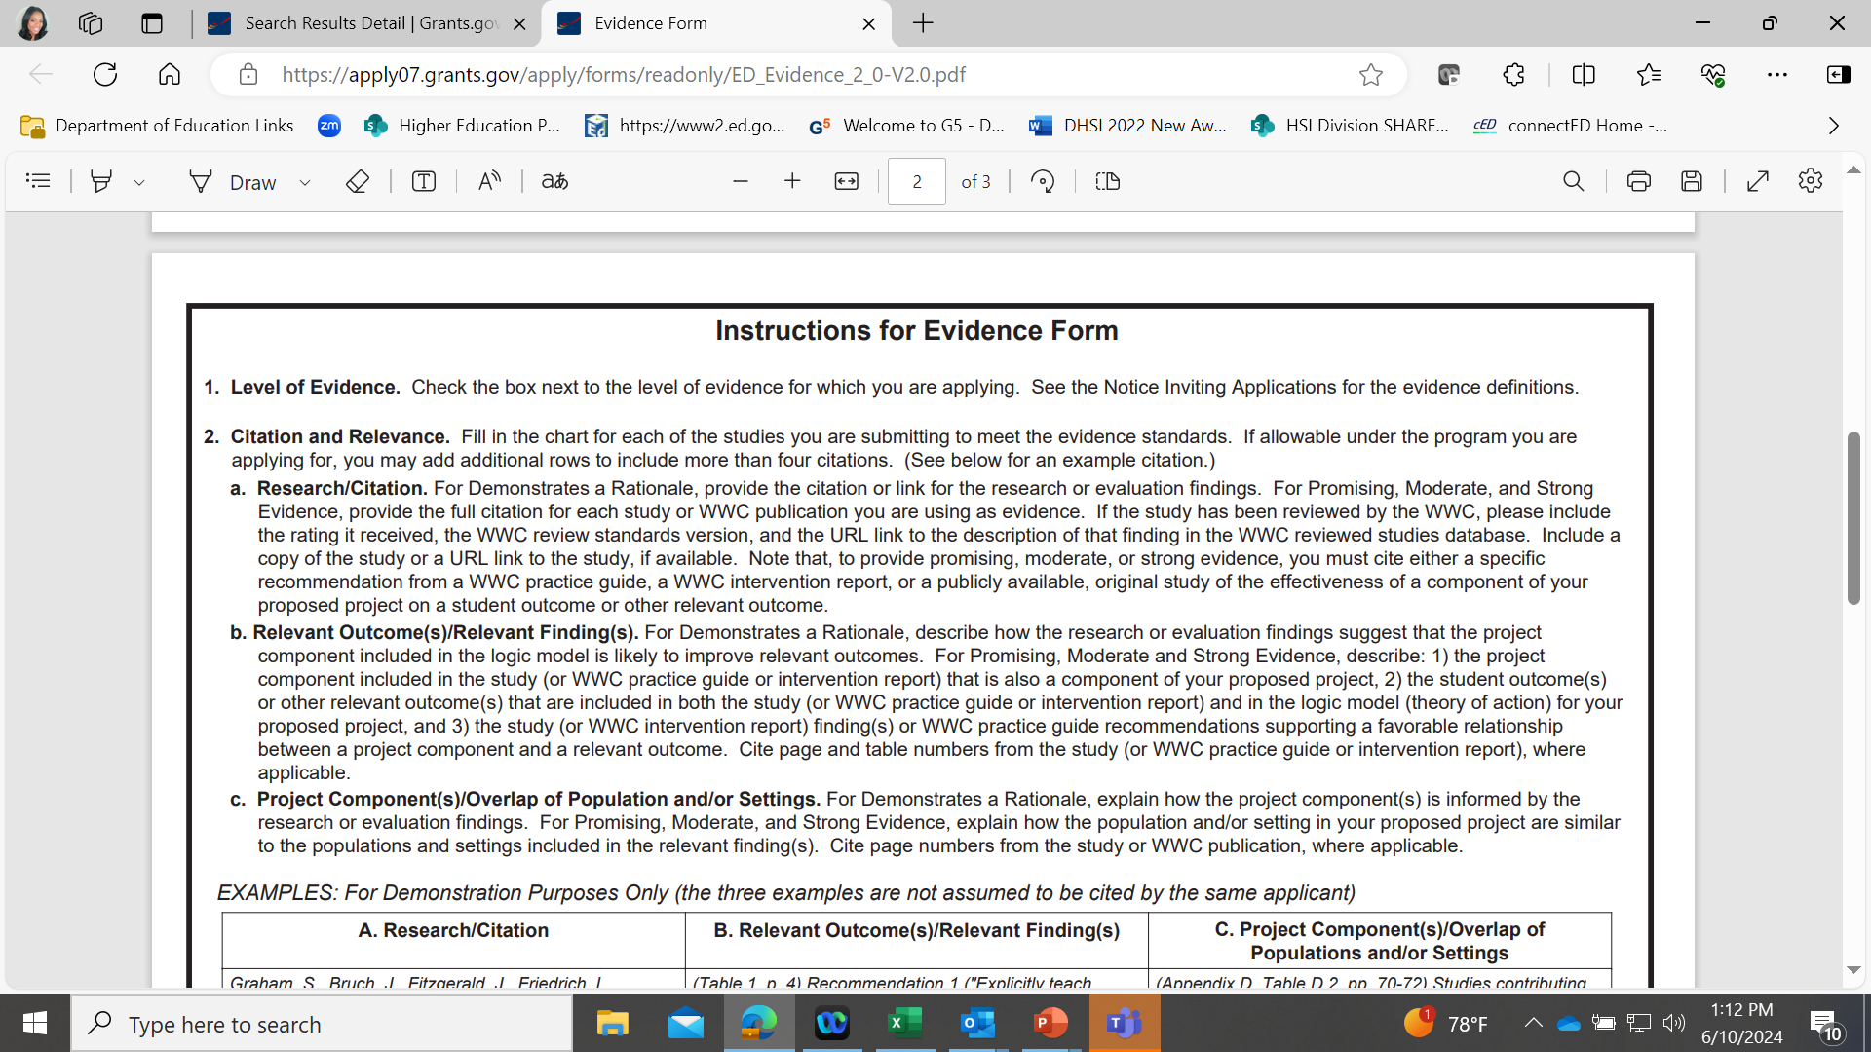

Slide 48
Planning Your Grant Proposal
Identify
Identify realistic goals for your proposed project and partners who will help you achieve these goals.
Analyze
Analyze each proposed activity to ensure that it is attainable, meaningful, and measurable.
Choose
Choose metrics and evaluation methods that will produce evidence about the project’s effectiveness.
Use
Use the identified Performance Measures to build your project assessments.
Conduct
Conduct a needs assessment to determine gaps and weaknesses in your infrastructure and current services.

Slide 49
Planning Your Grant Proposal
Review
Review the Notice Inviting Applications (Federal Register Notice) and the Instructions booklet carefully.
Register
Be certain that your institution is fully registered in grants.gov and the person who is responsible for submitting the application has the appropriate permissions.

Slide 50

Resources

Slide 51
Indirect Costs
Applicable Indirect Cost Rate Type
unrestricted indirect cost rate
Cognizant Agencies for Indirect Cost Institutions of Higher Education
Department of Health and Human Services (DHHS)
https://www.hhs.gov/about/agencies/asa/psc/indirect-cost-negotiations/index.html
or
Office of Naval Research (ONR)
https://www.nre.navy.mil/work-with-us/manage-your-award/manage-grant-award
Regulation
Uniform Guidance
  2 CFR 200 Subpart E
Departmental Regulations
Education Department General Administrative Regulations
  34CFR 75.560 - 75.580
  34 CFR 76.560 - 76.580
Guidance
OMB Uniform Guidance Frequently Asked Questions updated
https://www.cfo.gov/assets/files/2CFR-FrequentlyAskedQuestions_2021050321.pdf

Slide 52

Regional Educational Laboratory (REL)
Resources on Logic Models
Logic Models: A Tool for Effective Program Planning, Collaboration, and Monitoring
  https://ies.ed.gov/ncee/edlabs/projects/project.asp?projectID=409
Logic Models for Program Design, Implementation, and Evaluation: Workshop Toolkit
  https://ies.ed.gov/ncee/edlabs/projects/project.asp?ProjectID=401
Education Logic Model application for creating logic models:
  https://ies.ed.gov/ncee/edlabs/regions/pacific/elm.asp

Slide 53
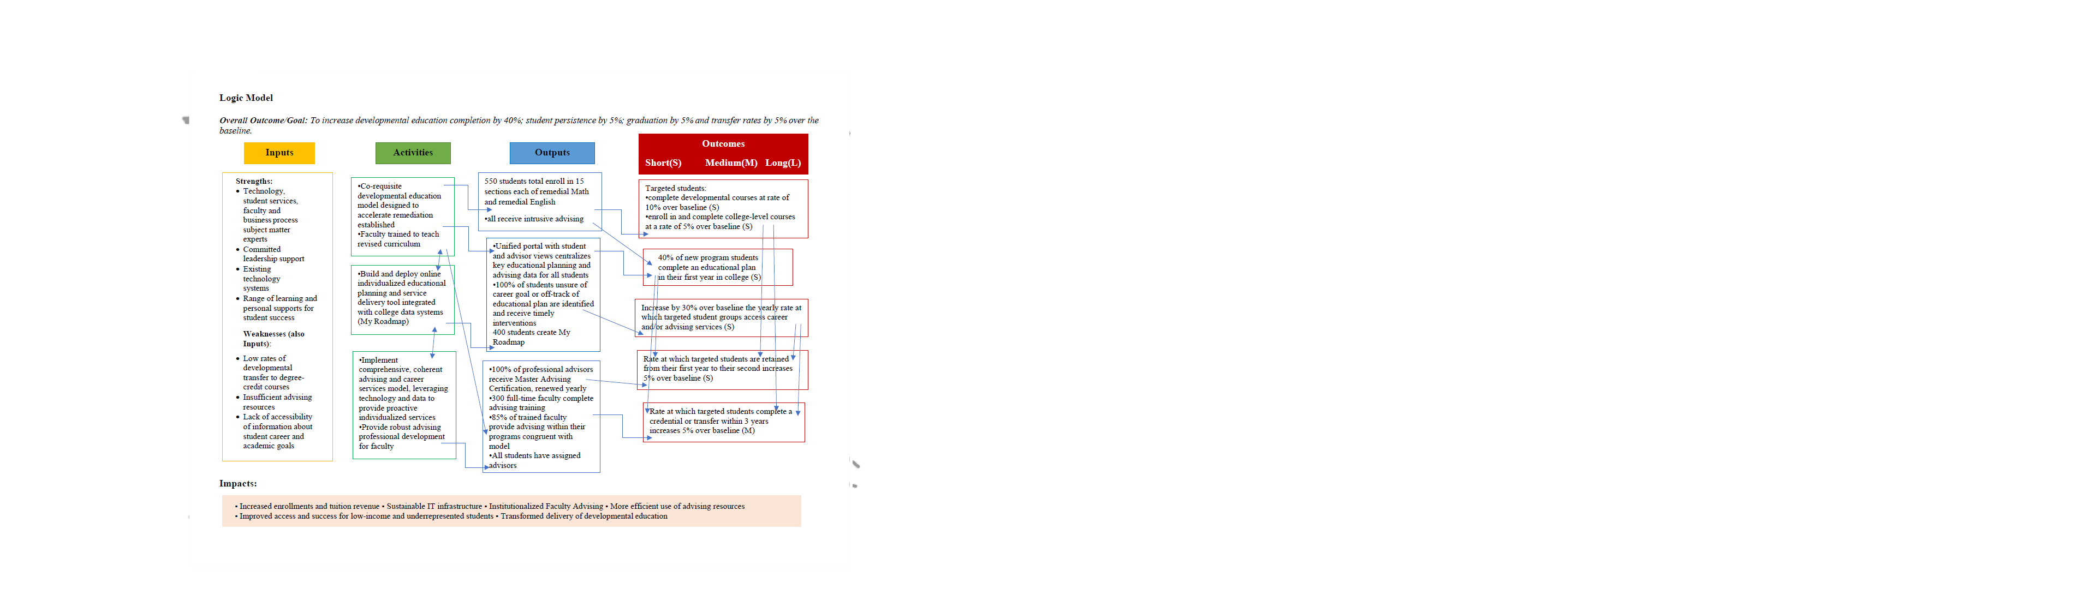
Sample Logic Model

Slide 54
Program Contacts
Njeri Clark, Competition Manager| Njeri.clark@ed.gov, 202-453-6224
Program website: https://www2.ed.gov/programs/basic-need/index.html

Slide 55
Final tips
Read the Notice Inviting Applications (NIA) carefully.
Go to Grants.gov immediately to register or confirm your registration and to locate the opportunity. Do not forget to review the Related Documents tab for this opportunity.
Follow Grants.gov submission tips found in the application booklet.
Develop a thoughtful logic model- it’s the road map for your entire project.
Write a clear, comprehensive proposal that reviewers understand.
Consider the outcomes. What will change if the project is implemented?
Submit your application early!

Slide 56

Questions?

Slide 57

thank YOU!

