Slide 1
REQUEST FOR UNIQUE ENTITY IDENTIFIER (UEI)
DUNS numbers
http://fedgov.dnb.com/webform/pages/CCRSearch.jsp
SIC codes
http://www.sec.gov/info/edgar/siccodes.htm

Slide 2
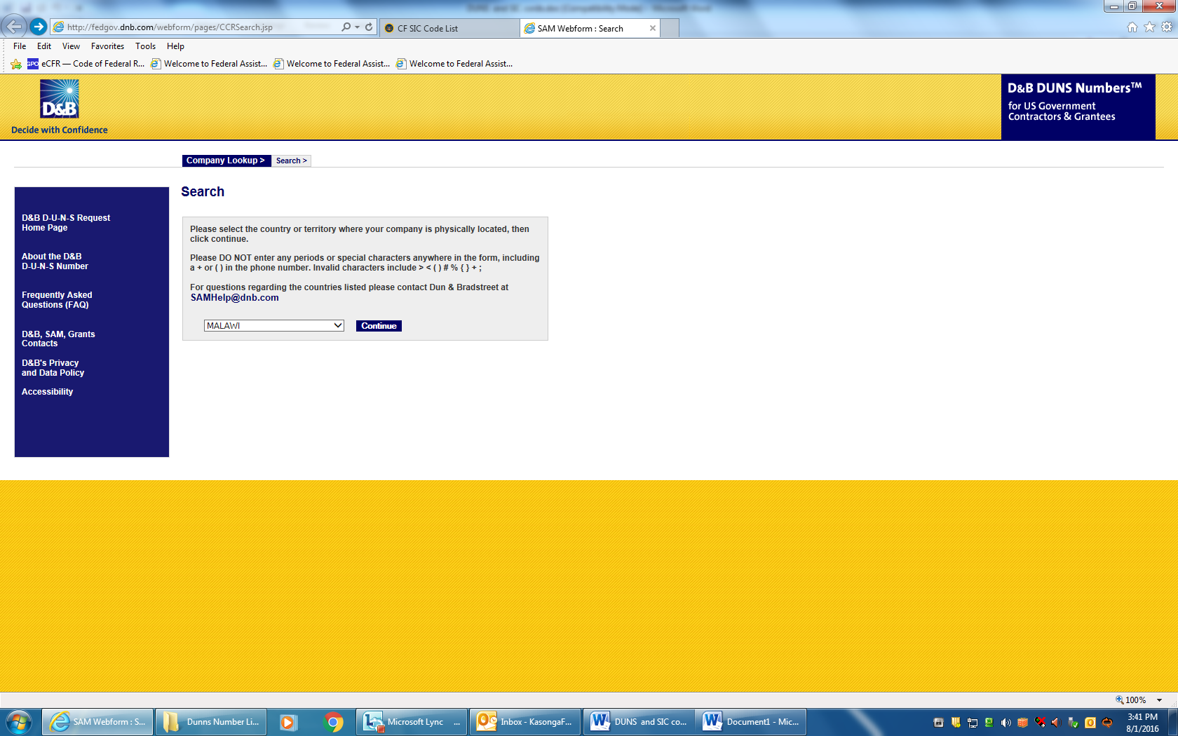

Slide 3
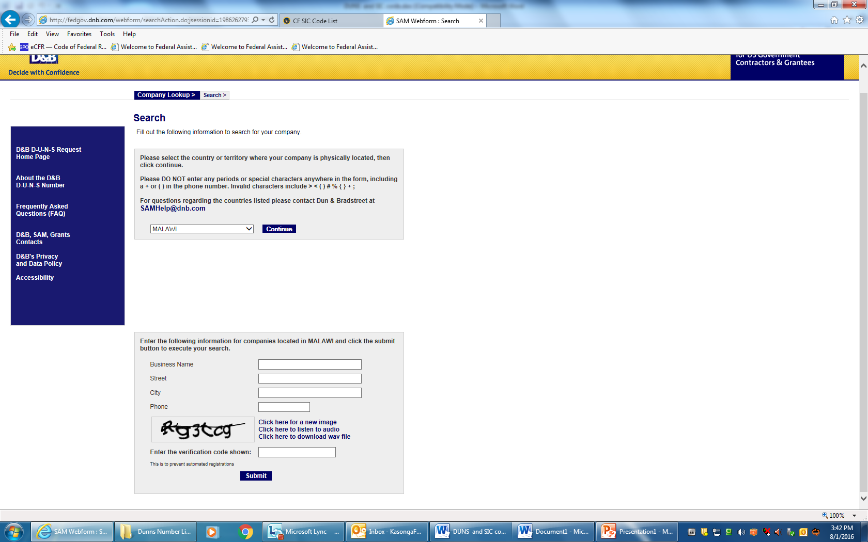


Slide 4
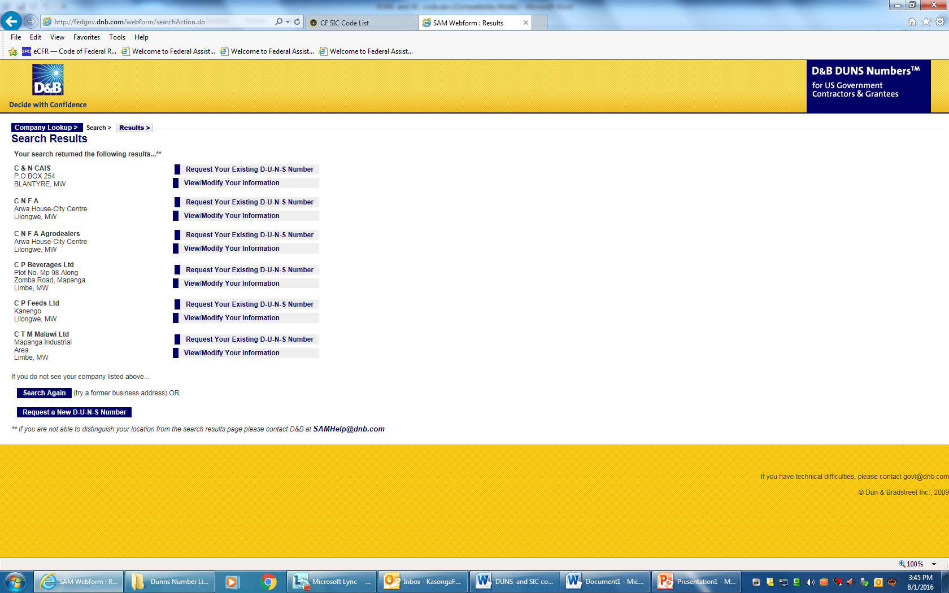

Slide 5
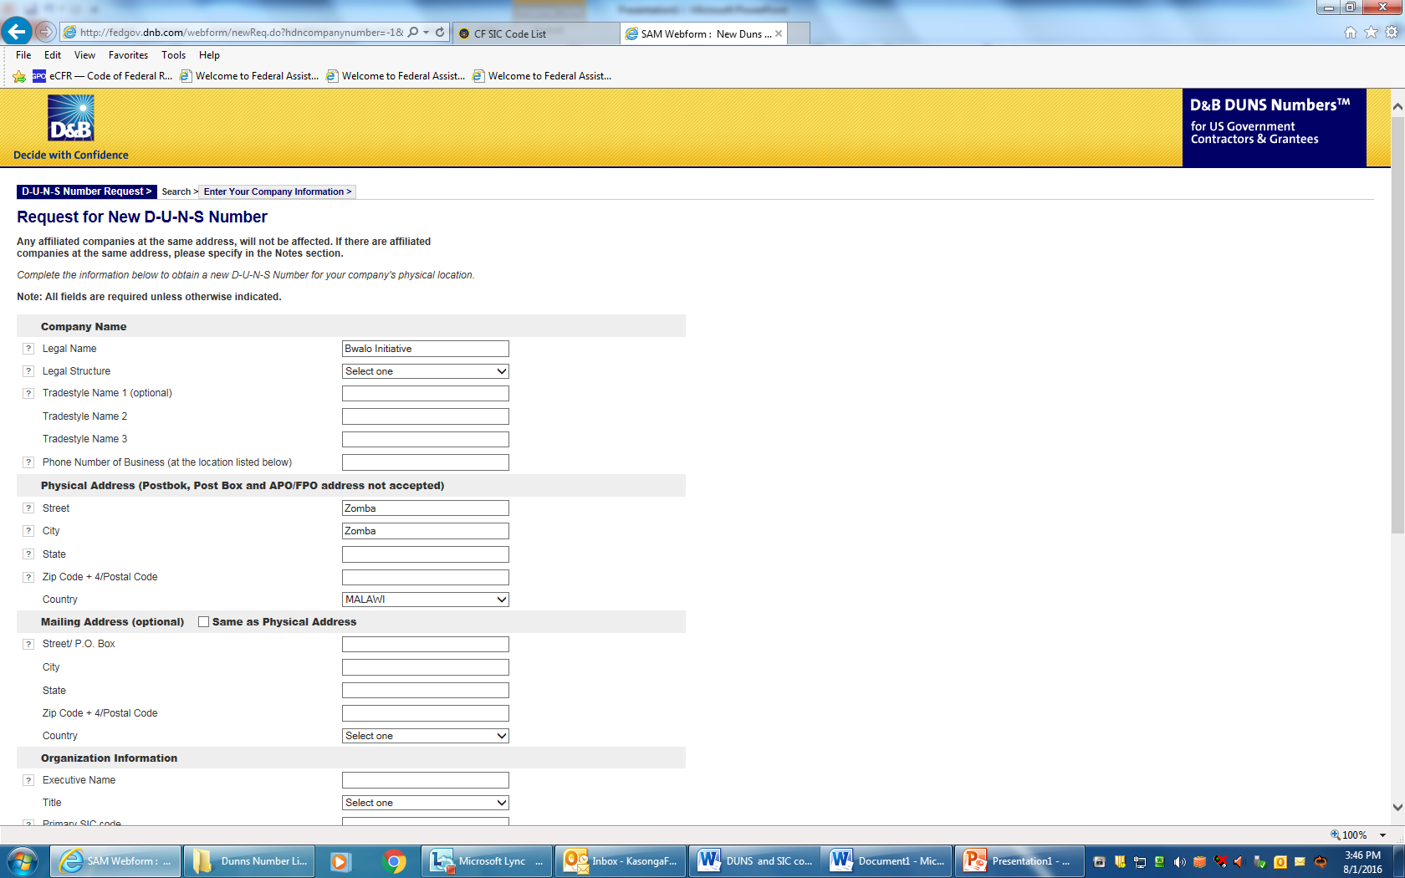

Slide 6
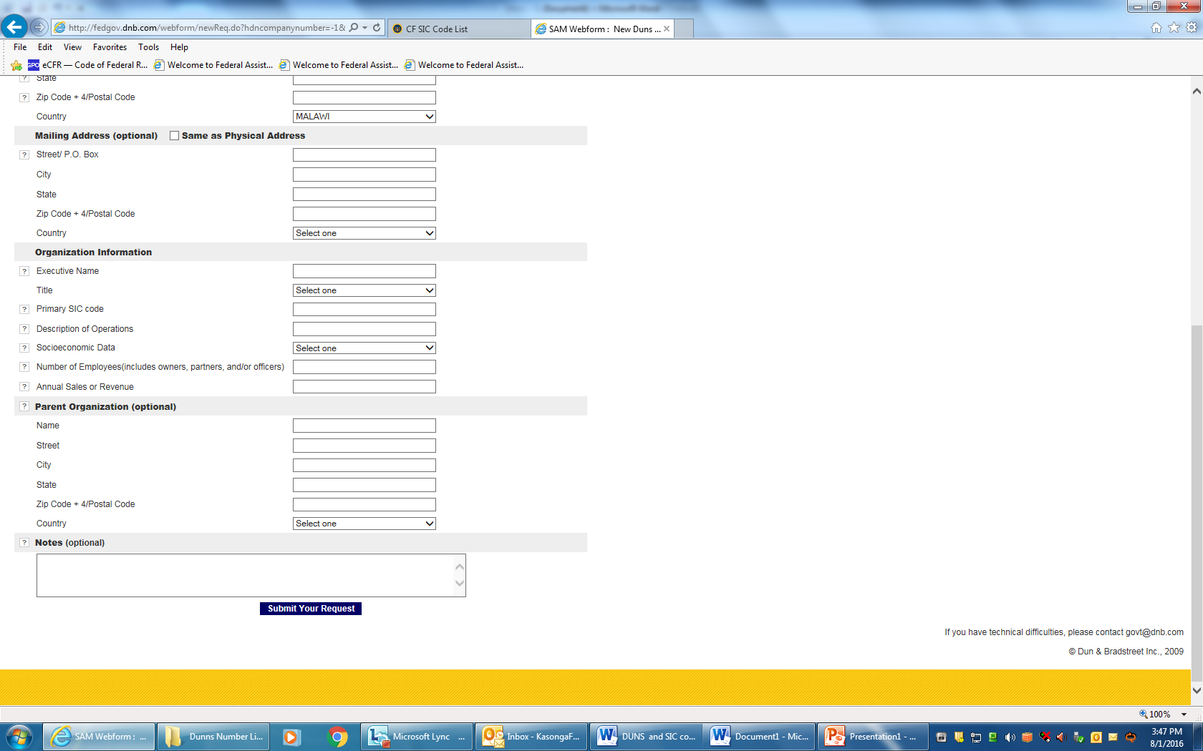
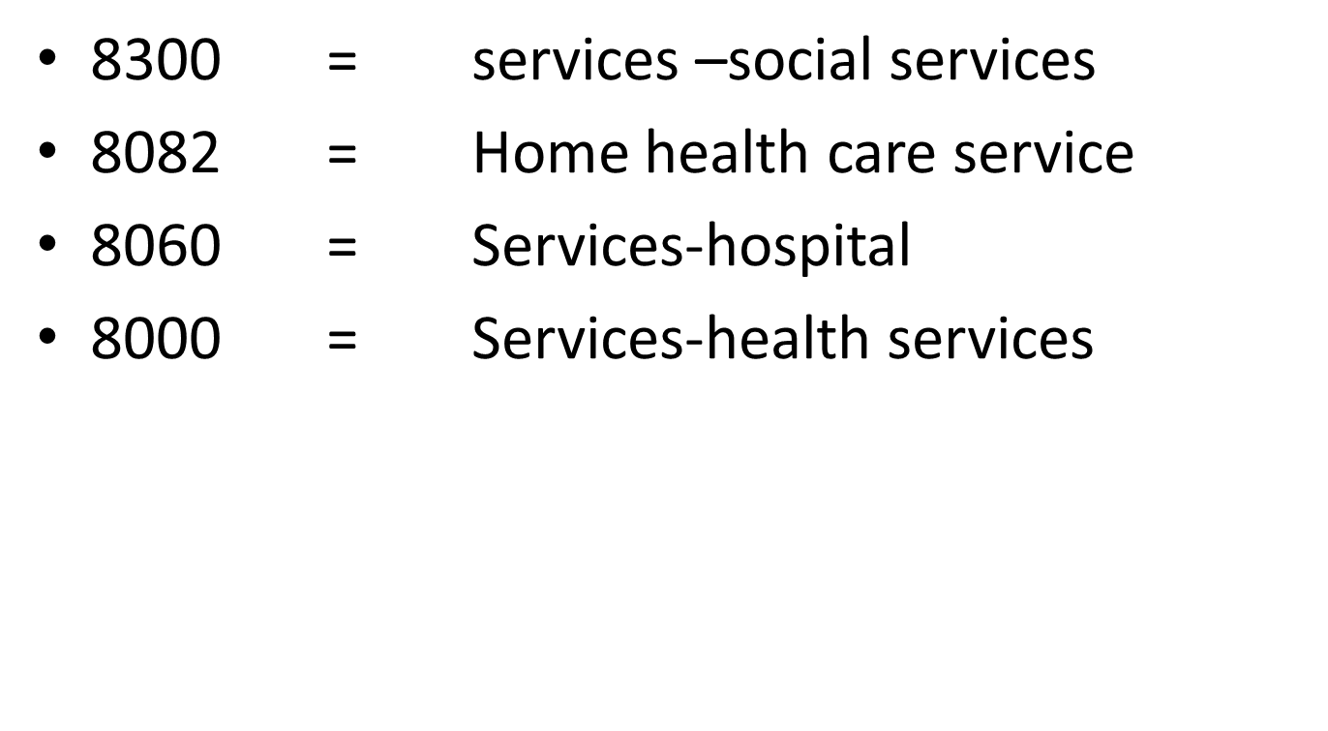

Slide 7
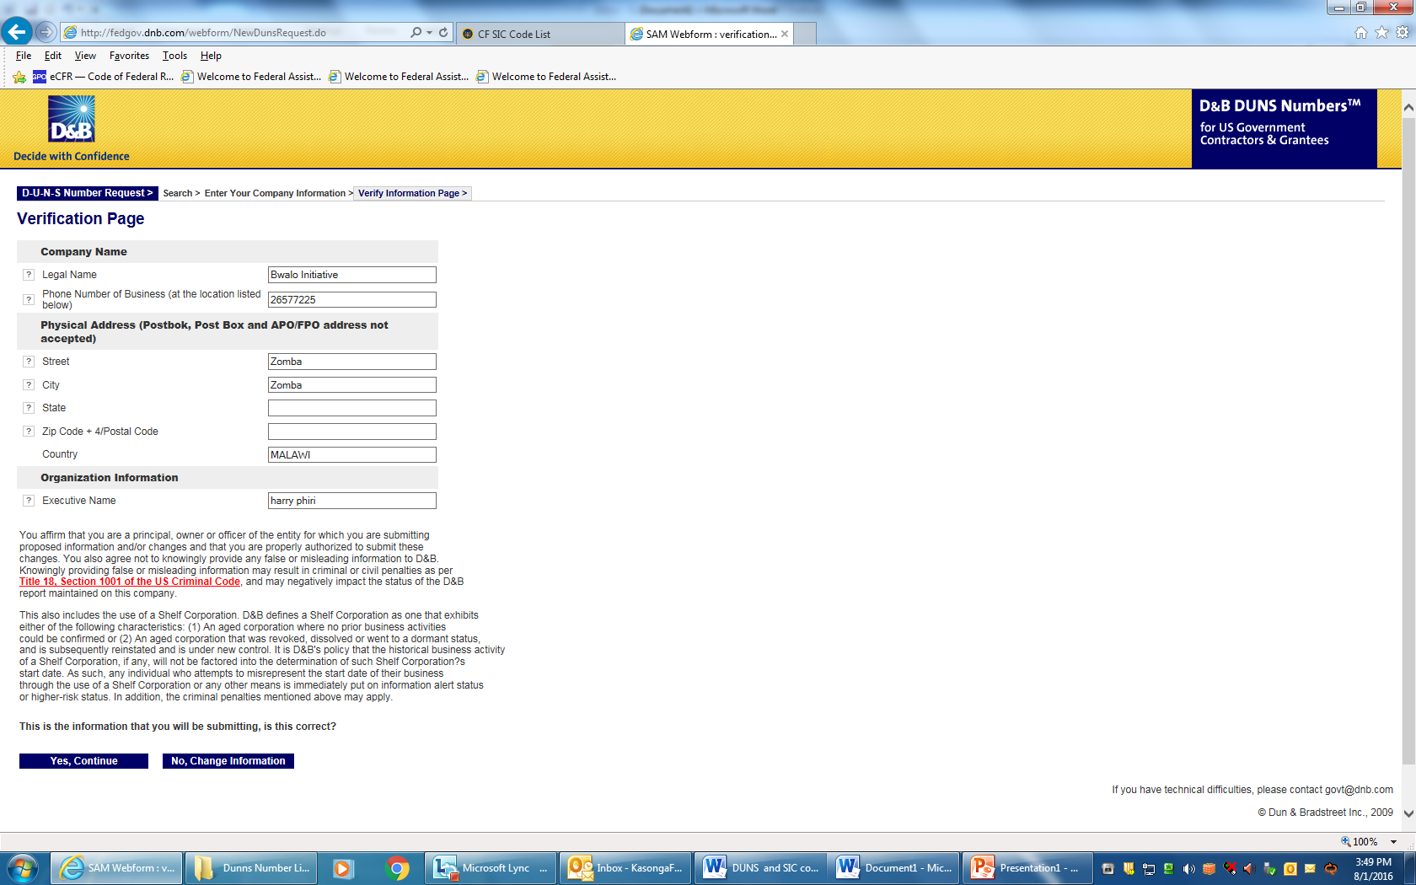

Slide 8
