Slide 1
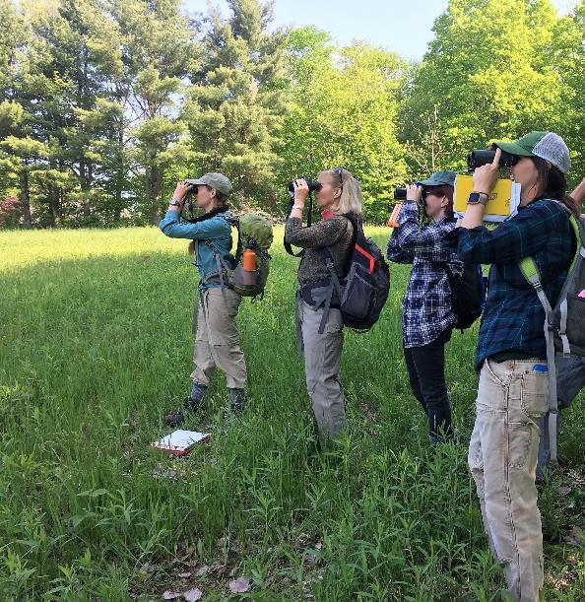
FY 2022 Landscape Scale Restoration
Competitive Grant Program for the Northeast and Midwest
Photo by Bob Zaino, from the Women in the Woods project in Vermont.

Slide 2
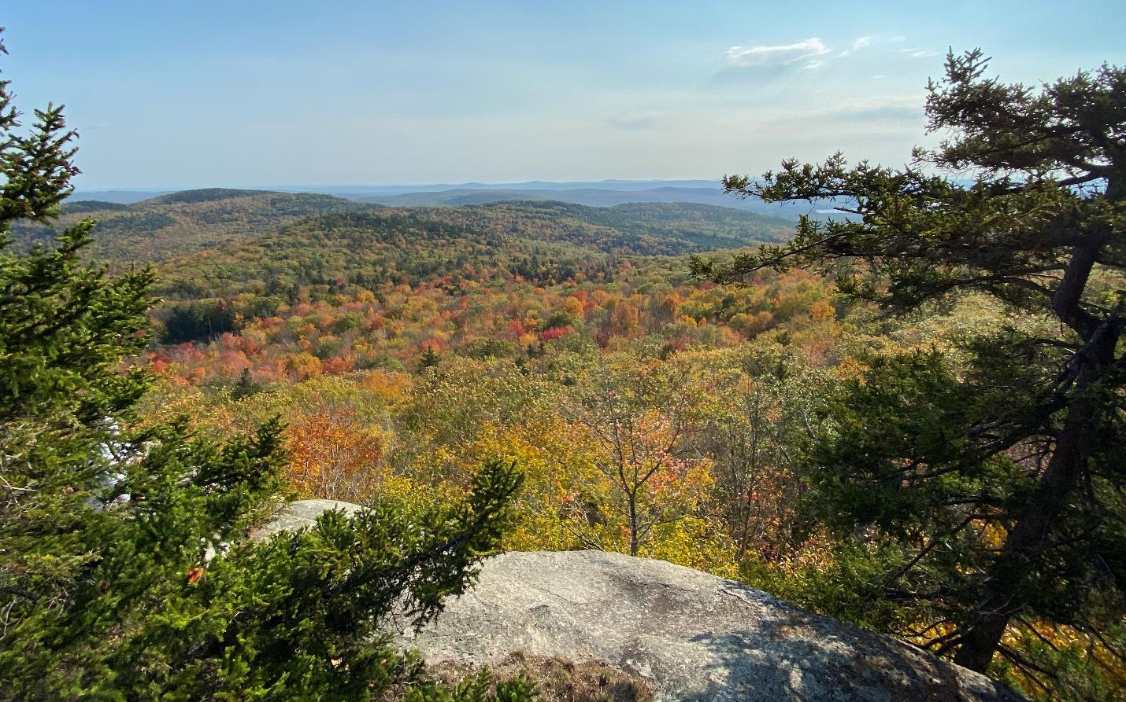
Presenting from N’dakinna, homeland of the Abenaki, Pennacook, and Wabanaki people, who I acknowledge and honor with gratitude.
Notes:
I’m presenting from N’dakinna, homeland of the Abenaki, Pennacook, and Wabanaki people. I acknowledge and honor with gratitude the land, waters, and alnobak who have stewarded N’dakinna throughout the generations.

Slide 3

Webinar Agenda
Program overview
Eligibility and key points
Scoring criteria
Application forms and process
Tips for a competitive application
Remaining Questions!
Notes:
Please type questions into the chat as you think of them! I’ll pause often throughout to answer the questions coming in. I’ll also pause to take questions verbally from those who are dialed in by phone.
Photo credit: Ken Dudzik, Northern Research Station (retired)

Slide 4
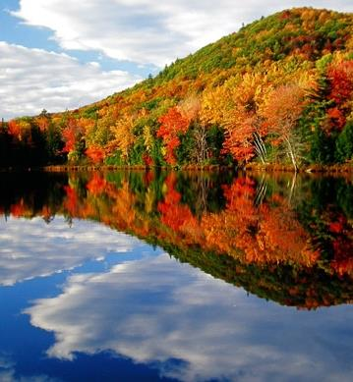
Landscape Scale Restoration (LSR)
Program Purpose:
Pg. 1
To encourage collaborative,
science-based restoration
of priority rural forest landscapes.
Notes:
The 2018 Farm Bill amended the Cooperative Forestry Assistance Act, codifying the State and Private Forestry Landscape Restoration Program and the program purpose to encourage collaborative, science-based restoration of priority forest landscapes.
Note: This presentation roughly follows the flow of our LSR instructions document. If you have that printed or open, you can follow-along with the relevant section using the page numbers shown in the blue page box at the top right.

Slide 5
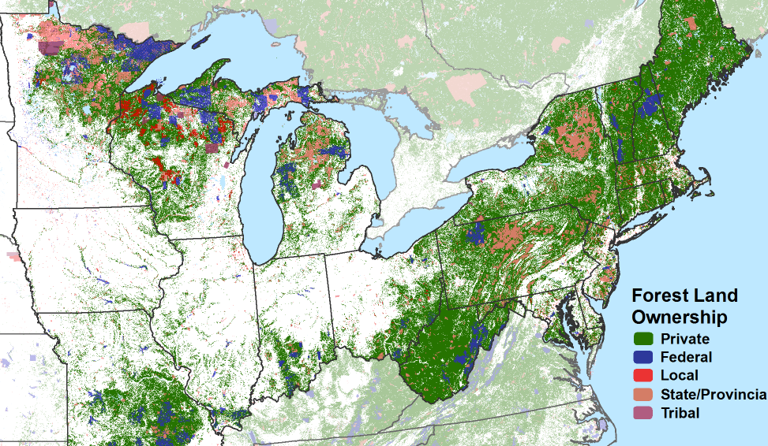
LSR Overview
Pg. 1
Competitive grant program authorized by Cooperative Forestry Assistance Act
Administered through 3 regional processes:
  Northeast & Midwest
  West
  South
Refer to the national LSR website for national directive on LSR.
Notes:
This national program is administered through 3 regional processes. This webinar is for the project locations in and sponsored by states across the Northeast and Midwest, shown in this map. Because there are some differences in how the program is implemented in each regional process, if you are looking to do a project in western or southern states, click the relevant link for more info from this slide.

Slide 6
LSR Overview
~$4 million annual Federal funding for Northeast & Midwest LSR program (last few years)
In FY21: 49 applications submitted, 15 funded
Most awards processed quickly since grant forms are included in grants.gov package.
R9 LSR website: Past applications, ranked and funded lists, and reviewer comments for FY21.

Slide 7
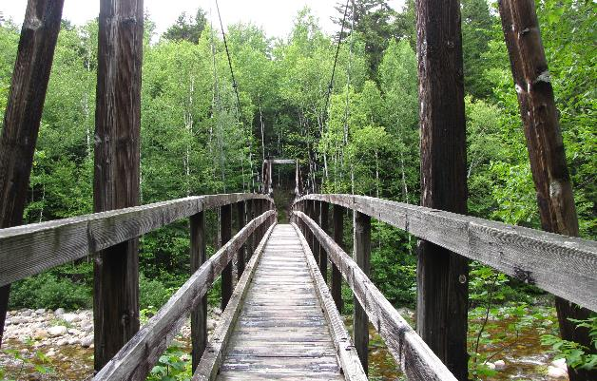
Eligible Applicants
Pg. 2, 3
State Forester sponsor letter required
State forestry or appropriate agencies
Nonprofit organizations (501c3)
Universities
Local units of government
Federally recognized Tribes (and Alaska Native Corporations)
Notes:
For profit organizations are not eligible to submit applications under this competition.
State Forester Sponsorship: All applications submitted, except those submitted by Tribes, must have a State Forester sponsor. Each State Forester may sponsor no more than 5 applications (single, multistate, or cross-regional); however, applications with 11 or more State Forester sponsors and applications submitted by Tribes do not count against this limit of 5 applications per State.
Photo Credit: Sherri Wormstead

Slide 8
Outcomes on Rural Forest Land that Support State Forest Action Plans
Pg. 2
LSR Directive: “High impact projects that lead to measurable outcomes on the landscape, leverage public and private resources, and further priorities identified in each State Forest Action Plan or equivalent restoration strategy.”
Outcomes on rural nonindustrial private, Tribal, State, and/or local government forest land.
While projects may include a component of outreach, education, and/or training to achieve the project goals, it should not be the sole outcome.
Notes:
As noted in the Landscape Scale Restoration Manual (FSM 3800), this competitive grant program supports, “high impact projects that lead to measurable outcomes on the landscape, leverage public and private resources, and further priorities identified in each State Forest Action Plan or equivalent restoration strategy.”
On-the-Ground Outcomes on Rural Lands: Projects must achieve on-the-ground outcomes on rural, nonindustrial private forest land and/or rural Tribal, State, or local government forest land. LSR Project Planning Tool (Project Eligibility Tab) to confirm if a city or town is rural according to this definition. Note: While projects may include outreach, education, and/or training as a means to achieve project goals, those should not be the sole outcome. For what is considered “on-the-ground” outcomes for LSR, see the national quantitative accomplishment measures. All LSR projects must accomplish at least one of those measures. 4 For the purposes of this program, “rural” means any area other than an urbanized area such as a city or town that has a population of greater than 50,000 inhabitants according to the latest census.
For what is considered “on-the-ground” outcomes for LSR, see the national quantitative accomplishment measures. All LSR projects must accomplish at least one of those measures.
Note: Tribal land held in trust by the United States is not considered “Indian-owned land.”

Slide 9
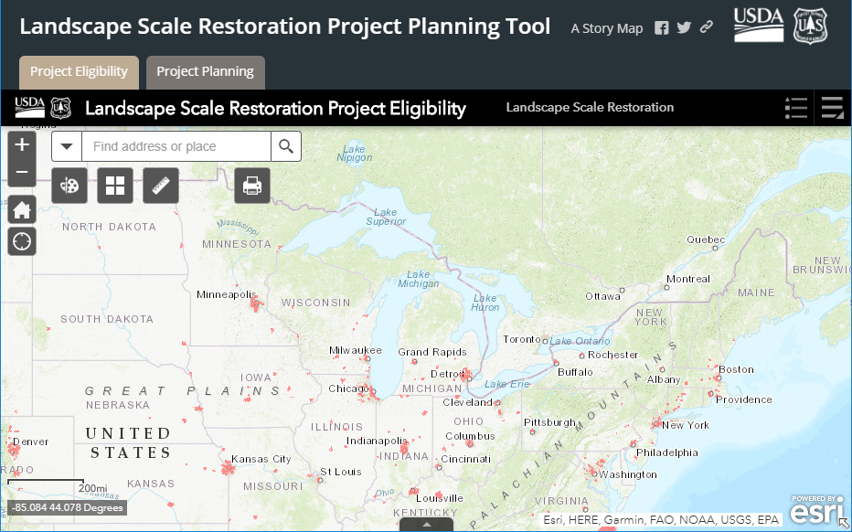
Rural =
Town with population of 50,000 or less.
Pg. 2
Use this LSR Project Planning Tool (Project Eligibility Tab) to confirm if a city or town is rural.
Notes:
On-the-Ground Outcomes on Rural Lands: For the purposes of this program, “rural” means any area other than an urbanized area such as a city or town that has a population of greater than 50,000 inhabitants according to the latest census.
Use the LSR Project Planning Tool (Project Eligibility Tab) to confirm if a city or town is rural according to this definition.
Applicants can use this map to confirm that their proposed project is rural or outside the areas in red, which are the US Census Populated Places (2017).
These designated places (cities, towns and municipalities) have a population of more than 50,000 people as of 2017.
See the US Census for updated estimates.

Slide 10
Minimums and Maximums
Pg. 2
Minimum application Fed. amount = $25,000
Each State can submit/sponsor 5 applications
  Note: Applications with 11 or more State Forester sponsors and applications submitted by Tribes do not count against the 5
Max. total funding awarded to any one State or Tribe = 15% of total available (~$4 million annually for Northeast and Midwest)
Max. Fed. funding for multistate projects = $600,000
Notes:
Minimum and Maximum Funding Levels:
The minimum Federal funding per project is $25,000.
The maximum amount of Federal funding awarded to any one State (State cap) or Tribe via this competitive process is 15% of the total available. As in past years, for FY 2022, funds available to the Eastern Region are based on the final fiscal year appropriation from Congress for the LSR Program and the funding allocation to the Region from the Agency’s Washington Office. While the funding level may fluctuate from year to year, for planning purposes, the Eastern Region Federal funding for LSR has been approximately $4 million annually.
The maximum Federal funding for a multistate or cross-regional project is $600,000.
Required Matching Funds of 1:1: One-to-one matching funds must be derived entirely from non-Federal sources. The match must be met by eligible and allowable costs and is subject to match provisions in grant regulations (Code of Federal Regulations Title 2 Part 200.306 and Subpart E for Cost Principles). Match must meet all the same requirements as the Federal share and be documented sufficiently to support financial tracking and accountability. See the Matching Funds document for more guidance.

Slide 11
1:1 Matching Funds Required
Pg. 2
Match is funding or in-kind contributions from non-Federal sources.
Some eligible sources of match:
Funding from your (applicant) agency or org.
Funding from non-Federal partners
Volunteer time implementing the project
Donation of equipment, supplies, meeting space
Services provided at a reduced cost
Tribal 638 BIA Contracting Funds
Refer to the “Matching Funds” document for more info.
Notes:
Required Matching Funds of 1:1: The match must be met by eligible and allowable costs and is subject to match provisions in grant regulations (Code of Federal Regulations Title 2 Part 200.306 and Subpart E for Cost Principles). Match must meet all the same requirements as the Federal share and be documented sufficiently to support financial tracking and accountability. See the Matching Funds document for more guidance.
BIA 638 funds are allowed to be used as match per the Indian Self Determination and Education Act.

Slide 12

S&PF Authorities for LSR Projects
Pg. 4
Forest Stewardship
Rural Forestry Assistance
Urban and Community Forestry
Forest Health Protection
State Fire Assistance
Cooperative Forestry Assistance Act
Notes:
Eligible Authorities and Project Types for LSR
Projects must conform to laws and authorities in the Cooperative Forestry Assistance Act.
Allowable authorities for LSR: Forest Stewardship, Rural Forestry Assistance, Urban and Community Forestry, Forest Health Protection, and Community and Private Land Fire Assistance (State Fire Assistance). The authorities for this RFA may be used singly or in combination.
Ineligible authorities for LSR: Rural Volunteer Fire Department Assistance, Forest Legacy, Community Forest and Open Space, and Federal Lands Forest Health Management.
Photo Credit: Ken Dudzik, NRS

Slide 13
Example Eligible Projects
Pg. 4
Forest management treatments to improve water quality and watershed health and/or wildlife habitat.
Survey, prioritization, and treatment to control invasive plants in a high-priority landscape.
Tree planting projects in communities with a population of 50,000 or less.
Demonstration projects that achieve on-the-ground accomplishments and provide education/training.
Treatments to reduce or mitigate hazardous wildland fire fuels in priority rural forest lands.

Slide 14
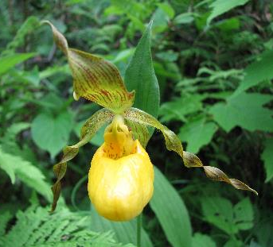
Some Activities Not Eligible
For LSR Funding and 1:1 Match
Pg. 5
Cost-share, reimbursement, and other payments directly to private landowners
Construction and capital improvements
Research
Small business start-up funding
Projects on Federal land
Projects in cities/towns with population over 50,000
Forest Legacy Program projects (land purchase and conservation easements)
Lymantria dispar (previously known by the common name gypsy moth) Slow-the-Spread (STS) projects
Notes:
Projects Not Eligible under this RFA
• Activities in cities or towns with greater than 50,000 inhabitants. Refer to the LSR Project Planning Tool.
• Research: Basic research as defined in 2CFR 422.1, “Systematic study directed toward fuller knowledge or understanding of the fundamental aspects of phenomena and of observable facts without specific applications towards processes or products in mind.” Note: Technical transfer, education, and outreach activities associated with applying research can be included in the application. A research entity can be included as a partner and can contribute research as non-match leverage (not funded with the LSR Federal dollars or associated match).
• Construction and capital improvements (facilities, infrastructure, roads). However, capital improvements may be listed as enhanced leverage (not part of the S&PF Federal funding or match).
• Purchase of fire department equipment, including fire weather stations and dry fire hydrants.
• Small business start-up funding.
• Cost-share, reimbursement, and other types of payment directly to private landowners; however, LSR funding (and match) may be used to perform work on private lands.
• While projects may include a component of outreach, education, and/or training as a means to achieve the project objectives, outreach and education should not be the sole outcome.
• Lymantria dispar (previously known by the common name gypsy moth) Slow-the-Spread (STS) projects. These are determined in cooperation with the STS Foundation.
• Forest Legacy Program and Community Forest and Open Space Program acquisition projects.
Note: Non-match leveraged contributions can be used to fund activities not eligible.
Photo Credit: USDA Forest Service Eastern Region

Slide 15
Scoring Criteria

Slide 16
Criteria for LSR Project Selection
Pg. 5-7
Priority Issues and/or Landscapes in the State Forest Action Plan(s) (25 points)
Measurable Outcomes (35 points)
Collaboration and Integrated Delivery (20 points)
Leverage (10 points)
Knowledge and Technical Transfer (10 points)

Slide 17
Criteria 1. Priority Issues/ Landscapes in
State Forest Action Plan(s) (SFAP)*
25
points
Pg. 5
Demonstrate focus on a significant issue and/or priority landscape in the respective SFAP(s).
Describe how the project will bring a State or region to a desired future condition, goal, or strategy as articulated in the respective SFAP(s).
Note: All states have a 2020 SFAP, except Vermont for which 2017 is their current plan. Ask Sherri Wormstead or the State Forester if you cannot find the 2020 SFAP.
* Or equivalent restoration strategy (see page 5 of the National Directive)
Notes:
Criteria 1. Priority Issues and/or Landscapes in the State Forest Action Plan(s) (25 points)
Projects will be based on an analysis within the State or region that identifies the issue or landscape being addressed as a priority in the State Forest Action Plan(s) or equivalent restoration strategy.
• Demonstrate focus on a significant issue and/or priority landscape in the respective State Forest Action Plan(s).
• Describe how the project will bring a State or region to a desired future condition, goal, or strategy as articulated in the respective State Forest Action Plan(s).
Note: Most States now have a 2020 State Forest Action Plan (except Vermont, which was revised in 2017). The plans are posted on the National Association of State Foresters website. If you don’t see the 2020 plan posted there yet, contact the relevant State Forester(s) or Sherri Wormstead.
Equivalent Restoration Strategy (from the Forest Service Directive for LSR):
Is complete or substantially complete;
Is for a multi-year period;
Covers non-industrial private forest land or state forest land;
Is accessible by wood processing infrastructure; and
Is based on the best available science.

Slide 18
Criteria 2.
Measurable Outcomes
35
points
Pg. 5-6
Describe how project outcomes will result in science-based restoration of priority landscapes.
Prioritize funding and other resources toward one or more of the national LSR objectives.
Accomplish at least one on-the-ground national quantitative measures; show how the Federal investment will lead to outcomes on the landscape.
Note: Reviewers will assess if outcomes are commensurate with the budget.
Notes:
Criteria 2. Measurable Outcomes (35 points)
Describe how the project outcomes will result in science-based restoration of priority landscapes.
Projects shall prioritize funding and other resources toward one or more of the national LSR objectives (next slide)
Each LSR project must accomplish at least one of the on-the-ground national quantitative measures (listed on slide 19) and may include additional specific measurable results that show how the Federal investment will lead to outcomes on the landscape. The measures/metrics should be specific, measurable, achievable, realistic, and timely.
Include description of less quantifiable return on investments in the narrative section.
Reviewers will assess if outcomes are commensurate with the budget.

Slide 19
National LSR Objectives
Pg. 5
Reduce the risk of uncharacteristic wildfires.
Improve fish and wildlife habitats, including for threatened and endangered species.
Maintain or improve water quality and watershed function.
Mitigate invasive species, insect infestation, and disease.
Improve important forest ecosystems.
Measure ecological and economic benefits including air quality and soil quality and productivity.
Notes:
Projects shall prioritize funding and other resources toward one or more of these national LSR objectives.

Slide 20
National Quantitative Measures for LSR “Outcomes on the Ground”
Pg. 6
Acres treated to reduce hazardous fuels
Miles of riparian forest treated to enhance wildlife
Acres of habitat treated to enhance wildlife
Acres of trees/seedlings planted to enhance water quality
Miles of riparian forest treated to enhance water quality
Acres treated for insects and disease
Infested acres treated for invasive plants
Acres of other silvicultural treatments
Acres under new forest management plans
Private landowners reached through technical assistance
Tons of forest products produced (biomass)
Board feet of forest products produced (timber)
Notes:
These measures are in LaSR, the reporting system for LSR.
Each LSR project must accomplish at least one of these on-the-ground national quantitative measures.
This list also serves as the list of what can be consider “on-the-ground” for that program requirement.
Plans: A new forest management plan can include a Forest Stewardship Plan; CAP 106 plan, Tree Farm plan, tax abatement plan, equivalent State forest management plan or a landscape plan. If a landscape plan, the plan must focus on discrete/specific geography such as a watershed and not a state-wide landscape level plan.
Private forest landowners reached through technical assistance that are known to have benefited in some significant and lasting way from the project through more than one interaction. This does not include landowner who only attended a technical or training session without any follow-up or were spoken to only once, such as over the phone, with no follow-up.

Slide 21
Criteria 3. Collaboration and Integrated Delivery
20
points
Pg. 7
ID partners that demonstrate a commitment and add value to the project.
Seek to improve delivery of public benefits from forest management by coordinating with complementary State and Federal programs and partnership efforts.
Describe land ownerships for the project area and cross-boundary goals: Can include combination of Tribal, State, local government, and private lands.
Demonstrate benefits as a result of collaboration.
Notes:
Criteria 3. Collaboration and Integrated Delivery (20 points)
Identify partners that have demonstrated a commitment and add value towards planning and carrying out the project and describe what these partners contribute.
Seek to improve the delivery of public benefits from forest management by coordination with or proximity to complementary State and Federal programs and partnership efforts when possible, e.g., Collaborative Forest Landscape Restoration Program, landscape areas designated for insect and disease treatments under section 602 of the Healthy Forest Restoration Act of 2003, Good Neighbor Authority, National Forest stewardship contracting projects, Natural Resources Conservation Service programs, Shared Stewardship agreements, and relevant state-level programs.
Describe land ownerships for the project area and cross-boundary goals, which can include a combination of Tribal, State, local government, and private land ownerships, e.g., multiple private landowners, private and State landowners, State and Federal landowners, State and local government, State and Tribal landowners, etc..
Demonstrate residual positive benefits, as a result of collaboration, related to capacity, skills, knowledge, infrastructure, or a replicable approach, among others.
Note: Collaboration may be qualitative in nature, and the contribution of the partners may be more important than the number of partners involved. Multistate collaboration and integration of projects are encouraged.

Slide 22
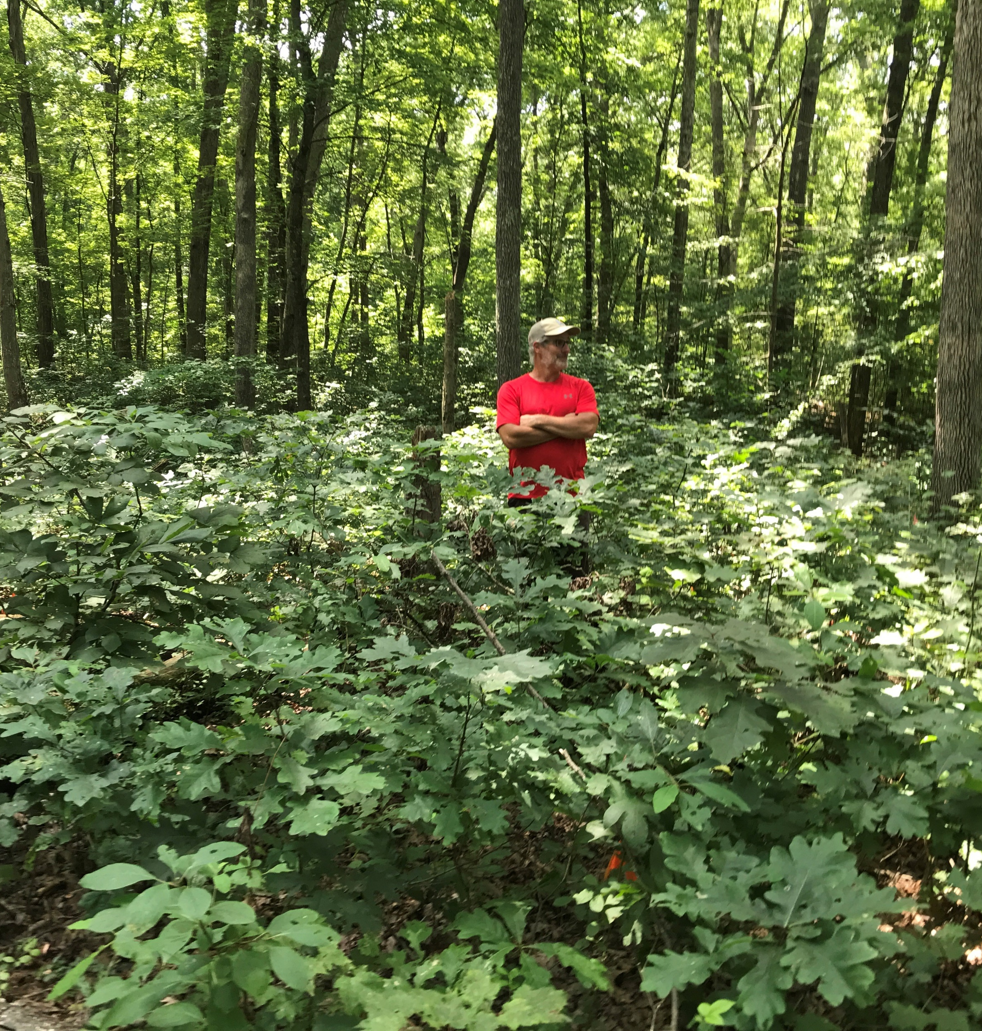
Criteria 4. Leverage
10
points
Pg. 7
Projects should maximize S&PF funding by using it to leverage contributions from both Federal and non-Federal entities.
Describe contributions from partners in this section and clearly list in the Budget Spreadsheet.
Include match and additional
  non-match leveraged.
Photo by Cotton Randall, from White Oak Project in Ohio.
Notes:
Criteria 4. Leverage (10 points)
Projects should maximize S&PF funding by using it to leverage contributions from both Federal and non-Federal entities. Project applications need to clearly identify the LSR Federal funds requested and the associated non-Federal contributions in the SF-424A and Budget Spreadsheet. Provide details about leveraged contributions, including match from partners and additional non-match leveraged contributions. Note: Collaboration with a for-profit Conservation Finance partner can be a powerful leverage multiplier, but this requires careful budget segregation to ensure Federal grants are not earning income.
Photo Credit: Cotton Randall

Slide 23
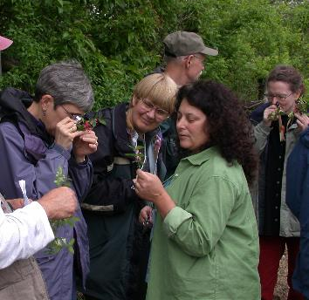
Criteria 5. Knowledge and
Technical Transfer
10
points
Pg. 7
Technical transfer: The sharing of knowledge, tools, and innovations for practical application.
Describe how others will learn from the work done on this project… potential to inform practitioners and enhance the effectiveness of similar initiatives.
Projects should include a component of outreach, training, lessons learned, or related opportunities.
Notes:
Criteria 5. Knowledge and Technical Transfer (10 points)
Technical transfer is defined as the sharing of knowledge, tools, and innovations for practical application. As specifically as possible, describe how others will learn from the work done on this project. Describe the project’s potential to inform practitioners and enhance the effectiveness of similar initiatives. Knowledge and technical transfer need not necessarily be between States, but should aim to share innovation across the landscapes of importance wherever it can be utilized. Projects should include a component of outreach, training, lessons learned, or related opportunities so that carrying out the project results in skills and capability that extend beyond the life of the grant.
While projects may include a component of outreach, education, and/or training as a means to achieve the project goals, outreach and education should not be the sole outcome.

Slide 24
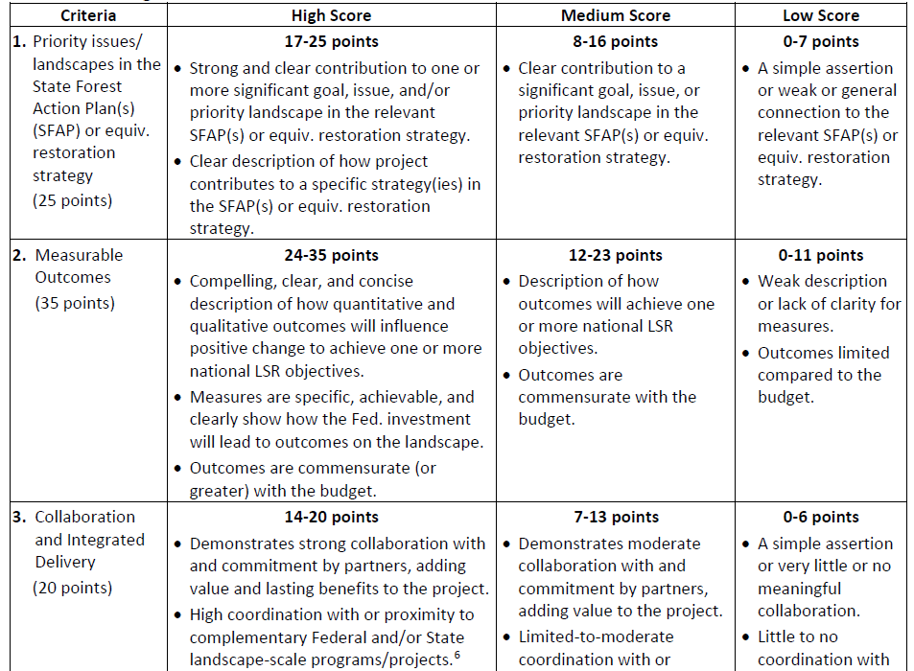
New! Scoring Rubric
Pg. 8
Notes:
This rubric is for the review team members to reference while scoring the applications.

Slide 25
Exec. Order 13985: Advancing Racial Equity and Support for Underserved Communities through the Federal Government
Pg. 2
The policy of the Federal Government to, “pursue a comprehensive approach to advancing equity for all, including people of color and others who have been historically underserved, marginalized, and adversely affected by persistent poverty and inequality.”
Equity = “consistent and systematic fair, just, and impartial treatment of all individuals, including individuals who belong to underserved communities that have been denied such treatment, such as:
  Black, Latino, and Indigenous and Native American persons, Asian Americans and Pacific Islanders and other persons of color;
  Members of religious minorities;
  Lesbian, gay, bisexual, transgender, and queer (LGBTQ+) persons
  Persons with disabilities;
  Persons who live in rural areas; and
  Persons otherwise adversely affected by persistent poverty or inequality.”

Slide 26
Exec. Order 13985: Advancing Racial Equity and Support for Underserved Communities through the Fed. Government
Pg. 2
We encourage applications that show a clear benefit to underserved/historically marginalized people and the communities where they reside or the forest areas that they value.
Where this is the case: Describe in the Narrative Form.
Two resources:
CDC Social Vulnerability Index
Opportunity Zones, economically distressed communities identified by governors.
Notes:
CDC Social Vulnerability Index: The CDC/ATSDR SVI indicates the relative vulnerability of every U.S. Census tract. Census tracts are subdivisions of counties for which the Census collects statistical data. SVI ranks the tracts on 15 social factors, including unemployment, minority status, and disability, and further groups them into four related themes. Thus, each tract receives a ranking for each Census variable and for each of the four themes, as well as an overall ranking. The four themes and 15 factors are:
Socioeconomic Status: Below Poverty, Unemployed, Income, No High School Diploma
Household Composition & Disability: Aged 65 or Older, Aged 17 or Younger, Civilian with a Disability, Single-Parent Households
Minority Status & Language: Minority, Aged 5 or Older who Speaks English “Less than Well”
Housing Type & Transportation: Multi-Unit Structures, Mobile Homes, Crowding, No Vehicle, Group Quarters
Opportunity Zones are economically distressed communities, defined by individual census tract, nominated by America’s governors, and certified by the U.S. Secretary of the Treasury via his delegation of that authority to the Internal Revenue Service. Under certain conditions, new investments in Opportunity Zones may be eligible for preferential tax treatment. There are 8,764 Opportunity Zones in the United States, many of which have experienced a lack of investment for decades. The Opportunity Zones initiative is not a top-down government program from Washington but an incentive to spur private and public investment in America’s underserved communities.

Slide 27
Application Forms and Process

Slide 28
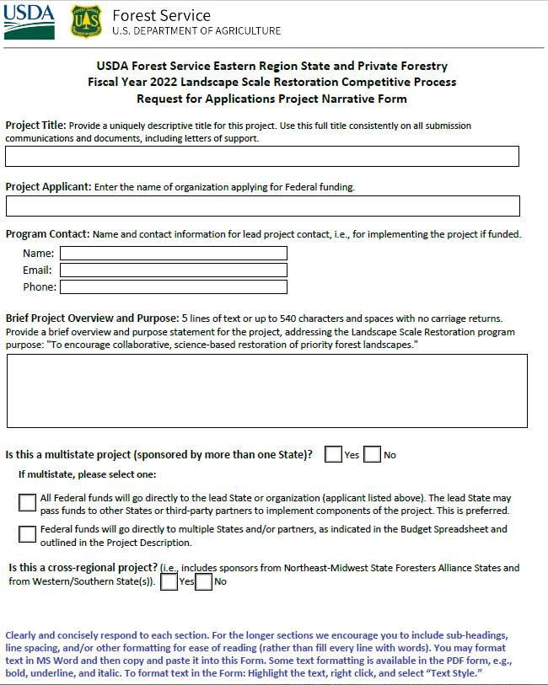
Project Narrative Form
Pg. 10
Fillable Form (PDF)
Notes:
Note: Clearly articulate the methods employed, timelines, and resources needed in the “Project Description” section of the Project Narrative Form.
Clearly and concisely respond to each section. For the longer sections we encourage you to include sub-headings, line spacing, and/or other formatting for ease of reading (rather than fill every line with words). You may format text in MS Word and then copy and paste it into this Form. Some text formatting is available in the PDF form, e.g., bold, underline, and italic. To format text in the Form: Highlight the text, right click, and select “Text Style.”

Slide 29
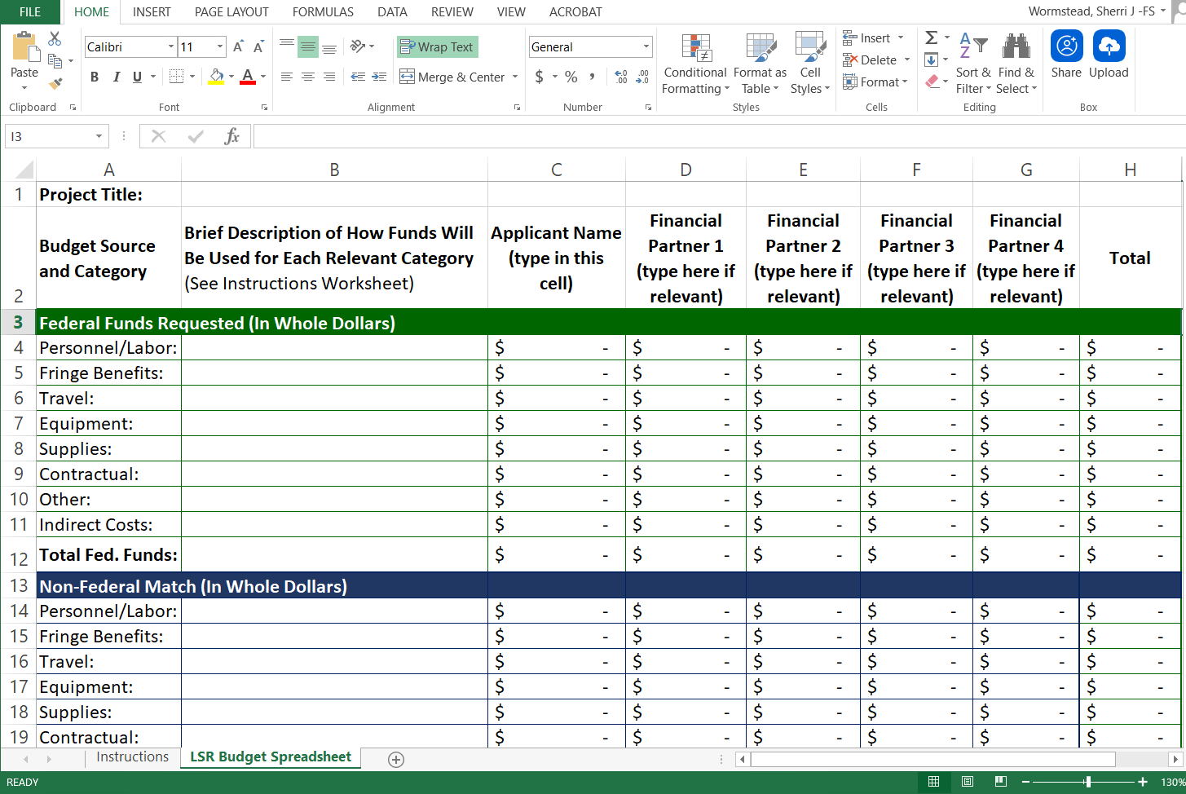
Budget Spreadsheet
Pg. 10
Required for all applications
Notes:
Refer to the instructions tab of the spreadsheet.

Slide 30
How to Apply
Pg. 9, 12
Submit all applications through Grants.gov
Search for LSR or Opportunity: USDA-FS-2022-LSR
Sept. 24: Submit draft of application form and budget table to involved State Forester(s) (not required for Tribes)
Nov. 5 (by 6 p.m. Eastern): Applications due in Grants.gov
Grants.gov provides 24/7 support:
  Toll-free number = 1-800-518-4726
  Email = support@grants.gov

Slide 31
Getting Ready to Apply
Pg. 9, 12
Before working in Grants.gov you will need:
Employer Identification Number (~5 weeks)
DUNS Number (1-2 days)
System Award Management (SAM) registration (~2 weeks)
Grants.gov account with Authorized Organization Representative (AOR) role (same day)

Slide 32
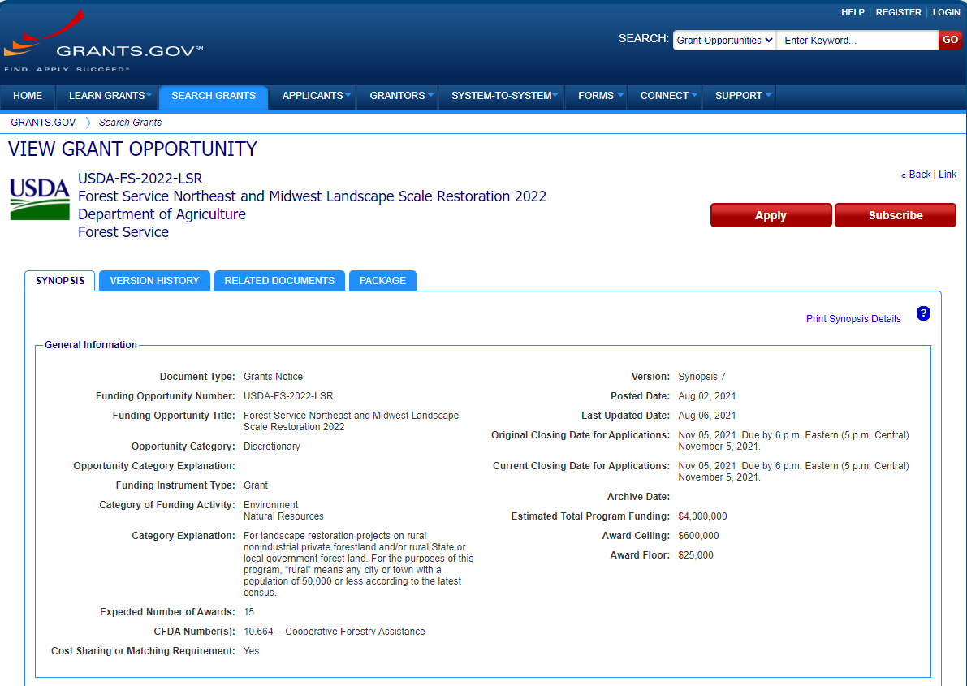
Grants.gov Opportunity: USDA-FS-2022-LSR

Slide 33
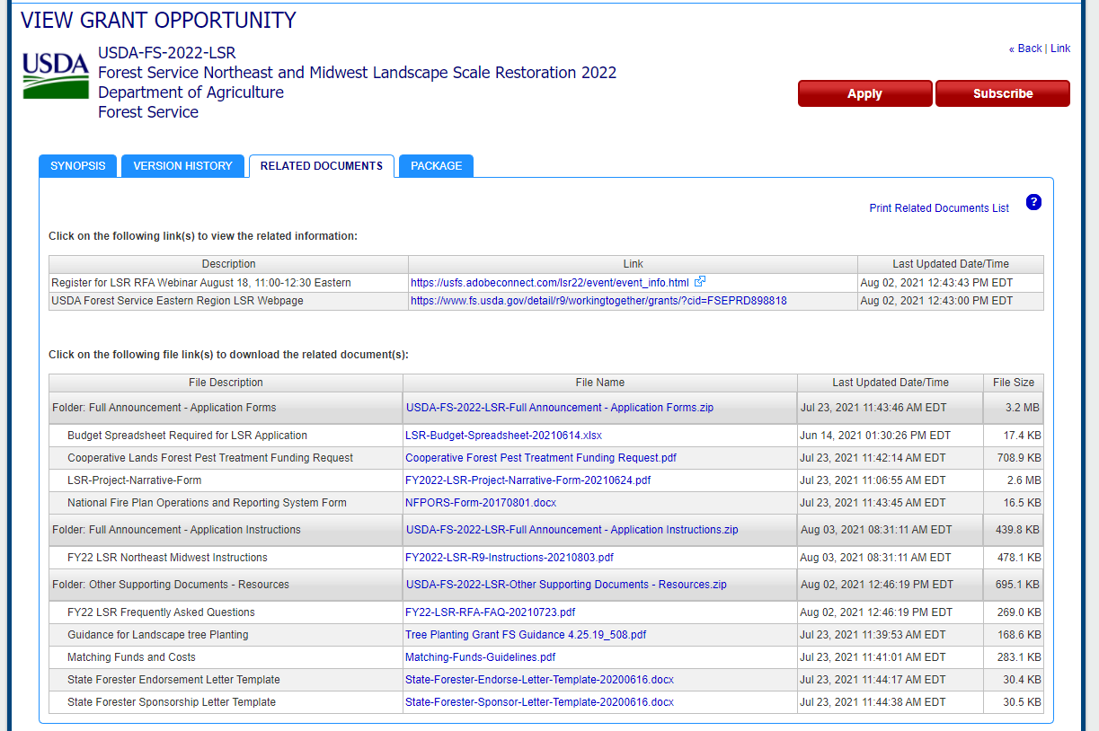
Grants.gov Opportunity:
Related Documents Tab

Slide 34
Grants.gov Package
Pg. 9 & 15
Project Narrative Form*
Maps or photos (optional)*
Budget Spreadsheet*
SF-424 Application for Federal Assistance
SF-424A Budget Information for Non-Construction Programs
Letter(s) of Sponsorship and Support*
USDA AD-1047 Certification Regarding Debarment and Suspension, Drug-Free Workplace Certification, and others
As applicable:
  Cooperative Lands Forest Health Treatment Funding Request*
  NFPORS Form for fire mitigation and fire activities*
*Submit through Grants.gov “Attachments Form”

Slide 35
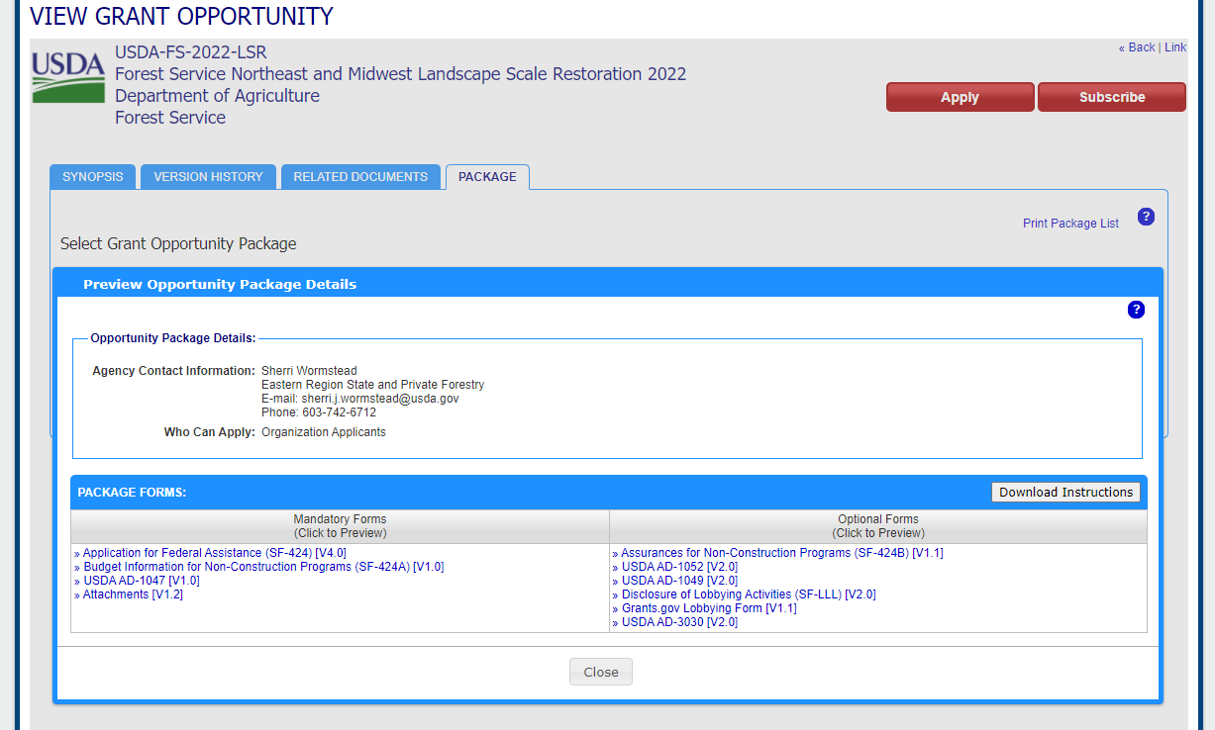
Grants.gov Opportunity:
Package Tab

Slide 36
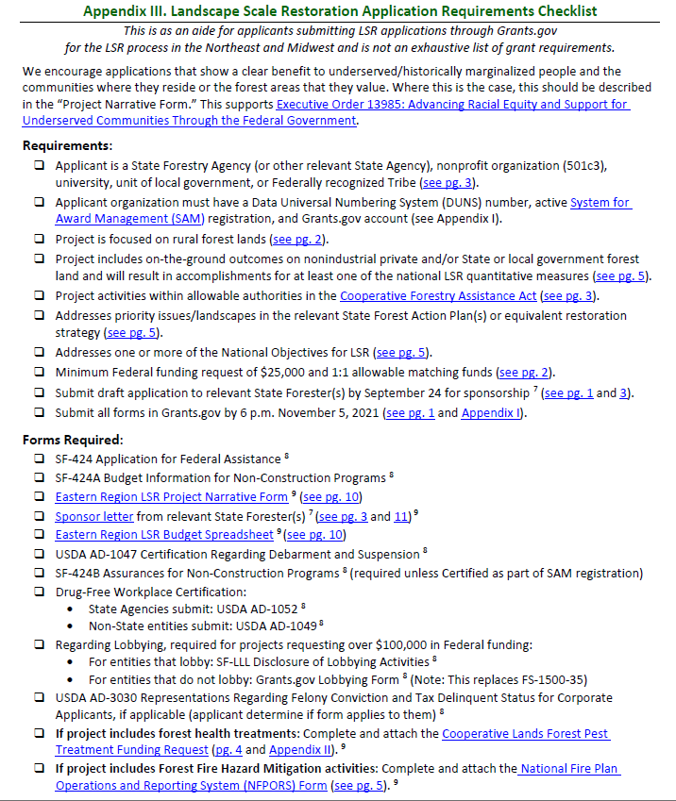
Checklist: Requirements and Forms:
See
Instructions Appendix III
Pg. 15

Slide 37
LSR FY22 Timeline
Pg. 11
Aug. 3: Request for Applications Open
Sept. 24: Submit draft of application to relevant State Forester(s) (not required for Fed.-recognized Tribes)
Nov. 5 (6 p.m. EDT): Submit application in Grants.gov
Preliminary review: Ensure eligibility and requirements
Interagency Review Team: Review and ranking
By Feb. 1: Regional ranked project list submitted to Forest Service Washington Office and posted online
Spring 2022 (when funds available): Announce projects funded
Notes:
Project Selection
An LSR Competitive Allocation Review Team consisting of an equal number of State representatives and Eastern Region S&PF leaders will collaboratively review, evaluate, and prioritize project applications.
Applications undergo a preliminary review to ensure eligibility and verify requirements.
The interagency review team completes the review of applications and develops a recommended ranked list of projects.
The recommended list of projects is submitted to the NMSFA (Northeast–Midwest State Forester Alliance) Executive Committee for concurrence and to the Eastern Regional Forester for approval.
The regionally recommended projects list is submitted to the USDA Forest Service Washington Office by February 1, 2022.
Projects ranked but not funded will receive further consideration by the NMSFA Executive Committee and the Eastern Regional Forester should additional funds become available.

Slide 38
Grant Implementation and Reporting
Pg. 3
A Forest Service grant monitor is assigned.
Projects completed in 1-3 years.
Annual reporting:
  March 31: Grant performance reporting
  Oct. 28: Project performance and spatial data reporting in the Landscape Scale Restoration (LaSR) database
    Public view of LSR Projects Database
    LSR Interactive Map
Notes:
Reporting: In addition to the standard annual reporting requirements associated with all U.S. Forest Service grants to States and partners, funded LSR projects are required to provide annual project performance and spatial data through the Landscape Scale Restoration database (LaSR) no later than October 28 each year. This requires both Forest Service grant monitors and LSR grant recipients to coordinate in entering project information. If an LSR grant recipient is new to this reporting process, they will need to sign up for an account to access the LaSR module. The assigned Forest Service grant monitor can assist with this.

Slide 39
Tips!

Slide 40
Tips from Past Reviewers for Competitive Applications
Clear Writing: Succinct who, what, when, where, and why. Good organization and formatting. Have others review/edit.
Why Important? Clear problem statement with info. to provide context for the issue and/or project area.
State Forest Action Plan (SFAP): Strong, direct, detailed connection to specific SFAP priorities/strategies.
Budget: Clear explanation of how Fed. funds and match will be used. Costs relative to deliverables. Make sure the math adds up across the narrative form, budget spreadsheet, SF-424, and SF-424A.

Slide 41
Tips from Past Reviewers for Competitive Applications
Partners and Cross-Boundary: Strong partner collaboration (and key support letters). Describe if builds on existing efforts in project area/adjacent lands.
Outcomes: Strong focus and description on realistic outcomes.
Identify the land ownership(s) where activities will take place.
Don’t be discouraged if a past application was not funded—try again!
Reach out to the USDA Forest Service Field Office with questions regarding activities allowed, etc.

Slide 42
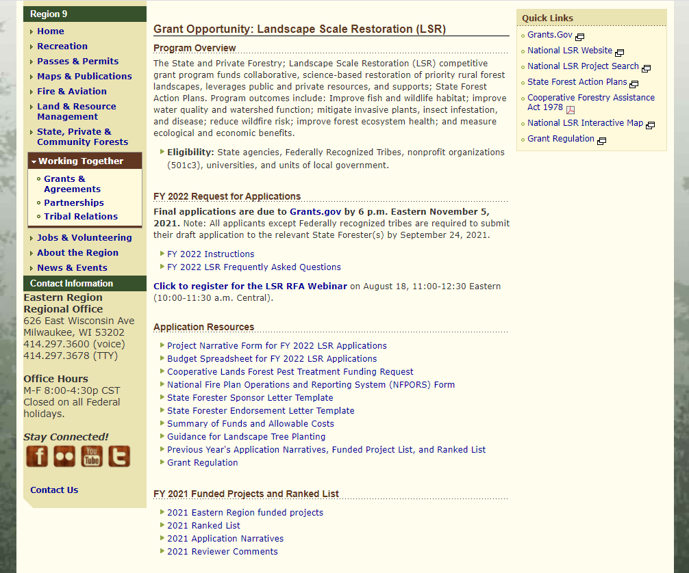
Regional LSR Website

Slide 43
Forest Service Eastern Region LSR Contacts
Eastern Region S&PF Contact for LSR: Sherri Wormstead, 603-244-0799, sherri.j.wormstead@usda.gov
New England and New York: Constance Carpenter, Durham, NH Field Office Rep., 603-868-7694, constance.carpenter@usda.gov
Mid-Atlantic States (DC, DE, MD, NJ, OH, PA, WV): Joe Koloski, Morgantown, WV Field Office Rep., 304-285-1540, joseph.koloski@usda.gov
Midwest States (IA, IL, IN, MI, MN, MO, WI): Until Aug. 28: Carleen Yocum, St. Paul, MN Field Office Rep., 651-649-5276, carleen.yocum@usda.gov. After Aug. 28: Sunny Lucas, Acting Field. Rep., 651-649-5180, sunny.l.lucas@usda.gov
For Tribes: Field Reps. or Stephen Handler, Acting Tribal Relations Program Lead, 319-270-9664, stephen.handler@usda.gov
Pg. 11
Notes:
Note: These contacts are listed on page 11 of the guidance and instructions document.

