Slide 1


Electronic Warfare Technology
Industry Day
Dr. Daniel S. Green
Distribution A. Approved for public release 43-4610-18, distribution is unlimited.
ACCELERATING TO THE NAVY & MARINE CORPS AFTER NEXT

Slide 2

ONR Discovery & Invention
ONR Special Notice# N00014-19-R-S002
Posted: 19 October 2018
Agency Name: Office of Naval Research
Research Opportunity Title: Electronic Warfare Technology
Program Name: Electronic Warfare Discovery & Invention (D&I)
Response Dates:
  White Papers: 12 December 2018
  Full Proposals: 28 February 2019

Slide 3
Agenda
ONR and Electronic Warfare Team Introduction
2018 EW Discovery and Invention Investment
  2018 Scene Setting: Overcoming SWaP
  Focus: Technical Area Descriptions
    Alternate Computing Technologies
    Distributing RF Power
    Compact EO/IR Solutions
    Innovative Component Technologies (Game changers)
  Mechanics
    Long Range BAA
    Timeline
Break
Contracting Processes (Mr. Stephen Hughes)
    Contract questions
Questions

Slide 4



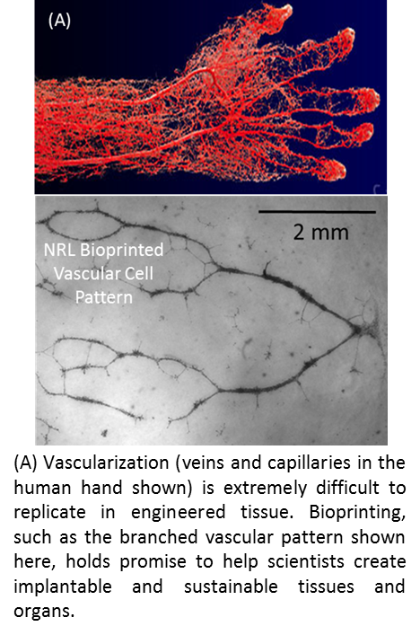
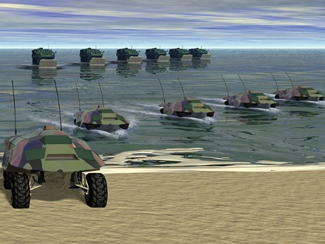


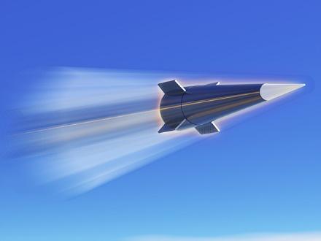
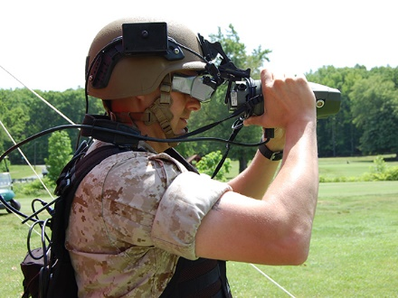
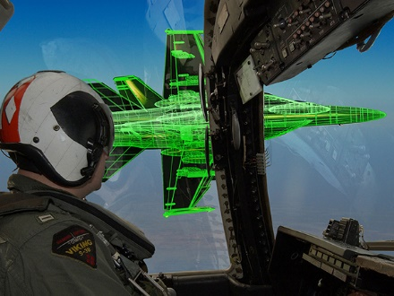
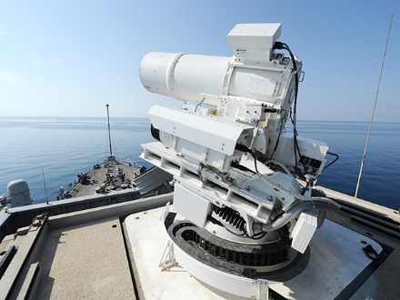
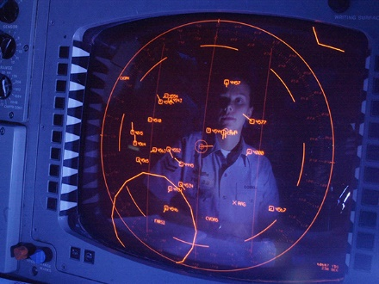
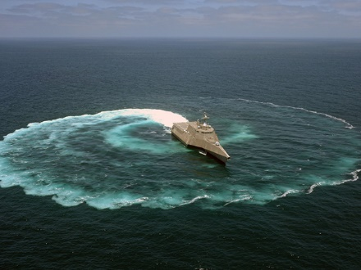
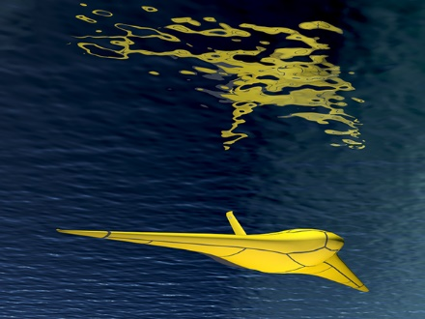
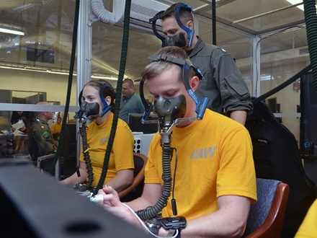
The Naval Research Enterprise
ONR HQ
NRL
ONR Global
4,000+ People
23 Locations
$2.1B / year
>1,000 Partners
Notes:
1. 6 SEP 2017 VIIRS Satellite capture of 3 Atlantic hurricanes (Undersea Battlespace and Maritime Domain Access/Code 32)
2. Unmanned Combat Amphibious Swarming System (Amphibious Expeditionary Maneuver/Code 30)
3. Hyper Velocity Projectile (Aviation, Force Projection and Integrated Defense/Code 35)
4. Augmented Reality Visor (Amphibious Expeditionary Maneuver/Code 30)
5. CIC Display (Information, Cyber and Spectrum Superiority/Code 31)
6. ZRay Glider (Undersea Battlespace and Maritime Domain Access/Code 32)
7. Advanced Naval Power Systems (Mission Capable, Persistent and Survivable Sea Platforms/Code 33)
8. Research Protections Division (Warfighter Supremacy/Code 34)
9. Solid State Laser (Aviation, Force Projection and Integrated Defense/Code 35)
10. Virtual and Constructive Representations on Live Avionics Displays (Warfighter Supremacy/Code 34)

Slide 5
ONR 312 Electronic Warfare
Technology Team
D&I Portfolio Areas
Dr. Daniel S. Green
EW Program Manager
ES System
Apertures
WB RF Receivers
RF Antennas
Dr. Amy Bell
EW Program Officer
Dr. Kevin Leonard
EW Program Officer
EO/IR Sensing
EO/IR Beam Steering
ES Components
Aperture Isolation
Dr. Trevor Snow
EW Program Officer
Mr. Charles (CJ) Bakker
EW Program Officer
EA System
Processing
RF/mmW Tx
ES Processing
Mr. Shane Stein
Envisioneering
CAPT (ret) Steve Debus
Envisioneering
EO/IR Tx
ES Techniques
EA Components
EA Processing
Dr. Andrew Pipino
Envisioneering
EA Techniques
FY19 ONR Special Notice
Cognitive EW Techniques & Tools
Business Team
EW/Cyber Shared Domain Tools
CAPT (ret) Bob Kusuda
Envisioneering
Ms. Adrien Fairweather
Envisioneering
EW D&I Thrust
Government
SETA Support
Sub-Thrust Area

Slide 6
2018 Electronic Warfare
Scene Setting

Slide 7
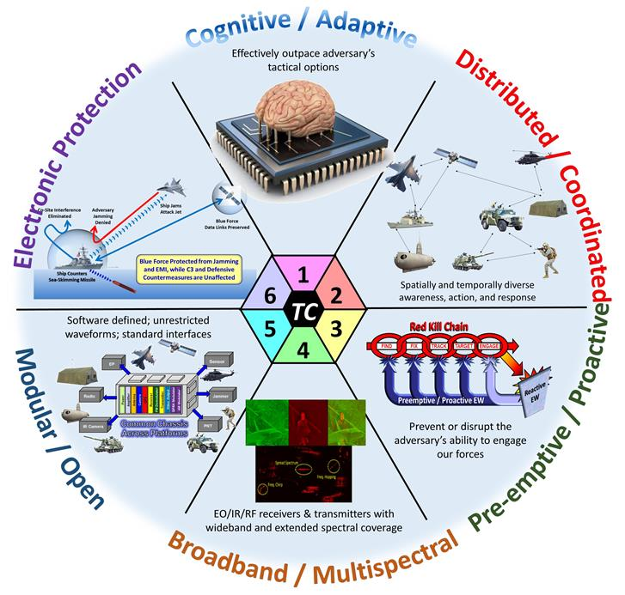
Joint EW Technology Challenges
& Opportunities for EW Collaboration
The EW COI
Science & Technology
Roadmap
“A Cross-cutting S&T investment strategy with resulting leap-ahead capabilities involving the use of Electro-Magnetic (EM) and directed energy to control the EM Spectrum or to attack the enemy while protecting our own EM systems against interference.”
ONR’s EW S&T investments synchronized across the Services
Notes:
Cleared from last year’s BAA Industry Day

Slide 8
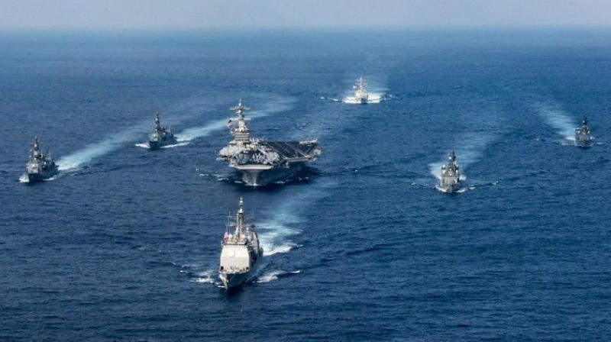

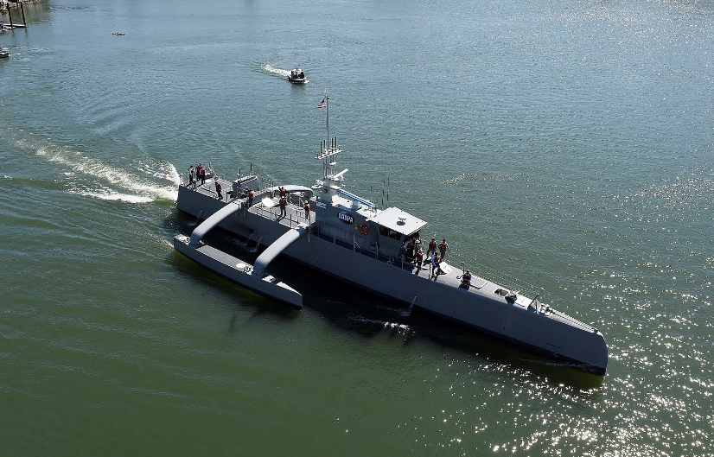
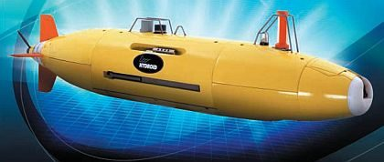
Distributed EMW Operations
UNCLASSIFIED
Extending Traditional EW Operations to Autonomous Off-board Platforms
Notes:
Picture 1 (Carrier Strike Group) - https://www.deccanchronicle.com/world/america/230617/us-ballistic-missile-intercept-test-fails.html
Picture 2 (Drone Swarm) - https://www.aertecsolutions.com/2016/02/08/drone-swarm/?lang=en
https://en.wikipedia.org/wiki/Sea_Hunter#/media/File:Sea_Hunter_gets_underway_on_the_Willamette_River_following_a_christening_ceremony_in_Portland,_Ore._(25702146834).jpg
https://www.militaryaerospace.com/articles/2013/05/Metron-LDUUV-autonomy.html

Slide 9
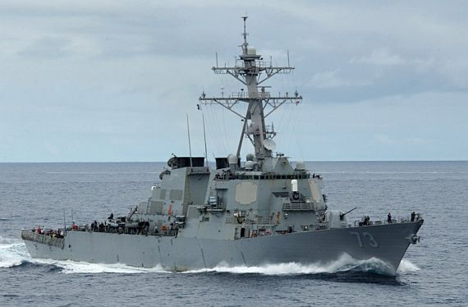
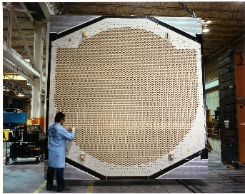
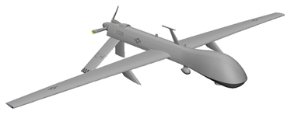
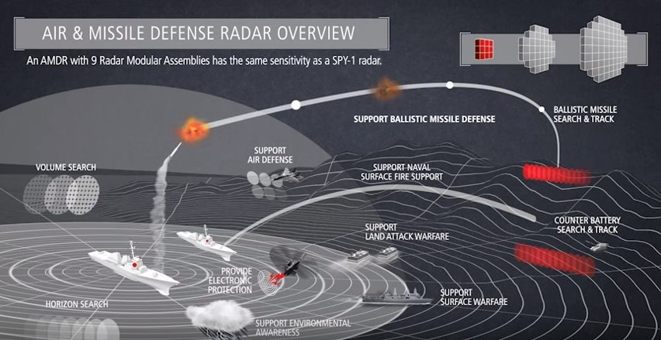
Advanced Off-board RF Capabilities
UNCLASSIFIED
Organic Off-board RF Sensing Capability in a much smaller form factor w/ lower SWaP-Cooling
Challenge: Maintain/improve RF capabilities in compromised platform
Notes:
Picture 1 (SPY-1 array) – http://radar-review.blogspot.com/2012/07/spy-radar-arrays-arrive-in-adelaide.html
Picture 2 (DDG 51 Flight III) – https://www.militaryaerospace.com/articles/2016/08/destroyer-shipboard-radar.html
Picture 3 (AMDR Overview ) – https://www.youtube.com/watch?v=s7fccxSjF0Q
Picture 4 (Predator UAV CAD model) – https://www.3dcadbrowser.com/download.aspx?3dmodel=52082

Slide 10


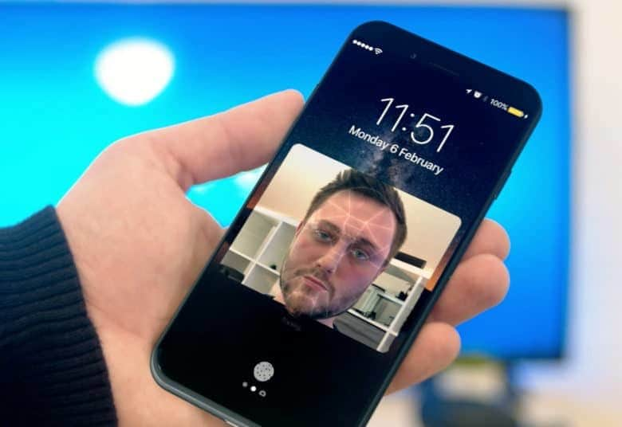

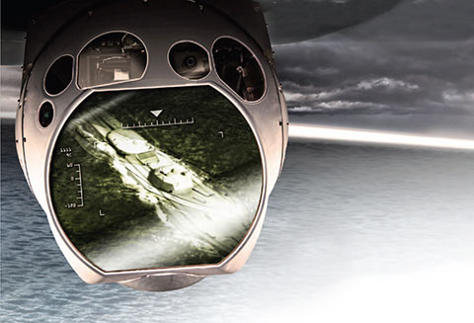
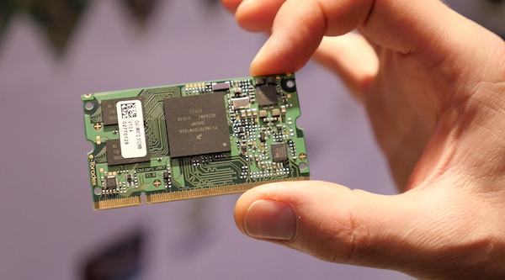
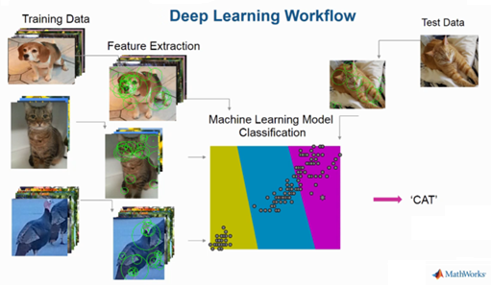
Distributed EMW Capabilities
UNCLASSIFIED
Modern “AI” applications require access to server farms
Distributed sensors may only have the processing of a Single Board Computer
Challenge: Access and interpret the spectrum aboard small, distributed platforms
Notes:
Picture 1 (Siri) – https://thenextweb.com/apple/2017/10/04/hey-siri-have-a-happy-birthday-and-remind-me-to-take-out-the-trash-tonight/
Picture 2 (Amazon Echo) – https://finance.yahoo.com/news/no-idea-amazon-echo-back-under-100-one-122027753.html
Picture 3 (Apple iPhone w/ Facial Recognition) – https://www.cultofmac.com/487120/apple-supplier-will-ship-3d-facial-recognition-sensors-time-iphone-8/
Picture 4 (Server Farm) – https://www.cloudyn.com/blog/10-facts-didnt-know-server-farms/
Picture 5 (EO/IR Ball) – https://www.raytheon.com/capabilities/products/mts
Picture 6 (Deep Learning Workflow) – https://www.mathworks.com
Picture 7 (Single Board Computer) - https://community.arm.com/iot/embedded/b/embedded-blog/posts/share-your-single-board-computer-stories

Slide 11
Electronic Warfare Technology
Special Notice Technology Focus

Slide 12
2018 EWT Focus
TA 1: Alternative Computational Approaches Applied to EW
TA 2: Compact, Efficient, Beam-Agile Transmitters
TA 3: Compact, Efficient, Electro-Optical/Infrared Transmitters
TA 4: Component Technologies for Innovative Distributed EW

Slide 13
TA 1: Alternative Computational Approaches Applied to EW
TA1 Objective: Major advancements in RF devices for:
Exploit emerging novel chipsets and architectures for EW big data / signal processing challenges
  Dramatically reduce SWAP for today’s performance
  Solve previously computationally prohibitive problem at reasonable SWAP
STAP in SAR
Ref: Open Geospatial Consortium,
OGC 12-077r1 , 2012
Ref: K.Y. Li, IEEE Radar, 2012

Slide 14
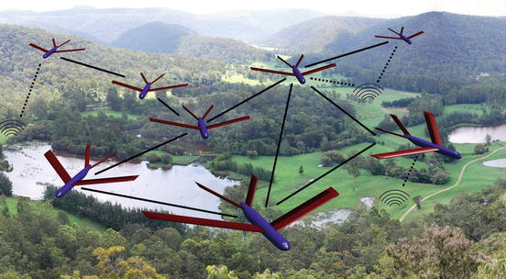
ML & Big Data - at the edge
Ref: A. Biswas, ISSCC, 2018
Ref: Handbook of UAV, Springer, 2014
AI revolution & ML
ML – Edge Computing
Face Recognition
Speech Recognition
Image Classification
Object Detection
Faster local decisions
Less communication
More secure
Requirements:
  Low power consumption
  Real time processing

Slide 15
ML Implications
Deep Learning for machine vision
  Milestone: AlexNet won ILSVRC-2012 challenge (Ref. A. Krizhevksy, NIPS 2012)
    Best classifier of 1.3 million images into 1000 classes (error rate 15.3%, next best rate 26.2%)
Deep CNN drives the use of multiply-and-accumulate (MAC) as basic computation unit in neural networks
Each MAC requires:
3 memory reads
1 memory write
Ref: V. Sze, arXiv, 2017
In worst case, every memory access goes through DRAM, so for AlexNet :
724M MACS 3000M DRAM accesses
Machine Learning Algorithms push computational resources in ways that exacerbate memory bottleneck in conventional compute architectures
Notes:
“Deep” means the neural network has anywhere from 5 to >1000 layers
“Convolutional” means that, within a layer of the neural network, the layer’s input feature map is convolved with filters to derive the layer’s output feature map

Slide 16
Alternative Computing Example
Custom ASIC Solution
Proactive memory approach: SRAM embedded compute, e.g. near-memory processing
Conv-SRAM Architecture for classification algorithm
Embedding memory in or near computing enables:
  Less data transfer more energy efficient
  More parallel operation higher throughput
60X improvement!
Ref: A. Biswas, ISSCC, 2018

Slide 17
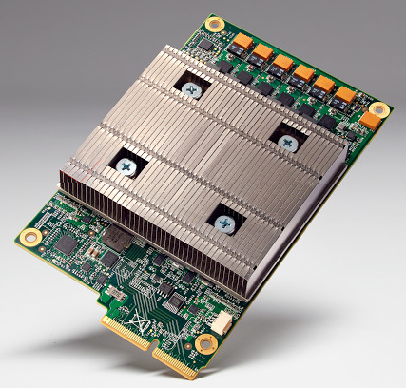
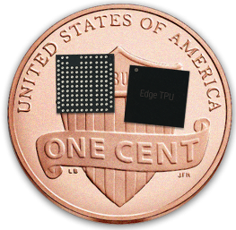
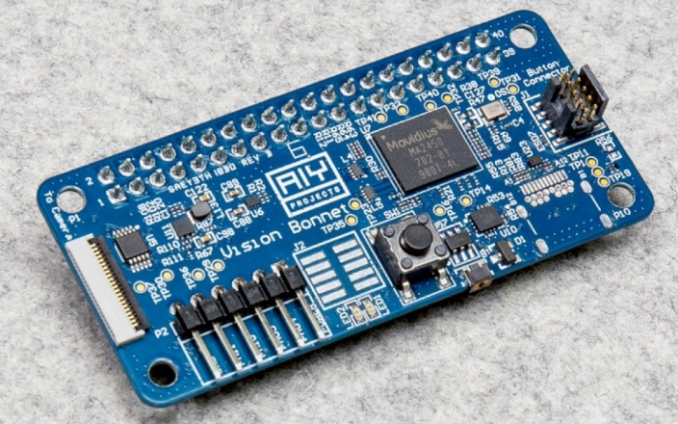
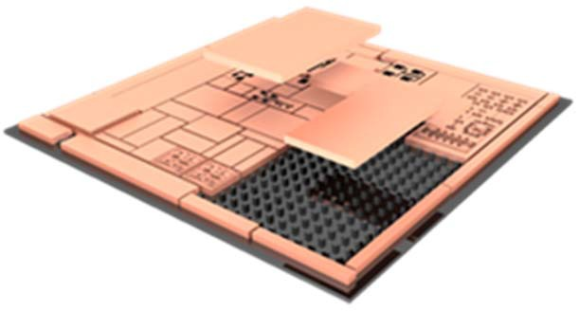
Technology Leverage
Google Edge TPU
Broad investment in processing chips across industry and government
Intel AIY
Ref: J. Vincent, The Verge, 2018
DARPA: CHIPS Program
www.darpa.mil
DARPA: Electronics Resurgence Initiative
Ref: Intel Movidius & Google AIY, ai.intel.com, 2018
EWT Investment seeks to leverage these emerging technical solutions for EW applications
Ref: FRANC Proposers Day, DARPA, 2017

Slide 18
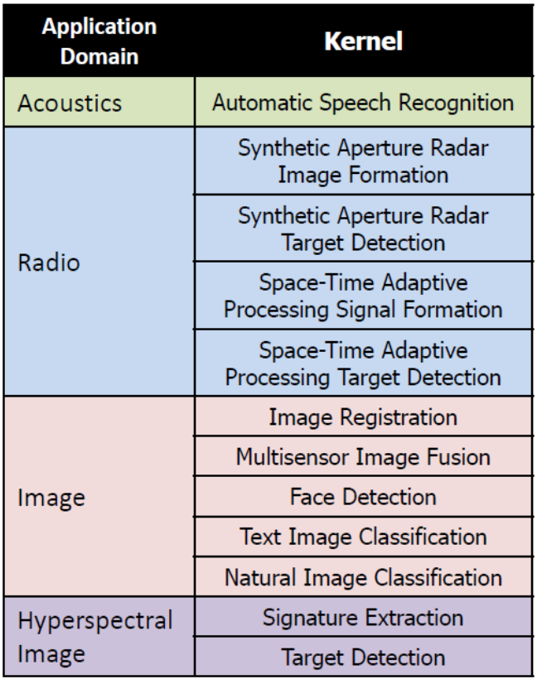
Benchmarks: PNNL’s PERFECT/SEAK
Pacific Northwest National Laboratory (PNNL) defined benchmark suite represent computing constrained embedded applications
http://hpc.pnnl.gov/PERFECT/
SEAK: suite of embedded applications and kernels intended to define computing problems of interest to the DoD
http://hpc.pnnl.gov/SEAK/files/SEAK-Specification.pdf
Ref: FRANC Proposers Day, DARPA, 2017

Slide 19
TA1: Key Solution Features
Focus on signal processing engine in context of EW application
Solution set beyond solely FPGA, GPU or CPU
Include discussion of how to test for success

Slide 20
TA2: Compact, Efficient, Beam Agile Transmitters
TA2 Objective: Major advance in RF devices for distributed sources
Organic Off-board RF Sensing Capability in a much smaller form factor w/ lower SWaP-Cooling
What are needed component technologies to drive this vision?

Slide 21
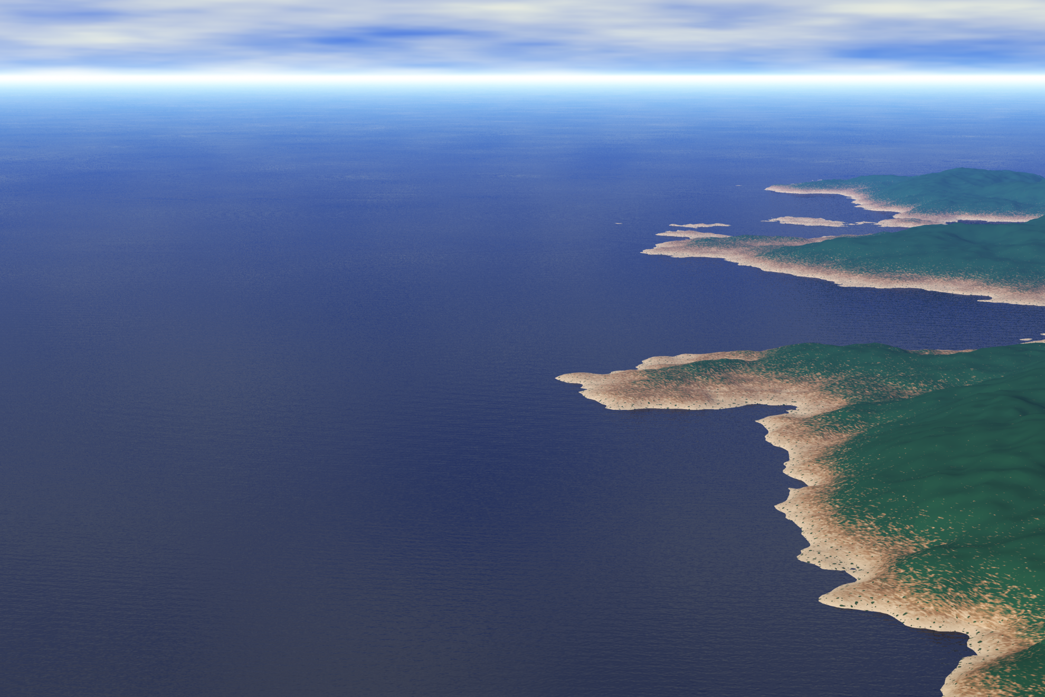

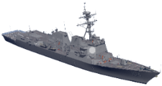
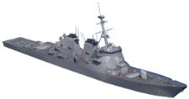
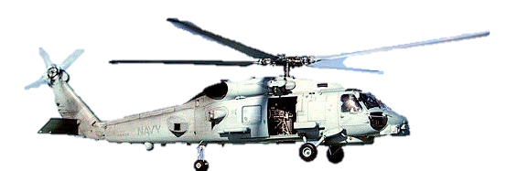

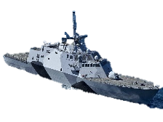

Distributing RF Power
Monolithic RF Power Sources
Few, large platforms
Easier SWaP constraints
Limited delivery of RF power (horizon limits, etc.)
Distributed RF Power Sources
Numerous, smaller platforms
Greater flexibility in allocating RF power to geographic locations
Requires lightweight, efficient solutions

Slide 22



TA 2: RF Power Sub-Areas
TA2 Objectives: Major advancements in RF devices for:
Area 2A - Improved peak power for larger systems
Area 2B – Improved average power for compact systems
Volume: ~ 8 ft³
Aperture: ~ 4 ft²
Volume: ~ 1 ft³
Aperture: ~ 2 ft²
Interested in:
Scalable demonstrators
Component or other subsystem technologies

Slide 23
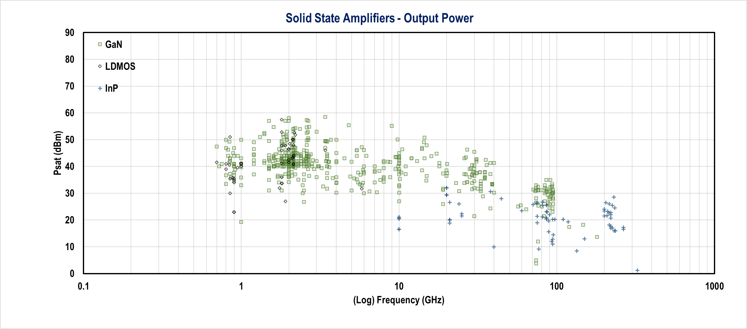
TA 2: Distributing RF Power
Single Devices
Phased Array Element Power
Hua Wang, Fei Wang, Huy Thong Nguyen, Sensen Li, Tzu-Yuan Huang, Amr S. Ahmed, Michael Edward Duffy Smith, Naga Sasikanth Mannem, and Jeongseok Lee, "Power Amplifiers Performance Survey 2000-Present," [Online]. Available: https://gems.ece.gatech.edu/PA_survey.html

Slide 24

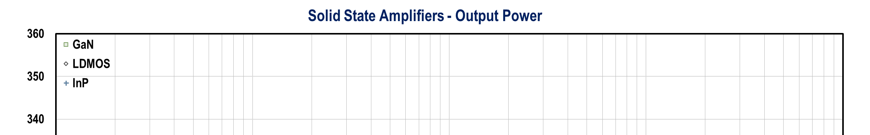

TA 2: Distributing RF Power
470 dBm
“These go to 11”
Gamma Ray Bursts
1.3e24 W/mm
Black Hole Jets
Growth Mindset
Single Devices
Phased Array Element Power
Hua Wang, Fei Wang, Huy Thong Nguyen, Sensen Li, Tzu-Yuan Huang, Amr S. Ahmed, Michael Edward Duffy Smith, Naga Sasikanth Mannem, and Jeongseok Lee, "Power Amplifiers Performance Survey 2000-Present," [Online]. Available: https://gems.ece.gatech.edu/PA_survey.html
https://en.wikipedia.org/wiki/Gamma-ray_burst#/media/File:GRB080319B_illustration_NASA.jpg
https://science.nasa.gov/astrophysics/focus-areas/black-holes

Slide 25
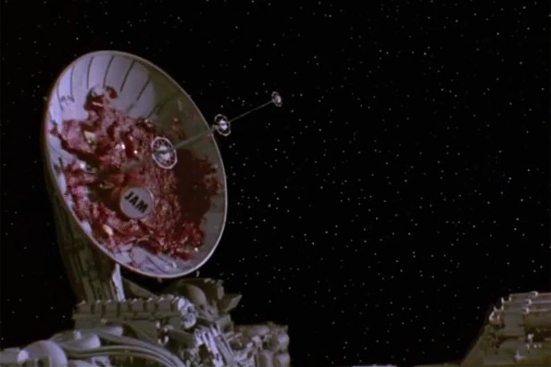

TA 2: RF Component Space
Existing technology and Prior Efforts
Just right
Too Costly
Transistors
MMIC
T/R Modules
Small Aperture Building Block
Full-Scale Arrays
DARPA DREAM
High W/mm Devices
Temp. Tolerant / Improved Thermal Management
DARPA ICECOOL
Compact, Efficient Vacuum Devices
Magnetrons / TWT
High Efficiency COTS devices
High Efficiency, Adaptive, Tunable Architectures
High-power switches / tunable filters and matching networks
Luneberg lens, artificial dielectrics, reflect arrays
Compact High Power Electronic Beam-steering
All submissions should describe their technology relates to state-of-the-art and how the technology could scale to Area 2A/2B full-sized systems.
https://decider.com/2017/06/24/my-first-time-spaceballs-anniversary/

Slide 26
TA 2: Component Technology
Proposed efforts should focus on component technology
Technology should be extrapolated to full system performance for TA2.A or TA2.B
Avoid basic research on materials or transistors
Technology can address TA2.A or TA2.B or both

Slide 27
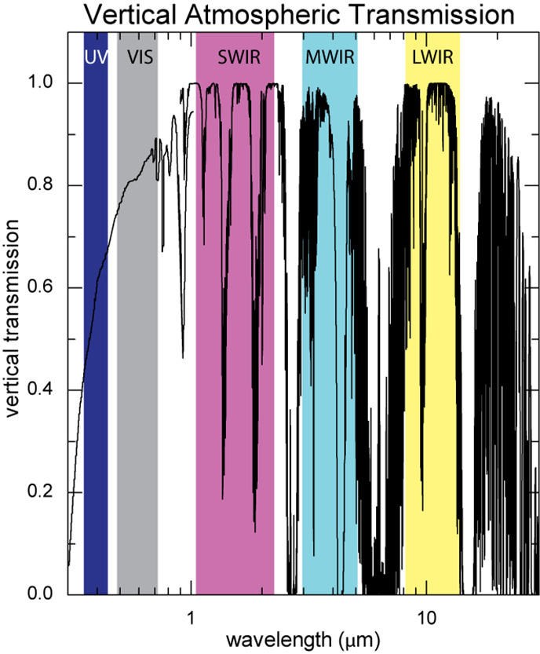
TA 3: Compact EO/IR Transmitters
TA3 Objective: Better sources for optical power from UV to LWIR
EMS usage has proliferated beyond the traditional RF spectrum
Need to be able to utilize all the optically “transparent” atmospheric windows effectively and efficiently
Need to be able to have this advantage even on SWAP constrained platforms
TA3 Looks to Develop Compact, Efficient, EO/IR Sources and Systems across the Electromagnetic Spectrum

Slide 28
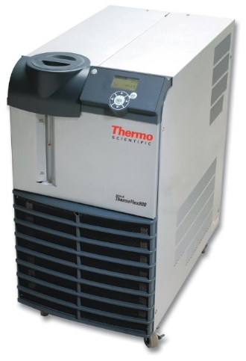
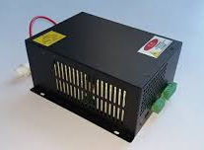
TA 3.A: Multi-Spectral Laser Systems
Novel concepts for efficient, multi-band semiconductor laser system with reduced total system size benchmarked to current state-of-the-art.
Laser should include at least two bands from (Visible, Mid Wave Infrared (MWIR) and Long Wave Infrared (LWIR)) -- MWIR preferred
Single, high brightness output (M^2 <3)
Each band should have at least 10W continuous wave (CW) output power.
Minimal to no free-space optics preferred (to reduce the effects of shock, vibration and extreme temperature variations)
Total system size (including cooling) should be less than 200 cubic inches.
Discuss engineering trades.
Lab Chiller
(from https://www.thermofisher.com/)
Power Supply
Chiller and Power Supply can be >70% of the system size

Slide 29
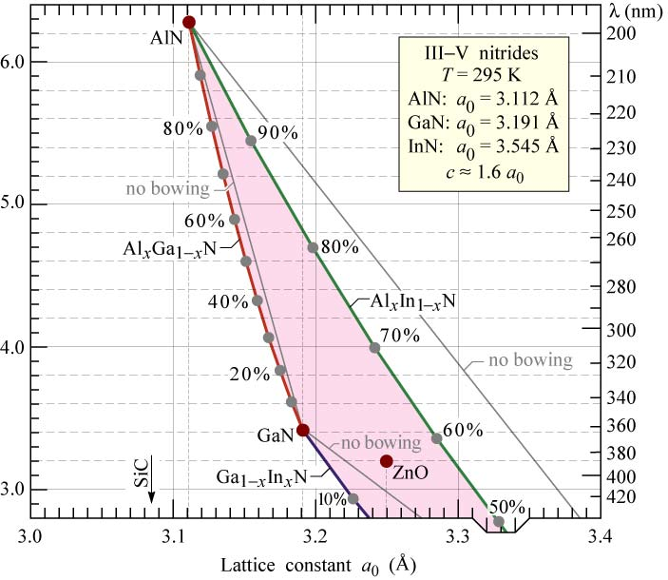
TA 3.B: High Power UVA Lasers
First blue and violet InGaN/GaN diode lasers demonstrated in 1990s (Nakamura et. al. from Nichia)
OSRAM recently demonstrated a 83W CW 450nm laser bar at SPIE Photonics West (König, et. al.)
GaN limited to 362nm on the short end of the wavelength spectrum due to bandgap energy
Some progress seen with AlGaN and AlN materials for pulsed operation
Band Gap Energy (eV)
Schubert, Light-Emitting Diodes (Cambridge Univ. Press)
Need for higher power, more efficient, high quality UVA (315-400nm) emitters and laser bars to enable beam combining in a compact package

Slide 30
TA 3.B: Technical Details
Development of more efficient, higher power emitters and laser systems in the Ultraviolet A (UVA) (315-400 nm) desired
  Current commercial UV diodes are less than 250mW in the UVA band
Spectral beam combining of individual emitters and/or laser bars has shown promise.
Ideal UVA system would be able to:
  Accommodate 3 or more lines anywhere within the UVA band,
  Provide greater than 10W power output
  Permit 2 to 3 orders of magnitude amplitude control,
  Quickly switch between waveforms (DC thru 10kHz
  Couple to a 100-micron core fiber output.
  CW-desired, but pulsed sources with repetition frequencies of greater than 100 kHz and pulse widths greater than 10ns would be considered
  Volume of the full system should not exceed 75 cubic inches.
Both higher power emitter technologies and/or novel system designs to meet the above metrics are of interest under Technical Area 3.B

Slide 31
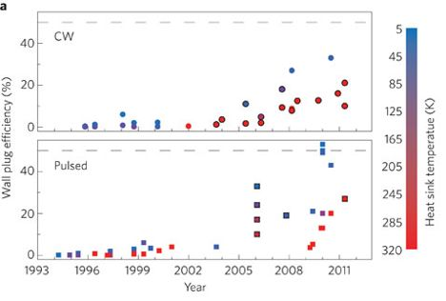
TA 3.C: Low SWaP MWIR/LWIR Enablers
QCL WPE vs. Wavelength
Published WPE Results vs. Time
(Model)
(Experimental)
Botez, et. al., High-efficiency, high-power mid-infrared quantum cascade lasers, Optical Materials Express 8(5), 1378 (2018)
Yao, et. al., Mid-infrared quantum cascade lasers, Nature Photonics 6, 432 (2012)
Modelling Suggests 40% Wall Plug Efficiency is Possible
Trend over time demonstrates device efficiency is improving
Proposed efforts should specify the level of expected increase in Wall Plug Efficiency (WPE) and/or device power over state-of-the-art systems
Desire Efficient, High Power MWIR/LWIR Emitters/Bars to Support Low SWaP Systems

Slide 32
TA 3: EO/IR Solutions
Proposed efforts should target one sub-area
Document technology metrics and comparison to state of the art
Focus on optical source development with plan for future system integration

Slide 33
TA 4: Innovative Component Technologies
TA4 Objective: Breakthrough tech with quantitative benefits
*
Open to the possibility of breakthrough technology enabling to EW missions
Focus on radical technology opportunity by requiring quantitative FOM increase of 1000X
FOM is proposer defined, for example:
Notional EW widget: Offers potential to improve simultaneously the instantaneous bandwidth by 10X, while it reduces the system power and size to 10% of original
Define FOM = IBW x (1/Power) x (1/Size) = 10 x 10 x 10 = 1000 ✓

Slide 34
Electronic Warfare Technology
Special Notice Research Call and Programmatic Considerations

Slide 35
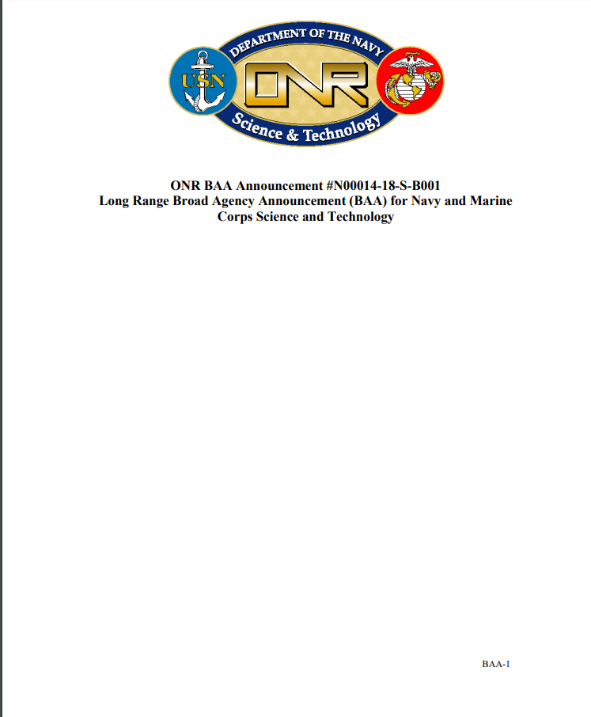
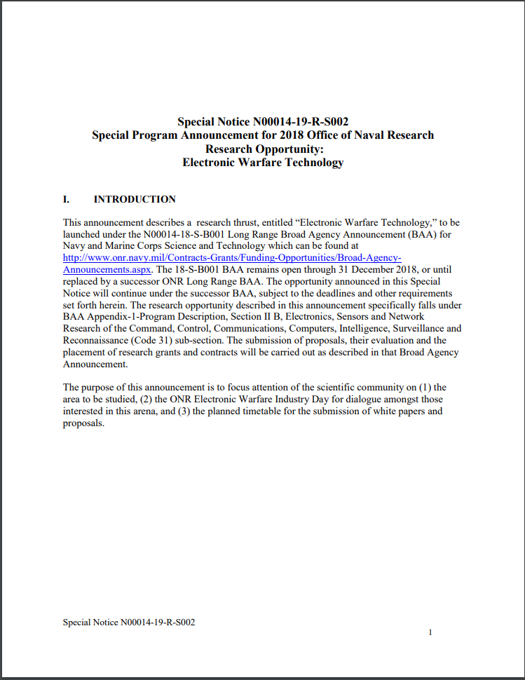
EW Opportunity
ONR Long Range BAA
N00014-18-S-B001
Special Notice
N00014-19-R-S002
Provides formal proposal methodology
Documents technical evaluation criteria
Supplies technology investment focus
Details timeline for action

Slide 36
ONR Discovery & Invention
Total funding under is anticipated to be ~$8-10M per year, or $25-30M over three years.
The period of performance for projects may be from 12 to 36 months.
The estimated start date of selected projects is subject to date of final award and availability of fiscal year (FY) funds with notional timeline:
Special Notice
Oct 19
Industry Day
Nov 13
Contract Award
July*
Gov Feedback
Jan 10*
Workshop
Jan 23-24
Feedback
Jan 29*
White Papers Due
Dec 12
Full Proposal
Feb 28
* Estimated Date

Slide 37
ONR Discovery & Invention: Eligibility
All responsible sources from academia and industry may submit proposals under the ONR Long Range BAA.
University Affiliated Research Centers (UARC) are eligible to submit proposals under this BAA unless precluded from doing so by their Department of Defense UARC contracts.
There will be no set asides for Historically Black Colleges and Universities (HBCUs) and Minority Institutions (MIs).
Navy laboratories and warfare centers, as well as other Department of Defense and civilian agency laboratories, and Federally Funded Research & Development Centers (FFRDCs), including Department of Energy National Laboratories, are not eligible to receive awards under the ONR Long Range BAA and should not directly submit either white papers or full proposals in response to this BAA.

Slide 38
ONR Discovery & Invention: Eligibility
ONR has distributed a parallel call to government labs and other parties that are barred from proposing to the BAA. There are no fixed percentages or set-asides for the two initiatives and ALL the White Papers/Oral Briefs/Proposals are evaluated together to determine which should be funded using evaluation criteria specified in the BAA. Responses from these organizations are being solicited separately, using the same guidance regarding research areas of interest, white paper format, deadlines, and evaluation criteria.
Bottom line: All civilian, industry, government, and military organizations are encouraged to submit white paper responses to the four ONR EW research areas as solicited.

Slide 39
ONR Discovery & Invention: Security
Some topics cover export controlled technologies. Research in these areas is limited to “U.S. persons” as defined in the International Traffic in Arms Regulations (ITAR) - 22 CFR § 1201.1 et seq.
White papers and proposals are expected to be unclassified. However, classified white papers and proposals are permitted.
In order to facilitate intra-program collaboration and technology transfer, the Government will attempt to enable awardees to work at the unclassified level to the maximum extent possible.
If awardees use unclassified data in their deliveries and demonstrations regarding a potentially classified project, they should use methods and conventions consistent with those used in classified environments.
It is the responsibility of the proposer to ensure that all applicable security classification guides are followed and materials are controlled at the appropriate level.

Slide 40
Evaluation Criteria (BAA)
Evaluations will be conducted using the following evaluation criteria:
Overall scientific and technical merits of the proposal and responsiveness to the topic (i.e., the degree of innovation, soundness of technical concept, Offeror's awareness of the state of the art and understanding of the scope of the problem, significance and originality of the technical approach and effort needed to address/solve the problem, and anticipated scientific impact within the field. The following areas will also be considered:
  Offeror’s capabilities, related experience, facilities, techniques or unique combinations of these which are integral factors for achieving the proposal objectives, and
  Qualifications, capabilities and experience of proposed Principal Investigator (PI), team leader & key personnel who are critical to achieving the proposal objectives.
Potential Naval relevance and contribution to the ONR and Department of Navy mission.
Availability of funds. (Not applicable to white papers.)
Criteria 1, 2, and 3 are equally important.

Slide 41
Proposal Structure
Seek proposals with defined milestones
Request initial 6 months milestone
Exact timeline can vary based on development plan and extent of work
Contract Award
Option 1
Tech
Demo
Option 2
6 mos
12 mos
18 mos
Milestone1
Milestone2
Notional Program Plan

Slide 42
ONR Discovery & Invention: Timing
White papers should be submitted no later than 4:00pm EST on 12 December 2018.
White papers received after that date will be considered as time and availability of funding permit.
Follow format instructions in Special Notice.

Slide 43
ONR Discovery & Invention:
Points of Contact
Technical
Dr. Daniel Green
Electronic Warfare Program Manager
Office of Naval Research (ONR 312)
875 North Randolph Street, Suite 1112
Arlington, VA 22203-1995
E-mail: daniel.s.green2@navy.mil
Business
Mr. Stephen Hughes
ONR Contracting Officer
875 North Randolph Street
Arlington, VA 22203-1995
E-mail: stephen.t.hughes@navy.mil

Slide 44
Questions?
Submit written questions…
Presentation slides and answers to questions submitted to this Special Notice will be posted to the following web pages no later than 21 November 2018:
Federal business opportunities (fedbizopps) webpage – https://www.Fbo.Gov/
Grants.Gov webpage – http://www.Grants.Gov/
ONR special notice webpage - http://www.Onr.Navy.Mil/contracts-grants/funding-opportunities/special-notices.Aspx

Slide 45
Doing Business with Office of Naval Research (ONR)
Stephen Hughes – Contracting Officer

Slide 46
Agenda
Broad Agency Announcement (BAA)
Instruments
Communications
Performance/Getting Paid

Slide 47
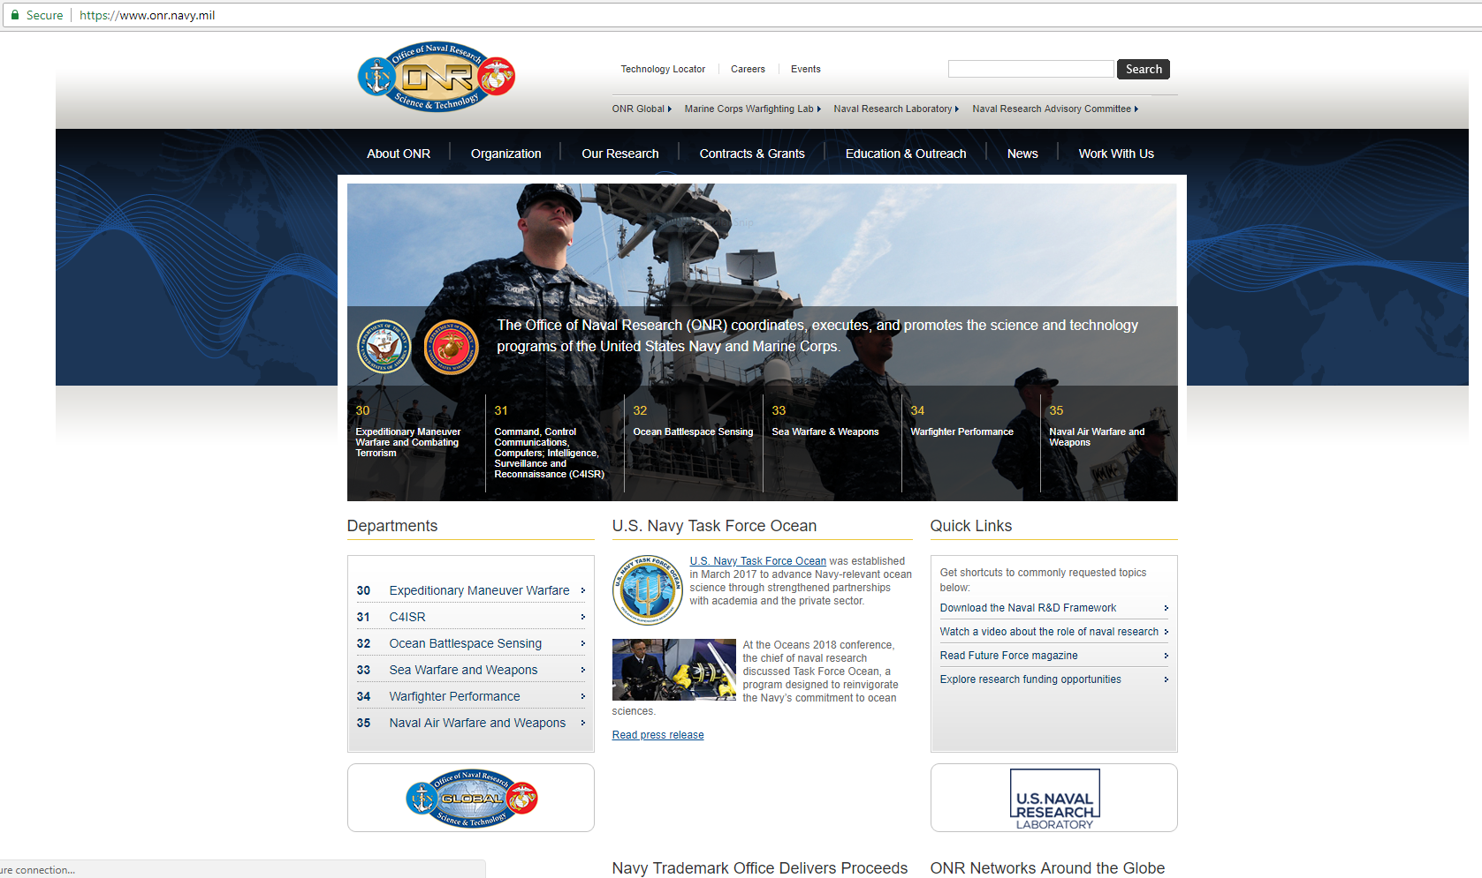
Broad Agency Announcement (BAA)

Slide 48

Broad Agency Announcement (BAA)

Slide 49
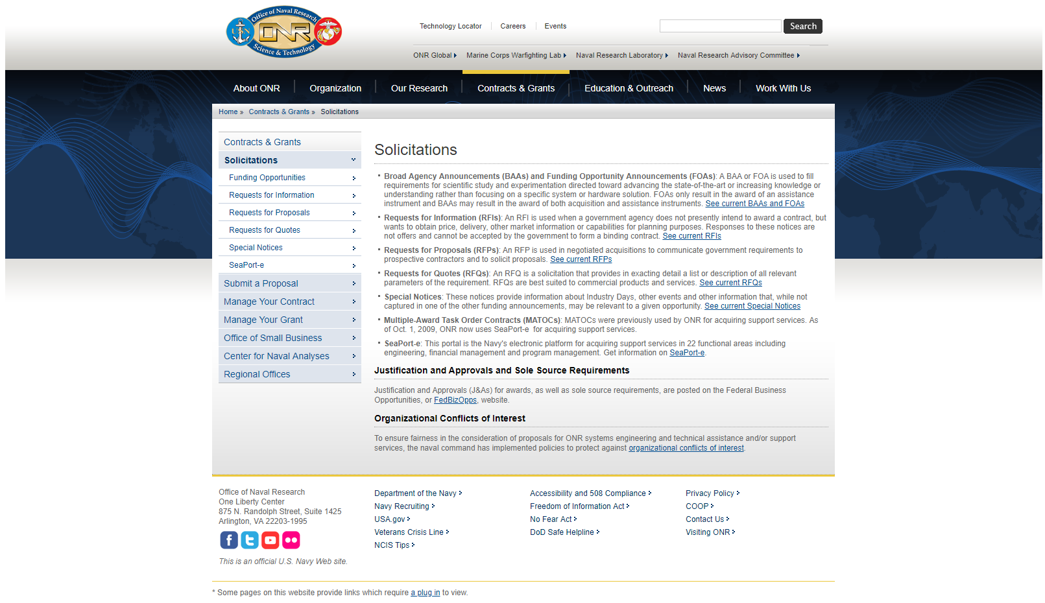
Broad Agency Announcement (BAA)

Slide 50
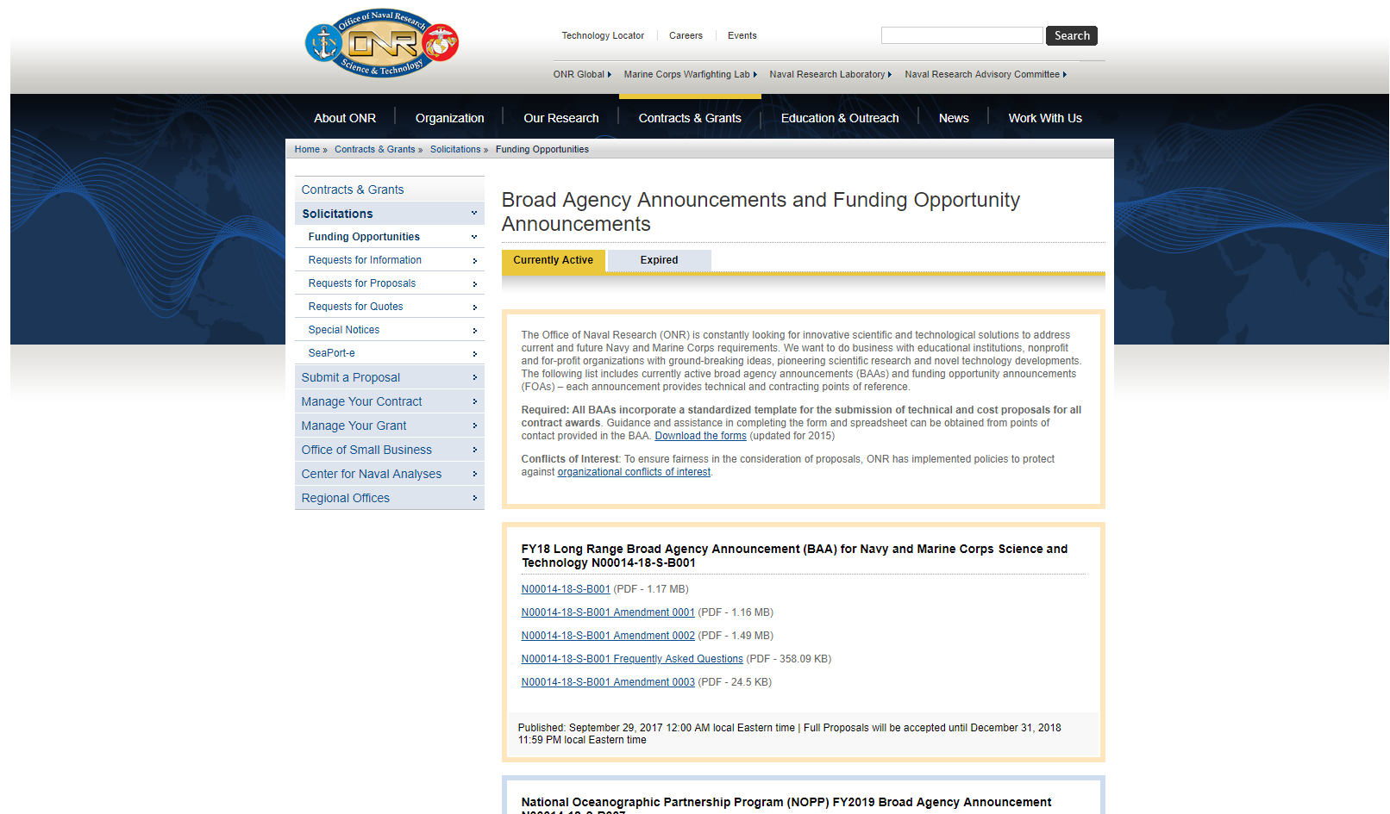
Broad Agency Announcement (BAA)

Slide 51
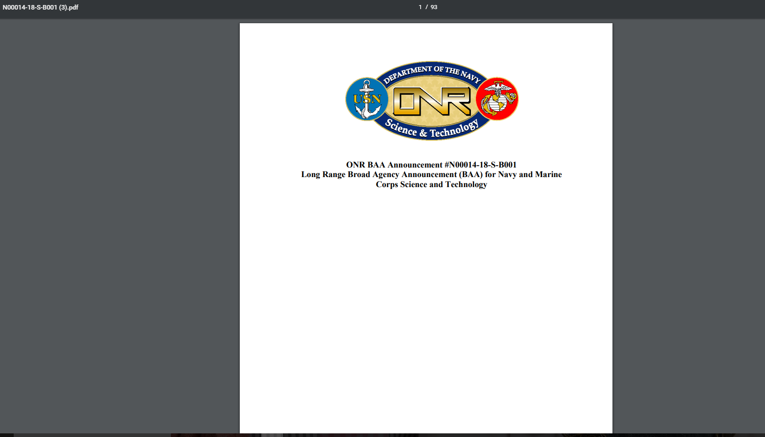
Broad Agency Announcement (BAA)

Slide 52
Instruments
Grants
2 CFR 200 & DoDGARS
Contracts
FAR Based 10/41 USC
Other Transaction Authorities (OTA)
10 USC 2371 …

Slide 53
Instruments
Grant: Principle purpose = stimulation of research
  No Profit/Fee
  Regulations are different
  Release of information is assumed

Slide 54
Instruments
Contract: Principle purpose = stimulation of research
  Profit/Fee
  FAR Clauses including Data Rights
  Release of information can be restricted

Slide 55
Instruments
Other Transaction Authorities (OTA):
  Regulations are less restrictive
  Generally non-traditional firms
  Data Rights are negotiable
  Payment schedule

Slide 56
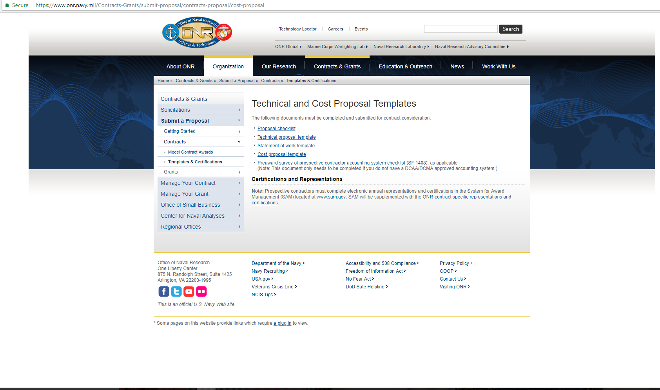
Instruments

Slide 57
Communications
Communications are not restricted at any point in our Broad Agency Announcement Process
    Business POC: Stephen Hughes
      Stephen.T.Hughes@navy.mil
      Office: 703.696.1575
    Small Business Liaison: Brenda Pickett
      Brenda.Pickett@navy.mil
      Office: 703.696.2607

Slide 58
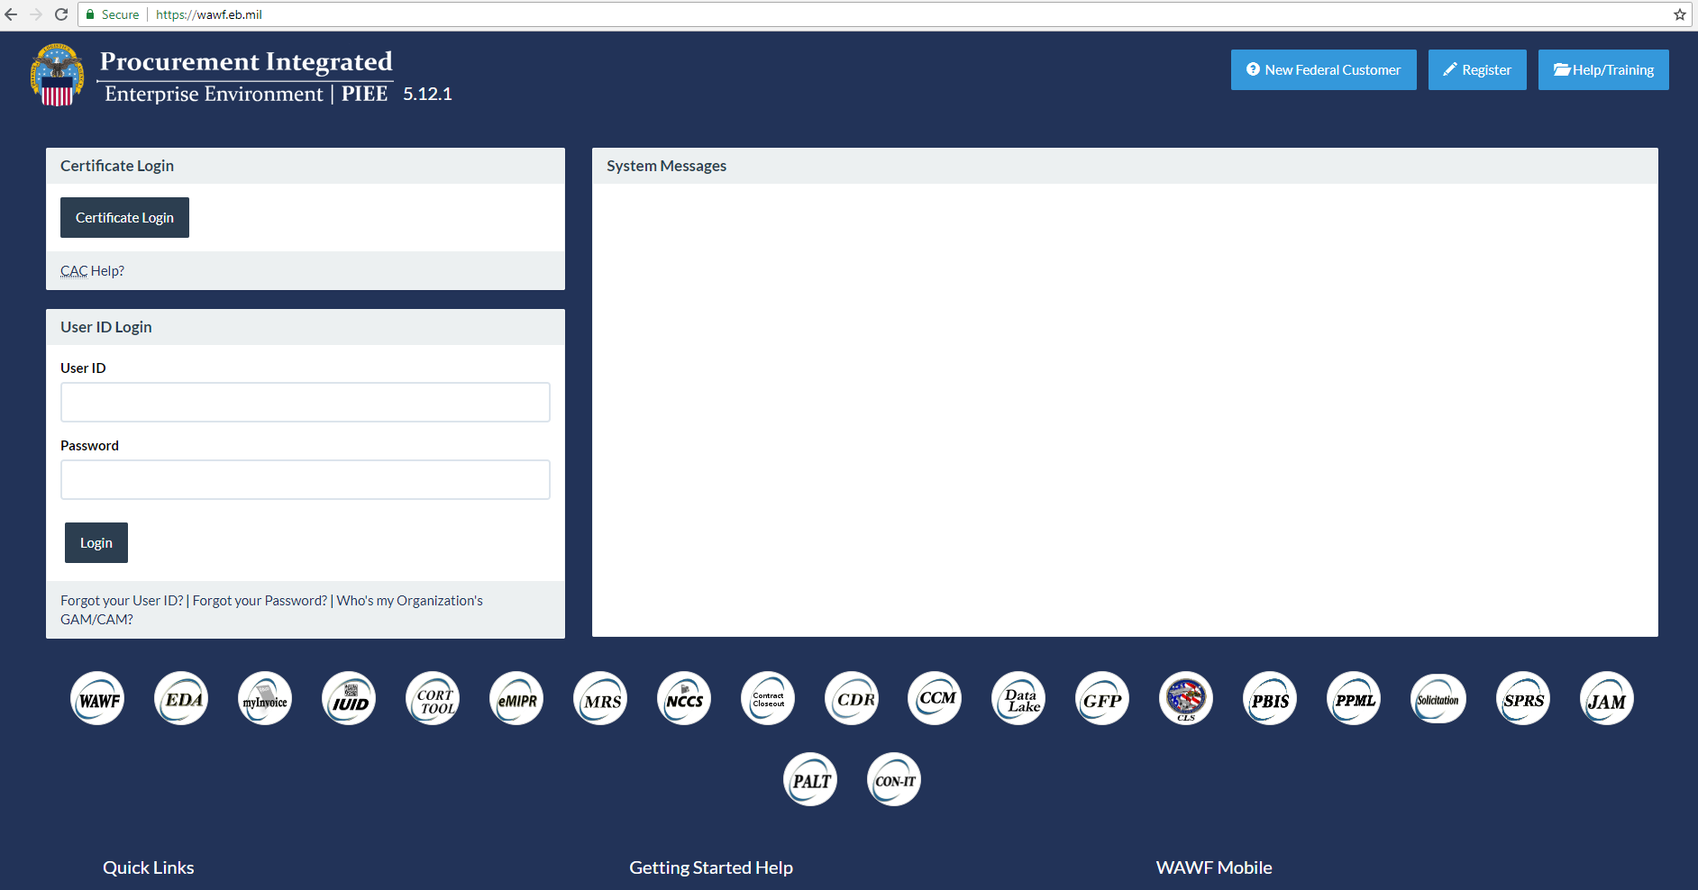
Performance/Getting Paid

Slide 59
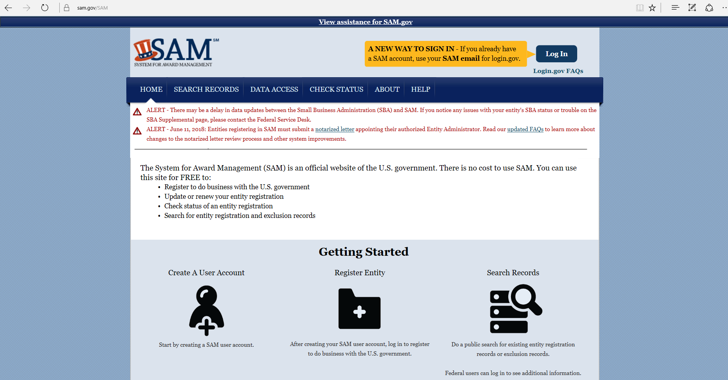
Performance/Getting Paid

Slide 60
Performance/Getting Paid
WWW.SAM.GOV
https://wawf.eb.mil/

Slide 61

Questions

