Slide 1
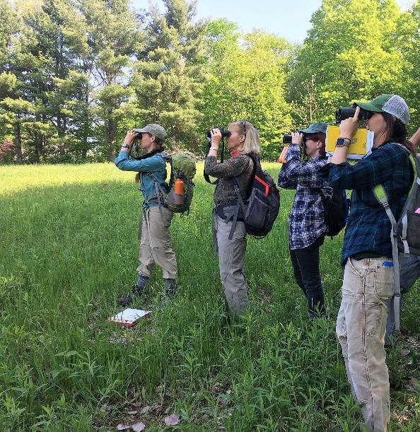
Landscape Scale Restoration
Competitive Grant Program for the Northeast and Midwest
Vermont Women in the Woods project, photo by Bob Zaino.
USDA is an equal opportunity employer and provider.

Slide 2
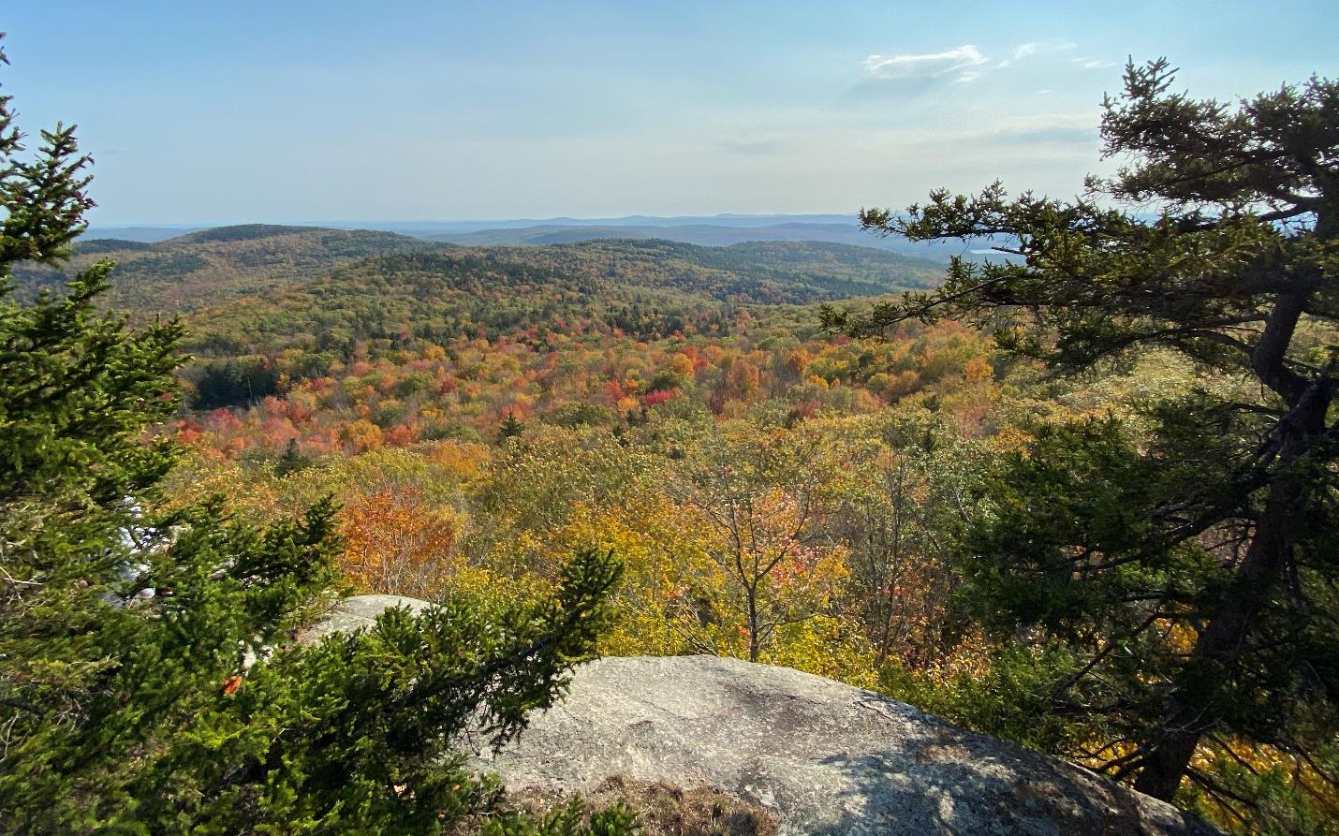
Presenting from N’dakinna, homeland of the Abenaki, Pennacook, and Wabanaki people, who I acknowledge and honor with gratitude.
Notes:
I’m presenting from N’dakinna, homeland of the Abenaki, Pennacook, and Wabanaki people. I acknowledge and honor with gratitude the land, waters, and alnobak who have stewarded N’dakinna throughout the generations.
USDA Forest Service photo by Sherri Wormstead.

Slide 3

Webinar Agenda
Program overview, eligibility, and key points
Scoring criteria
Application and process
Tips for a competitive application
Questions
USDA Forest Service photo
Notes:
Photo credit: Kenneth Dudzik, Northern Research Station (retired)

Slide 4
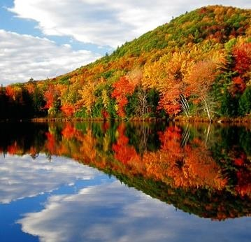
Landscape Scale Restoration (LSR)
Program Purpose:
To encourage collaborative,
science-based restoration
of priority rural forest landscapes.
USDA Forest Service photo
Competitive grant program authorized by Cooperative Forestry Assistance Act
Notes:
The 2018 Farm Bill amended the Cooperative Forestry Assistance Act, codifying the Landscape Scale Restoration Program to encourage collaborative, science-based restoration of priority forest landscapes.

Slide 5
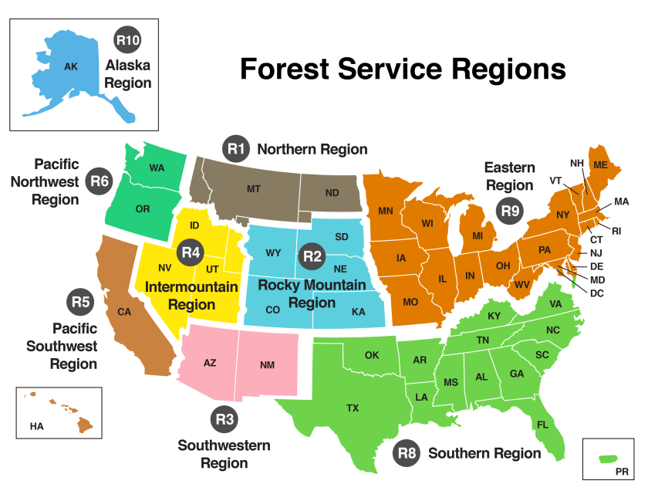
Four LSR Funding Opportunities
Northeast and Midwest
South
West
For federally recognized Tribes and Alaska Native Corporations
Refer to the national LSR website for the LSR directive.
Notes:
National RFP for Tribes: Is for federally recognized Tribes, Alaska Native Corporations, and Tribal organizations as defined in 25 U.S. Code 5304 (1) (requires a letter of support from the Tribe). Proposals for this RFP are submitted by email and due Dec. 16.

Slide 6
National LSR Objectives
(projects need to support one of these)
Reduce the risk of uncharacteristic wildfires.
Improve fish and wildlife habitats, including for threatened and endangered species.
Maintain or improve water quality and watershed function.
Mitigate invasive species, insect infestation, and disease.
Improve important forest ecosystems.
Measure ecological and economic benefits including air quality and soil quality and productivity.

Slide 7
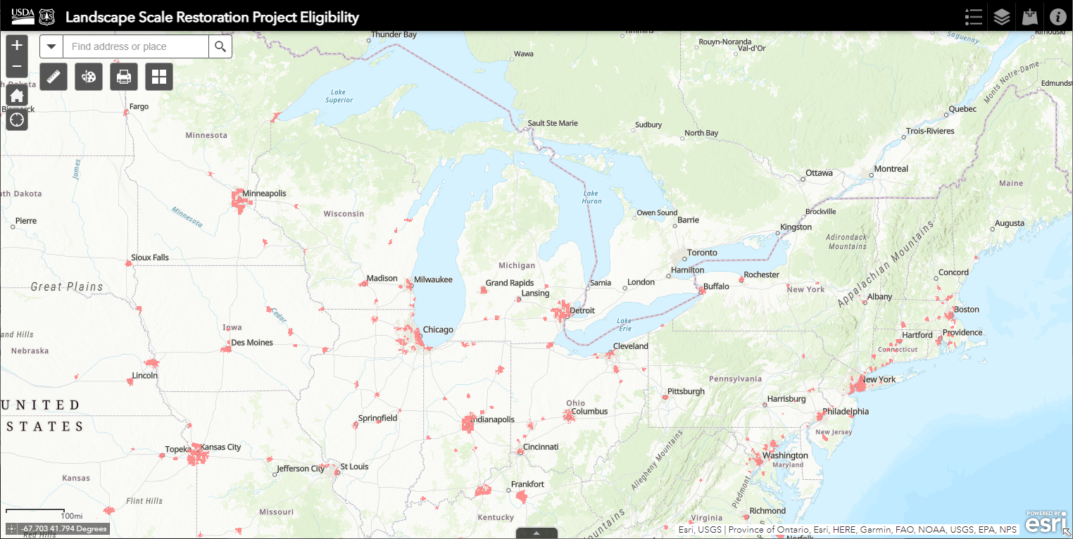
Outcomes on Non-Federal Rural Lands = population of 50,000 or less
Use this LSR Project Planning Tool (Project Eligibility Tab) to confirm if a city or town is rural (2020 Census).
Notes:
LSR Directive: “High impact projects that lead to measurable outcomes on the landscape, leverage public and private resources, and further priorities identified in each State Forest Action Plan or equivalent restoration strategy.”
Outcomes on rural nonindustrial private, Tribal (including Tribal trust land), State, and/or local government forest land.
On-the-Ground Outcomes on Rural Lands: For the purposes of this program, “rural” means any area other than an urbanized area such as a city or town that has a population of greater than 50,000 inhabitants according to the latest census.
Landscape Scale Restoration projects focus on rural land. Applicants can use this map to confirm that their proposed project is rural or outside the areas in red, which are the US Census Populated Places. These designated places (cities, towns and municipalities) have a population of more than 50,000 people as of 2020

Slide 8
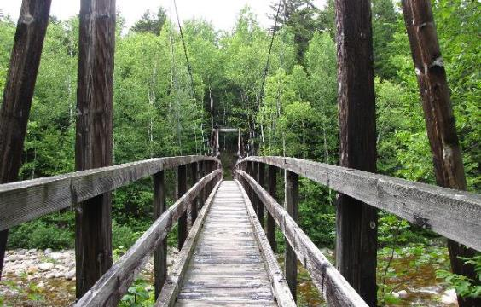
Eligible Applicants
State agencies
Nonprofit organizations
Universities
Local units of government
Federally recognized Tribes (and Alaska Native Corporations)
State Forester sponsor letter required
USDA Forest Service photo
Notes:
For profit organizations are not eligible to submit applications under this competition.
Photo Credit: Sherri Wormstead

Slide 9
Minimums and Maximums
Minimum application Fed. amount = $25,000
Max. total funding awarded to benefit any one State or Tribe = 15% of total available for Northeast and Midwest
Max. Fed. funding for multistate projects = $600,000
Each State Forester can sponsor 5 applications
  Note: Applications with 11 or more State Forester sponsors and applications submitted by Tribes do not count against the 5.
LSR grants are completed within 3 years.
The Federal Government’s obligation under this program is contingent upon the availability of funds.
Notes:
Minimum and Maximum Funding Levels:
The minimum Federal funding per project is $25,000.
The maximum amount of Federal funding awarded to any one State (State cap) or Tribe via this competitive process is 15% of the total available. Funds available to the Eastern Region are based on the final fiscal year appropriation from Congress for the LSR Program and the funding allocation to the Region from the Agency’s Washington Office.
The maximum Federal funding for a multistate or cross-regional project is $600,000.
Note: In FY24, 29 applications were submitted (Federal funding request of $7,472,201) and we funded 12 (with the Federal funding amount of $3,849,075) for Northeast & Midwest LSR program.

Slide 10
1 to 1 Matching Funds Required
Match is funding or in-kind contributions
from non-Federal sources.
Some eligible sources of match:
Funding from your (applicant) agency or org.
Funding from non-Federal partners
Volunteer time implementing the project*
Donation of equipment, supplies, meeting space
Services provided at a reduced cost
Tribal 638 BIA Contracting Funds
Refer to the “Matching Funds” document for more info.
* Consult the Independent Sector value of volunteer time for rates by State (ranges from $28.17 to $40.97).
Notes:
Required Matching Funds of 1 to 1: One-to-one matching funds must be derived entirely from non-Federal sources. The match must be met by eligible and allowable costs and is subject to match provisions in grant regulations (Code of Federal Regulations Title 2 Part 200.306 and Subpart E for Cost Principles). Match must meet all the same requirements as the Federal share and be documented sufficiently to support financial tracking and accountability. See the Matching Funds document for more guidance.
BIA 638 funds are allowed to be used as match per the Indian Self Determination and Education Act.

Slide 11
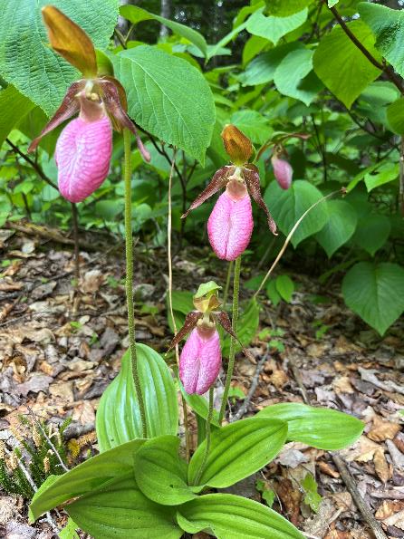
Authorities for LSR Projects
LSR is authorized in Section 13A of the Cooperative Forest Assistance Act (CFAA) and uses the authorities for the following CFAA programs:
Forest Stewardship
Rural Forestry Assistance
Urban and Community Forestry
Forest Health Protection
State Fire Assistance
USDA Forest Service photo
Notes:
Eligible Authorities and Project Types for LSR
Projects must conform to laws and authorities in the Cooperative Forestry Assistance Act.
Allowable authorities for LSR: Forest Stewardship, Rural Forestry Assistance, Urban and Community Forestry, Forest Health Protection, and Community and Private Land Fire Assistance (State Fire Assistance). The authorities for this RFA may be used singly or in combination.
Ineligible authorities for LSR: Rural Volunteer Fire Department Assistance, Forest Legacy, Community Forest and Open Space, and Federal Lands Forest Health Management.
Photo Credit: USDA Forest Service, photo by Indiana Wormstead

Slide 12
Example Eligible Projects
Forest management treatments to improve water quality and/or wildlife habitat.
Survey, prioritization, and treatment to control invasive plants in a high-priority landscape.
Tree planting in communities with pop. 50,000 or less.
Treatments and practices that address climate change vulnerabilities through adaptation actions.
Demonstration projects that achieve on-the-ground accomplishments and provide education/training.
Treatments to reduce or mitigate hazardous wildland fire fuels in priority rural forest lands.
See more examples in the Instructions doc. (pg. 4-5).

Slide 13
Forest Health Activities
Require Prior Coordination
If your project will include forest health activities such as:
Invasive plant control
Insect and/or disease prevention, detection, eradication, or suppression
Then you are required to coordinate with a U.S. Forest Service and/or State agency forest health specialist. See instructions Appendix II.
Provide documentation of this coordination (their review of your project) in the application narrative and/or as an attached document.

Slide 14
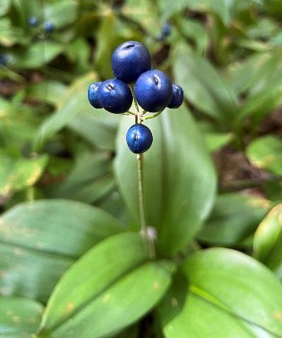
Some Activities Not Eligible
For LSR Funding and 1 to 1 Match
Cost-share, reimbursement, and other payments directly to private landowners
Construction and capital improvements
Research
Small business start-up funding
Projects on Federal land
Projects in cities/towns with population over 50,000
Land purchase and purchase of conservation easements
Spongy moth Slow-the-Spread (STS) projects
USDA Forest Service photo
Notes:
Projects Not Eligible under this RFA
• Activities in cities or towns with greater than 50,000 inhabitants. Refer to the LSR Project Planning Tool.
• Research: Basic research as defined in 2CFR 422.1, “Systematic study directed toward fuller knowledge or understanding of the fundamental aspects of phenomena and of observable facts without specific applications towards processes or products in mind.” Note: Technical transfer, education, and outreach activities associated with applying research can be included in the application. A research entity can be included as a partner and can contribute research as non-match leverage (not funded with the LSR Federal dollars or associated match).
• Construction and capital improvements (facilities, infrastructure, roads). However, capital improvements may be listed as enhanced leverage (not part of the S&PF Federal funding or match).
• Purchase of fire department equipment, including fire weather stations and dry fire hydrants.
• Small business start-up funding.
• Cost-share, reimbursement, and other types of payment directly to private landowners; however, LSR funding (and match) may be used to perform work on private lands.
• While projects may include a component of outreach, education, and/or training as a means to achieve the project objectives, outreach and education should not be the sole outcome.
• Spongy Moth Slow-the-Spread (STS) projects. These are determined in cooperation with the STS Foundation.
• Forest Legacy Program and Community Forest and Open Space Program acquisition projects.
Note: Non-match leveraged contributions can be used to fund activities not eligible.
Photo Credit: USDA Forest Service, photo by Sherri Wormstead

Slide 15
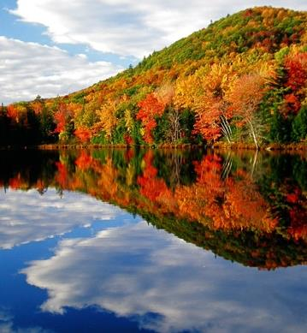
Scoring Criteria
USDA Forest Service photo
15

Slide 16
Scoring Criteria for
LSR Project Selection
Priority Issues and/or Landscapes in the State Forest Action Plan(s) (25 points)
Measurable Outcomes (35 points)
Collaboration and Integrated Delivery (20 points)
Leverage (10 points)
Knowledge and Technical Transfer (10 points)
Benefit to Disadvantaged Communities/People (6 points)

Slide 17
Criteria 1. Priority Issues/ Landscapes in
State Forest Action Plan(s) (SFAP) or Equivalent Restoration Strategy
25
points
Demonstrate focus on a significant issue and/or priority landscape in the respective plan(s).
Describe how the project will bring a State or region to a desired future condition, goal, or strategy as articulated in the respective plan(s).
Equivalent Restoration Strategy:
Is complete or substantially complete;
Is for a multi-year period;
Covers non-industrial private forest land or state forest land;
Is accessible by wood processing infrastructure; and
Is based on the best available science.

Slide 18
Criteria 2.
Measurable Outcomes
35
points
Describe how project outcomes will result in science-based restoration of priority landscapes.
Prioritize funding and other resources toward one or more of the national LSR objectives.
Accomplish at least one on-the-ground national quantitative measures; show how the Federal investment will lead to outcomes on the landscape.
Describe outcomes in relationship to proposed budget. Reviewers will assess if outcomes are commensurate with the budget.

Slide 19
National LSR Objectives
Reduce the risk of uncharacteristic wildfires.
Improve fish and wildlife habitats, including for threatened and endangered species.
Maintain or improve water quality and watershed function.
Mitigate invasive species, insect infestation, and disease.
Improve important forest ecosystems.
Measure ecological and economic benefits including air quality and soil quality and productivity.

Slide 20
National Quantitative Measures for LSR “Outcomes on the Ground”
Acres treated to reduce hazardous fuels
Acres treated to enhance wildlife habitat
Miles of riparian forest treated to enhance wildlife habitat
Acres of trees/seedlings planted to enhance water quality
Miles of riparian forest treated to enhance water quality
Number of trees, saplings, and/or seedlings planted to enhance water quality
Acres treated for insects and disease
Acres invasive plant/weed management
Acres new forest stewardship or other forest management plans
Number of forest landowners reached through technical assistance in more than on interaction and benefit in significant, lasting way
Tons of pulpwood or biomass produced
Board feet of logs/sawlogs produced
Notes:
These measures are in LaSR, the reporting system for LSR.
Each LSR project must accomplish at least one of these on-the-ground national quantitative measures.
This list also serves as the list of what can be consider “on-the-ground” for that program requirement.
Plans: A forest management plan could include a Tribal forest management plan, Forest Stewardship Plan, CAP 106 plan, Tree Farm plan, tax abatement plan, or equivalent state forest, watershed, or landscape plan. If a landscape plan, the plan must focus on discrete/specific geography such as a watershed and is not state-wide.
Forest landowners reached through technical assistance in more than one interaction and known to have benefited in some significant and lasting way (e.g., developed or implemented a forest management activity or practice). This does not include a landowner who simply attended a technical or training session without any follow-up or were spoken to only once, such as over the phone, with no follow-up.

Slide 21
Criteria 3. Collaboration and Integrated Delivery
20
points
ID partners that demonstrate a commitment and add value to the project.
Seek to improve delivery of public benefits from forest management by coordinating with complementary State and Federal programs and partnership efforts.
Describe land ownerships for the project area and cross-boundary goals. Can include combination of Tribal, State, local government, and private lands.
Demonstrate benefits resulting from collaboration.

Slide 22
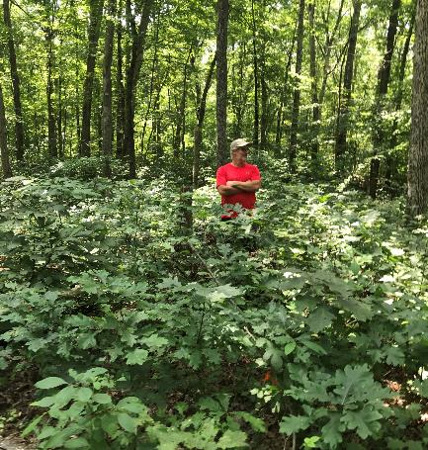
Criteria 4. Leverage
10
points
Projects should maximize Federal funding by using it to leverage contributions from both Federal and non-Federal entities.
Describe contributions from partners in this section and clearly list in Budget Spreadsheet.
Include match and additional
  non-match leveraged.
White Oak Project in Ohio, photo by Cotton Randall.
Notes:
Criteria 4. Leverage (10 points)
Projects should maximize SPTF funding by using it to leverage contributions from both Federal and non-Federal entities. Project applications need to clearly identify the LSR Federal funds requested and the associated non-Federal contributions in the SF-424A and Budget Spreadsheet. Provide details about leveraged contributions, including match from partners and additional non-match leveraged contributions. Note: Collaboration with a for-profit Conservation Finance partner can be a powerful leverage multiplier, but this requires careful budget segregation to ensure Federal grants are not earning income.

Slide 23
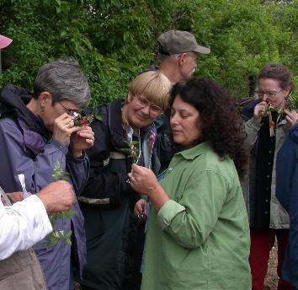
Criteria 5. Knowledge and
Technical Transfer
10
points
Technical transfer: The sharing of knowledge, tools, and innovations for practical application.
Describe how others will learn from the work done on this project… potential to inform practitioners and enhance the effectiveness of similar initiatives.
Projects should include a component of outreach, training, lessons learned, or related opportunities.
USDA Forest Service photo
Notes:
Criteria 5. Knowledge and Technical Transfer (10 points)
Technical transfer is defined as the sharing of knowledge, tools, and innovations for practical application. As specifically as possible, describe how others will learn from the work done on this project. Describe the project’s potential to inform practitioners and enhance the effectiveness of similar initiatives. Knowledge and technical transfer need not necessarily be between States but should aim to share innovation across the landscapes of importance wherever it can be utilized. Projects should include a component of outreach, training, lessons learned, or related opportunities so that carrying out the project results in skills and capability that extend beyond the life of the grant. While projects may include a component of outreach, education, and/or training to achieve the project goals, outreach and education should not be the sole outcome.

Slide 24
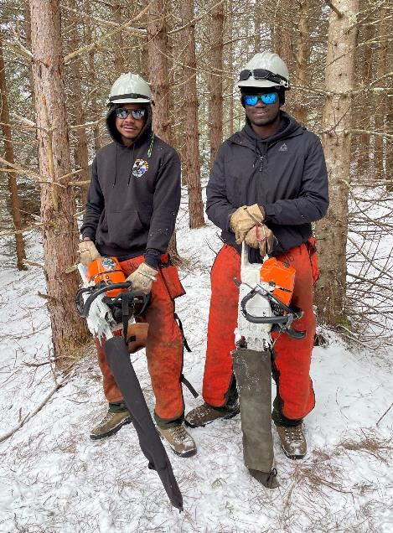
Criteria 6. Benefit to Disadvantaged Communities/People
6
points
In support of Executive Order 14008, Tackling the Climate Crisis at Home and Abroad and the Forest Service Equity Action Plan.
Includes:
Description of benefitting communities/recipients
Description of how the project engages and benefits disadvantaged communities/people
USDA Forest Service photo by Justin Sperry
24
Notes:
In support of Executive Order 14008 Tackling the Climate Crisis at Home and Abroad and the Forest Service Equity Action Plan, FY 2024 national guidance for LSR requires the regional LSR processes to promote equity in the guidance and scoring criteria to ensure Tribes and disadvantaged communities have equitable access to and benefit from the LSR program. LSR applicants are strongly encouraged to meaningfully incorporate these elements:
A. Description of the benefiting community(ies) or recipient(s).
B. Adescription of how the project engages and benefits disadvantaged communities/people.

Slide 25
Identifying and Describing Disadvantaged Communities/People
Community: Geographically defined or dispersed group of individuals experiencing common conditions.
Some examples:
  Low income, persistent poverty, high unemployment
  Racial/ethnic segregation and linguistic isolation
  High housing cost burden, substandard housing
  Disproportionate environmental stressor burden
  Disproportionate impacts from climate change
Use local/State data and/or National data to identify and describe disadvantaged communities/people.
25
Notes:
The Interim Implementation Guidance for the Justice40 Initiative, released by OMB in July 2021, provides the following definitions.
Community: Either a group of individuals living in geographic proximity to one another, or a geographically dispersed set of individuals (such as migrant workers or Native Americans), where either type of group experiences common conditions.
Disadvantaged: The term includes, but is not limited to, communities that experience the following:
Low income, high and/or persistent poverty
High unemployment and underemployment
Racial and ethnic residential segregation, particularly where the segregation stems from discrimination by government entities.
Linguistic isolation
High housing cost burden and substandard housing
Distressed neighborhoods
High transportation cost burden and/or low transportation access
Disproportionate environmental stressor burden and high cumulative impacts
Limited water and sanitation access and affordability
Disproportionate impacts from climate change
High energy cost burden and low energy access
Jobs lost through the energy transition
Access to healthcare
In addition to the definition, geographic areas within Tribal jurisdiction should be included.

Slide 26
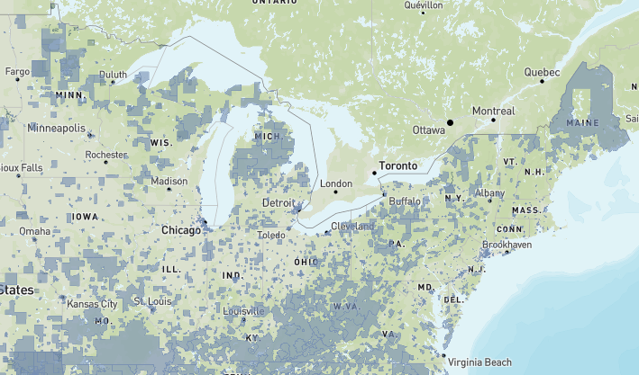
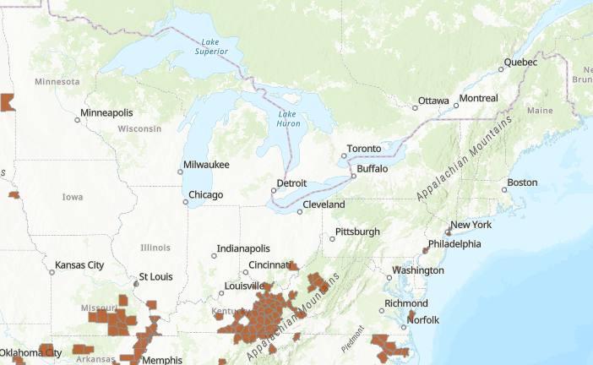
Optional: Layers in the
LSR Project Planning Tool
Climate and Economic Justice Screening Tool (CEJST)
  Persistent Poverty Counties
26
Notes:
White House Council on Environmental Quality, Climate and Economic Justice Screening Tool (CEJST): This interactive map identifies disadvantaged communities using indicators of burdens in eight categories: climate change, energy, health, housing, legacy pollution, transportation, water and wastewater, and workforce development. A community is highlighted as disadvantaged if it is in a census tract that is (1) at or above the threshold for one or more environmental, climate, or other burdens, and (2) at or above the threshold for an associated socioeconomic burden. Federally recognized Tribes are also considered disadvantaged communities.
Persistent Poverty Counties: The USDA Economic Research Service (ERS) defines counties as being persistently poor if 20 percent or more of their populations were living in poverty based on three decades of U.S. Census Data. See the ERS County Typology Codes, 2015 Edition, for a full list of counties.

Slide 27
Example Benefits of an LSR Project to Disadvantaged Communities/People
Forest management actions that benefit disadvantaged communities and/or people.
Applicant or project partners that work with disadvantaged groups are actively engaged in project.
Watershed restoration that improves or protects drinking water supplies for communities with persistent poverty.
Hazardous fuels or forest health treatments that reduce risk to disadvantaged communities.
Employment or forest management job training for disadvantaged people.
Technical assistance that helps disadvantaged landowners establish management plans for their land.
27

Slide 28
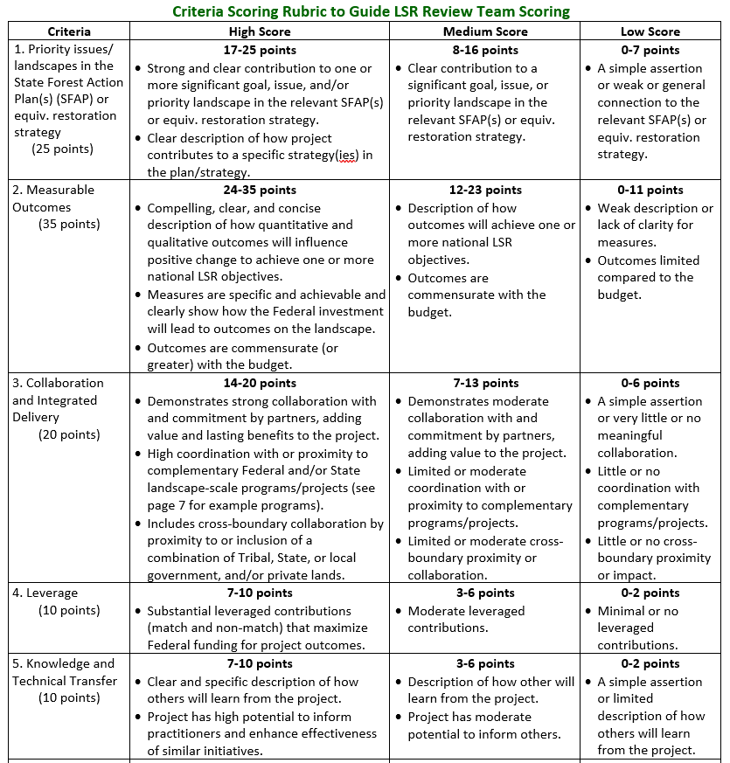
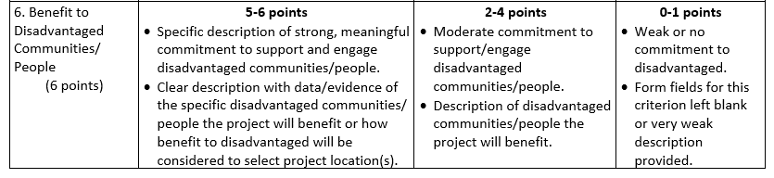
Scoring Rubric
See page 11 of the RFA Instructions
28
Notes:
This rubric is for the review team members to reference while scoring the applications.

Slide 29
Application Forms and Process
USDA Forest Service photo
29

Slide 30
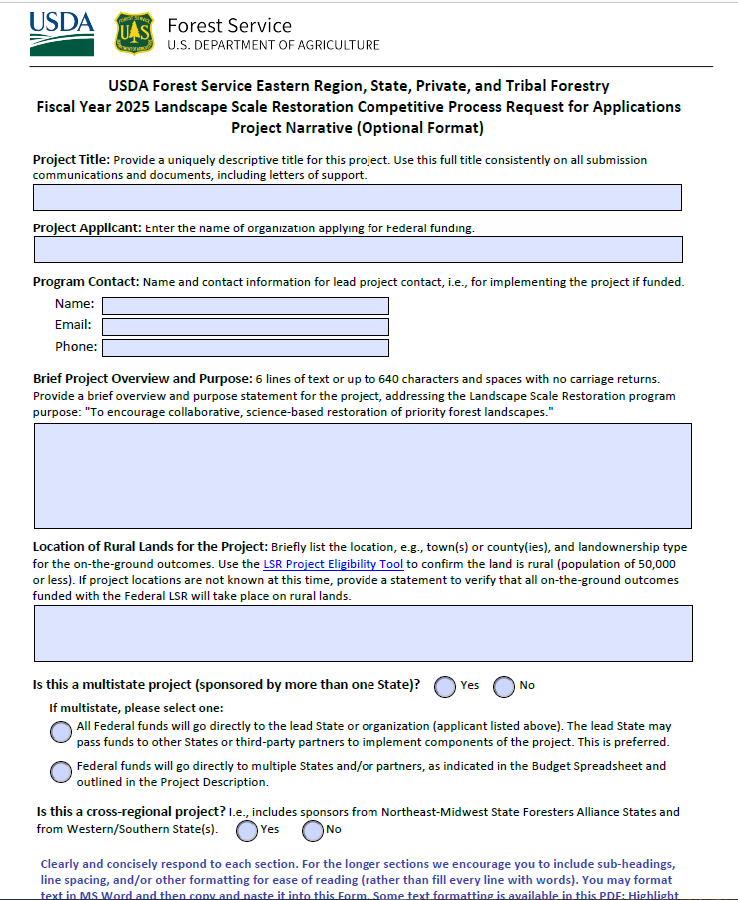
Project Narrative Fillable PDF
Notes:
Note: Clearly articulate the methods employed, timelines, and resources needed in the “Project Description” section of the Project Narrative Form.
Clearly and concisely respond to each section. For the longer sections we encourage you to include sub-headings, line spacing, and/or other formatting for ease of reading (rather than fill every line with words). You may format text in MS Word and then copy and paste it into this Form. Some text formatting is available in the PDF form, e.g., bold, underline, and italic. To format text in the Form: Highlight the text, right click, and select “Text Style.”
There is a section for each of the scoring criteria. On the measurable outcomes page, make sure to place the total acres/miles, as relevant at the bottom on the form. E.g., removing invasive plants on 100 acres also improves wildlife habitat on the same 100 acres; the total acres of rural forest land improved is 100.

Slide 31
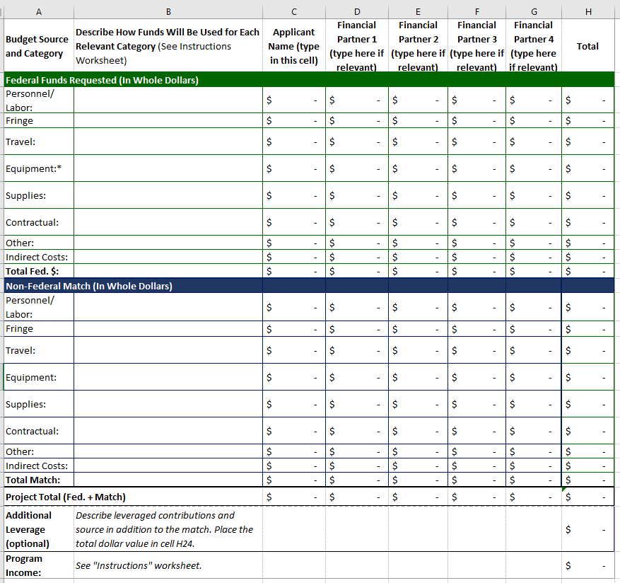
Budget Spreadsheet
Describe how funds will be used!
Delete/add columns as relevant.
Notes:
Refer to the instructions tab of the spreadsheet. Make sure to fill in a description of how the funds will be used to justify the expense.

Slide 32
How to Apply
Submit all applications through Grants.gov
LSR in Grants.gov: Opportunity USDA-FS-2025-LSR-Northeast-Midwest
Sept. 27: Submit draft of the narrative and budget table to relevant State Forester(s) (not required for Tribes)
Nov. 15 (by 6 p.m. Eastern): Applications due in Grants.gov
Grants.gov provides 24/7 support:
  Toll-free number = 1-800-518-4726
  Email = support@grants.gov

Slide 33
Getting Ready to Apply
To work in Grants.gov your organization needs:
Register with System Award Management (SAM) and obtain Unique Entity ID (UEI)
Register your organization/agency in Grants.gov with your UEI (same day)
Then individuals preparing the application:
Register for a Grants.gov account and add a profile for the Organization/Agency. Make sure the individual who will sign the application has the Authorized Organization Representative (AOR) role.

Slide 34
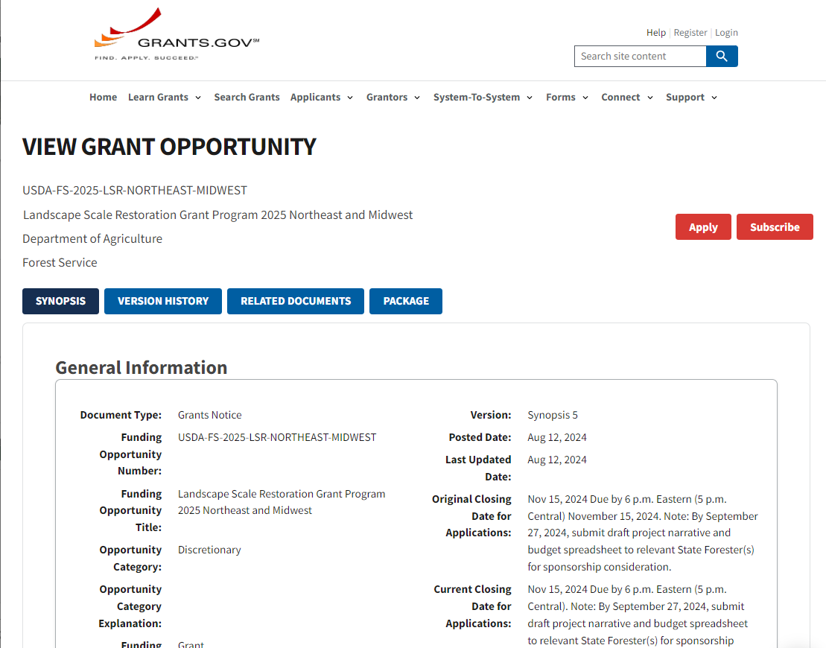
Grants.gov Opportunity: USDA-FS-2025-LSR-Northeast-Midwest
34

Slide 35
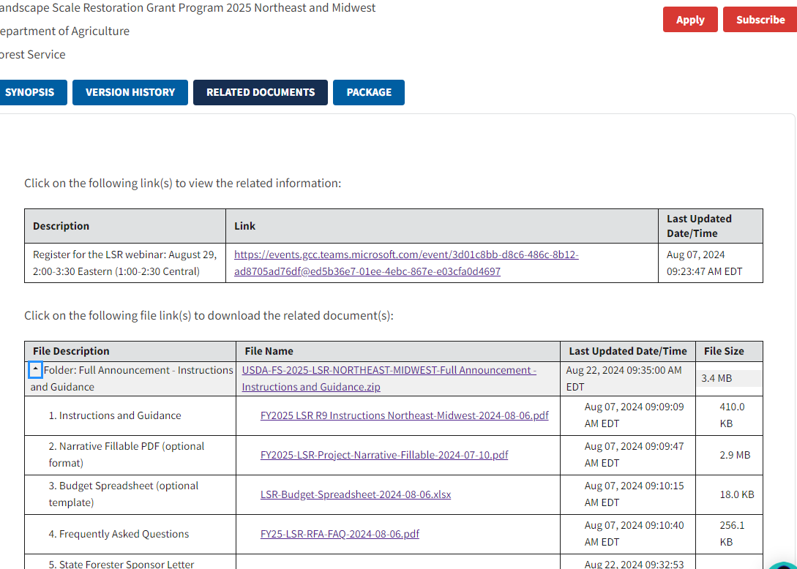
Grants.gov Opportunity:
Related Documents Tab
35

Slide 36
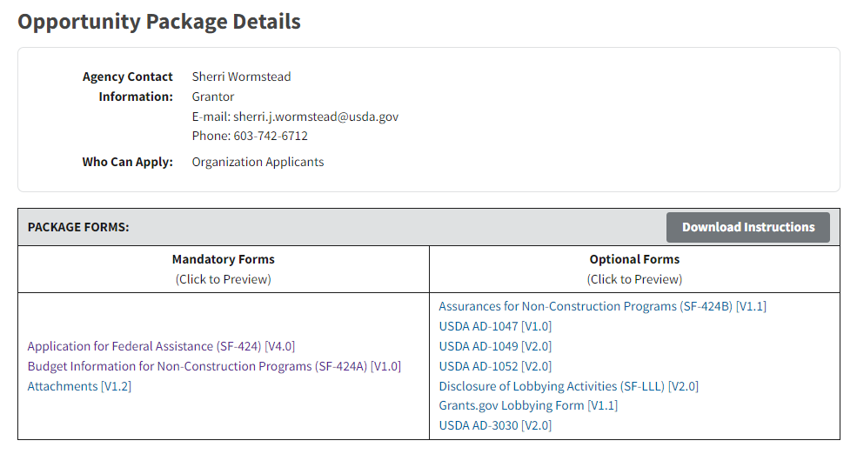
Grants.gov Opportunity: Package
For forms you need to submit, see Instructions document: Pages 12-16 and Appendix III (checklist).
36

Slide 37

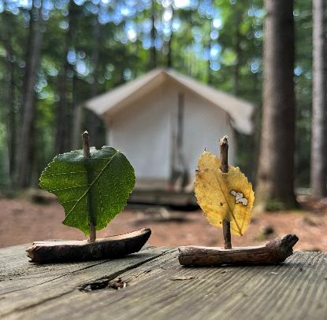
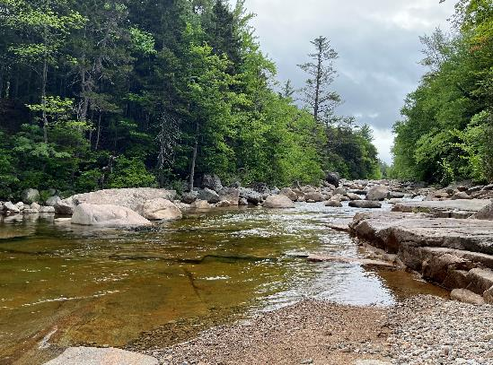
How To Videos
Eastern Region Grants Administration and Management web page has videos for applicants:
Applying for Federal awards
How to fill out the SF-424 form
How to fill out the SF-424A form
USDA Forest Service photos
37
Notes:
USDA Forest Service photos by Sherri Wormstead.

Slide 38
Timeline for FY 2025
Aug. 12: Announced RFA
Sept. 27: Narrative and budge due to State forester(s) for sponsorship
Nov. 15: Applications due in Grants.gov
Mid Nov. – Mid Dec.: Preliminary review of applications to ensure eligibility and requirements.
Jan. – Feb. 2025: Interagency Review Team scores applications.
By late Feb. 2025: Ranked list of projects.
Summer-Fall 2025: Award funded projects.
38

Slide 39
Grant Implementation and Reporting for Funded Projects
A Forest Service grant monitor is assigned.
Projects completed in 3 years.
Annual reporting:
  March 31: Annual Grant performance reporting
  Oct. 28: Annual accomplishments reporting, including spatial data (impact area map) in the Landscape Scale Restoration (LaSR) database
    Publicly available on LSR Interactive Map
Notes:
Reporting: In addition to the standard annual reporting requirements associated with all U.S. Forest Service grants to States and partners, funded LSR projects are required to provide annual project performance and spatial data through the Landscape Scale Restoration database (LaSR) no later than October 28 each year. This requires both Forest Service grant monitors and LSR grant recipients to coordinate in entering project information. If an LSR grant recipient is new to this reporting process, they will need to sign up for an account to access LaSR. The assigned Forest Service grant monitor can assist with this.

Slide 40
Tips!
USDA Forest Service photo
40

Slide 41
Tips from Past Reviewers for Competitive Applications
Clear Writing: Succinct who, what, when, where, and why. Good organization and formatting.
Why Important? Clear problem statement with info. to provide context for the issue and project area.
State Forest Action Plan (SFAP): Strong, direct connection to specific SFAP priorities/strategies.
Budget: Clear explanation of how Fed. funds and match will be used. Costs relative to deliverables.

Slide 42
Tips from Past Reviewers
(continued)
Partners and Cross-Boundary: Strong partner collaboration (and support letters). Describe if builds on existing efforts in project area/adjacent lands.
Outcomes: Strong description of realistic outcomes on the landscape (identify the landscape and ownership).
Have others review your application!
Reach out to the USDA Forest Service Field Office with questions regarding activities allowed, etc.

Slide 43
Forest Service Eastern Region LSR Contacts
Eastern Region SPTF Regional Contact for LSR:
  Sherri Wormstead, LSR Program Manager,
  603-244-0799, sherri.j.wormstead@usda.gov
New England and New York:
  Constance Carpenter, Durham, NH Field Office Rep.,
  603-809-8666, constance.carpenter@usda.gov
Mid-Atlantic States (DC, DE, MD, NJ, OH, PA, WV):
  Robert Gentry, Morgantown, WV Field Office,
  541-410-3281, robert.gentry@usda.gov
  Midwest States (IA, IL, IN, MI, MN, MO, WI):
  Gina Jorgensen, St. Paul, MN, Field Office Rep.,
  651-247-0130, gina.m.jorgensen@usda.gov
For Tribes: Field Reps., Sherri Wormstead, or
  Tribal Relations Specialist: Paul Cloutier,
  970-792-5300, gene.cloutier@usda.gov

Slide 44
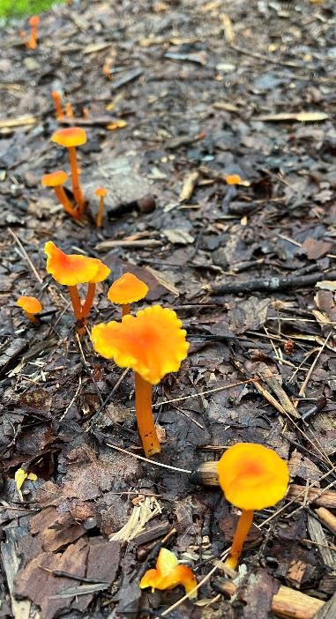
Thank You! Questions?
Contact Sherri Wormstead: sherri.j.wormstead@usda.gov, 603-742-6712
Grants.gov Opportunity USDA-FS-2025-LSR-Northeast-Midwest
R9 LSR website: Ranked lists, funded lists, and reviewer comments for FY 22, 23, and 24.
USDA Forest Service photo
USDA is an equal opportunity employer and provider.
44
Notes:
USDA Forest Service photo by Sherri Wormstead

