Slide 1
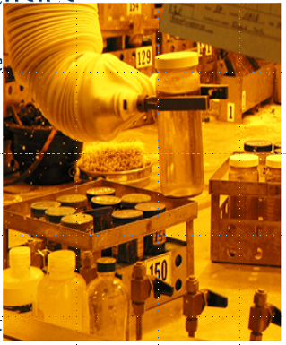

Countering Weapons of Mass Destruction Office
An Introduction to Nuclear Forensics
National Nuclear Forensics Expertise Development Program
Nuclear Forensics Research Award
August 2022
Sandra Gogol
Countering Weapons of Mass Destruction Office
Research & Development Division
National Nuclear Forensics Expertise Development Program

Slide 2
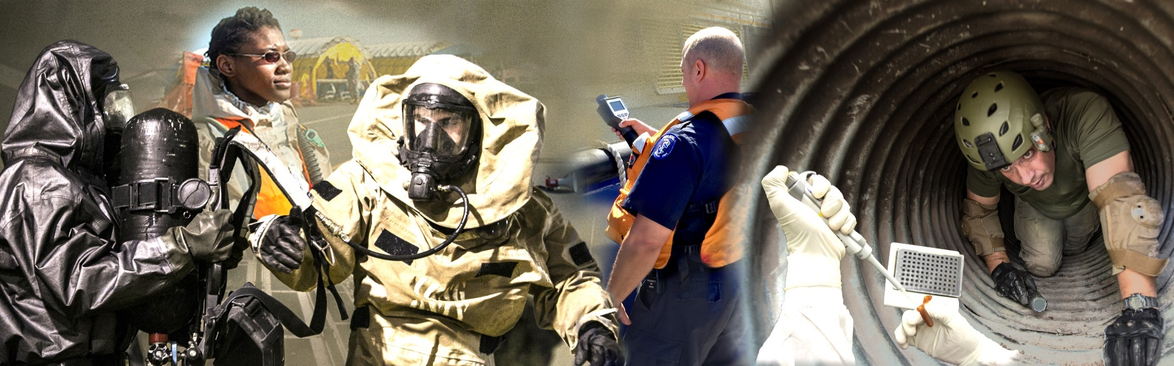
CWMD Mission
CWMD leads DHS efforts and coordinates with domestic and international partners to safeguard the United States against CBRN and related threats.
UNCLASSIFIED

Slide 3
Nuclear Forensics Legislative Authority
Established within the Nuclear Forensics and Attribution Act (NFAA) (P.L.111- 140), and later reaffirmed in the CWMD Act of 2018 (P.L 115-387)
The National Technical Nuclear Forensics Center to provide centralized stewardship, planning, assessment, gap analysis, exercises, improvement, and integration for all Federal nuclear forensics and attribution activities;
The National Nuclear Forensics Expertise Development Program (NNFEDP) to develop and maintain a vibrant and enduring academic pathway from undergraduate to post-doctorate study in nuclear and geochemical science specialties directly relevant to technical nuclear forensics, including radiochemistry, geochemistry, nuclear physics, nuclear engineering, materials science, and analytical chemistry.
UNCLASSIFIED

Slide 4
DHS CWMD Nuclear Forensics Roles
Plans & Policy:
  Represents DHS at White House/National Security Council meetings on CBRN, arms control, and related topics and supports DHS Policy development
  Develops Interagency, DHS, and CWMD Office Strategies and Strategic Implementation Plans
  Identifies DHS CBRN and related Capability Gaps, conducts analysis and prioritization
  Conducts national and tailored CBRN Risk Assessments
Systems Support:
  Expertise Development
  Biennial Laboratory Workforce Census
  Technical Support
Operations Support
UNCLASSIFIED

Slide 5
Nuclear Forensics Research Award
The NFRA supports the establishment of a team of faculty, students, and technical staff at the national or defense laboratories to conduct research in the nuclear forensics field.
Objectives
  Recruit and produce the next generation of leaders and technical experts in a wide-range of fields relevant to nuclear forensics.
  Enhance the ability of universities and the national laboratories to work collaboratively on advanced research in the nuclear forensics field.
  Key Personnel: University Principal Investigator (PI), Laboratory PI, and Graduate Fellow (all personnel must be U.S. Citizens and eligible to obtain a clearance)
Support: $300k per year to the University, $165k per year to the collaborating national or defense laboratory.
  3 years guaranteed, additional 2 optional years.

Slide 6

FY22
Notice of Funding Opportunity posted on Grants.gov, applications due August 30, 2022
Two NFRAs will be funded in FY22
  One will be reserved for Minority Serving Institutions

Slide 7
Eligibility Criteria
University Programs. Universities must have doctorate-level programs in related chemistry fields such as, analytical, geo- or radiochemistry; nuclear physics or engineering; computer science, physics, mathematics, geology, or materials science. Applications must include active participation from these doctoral programs.
Deadlines. DHS will not accept late applications. Without exception, applications must be received by Grants.gov on or before the deadline in this announcement or they will not be considered.
Application relevance. Applications that do not address the purpose of this announcement will not be considered.
Compliance and completeness. Applications must substantially comply with the application submission instructions and requirements in this announcement, or they will not be considered.

Slide 8
Eligibility Criteria
Funding Limits. Applications exceeding the funding limits for a given topic will not be considered.
Project Period. Applications exceeding the project period of performance will not be considered.
Principal Investigator (PI) Limit. None specified
Limit on Number of Proposals per Organization. None specified
Limit on Number of Proposals per PI. One (1). Furthermore, an individual researcher may not be named as a participant on more than one proposal submitted to this solicitation. This limitation includes participation as a PI, co-PI, senior researcher, student, consultant, or any other role for which financial remuneration is requested.

Slide 9
Nuclear Forensics U.S. Government Research Laboratories
Argonne National Laboratory
Idaho National Laboratory
Lawrence Livermore National Laboratory
Los Alamos National Laboratory
National Institute of Standards and Technology
Oak Ridge National Laboratory
Remote Sensing Laboratory
Sandia National Laboratories
Savannah River National Laboratory
Pacific Northwest National Laboratory
Y-12 National Security Complex

Slide 10
For More Information…
Nuclear Forensics Research Award:
Grants.gov
DHS-22-DN-130-MSI
DHS-22-DN-130-001
Other Student Opportunities
The Department of Homeland Security offers a variety of prestigious scholarships, fellowships, internships and training opportunities to expose talented students to the broad national security mission.
  https://www.dhs.gov/homeland-security-careers/students

Slide 11
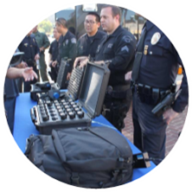

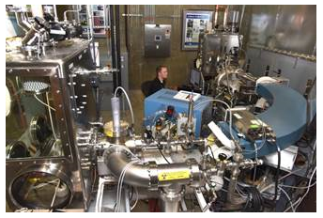

Nuclear Forensics (NF) Defined
Nuclear forensics is the collection, analysis, and evaluation of pre-detonation (intact) and post-detonation (exploded) radiological or nuclear materials, devices, and debris, as well as the immediate effects created by a nuclear detonation.
Analysis
Taking measurements from samples and analyzing data for signatures
Event/Interdiction
Occurs
Collection
Samples and data
Evaluation
Interpreting signatures; leads to technical nuclear forensics results

Slide 12
U.S. Declaratory Policy
“The United States will hold fully accountable any state, terrorist group, or other non-state actor that supports or enables terrorist efforts to obtain or employ nuclear devices.”
“Should an act of nuclear terrorism occur, the United States also maintains advanced nuclear forensics capabilities to identify the source of the material used in a nuclear device, thereby strengthening the deterrence of such an attack. We will continue to improve our ability to attribute the source of a nuclear attack by establishing a nuclear materials archive to store, consolidate, and analyze high-value nuclear materials.”
Nuclear Posture Review Report, April 2018

Slide 13
Imagine if, in a U.S. city or at the border:
A
Container of nuclear materials
B
Improvised nuclear device prior to detonation
C
Radioactive debris after detonation
The United States Government (USG) detects and/or interdicts:
In all three scenarios, there will be intense pressure for the USG to answer some urgent questions:
  Was the nuclear material ours?
  What type of device is it?
  Where did it come from?
  Is there another device?
  Who did it?
  Who is responsible?
Nuclear forensics helps to provide the answers!

Slide 14
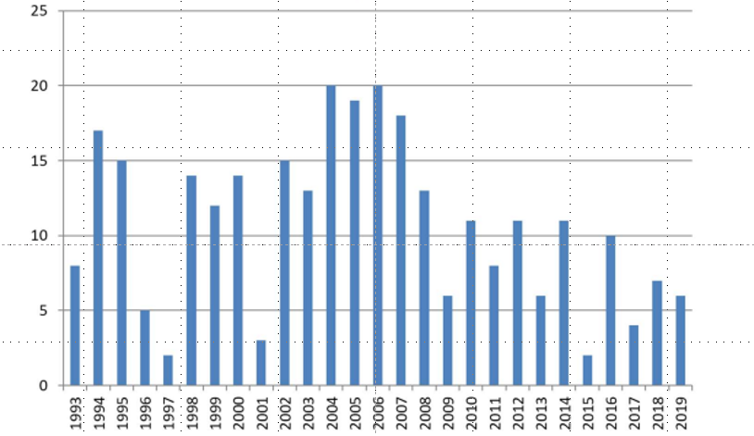
Incidents related to trafficking or malicious use, 1993-2019
Incidents reported to the International Atomic Energy Agency’s Incident and Trafficking Database that are confirmed, or likely to be related to trafficking or malicious use.

Slide 15
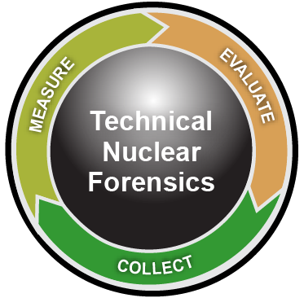
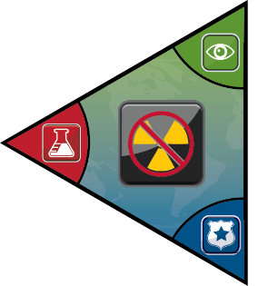

Nuclear Forensics and Attribution
Enhances deterrence
Traces origin of materials
Supports prosecution
Disrupts follow-on event
Informs national response
decisions
Intelligence
Community
}
Technical
Nuclear
Forensics
All-source
info fused
Law
Enforcement
Materials
Device
Debris
Deter-
Dissuade
Render
Safe
Post-Det –
Consequence Management
Secure
Detect
Interdict
Recovery
Attribution
Nuclear Defense Spectrum
Notes:
.

Slide 16








Whole-of-Government Approach
DoD
FBI
DOE
POST-DET
LEAD AGENCY INVESTIGATION
PRE- TO
POST- DET
DOS
DHS
ODNI
INTERNATIONAL
Federal Interagency CoordinAtion and Expertise Development
INTELLIGENCE
ANL
INL
LANL
LLNL
RSL
NIST
ORNL
PNNL
SRNL
SNL
Y-12
DoD Labs

Slide 17

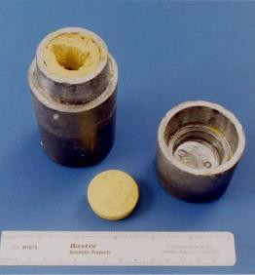
Left of Boom, Right of Boom
Deter-
Dissuade
Render
Safe
Post-Det –
Consequence Management
Secure
Detect
Interdict
Recovery
Attribution
Pre-Detonation
Post-Detonation
Scenario: A small vial of radioactive material is found in an apartment.
What is it?
  What form is it in? Metal, ceramic, powder?
  Does the container have markings? Traditional forensics
  Does this contain Uranium, Plutonium, other radioactive material?
When was the material produced?
Where did it come from? Is there more material?
  Ultimately, is it ours?
Related to Technical Mission Area 1 & 2

Slide 18
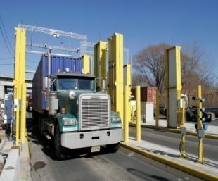

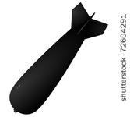
Left of Boom, Right of Boom
Pre-Detonation
Post-Detonation
Deter-
Dissuade
Render
Safe
Post-Det –
Consequence Management
Secure
Detect
Interdict
Recovery
Attribution
Scenario: A suspected nuclear device is interdicted at a radiation portal monitor at the border.
After ‘render safe’ and dismantling of the device, a sample of the bulk nuclear material is taken for analysis
  What nuclear material is it? How was it made?
    Chemical characterization
    Physical characterization
  When was the material made?
  Where did it come from? Is there more?
Related to Technical Mission Areas 1 & 2

Slide 19
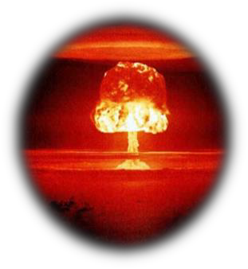
Left of Boom, Right of Boom
Deter-
Dissuade
Render
Safe
Post-Det
Secure
Detect
Interdict
Recovery
Attribution
Pre-Detonation
Post-Detonation
Scenario: A nuclear device was just detonated.
Were prompt emission signals from the detonation observed?
  Can we reverse model the signals to what they looked like at the signal origination, i.e. ground zero?
  Can the prompt signals tell us anything about the nuclear material and device design?
What can we tell from ground collections?
Related to Technical Mission Area 4

Slide 20
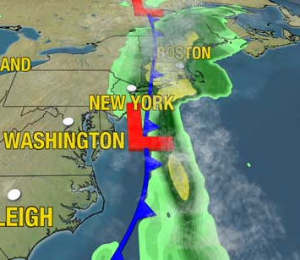
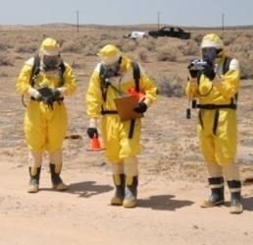
Left of Boom, Right of Boom
Deter-
Dissuade
Render
Safe
Post-Det
Secure
Detect
Interdict
Recovery
Attribution
Pre-Detonation
Post-Detonation
Scenario: A nuclear device was detonated hours ago.
Need to figure out specifics of the nuclear material and device design
Nuclear fallout – Where is it going?
  Locate: Where do we look for relevant nuclear fallout debris?
  Analyze: What can we learn in the field?
Related to Technical Mission Area 3

Slide 21
Nuclear Forensics Areas of Expertise
In the early 2000s, expert studies recognized that the cadre of nuclear forensics experts at U.S. National Laboratories and in academia had been rapidly diminishing since the end of the Cold War.
A 2004 DOE National Science Foundation Nuclear Science Advisory Committee report assessed that within ten years, “more than three quarters of the workforce in nuclear engineering and at the National Laboratories will reach retirement age.”
A decline in U.S. academic programs in relevant technical nuclear forensics, such as radio- and nuclear chemistry, had reached alarmingly low levels.
The National Academy of Sciences and the U.S. Government Accountability Office all highlighted these gaps as a crisis and recommended they be addressed.
Relies on Multi-Disciplinary Expertise
Analytical Chemists/Radiochemists
Computer Scientists
Nuclear Engineers
Geologists/Geochemists
Mathematicians
Material Scientists
Nuclear and General Physicists
Modelers/Fate and Transport Modelers

Slide 22
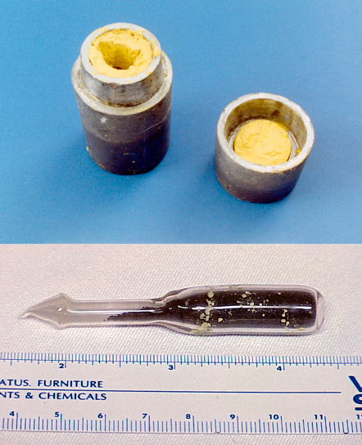
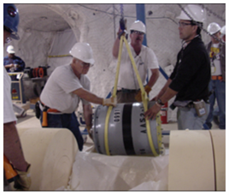
Pre-Det Sample: Traditional and Nuclear Forensics
Traditional Forensics
Pre-Det Material
Nuclear Forensics
Wax Type
Wax Colorant
Paper Origin
Pb Metallurgy
Pb Isotopics
Ampoule Material
Fingerprints and fibers
Surface contamination
Device Material
Optical and SEM measurements of microstructure
Measurement of large scale features – morphology and mass
Chemical Form
Age-dating
Material Isotopics
Impurity Elements
Residual Radionuclides
Particle Characterization
Morphology
Dose Rate Measurements
Gamma spectroscopy and radiochemical separations
Pre-Det Device
Traditional forensics is done as well as Nuclear Forensics

Slide 23
Laboratory Analysis
Radiochemistry
Elemental Analysis
Isotopics/ Radiochronometry
Morphology (SEM and XRD)
Radiological Analysis/ Gamma Spectroscopy
Color

Slide 24
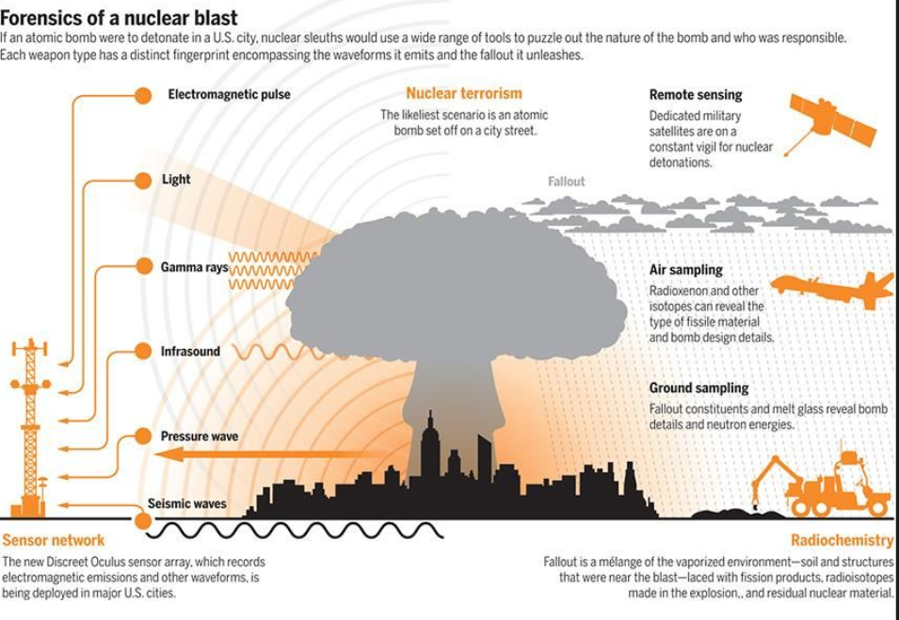
Post-Detonation Forensics
Notes:
Provide citation

Slide 25
Technical Mission Areas – Pre-Detonation
TMA 1. Pre-Detonation Material and Device Signatures
Physical, chemical, and isotopic characteristics of a radiological or nuclear material can be used to determine aspects of the material’s history and are therefore important to nuclear forensics. In general, a nuclear forensic signature is a set of measurable characteristics that points to the origin or history of a sample and may specifically include or exclude the sample from a specific class or category of materials. Physical signatures may include morphology, texture, size, and shape of a material or parts of the device. Chemical signatures may include the elemental or molecular form of the material (e.g., uranium dioxide, plutonium oxalate) and abundances of impurities in the sample. Isotopic signatures reflect the isotopic composition of a sample (indicating its enrichment, burnup, intended or actual use) and may be used to derive the time since the material was last processed chemically. The R&D focus in these areas includes production, acquisition, and/or retrieval of radiological and nuclear materials of historical interest; laboratory analysis of the materials to document their characteristics; development of production and processing models relating processing parameters (chemical, physical, engineering, machining) to observed product characteristics; assessment of which characteristics persist through (or are modified by) various stages of the production, storage, and transport processes; development of libraries of material characteristics; and ultimately evaluation of material characteristics (or combination of characteristics) for their uniqueness or value as nuclear forensics signatures.

Slide 26
Technical Mission Areas – Pre-Detonation
TMA 2. Pre-Detonation Analysis Methods and Tools
While current methods of sample analysis and data interpretation provide a highly sophisticated level of material characterization and classification, even more advanced methods are required to identify new signatures and enable new insights into material provenance. R&D priorities in this area include development of new laboratory analytical methods for determination of spatially and/or temporally distinct features in radiological and nuclear materials; analytical methods that enable determination of new (i.e., previously unrecognized) characteristics and signatures in rad/nuc materials; mathematical and statistical methods to identify and evaluate correlated material characteristics; modeling and simulation tools to predict forward and inverse relationships between physical/chemical material production processes and measurable characteristics; data visualization methods to enable improved interpretation of data relationships; and data management and knowledge capture tools to enable efficient storage, retrieval, and interpretation of diverse sets of material information.

Slide 27
Technical Mission Areas – Post-Detonation
TMA 3. Post Detonation Material Collection and Analysis Methods
Post-detonation material R&D explores novel methods and advancements in the ability to collect samples of material, analyze radioactive debris, and identify signatures from debris analysis. The overall goal is to obtain accurate debris characterization more rapidly than is currently possible, and to do so in all environments and conditions. Chronologically, this starts with targeted airborne and ground collection methods that are robust under a wide variety of adverse conditions. Methods with the potential to enable remote characterization and quantification of airborne debris are of interest, as are methods that combine collection and analysis, and field deployable systems, with realtime analysis capability. Following sample collection, improved methods are sought for rapid dissolution and pre-concentration of post-detonation debris using environmentally friendly, potentially field-deployable, techniques on a reasonable time scale. The R&D focus for sample analysis includes non-destructive analytical techniques; innovations that rapidly identify and quantify elemental and isotopic constituents (major, minor, and trace) in fresh radioactive fallout debris; and fundamental phenomenology of laser spectroscopy, mass spectrometry, and associated ionization methods. Improvements are also sought in data handling methodologies for compiling, assessing, and interpreting large sets of data; advancing the treatment of data uncertainties; and improving databases of physical constants, such as nuclear cross sections, decay branching ratios, or nuclear energy levels relevant to nuclear forensic analysis.

Slide 28
Technical Mission Areas – Post-Detonation
TMA 4. Post-Detonation Prompt Signal Analysis
Post-detonation prompt signal analysis explores R&D that may enable accurate knowledge of the specifics of a nuclear device (e.g., special nuclear material type and mass, device sophistication, etc.) after a detonation. Ideally this knowledge would be available in as short a time as possible with a high degree of confidence. This topic investigates basic physical research on the prompt signatures of nuclear explosive events, such as novel methods for yield determination, device reaction history, or the radiation outputs of these nuclear explosions. Research could focus on the understanding of unique identifiers of these explosions, measurements of these identifiers, or other topics. In this context, prompt signatures indicate those which can be measured instantaneously to within a few days after the event. These signatures are generally separate from radiochemical signatures.

Slide 29
Questions?

