Slide 1

August 17, 2023
Nationally Significant Federal Lands and Tribal Projects (NSFLTP) Program
Presenters:
Frances Ramirez
Jeff Mann
Angela Jones
Moderator: Lourdes Boulware

Slide 2
Disclaimer
Except for any statutes and regulations cited, the contents of this presentation do not have the force and effect of law and are not meant to bind grant recipients in any way. This presentation is intended only to provide information and clarity on existing requirements under the law or agency policies.

Slide 3
This is a webinar for the Fiscal Year (FY) 2023 NSFLTP Program Notice of Funding Opportunity (NOFO)
FY23 NSFLTP NOFO
Funding Opportunity Number:
693JJ3-NSFTLP-FY23
Posted: July 6, 2023
Applications Due: November 6, 2023
NOFO Link: https://www.grants.gov/web/grants/view-opportunity.html?oppId=349112
NSFLTP Website Link: https://highways.dot.gov/federal-lands/programs/significant

Slide 4
NSFLTP Program Description
What changed from the FY 2022 NSFLTP NOFO?
How much funding is available?
What projects are eligible?
What is a Sponsorship Coordinator?
How to apply?
How will applications be reviewed?
How will recipients be announced?
What are the reporting requirements?
Where can you find more information?
Important Websites
Questions
Overview

Slide 5
NSFLTP Program Description
Program purpose
  To provide funding for the construction, reconstruction, and rehabilitation of nationally-significant projects on Federal or tribal lands.
Statutory citation
  FAST Act § 1123, IIJA § 11127
Eligible Applicants
  Federal Land Management Agencies (FLMA)
  Tribal Governments
  States and local transportation agencies may also apply, but only if sponsored by an FLMA or Tribal Government.

Slide 6
NSFLTP Program Description
Minimum Project Construction Cost –$12,500,000.
50% of the available funds must go to Tribal transportation facilities
Not less than one eligible project from National Park Service for a unit with 3,000,000 annual visitors or more shall receive funds
Federal share
  100% for Projects on Tribal transportation facilities
  90% for other Projects not on Tribal transportation facilities
  Allows the use of Federal funding as match, including Title 23 and 49 funds
Funding Availability
  3 fiscal years following the fiscal year for which the amounts are appropriated.

Slide 7
Changes from the FY 2022 NSFLTP NOFO
The FY 2023 NOFO updated the funding available
Amendment #2 extended the application timeline from 60 to 120 days

Slide 8
FY 2023 NSFLTP funding available
The funding available for award in FY 2023 is $88,290,000
$44,145,000 Available for tribal transportation facilities

Slide 9
NSFLTP Eligibility Information
A single continuous project on a Federal lands transportation facility, a Federal lands access transportation facility*, or a tribal transportation facility*
  *The facility is not required to be included in an inventory described in 23 U.S.C. sections 202 or 203 [FAST Act, section 1123(c)(1)];
NEPA must be complete, as demonstrated through—
  a record of decision with respect to the project;
  a finding that the project has no significant impact; or
  a determination that the project is categorically excluded; and
The project must have an estimated total project cost equal to or exceeding $12,500,000

Slide 10
NSFLTP Eligibility Information
Eligible Activities
  Construction related costs only
  Design or preliminary engineering are not eligible activities/costs
Eligible Applicants
  FLMA
  Tribal Governments
  States and local transportation agencies* may also apply, but the application must include documentation that an FLMA or Tribe supports the project
    *This includes States, local governments, political subdivisions of a State or local government, metropolitan planning organizations or MPOs, and special purpose districts or public authorities with a transportation function, including port authorities.

Slide 11
Sponsorship Coordinator
Sponsorship Coordinator provides
  FHWA a list of sponsored applications, including their own.
  Enough detail to match the projects with applications.
Each Tribe and FLMA should designate one person to be Sponsorship Coordinator.
A list of Sponsorship Coordinators can be obtained at: https://highways.dot.gov/federal-lands/programs/significant/list-sponsorship-coordinators
Notes:
Sponsorship is not a rigorous process. To sponsor a project, an FLMA or Tribe only has to indicate support of the project. Because anyone can enter an application, FHWA will also consult with a Tribe or FLMA directly if sponsorship is not apparent in the application package

Slide 12
Application and Submission Information
All applications must be submitted in Grants.gov
Content and Form of Application Submission
  Standard Form 424, 424C, 424D, LLL, and Key Contacts
  Cover Page
  Narrative, including a project description, location, parties involved, funding, budgeting, project risks, and a discussion of how the project addresses Statutory and Discretionary criteria.
  NEPA documentation, maps, letters of support
NOFO’s link on Grants.gov: https://www.grants.gov/web/grants/view-opportunity.html?oppId=349112
Notes:
materials can be provided as attachments. Commonly, applicants will attach a map for the location.

Slide 13
Application Review Information, overview
FHWA reviews applications
Technical staff from FHWA Reviews projects for eligibility and rate applications against the selection criteria described in the NOFO.
Senior Team
Executive leaders from FHWA decide which applications are sent to the Administrator as Highly Rated
FHWA Administrator makes the final selections
Technical Review Team
FHWA reviews applications to ensure the materials are complete and responsive to the NOFO instructions.

Slide 14
Application Review Information, Statutory Criteria
Statutory criteria
  Applications will be evaluated against the nine criteria provided in statute and in the NOFO:
  Furthers the Department’s goals, including state of good repair, economic competitiveness, quality of life, and safety;
  Improves the condition of critical transportation facilities, including multimodal transportation facilities;
  Needs construction, reconstruction, or rehabilitation;
  Has matching funds (projects with a greater percentage of matching funds rank higher than projects with a lesser percentage of matching funds);

Slide 15
Application Review Information, Statutory Criteria
Statutory criteria continues
  Is included on or eligible for the National Register of Historic Places
  Uses new technologies and innovations to increase project efficiency;
  Is supported (whether for construction or for operation and maintenance) by funds other than those received under this program;
  Spans two or more States; and
  Serves land owned by multiple Federal agencies or Indian tribes.

Slide 16
Application Review Information, Discretionary Criteria
Discretionary criteria
  Applies to all applications:
    The project’s demonstrated project readiness.
  Applies only to applications on Federal lands access transportation facilities or on Federal land transportation facilities (not on Tribal transportation facilities):
    Is the project located in an underserved community? as defined in Executive Order 13985;
    The extent to which the project reduces greenhouse gas emissions and improves environmental justice;
    The extent to which the project will advance the Racial Equity and Barriers to Opportunity Program objective; and
    The extent to which the project will advance the Job Quality, Workforce Development, and Workforce Equity objective.

Slide 17
Application Review Information, application rating guidelines
Highly Recommended
The project aligns extremely well with the objectives of the statutory criteria.
Recommended
The project aligns well with the objectives of the statutory criteria.
Acceptable
Projects with 4 or more criteria rated as Strong Alignment
Or Projects with all the statutory criteria rated as Alignment
Projects with at least1 criterion rated as Strong Alignment
or Projects with most of the statutory criteria (5 or more) rated as Alignment
Not Recommended
The project that aligns with the objectives of the statutory criterion under consideration.
Projects with no criteria rated as Strong Alignment but with several criteria rated as Alignment
The project does not align well with objectives of the statutory criterion under consideration or does not align with eligibility criteria.
Recommended, and Highly Recommended applications are sent to the FHWA Administrator as Highly Rated.
FHWA Administrator makes the final selections

Slide 18
Federal Award Administration Information
Notification of Selection
  The FHWA will announce awarded projects by posting a list of selected projects at https://flh.fhwa.dot.gov/programs/significant/
  Following the announcement, FHWA will call the point of contact listed in form SF-424 to initiate negotiation of a project-specific agreement
The selection announcement is not an authorization to start work and incur cost.
Recipients can only do work and incur costs after a grant/project agreement is in place

Slide 19
Federal Award Administration Information
Reporting
  Recipients of NSFLTP Program funding are responsible for meeting reporting requirements
  Federal Financial Report (SF-425) on the financial condition of the project bi-annually
  Annual Budget Review and Program Plan to monitor the use of Federal funds and ensure accountability and financial transparency in the NSFLTP Program
  FHWA reserves the right to request additional information, if deemed needed, to better understand the status of the project.
Notes:
Reporting - FHWA reserves the right to request additional information, if deemed needed, to better understand the status of the project. The successful applicant will provide additional financial reporting beyond the semi-annual reporting if such statements are necessary to address FHWA’s Stewardship and Oversight responsibility of the funds. The successful applicant also agrees to allow periodic project inspections and FHWA will provide notice for such inspections.

Slide 20
Important Websites
There are several websites mentioned in the NOFO, including
  Grants.gov https://www.grants.gov/web/grants/view-opportunity.html?oppId=343073
  SAM.gov
    https://sam.gov/content/home
  NSFLTP website
    https://highways.dot.gov/federal-lands/programs/significant

Slide 21
Websites: Grants.gov
Grants.gov
  Video on how to register, set up a profile, and navigate grants.gov: https://youtu.be/sj3X2XPAQ5g
Notes:
https://www.grants.gov/web/grants/home.html
You can enter NSFLTP and search
Applicants can select this link for How To Apply and Applicant Resources
Training Videos, User Guide and Support Center
Get Started

Slide 22
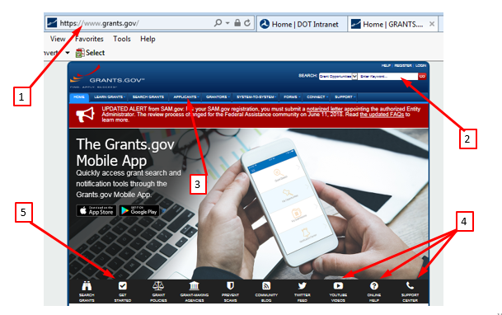
Websites: Grants.gov
Notes:
https://www.grants.gov/web/grants/home.html
You can enter NSFLTP and search
Applicants can select this link for How To Apply and Applicant Resources
Training Videos, User Guide and Support Center
Get Started

Slide 23
Websites: Grants.gov
Grants.gov
  Support Center
    FAQs
    Grants Learning Center
    Online Help
Direct Link to grants.gov support center: https://www.grants.gov/web/grants/support.html

Slide 24
Websites: Grants.gov
Helpdesk
  1-800-518-4726 (U.S.)
  1-606-545-5053 (International)
  Email: support@grants.gov
  Available 24 hours a day, 7 days a week (excluding Federal holidays)
Grants.gov Online Help: https://www.grants.gov/help/html/help/index.htm#t=GetStarted%2FGetStarted.htm

Slide 25
Websites: SAM.gov
What’s SAM.gov? System for Award Management is the website where you register to do business with the U.S. Government
How do you sign up?
  Create a user account.
  Register your entity to do business.
What if we are Tribe or Alaskan Native Village? Yes, you must be registered in SAM.gov to receive a Federal award

Slide 26
Websites: SAM.gov
Must be registered in SAM.gov
Must have an UEI (Unique Entity Identifier) (replaces DUNS Number)
These processes can take several weeks to complete, so should be started well before the application deadline.
Direct Link to SAM: https://sam.gov/content/home or https://sam.gov

Slide 27
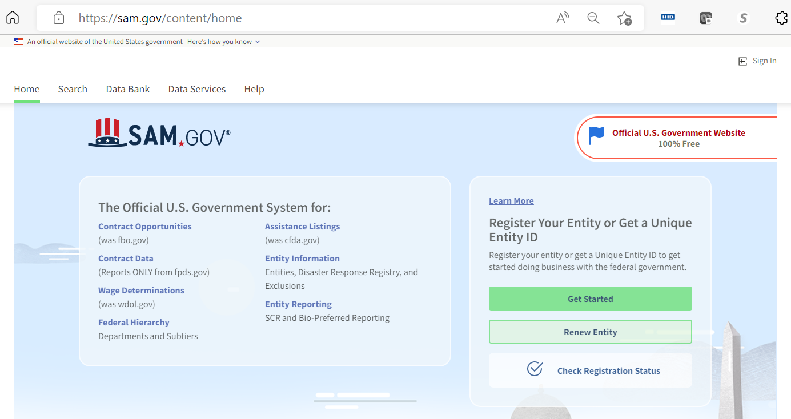
Websites: SAM.gov
1
2
Notes:
1. https://sam.gov/content/home or sam.gov
2. How to obtain an UEI

Slide 28
Websites: NSFLTP
NSFLTP website
  This website contains information specific to the NSFLTP Program.
  Program background
  Previously selected projects
  Frequently asked questions
  Link to the NOFO on Grants.gov
  https://highways.dot.gov/federal-lands/programs/significant

Slide 29

Email us at:
NSFLTP-Program@dot.gov
Questions?

