Slide 1
USFS Eastern Region
Cohesive Fire Strategy
2024 Request for Applications
U.S. Forest Service
Eastern Region State, Private & Tribal Forestry
Fire & Aviation Management, Cooperative Fire Program
Note: We are recording this session!

Slide 2

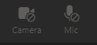
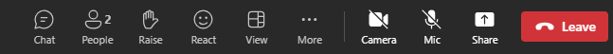
Audio and Webcam
For audio you can listen and speak through the computer or by phone.
Note: Right now, microphones are muted, and webcams are disabled.
We’ll enable them during the Q&A.
During the Q&A, when not speaking:
Please keep your mic./phone muted and webcam off.
2

Slide 3
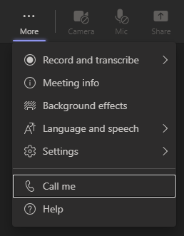
If audio is choppy (bandwidth limited), you can switch to phone audio:
Select the “More Actions” menu (…)
Select “Call Me”
Enter your phone number and select “Call Me”
Answer your phone!
OR dial into the number listed in More Actions (…) > Meeting Info. menu.
Also: Close other programs running on your computer.
3

Slide 4
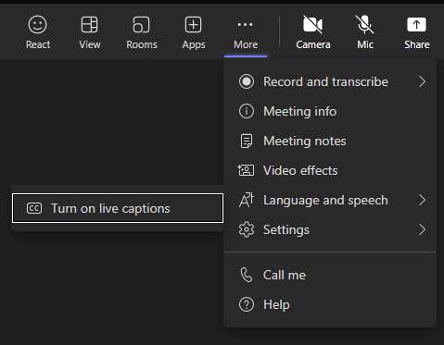
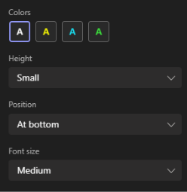
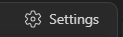
Captions
Select “More Actions” menu
Select “Language and speech”
Select “Turn on live captions”
Select “Settings” in lower right to adjust captions bar height, position, and font size.
4

Slide 5

Ask Questions in Chat!
Type questions in the Chat as you think of them.
During Q&A you can speak up with questions.
We’ll prompt you to raise your hand and will call on you.
5

Slide 6
USFS Eastern Region
Cohesive Fire Strategy
2024 Request for Applications
U.S. Forest Service
Eastern Region State, Private, & Tribal Forestry
Fire & Aviation Management, Cooperative Fire Program

Slide 7
Overview
National Cohesive Strategy
Northeast Regional Action Plan
Cross‐Boundary Wildfire Hazard Mitigation on Non‐Federal Lands
Wildfire Risk Reduction (WRR)
Wildfire Risk and Underserved Communities
Grants.gov
7

Slide 8
National Cohesive Strategy
Restore & Maintain Landscapes
  Landscapes across all jurisdictions are resilient to fire related disturbances in accordance with management objectives.
Fire Adapted Communities
  Human populations and infrastructure can withstand a wildfire without loss of life or property.
8

Slide 9
Northeast Regional Action Plan Implementation Actions
Use of Prescribed Fire for Multiple Benefits
Restore Fire Adapted Ecosystems
Mitigate “Event” Created Hazardous Fuels
Support Local Fire Adapted Communities
Treat Hazardous Fuels in the WUI
Promote Prevention Programs
Developed by the Northeast Regional Strategy Committee and stakeholders to identify the most important actions to progress on.
9

Slide 10
Cross-Boundary Mitigation Grant
Wildfire Risk Reduction Grant
Target: Goals 1 and 2 of the Cohesive Strategy
Restore and Maintain Landscapes
Fire Adapted Communities
Meet one or more Regional options 1-6
    Use of Prescribed Fire for Multiple Benefits
    Restore Fire Dependent Ecosystems
    Mitigate “Event” Created Fuels
    Support Local Fire Adaptation by Communities
    Treat Hazardous Fuels in the WUI
    Promote Prevention Programs
10

Slide 11
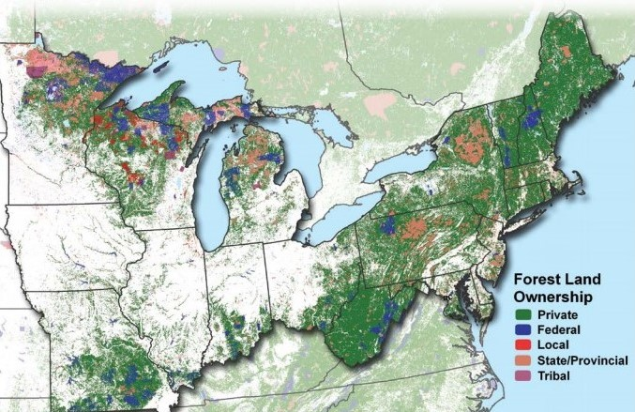
Eastern Area States

Slide 12
Eligibility
Cross-Boundary Mitigation:
State Forestry Agencies
Local Governments
Tribes
Nonprofit Organizations
National Forests (applying on behalf of adjacent non-Federal landowners)
Private landowners and associations
Wildfire Risk Reduction (WRR) Component:
State Forestry Agencies
Forest Fire Compacts
Groups of States
Tribes
Nonprofit Organizations
Academic Institutions
“For Profit” organizations are not eligible for this funding opportunity
12
Notes:
Find Mike’s email that explains Tribal stuff very well.

Slide 13
Funding Limits & Match Requirements:
Cross-Boundary Mitigation Projects
The FY 2024 allocation for this grant opportunity is subject to funding availability
No Funding Limit for individual projects
Match not required, but considered when ranking applications
13

Slide 14
Funding Limits & Match Requirements
Wildfire Risk Reduction (WRR)
The FY 2024 allocation for this grant opportunity is subject to funding availability
Individual grant application funding limit of $25,000 to $300,000 in Federal funds
Equipment: No more than 25% of Federal funds requested
WRR grant funds must be matched 100 percent or more by eligible and allowable costs and are subject to match provisions
14

Slide 15
Cross-Boundary Mitigation Criteria
Project must benefit resources on Federal Land
  State Forester and Forest Supervisor Support (completed project form)
  Treat priority areas within State Forest Action Plans, Risk Assessments, CWPP’s, etc.
  Fire prevention activities that Reduce the chance of fire starting and affecting National Forest System (NFS) land
  Treat hazardous fuels where fire transmission could affect NF system land
  Treat hazardous fuels and improve ecological conditions within watersheds, firesheds, or habitat that benefit NFS lands
15
Notes:
Non qualifying:
Research and development projects
Capital improvements
Economic development projects

Slide 16
Cross-Boundary Mitigation Examples
Examples:
  Hazardous fuels reduction activities (fuel breaks, Rx burning, timber harvest)
  Development and implementation of CWPP or equivalent
  Technical assistance (silvicultural prescriptions, burn plan development)
  Training or monitoring activities on non-federal lands that benefit resources on Federal land
Non-Qualifying Examples:
  Research and development projects
  Capital improvements
  Economic development projects
16
Notes:
Non qualifying:
Research and development projects
Capital improvements
Economic development projects

Slide 17
Wildfire Risk Reduction (WRR)
Example Activities
Use of Prescribed Fire
Use of Mechanical Fuel Reduction
Vegetation Management
Use of small diameter wood
Defensible Space
CWPPs or equivalent
Fuel Breaks & Fire Breaks
Dry Hydrants that support a Fire Adapted Community
Fire Mgmt. Planning in fire adapted landscapes w/ FAC’s
Slash Removal
Brochures, PSA’s
Property Assessments
Prescribed Fire or fire adapted communities related training
Exercises that support FAC’s
I&E, Firewise, RSG, FAC & Fire Prevention Programs
Wx station upgrades that support prescribed fire or community readiness
Non-Qualifying Examples:
  Research and development projects
  Capital improvements
  Economic development projects
17
Notes:
Non qualifying:
Research and development projects
Capital improvements
Economic development projects

Slide 18
National Fire Plan Operating & Reporting System (NFPORS) Forms are Required for WRR
Mandatory for all State Fire Capacity (SFC), Volunteer Fire Capacity (VFC), and WRR Grant applications
For questions on NFPORS please contact your Coop Fire staff
Please report accurately. The acres treated are part of the region’s accomplishment target
18

Slide 19
Cross-Boundary/WRR Review
Cross-Boundary – Submit your Project Proposal with State Forester and Forest Supervisor letters with signatures.
Cross-Boundary – Provide a map, shape file or .kml for fuels/land treatment as required by FACTS (Forest Service Activity Tracking System).
WRR – Submit a separate letter of support from the State Forester or appropriate designated authority (NJ, State Fire Warden; NY, Director of Forest Protection) for approving activities.
WRR – Provide current accomplishment data with a NFPORS form as required by NFPORS.
WRR – At least 100% match of requested Federal funds is required.
19

Slide 20
Application Ranking Criteria
100 Points Possible:
Address Northeast Regional Action Plan's Options (30 pts)
Engage in partnerships and collaboration (20 pts)
Assist Underserved Communities (10 pts)
Explain project effectiveness and efficiency (20 pts)
Demonstrate a Wildfire Risk Focus (20 pts)
20

Slide 21
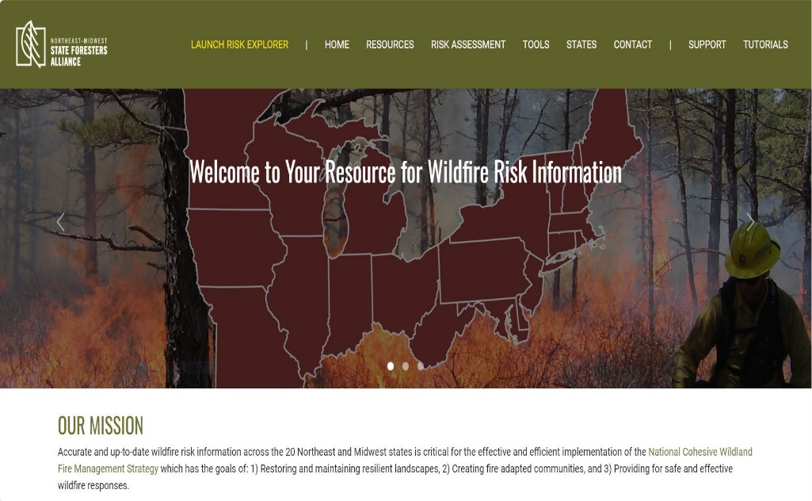
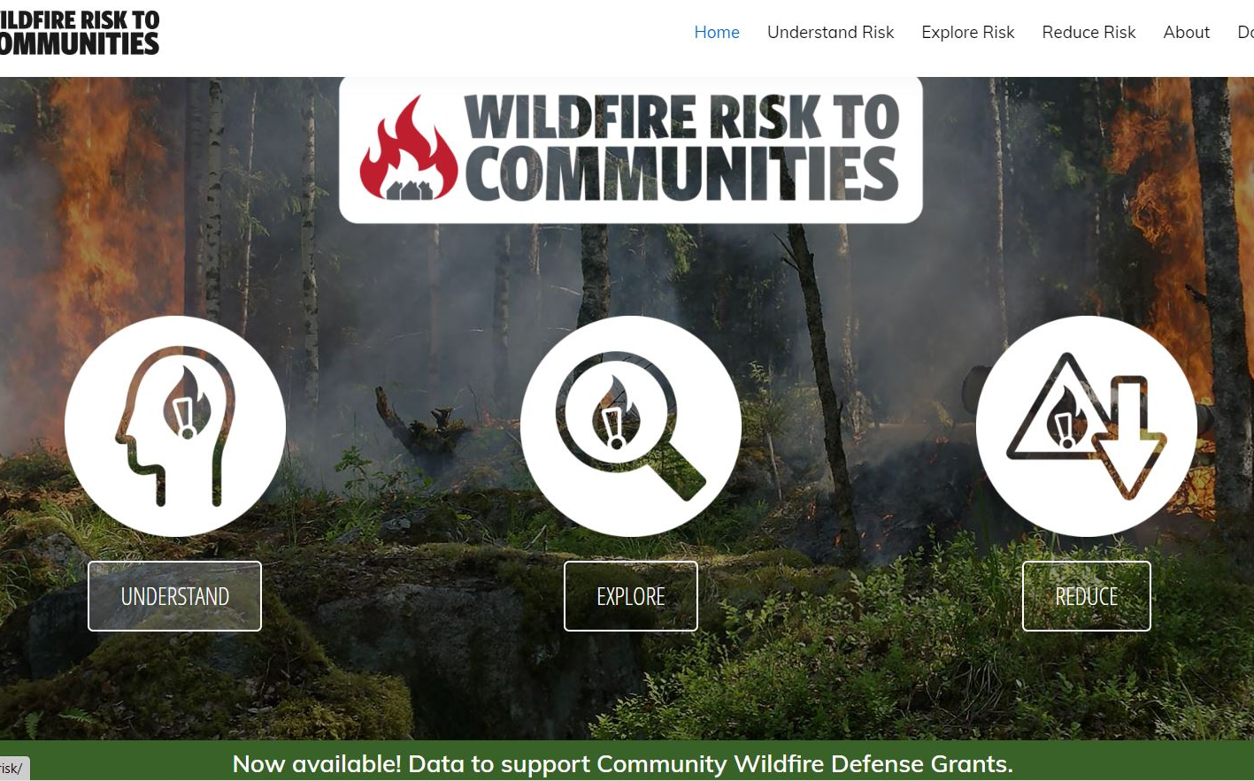
Wildfire Risk and
Underserved Communities
Northeast Midwest Risk Assessment.com
Wildfirerisk.org
Notes:
Removed SVI from the title. Add the CWDG Tool links for “Underserved/Low-Income”.

Slide 22
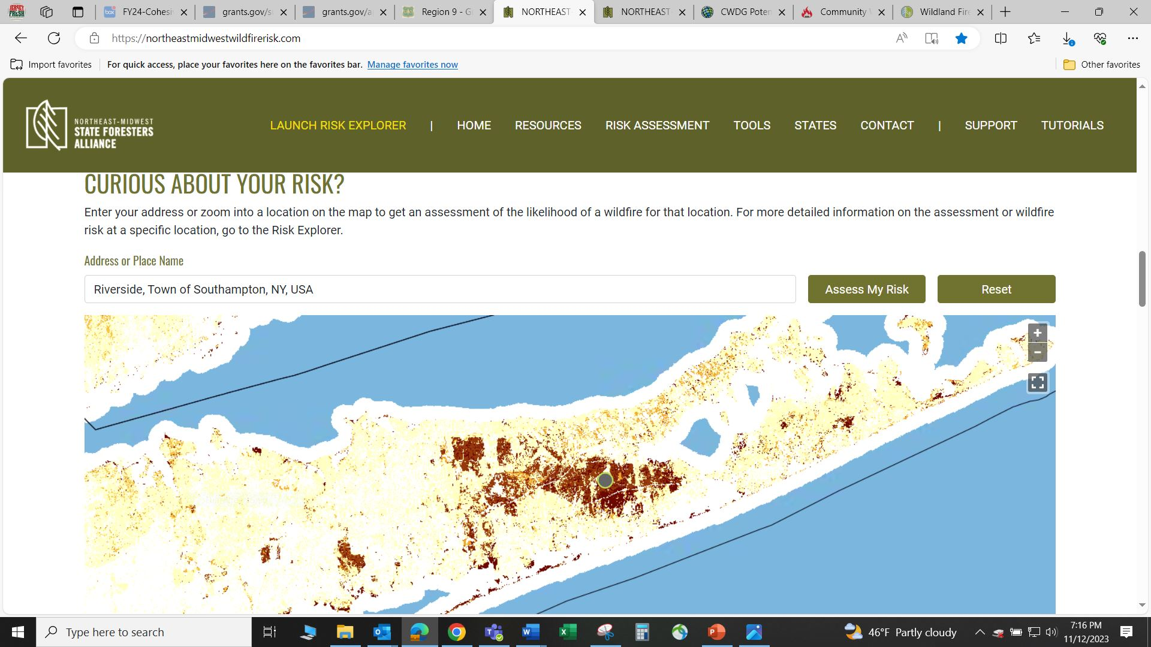
Sources to Support Your Application & Ranking Criteria
Northeast Midwest Risk Assessment.com
Riverside, NY – Curious About Your Risk?
22
Notes:
Add the CWDG Tool links for “Underserved/Low-Income”.
Central Pine Barrens Joint Planning and Policy Commission – Calverton and Riverside, NY

Slide 23
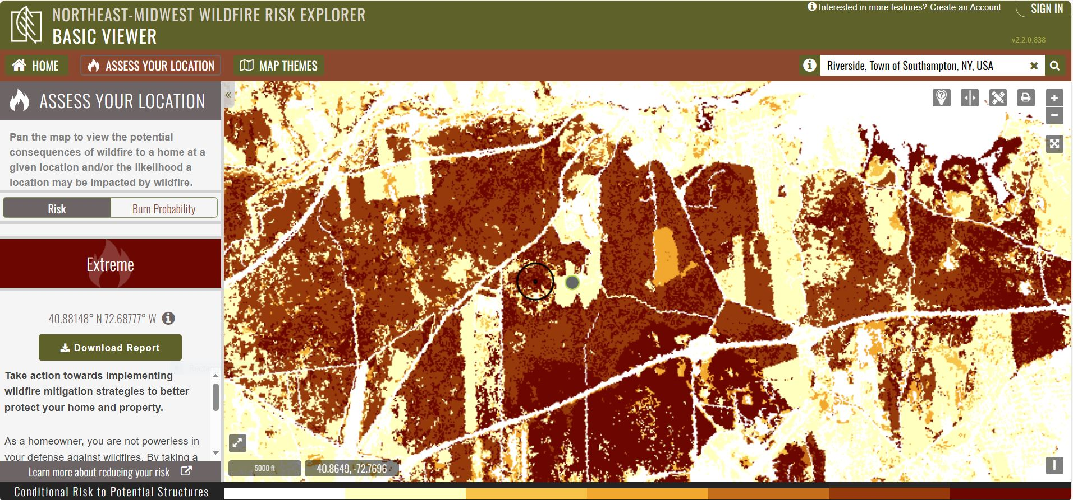
Sources to Support Your Application & Ranking Criteria
Northeast Midwest Risk Assessment.com
Risk Explorer > Basic Viewer > Risk > Extreme!
23
Notes:
Add the CWDG Tool links for “Underserved/Low-Income”.
Central Pine Barrens Joint Planning and Policy Commission – Calverton and Riverside, NY

Slide 24
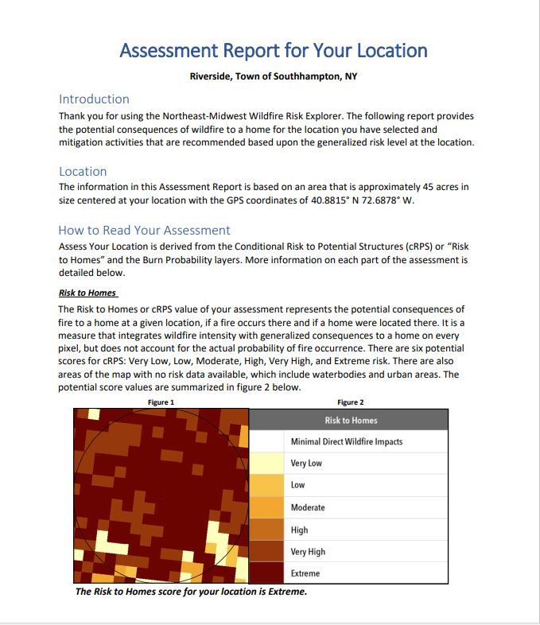
Sources to Support Your Application & Ranking Criteria
Northeast Midwest Risk Assessment.com
24
Notes:
Add the CWDG Tool links for “Underserved/Low-Income”.
Central Pine Barrens Joint Planning and Policy Commission – Calverton and Riverside, NY

Slide 25
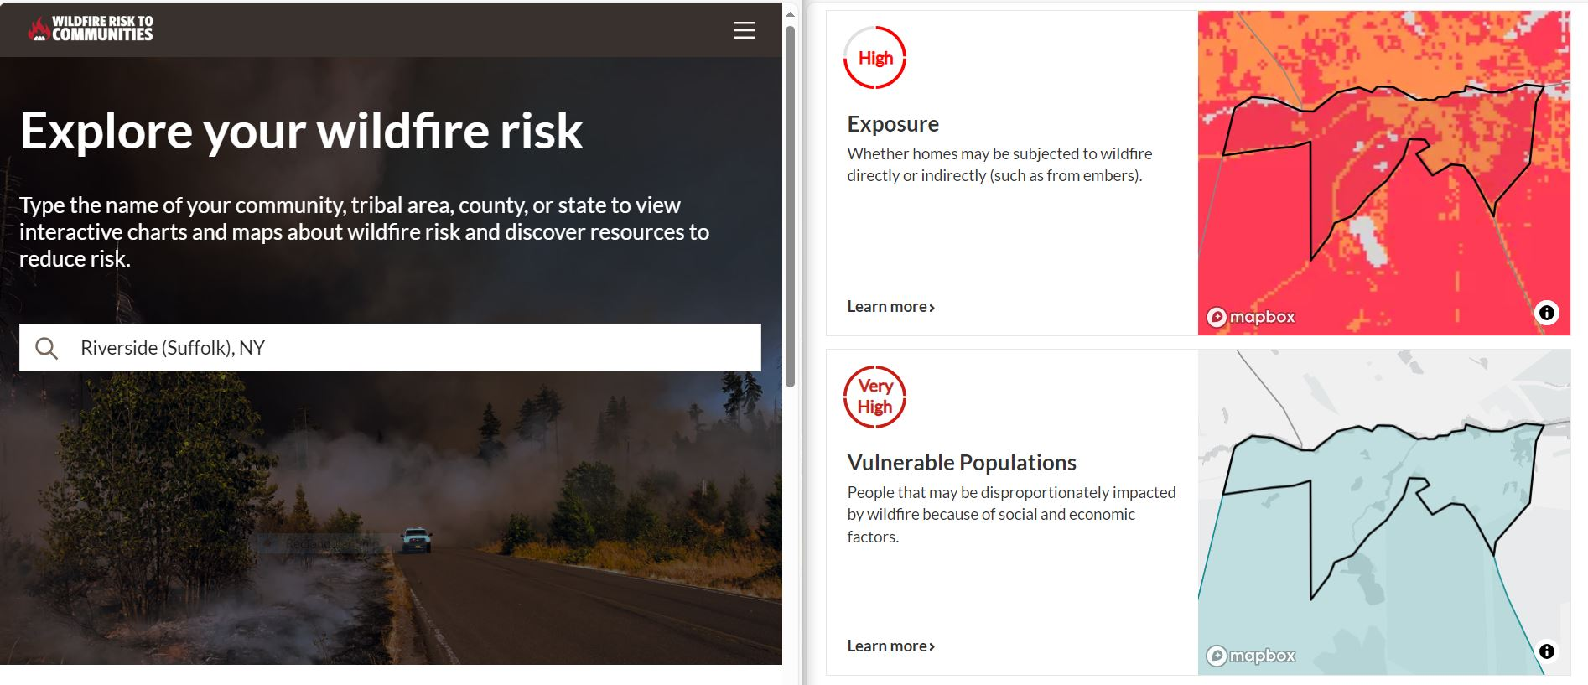
Sources to Support Your Application and Ranking Criteria
Demonstrate a Wildfire Risk Focus: Wildfirerisk.org
25
Notes:
Risk to Homes – Wildfire Potential – Exposure – Vulnerable Populations

Slide 26
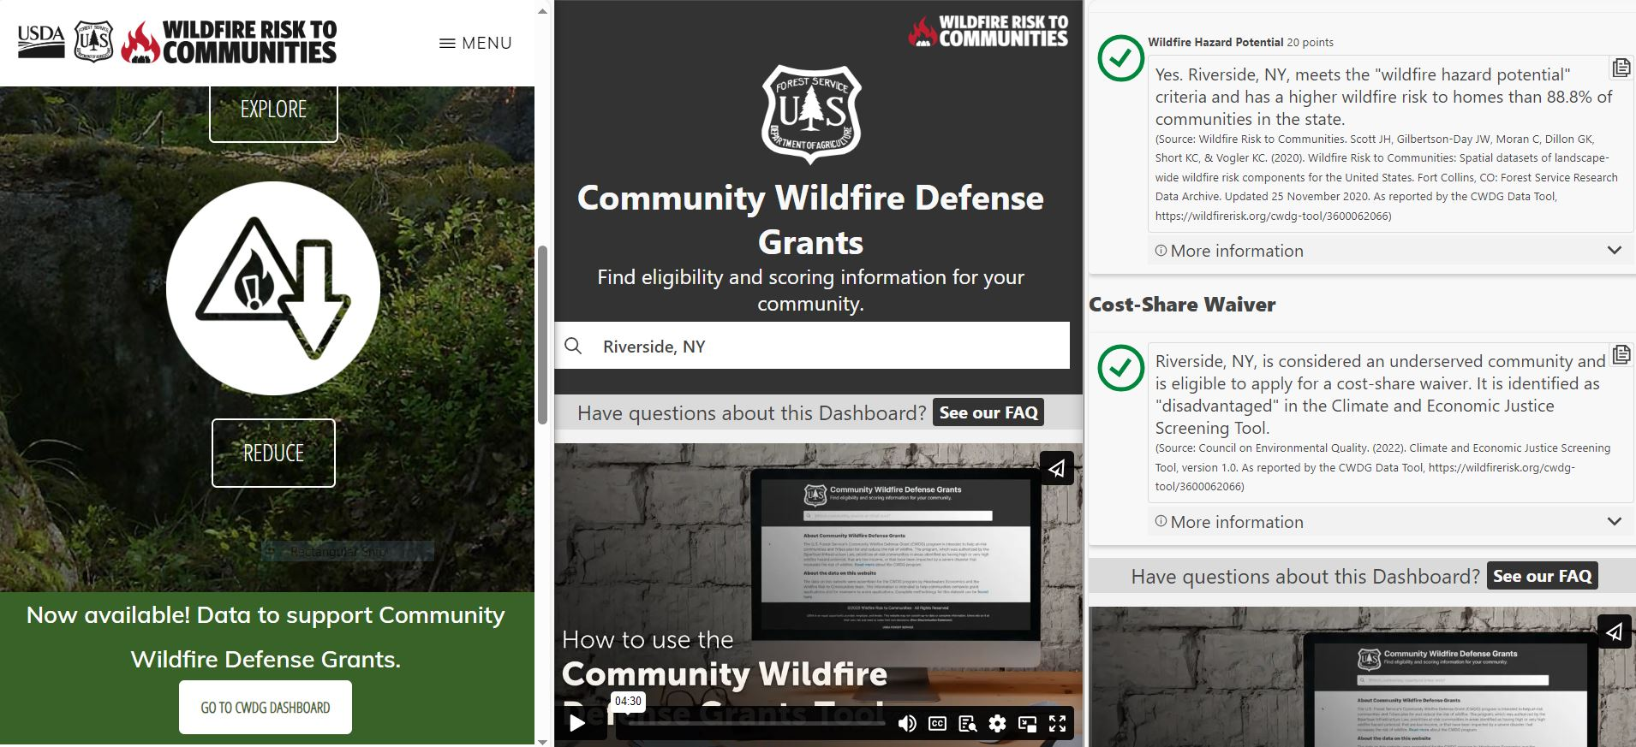

Sources to Support Your Application & Ranking Criteria
- Wildfire Hazard Potential
- Underserved Communities: Climate and Economic
Justice Screening Tool (CEJST)
- Wildfirerisk.org
26
Notes:
Add the CWDG Tool links for “Underserved/Low-Income”.

Slide 27
Once Again in FY 2024 – Grants.gov
Submit all applications through grants.gov
  Search for grant opportunity:
  USDA-FS-2024-COHESIVE-STRATEGY
  Application deadline is January 16, 2024
  Grants.gov provides 24/7 support:
  1-800-518-4726 or support@grants.gov
27

Slide 28
Preparing to Apply
FY 2024 guidance document has details on how to register and apply online through Grants.gov.
Before working in Grants.gov you will need:
    Employer Identification Number (~5 weeks)
    System for Award Management (SAM) registration (~2 weeks)
      Generates the Unique Entity Identifier (formally DUNS#)
    Grants.gov account with Authorized Organization Representative (AOR) role (same day)
One lead agency/grant applicant will submit an application in Grants.gov for all other contributors to the project.
Only Grants.gov users with the AOR role for the applying entity are eligible to submit applications to Grants.gov.
28

Slide 29
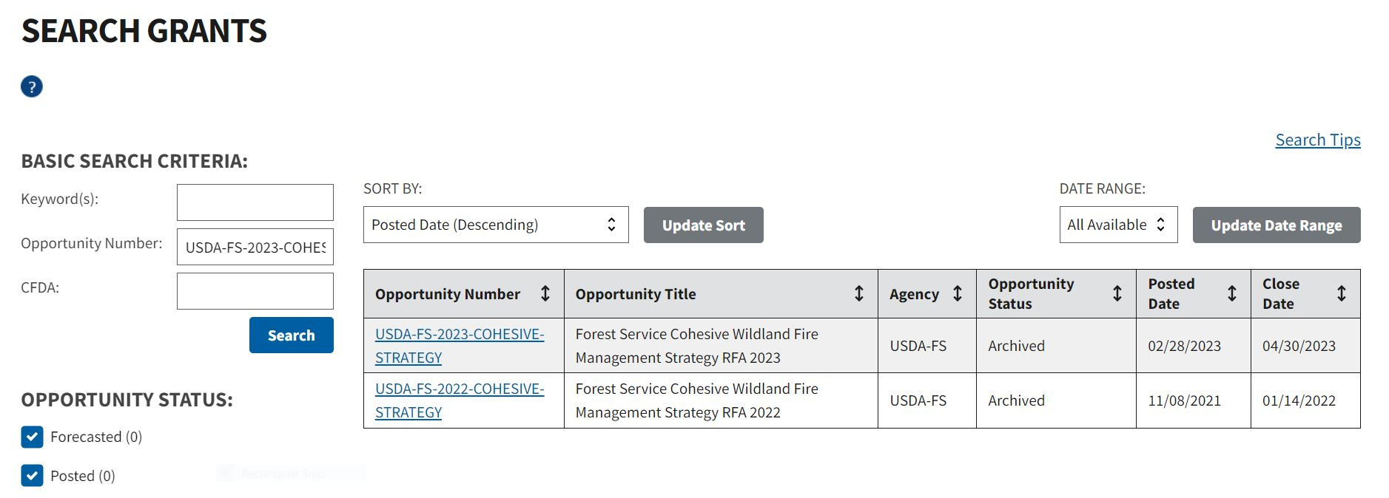
How to Apply: Search Grants
Search for Opportunity:
USDA-FS-2024-COHESIVE-STRATEGY
29
Notes:
Enter the opportunity ID at the top, as a keyword or opportunity number.

Slide 30
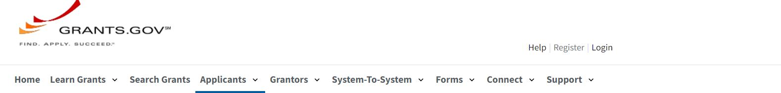
FOR APPLICANTS:
Check Your Availability
Get Registered
Apply for Grants
Track Your Application
Adobe Community
Applicant Training
Applicant FAQ’s
Manage Subscriptions

Slide 31
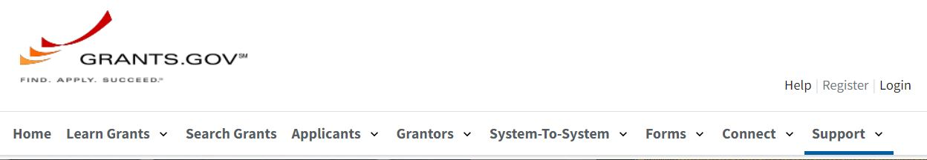
SUPPORT CENTER:
Welcome to Grants.gov Support
  Applicant Support is available 24/7
  1-800-518-4726 or support@grants.gov
FAQ’s
Report Fraud
Find Help and Learn
About the Program
Grants.gov Releases
Feedback

Slide 32
Reminders
Submit application and documents through grants.gov.
Link Project Proposal to NCS Goals/Regional Options and State Forest Action Plans.
Cross-Boundary – Submit your Project Proposal with State Forester and Forest Supervisor letters with signatures.
Cross-Boundary – Provide a map, shape file or .kml for fuels/land treatment as required by FACTS (Forest Service Activity Tracking System).
Cross-Boundary - Funding that will be managed or used by the local National Forest, send all required items directly to Brian Schaffler.
WRR – Submit a separate letter of support from the State Forester or appropriate designated authority (NJ, State Fire Warden; NY, Director of Forest Protection) for approving activities.
WRR – Provide current accomplishment data with a NFPORS form as required by NFPORS.
WRR – At least 100% match of requested Federal funds is required.
Proposals due by January 16, 2024 – Include ALL required items.
32

Slide 33
Contacts
For Cross-Boundary Mitigation and all R9 States with National Forests/Prairie:
Brian Schaffler, Fuels Program Manager
brian.schaffler@usda.gov
(517) 285-9258
For WRR in Delaware, Maryland, New Jersey, Pennsylvania, Ohio, West Virginia or Connecticut:
Maris Gabliks, Cooperative Fire Specialist
maris.g.gabliks@usda.gov
(609) 235-7524
For WRR in Indiana, Iowa, Illinois, Missouri, Minnesota, Wisconsin, or Michigan:
Caleb Schreiber, Cooperative Fire Specialist
caleb.schreiber@usda.gov
(715) 628-6999
For WRR in Massachusetts, Maine, New Hampshire, New York, Rhode Island, or Vermont:
Helene Hochholzer, Cooperative Fire Specialist
helene.hochholzer@usda.gov
(860) 861-7322

Slide 34
Key Sources to Support Your Application
Region 9 - Grants & Agreements
National Cohesive Wildland Fire Management Strategy
State Forest Action Plans
Northeast Regional Action Plan
Northeast-Midwest Wildfire Risk Assessment Portal (NMWRAP)
Wildfire Risk to Communities & Underserved Community Data
34

Slide 35
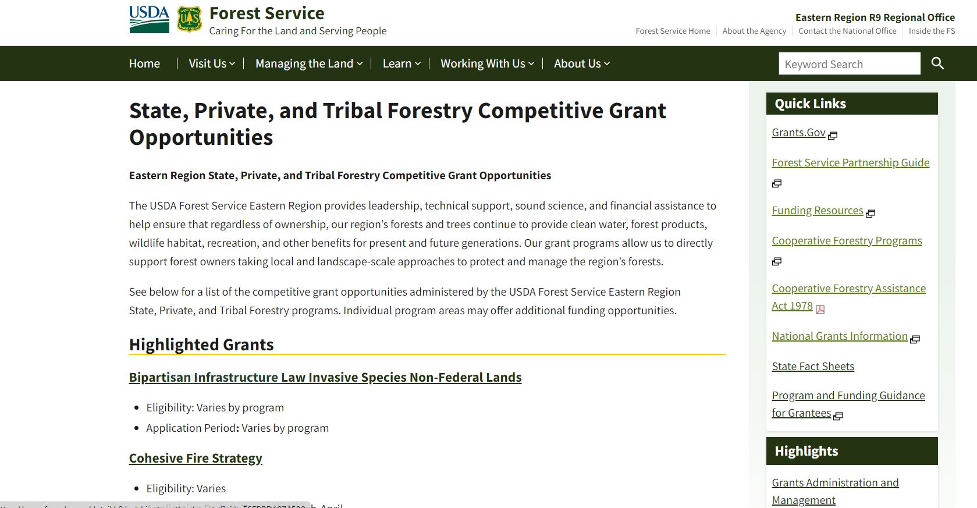
Region 9 - Grants & Agreements
35
Notes:
Add the CWDG Tool links for “Underserved/Low-Income”.
Central Pine Barrens Joint Planning and Policy Commission – Calverton and Riverside, NY

Slide 36
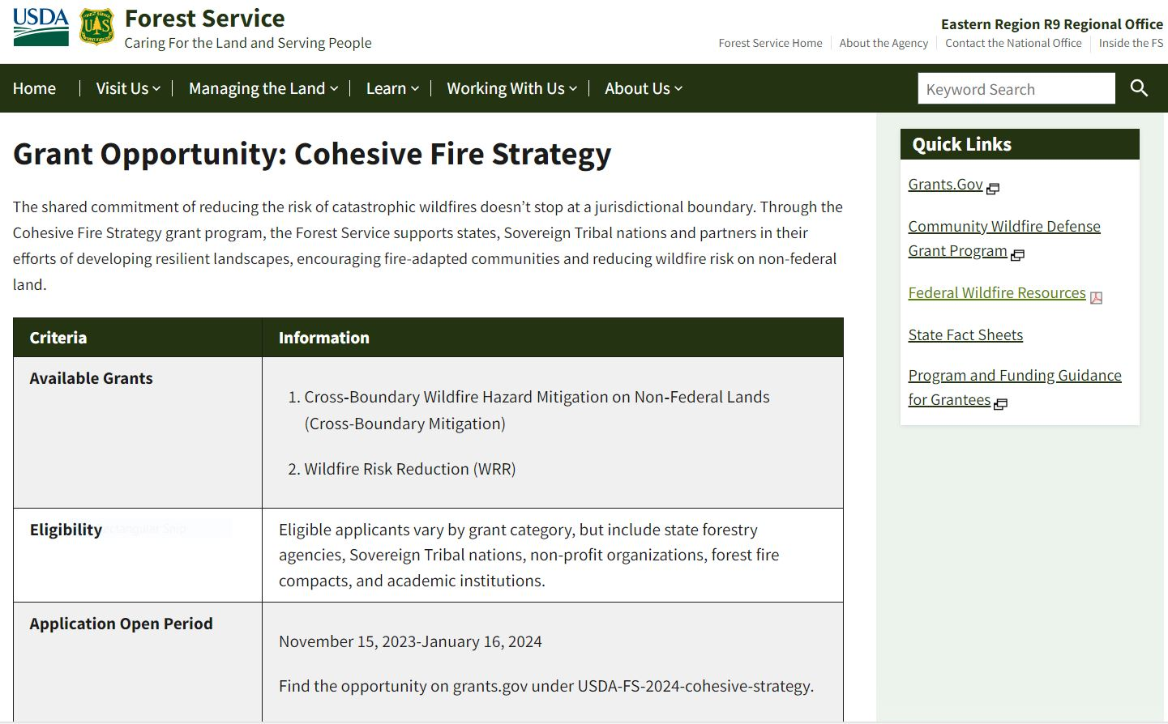
> Recorded Webinar
> 2024 Grant Information
- Guidance and Instructions
- Optional Narrative Template
> Contact Information
36
Notes:
Add the CWDG Tool links for “Underserved/Low-Income”.
Central Pine Barrens Joint Planning and Policy Commission – Calverton and Riverside, NY

Slide 37

Thank you for your participation!
Questions?
Type your questions in the Chat or
to speak up with your question:
Raise your hand (at top). Wait to be called on.
When called on: Start your webcam (optional), unmute, say your name and title, ask your question!
When done: Mute your mic. and stop your webcam.
37

