Slide 1
Webinar: Notice of Funding Opportunity for the Scientific Leadership Award for Minority Serving Institutions
August 27, 2020
Greg Simmons
Program Manager
Office of University Programs
Science and Technology Directorate

Slide 2
Webinar Information
Acronyms:
  COE = Center of Excellence
  HSE = Homeland Security Enterprise
  MSI = Minority Serving Institution
  NOFO = Notice of Funding Opportunity
  OUP = Office of University Programs
  SLA = Scientific Leadership Award
  STEM = Science, Technology, Engineering, and Math
Please submit questions in the Chat Box.
  Questions will be answered at the end of the webinar, time permitting.
  Questions/answers will be posted on grants.gov.
Questions about specific research themes, topics, or questions will not be addressed during this webinar.

Slide 3
Agenda
DHS S&T OUP Overview
MSI SLA
  Expectations of a SLA recipient
  Who can apply for a SLA
  Clarification about funding
DHS S&T COEs
Review Process
Tips to consider when applying for a SLA grant
Q&A

Slide 4
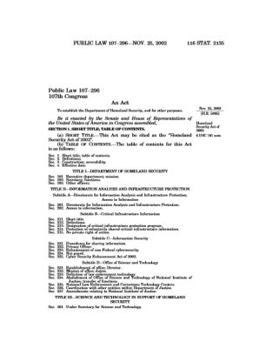
Congressional Direction
Homeland Security Act 2002
  The Under Secretary for Science and Technology shall have the responsibility for:
    “[establishing] … a coordinated, university-based system to enhance the Nation’s homeland security”
    “supporting United States leadership in science and technology”
    “merit review of research and development projects … and the dissemination of research conducted or sponsored by the Department”

Slide 5
DHS S&T
Office of University Programs
Streamlines access to the expertise of the Nation’s colleges and universities to address pressing homeland security needs:
  Makes it easy to tap into the intellectual power of America’s universities for homeland security research, development and education.
  DHS Components can access academic expertise to answer research questions, deliver technical solutions, and build a highly specialized workforce.
  Program Managers provide individualized service to DHS Components and assist with finding needed R&D capabilities within a network of over 200 partner institutions.
  Offers established vehicles through which DHS Components and other partners can access the research and expertise found at the DHS S&T COEs.

Slide 6
DHS S&T OUP Functions
Establishes and manages COEs, MSI programs, and workforce and professional development initiatives, including:
  Managing competitions and merit reviews
  Managing COE projects for DHS Components
  Establishing competed vehicles to provide access to COEs
  Establishing and managing academic-related vehicles
  Providing fellowship vehicles
  Matching Components with needed capabilities within the COE network
  Creating opportunities for the homeland security enterprise to interact with researchers

Slide 7
DHS S&T OUP Thrust Areas
COEs:
  COEs develop innovative, customer-driven homeland security science and technology solutions and train the next generation of homeland security experts.
    Each new university-based COE is a consortium competitively awarded for a ten-year term
    Network of ten COEs and more than 200 partners
MSIs:
  MSI programs diversify the academic institutions involved in the homeland security mission and train dedicated professionals who can sustain the homeland security and technology workforce.
    SLAs – institutional awards to support the development of homeland security science and engineering teaching initiatives
    Summer Research Team Program – grants supporting summer research collaborations that engage early career faculty and students with the COEs

Slide 8
Overview of SLAs
DHS S&T aims to support the ability of MSIs to learn techniques, build capacity, and connect with various organizations conducting business in or directly supporting homeland security mission areas.
SLAs provide funding to MSIs to support research and professional development opportunities for faculty, course development, and equipment purchases for capability enhancement.
SLAs support MSIs in their efforts to attract highly technical students and provide exposure and mentorship opportunities with DHS programs.
Students and faculty engage in research projects related to the homeland security enterprise (HSE), while also providing a pathway towards student internships or fellowship programs that provide relevant experiences to support DHS and the HSE at large.
SLA recipients consistently engage with DHS S&T to ensure that the program is effectively building the workforce that will support the HSE going forward.
Awarded institutions develop programs that provide experiential learning opportunities for students that already are pursuing STEM related degrees.

Slide 9
What are Expectations for SLAs?
SLAs are funded through cooperative agreements, which enable and require substantial federal agency involvement.
Applicants for SLAs should expect to:
  Dedicate time and resources to DHS S&T
  Perform research management and student oversight
  Adapt to evolving homeland security challenges and priorities
  Identify and partner with leading researchers in relevant disciplines
  Develop sustained relationships with homeland security stakeholders
  Collaborate with COEs and be actively engaged in the DHS S&T community
  Integrate homeland security research and topics into curriculum/courses

Slide 10
Who Can Apply?
Proposals may be submitted only by accredited Alaska Native-Serving and Native Hawaiian-Serving Institutions (ANNHs), Asian American and Native American Pacific Islander-Serving Institutions (AANAPISIs), Historically Black Colleges and Universities (HBCUs), Hispanic- Serving Institutions (HSIs), Native American-Serving Nontribal Institutions (NASNTI), Predominately Black Institutions (PBIs), or Tribal College or Universities (TCUs) in the U.S., its territories or possessions, and the Commonwealth of Puerto Rico; these institutions must award bachelors’ degrees in STEM fields
SLA Performer
  One grant will be awarded to an eligible institution
Applicants
  Any Principal Investigator at an accredited MSI can apply in partnership with other subcontractors or performers
  One project per proposal
  May submit more than 1 proposal for separate projects

Slide 11
Clarification about Funding
~$3.2 million is available for up to 7 SLA performers.
DHS S&T will award funds in two phases.
Minimum award amount for each phase is $250K with a maximum of $350K.
Phase 2 funding is contingent upon phase 1 progress and accomplishments.
Note that recipient must use 50% of total budget for direct support of students,
  Support may be in the form of stipends for unpaid internships, scholarships, student employment, etc.

Slide 12
Scientific Leadership Awards
COE Collaboration
  The proposal must include a letter of support from a DHS S&T COE, detailing how the COE and the SLA recipient will work collaboratively to advance proposed project(s)
    The COE thematic research areas should align with or compliment the applicants proposed research project(s)

Slide 13










Current DHS S&T
Centers of Excellence
Security Technology Transition/ Master of Business Administration
Logo - TBD

Slide 14
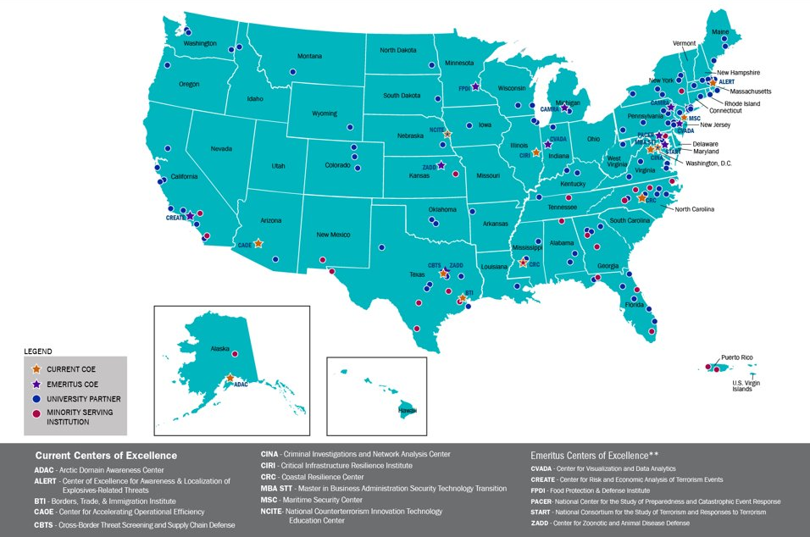
Current and Emeritus COE Network

Slide 15
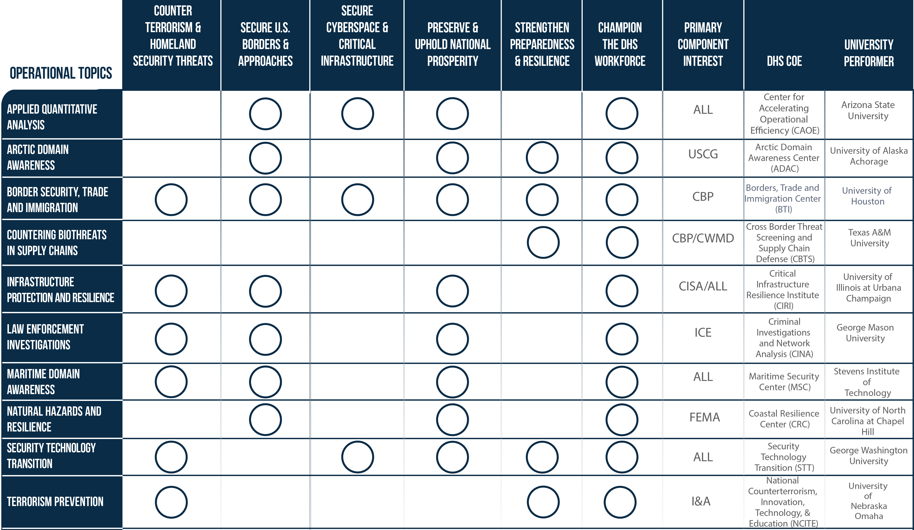
COE Topic Alignment to DHS Missions

Slide 16
Why Should You Apply?
Being a SLA recipient is a unique opportunity to:
Work on real homeland security challenges
Develop solutions to make the nation safer, more secure, and resilient against terrorism
Work closely with a combination of:
  Homeland security operational personnel including local, state, and other federal agencies
  Scientific subject matter experts
  Industry and nonprofit organizations
Foster and enable high-level, inter-agency and public-private partnerships and collaboration
Cultivate and mature the next-generation of STEM workforce ready to address homeland security challenges

Slide 17
Overall Review Process
Competition Dates:
  Posting of Funding Opportunity Announcement: August 10, 2020
  Submission of Proposals by Closing Date: October 9, 2020
Two-tiered Review:
Scientific Quality Review (External Review): October 12 – November 6, 2020
    Focus on the research quality and influence, the education program, and the appropriateness of the costs.
Relevancy Review (Internal DHS SMEs): October 12 – November 6, 2020
    Focus on the mission relevance of the proposed research, education and outreach programs and the applicant’s demonstrated capabilities.

Slide 18
Tips for Applying
Read the entire NOFO
Develop a diverse but integrated multi-institutional, multidisciplinary team
Structure projects to be measurable and managed using technical and programmatic milestones
Plan for transitioning research results or technologies
Create a matrix – did you address everything?
Notes:
TP: Carefully read the FOA. It is complicated and we ask a lot of Center Lead applicants. Please be responsive.

Slide 19
Questions?
What to know more about the DHS S&T Office of University Programs?
Visit:
https://www.dhs.gov/science-and-technology/office-university-programs

