Slide 1
USFS Eastern Region
Cohesive Fire Strategy
2023 Request for Applications
U.S. Forest Service
Eastern Region State, Private, & Tribal Forestry
Fire & Aviation Management, Cooperative Fire Program

Slide 2
Welcome and Overview
National Cohesive Strategy
2023 Cohesive Fire Strategy RFA
Wildfire Risk Reduction (WRR)
Cross‐Boundary Wildfire Hazard Mitigation on Non‐Federal Lands
Grants.gov
2

Slide 3
National Cohesive Strategy
Restore & Maintain Landscapes
  Landscapes across all jurisdictions are resilient to fire related disturbances in accordance with management objectives.
Fire Adapted Communities
  Human populations and infrastructure can withstand a wildfire without loss of life or property.
3

Slide 4
Northeast Regional Action Plan Implementation Actions
Use of Prescribed Fire for Multiple Benefits
Restore Fire Adapted Ecosystems
Mitigate “Event” Created Hazardous Fuels
Support Local Fire Adapted Communities
Treat Hazardous Fuels in the WUI
Promote Prevention Programs
Developed by the Northeast Regional Strategy Committee and stakeholders to identify the most important actions to progress on.
4

Slide 5
Cross-Boundary Mitigation Grant
Wildfire Risk Reduction Grant
Target: Goals 1 and 2 of the Cohesive Strategy
Restore and Maintain Landscapes
Fire Adapted Communities
Meet one or more Regional options 1-6
    Use of Prescribed Fire for Multiple Benefits
    Restore Fire Dependent Ecosystems
    Mitigate “Event” Created Fuels
    Support Local Fire Adaptation by Communities
    Treat Hazardous Fuels in the WUI
    Promote Prevention Programs
5

Slide 6
Eligibility
Cross-Boundary Mitigation:
State Forestry Agencies
Local Governments
Tribes
Nonprofit Organizations
National Forests (applying on behalf of adjacent non-Federal landowners)
Private landowners and associations
Wildfire Risk Reduction (WRR) Component:
State Forestry Agencies
Forest Fire Compacts
Groups of States
Tribes
Nonprofit Organizations
Academic Institutions
“For Profit” organizations are not eligible for this funding opportunity
6

Slide 7
Funding Limits & Match Requirements
Wildfire Risk Reduction (WRR)
$25,000 to $300,000 in Federal funds
Equipment: No more than 25% of Federal funds requested
Maximum amount awarded to any one State (State Cap) cannot exceed 15% of the total FY2023 funds allocated
Estimated FY 2023 cap for states is $420,000
Estimated FY 2023 WRR funding level is $2.8 million
Third Party funding is included in the overall State Cap
WRR grant funds must be matched 100 percent or more by eligible and allowable costs and are subject to match provisions
7

Slide 8
Funding Limits & Match Requirements:
Cross-Boundary Mitigation Projects
No Funding Limit for individual projects
No State Cap
FY2023 Grant Program funding level is $1.5 million
Match not required, but considered when ranking applications
8

Slide 9
Wildfire Risk Reduction (WRR)
Example Activities
Use of Prescribed Fire
Use of Mechanical Fuel Reduction
Vegetation Management
Use of small diameter wood
Defensible Space
CWPPs or equivalent
Fuel Breaks & Fire Breaks
Dry Hydrants that support a Fire Adapted Community
Fire Mngmt Planning in fire adapted landscapes w/ FAC’s
Slash Removal
Brochures, PSA’s
Property Assessments
Prescribed Fire or fire adapted communities related training
Exercises that support FAC’s
I&E, Firewise, RSG, FAC & Fire Prevention Programs
Wx station upgrades that support a FAC
Non-Qualifying Examples:
  Research and development projects
  Capital improvements
  Economic development projects
9
Notes:
Non qualifying:
Research and development projects
Capital improvements
Economic development projects

Slide 10
Cross-Boundary Mitigation Criteria
Project must benefit resources on Federal Land
  State Forester and Forest Supervisor Support (completed project form)
  Treat priority areas within State Forest Action Plans, Risk Assessments, CWPP’s, etc.
  Reduce chance of fire starting and affecting federal land (prevention)
  Treat hazardous fuels where fire transmission could affect NF system land
  Treat hazardous fuels and improve ecological conditions within watersheds with NFS lands
10
Notes:
Non qualifying:
Research and development projects
Capital improvements
Economic development projects

Slide 11
Cross-Boundary Mitigation Examples
Examples:
  Hazardous fuels reduction activities (fuel breaks, Rx burning, timber harvest)
  Development and implementation of CWPP or equivalent
  Technical assistance (silvicultural prescriptions, burn plan development)
  Training or monitoring activities on non-federal lands that benefit resources on Federal land
Non-Qualifying Examples:
  Research and development projects
  Capital improvements
  Economic development projects
11
Notes:
Non qualifying:
Research and development projects
Capital improvements
Economic development projects

Slide 12
NFPORS Forms are Required for WRR
Mandatory for all SFA, VFA, and WRR Grant applications
For questions on NFPORS please contact your Coop Fire staff
Please report accurately. The acres treated are part of the region’s accomplishment target
12

Slide 13
Ranking Criteria: 100 points possible
Address Northeast Regional Action Plan's Options (40 pts)
Engage in partnerships and collaboration (20 pts)
Assist Underserved Communities (5 pts)
Explain project effectiveness and efficiency (20 pts)
Demonstrate a Wildfire Risk Focus (15 pts)
13

Slide 14
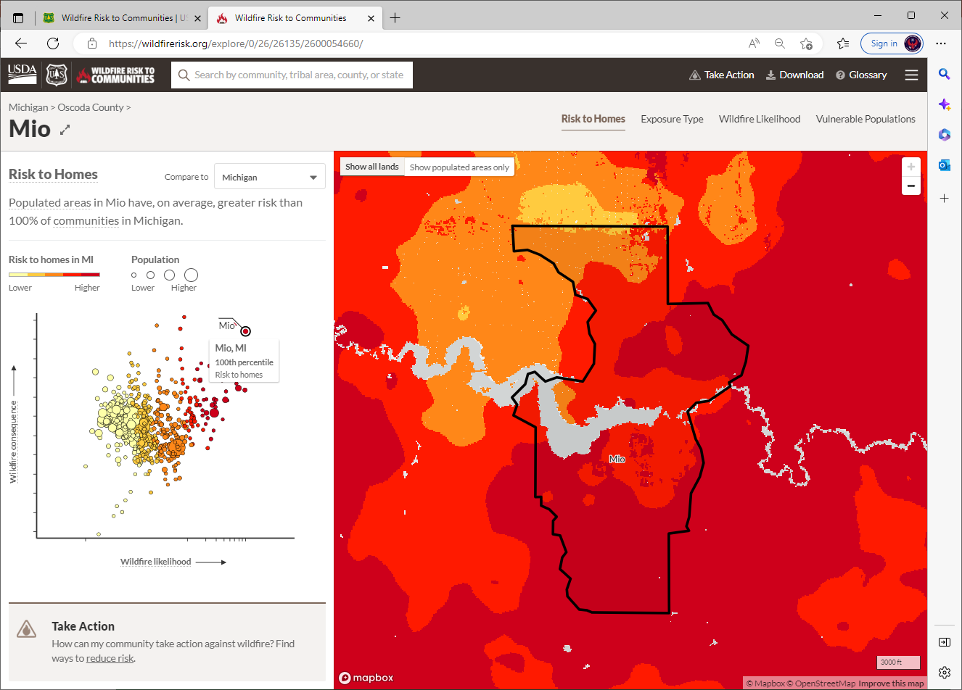
Sources to support your application and ranking criteria…
Demonstrate a Wildfire Risk Focus: https://wildfirerisk.org
14

Slide 15
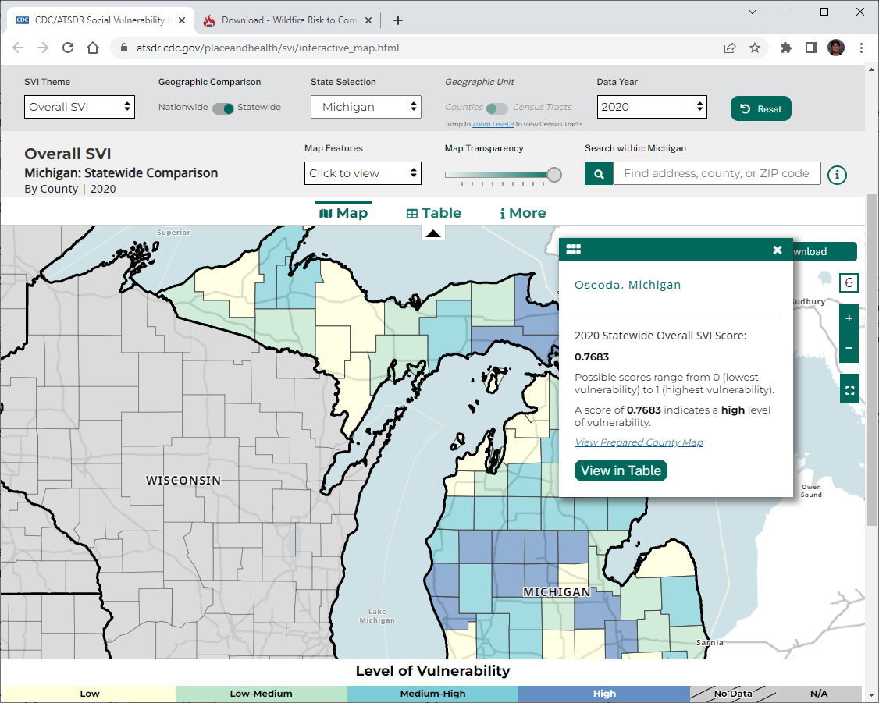
Sources to support your application & ranking criteria…
Underserved Communities: CDC Social Vulnerability Index (SVI)
https://www.atsdr.cdc.gov/placeandhealth/svi/interactive_map.html
https://wildfirerisk.org/download/
15

Slide 16
Again in FY 2023 – Grants.gov
Submit all applications through Grants.gov
  Search for grant opportunity:
  USDA-FS-2023-COHESIVE-STRATEGY
  Application deadline is April 30th, 2023
  Grants.gov provides 24/7 support:
  1-800-518-4726 or support@grants.gov
16

Slide 17
Preparing to Apply
FY 2023 guidance document has details on how to register and apply online through Grants.gov.
Before working in Grants.gov you will need:
    Employer Identification Number (~5 weeks)
    System for Award Management (SAM) registration (~2 weeks)
      Generates the Unique Entity Identifier (formally DUNS#)
    Grants.gov account with Authorized Organization Representative (AOR) role (same day)
One lead agency/grant applicant will submit an application in Grants.gov for all other contributors to the project.
Only Grants.gov users with the AOR role for the applying entity are eligible to submit applications to Grants.gov.
17

Slide 18
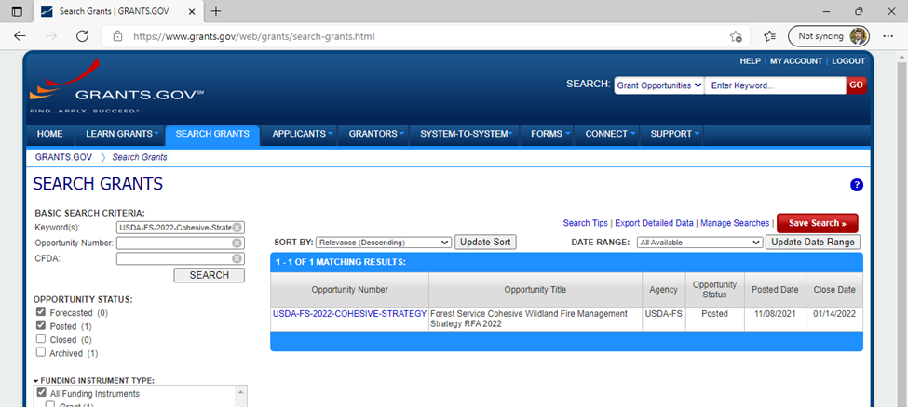
How to Apply: Search Grants
Search for Opportunity:
USDA-FS-2023-COHESIVE-STRATEGY
18
Notes:
Enter the opportunity ID at the top, as a keyword or opportunity number.

Slide 19
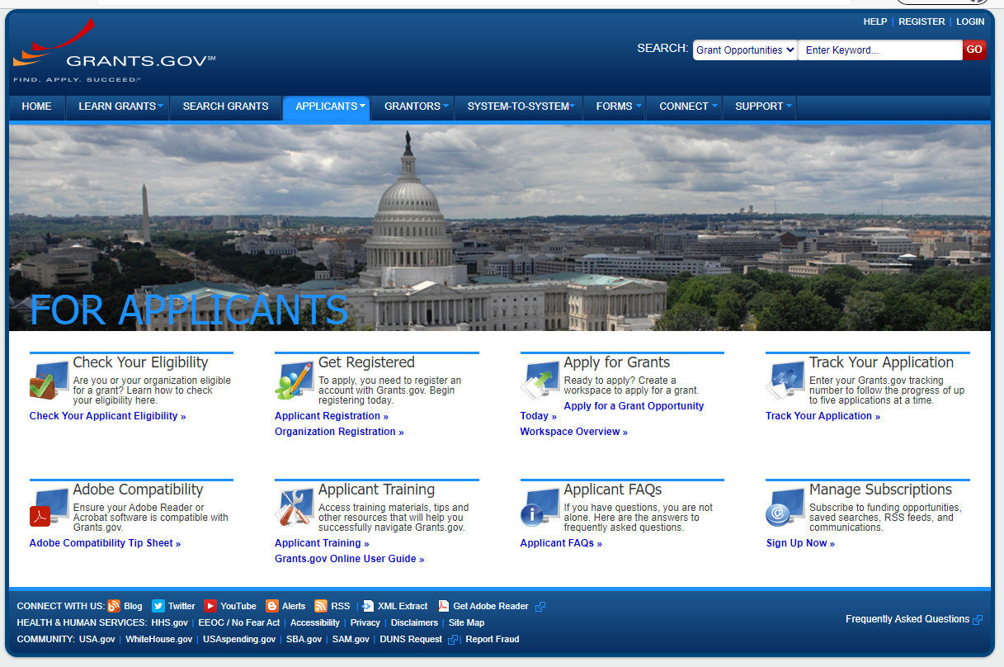
Grants.gov Support:
1-800-518-4726 and support@grants.gov
19

Slide 20
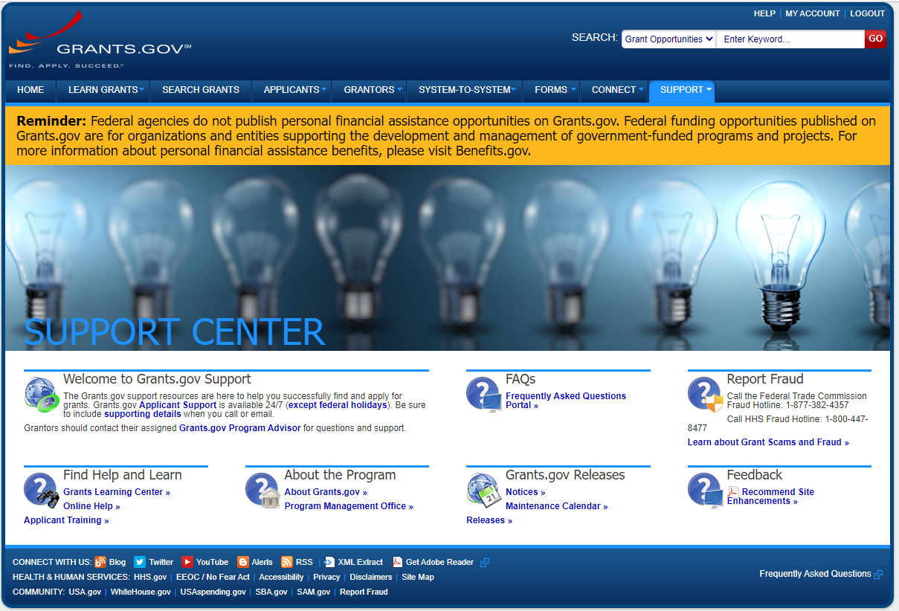
Grants.gov Support Center
20

Slide 21
Reminders
Submit a separate letter of support from the State Forester or appropriate designated authority (NJ, State Firewarden; NY, Director of Forest Protection) for approving activities for WRR.
Submit your Project Proposal Form with State Forester and Forest Supervisor signature for Cross-Boundary projects
Include a current NFPORS form for WRR.
Link Project Proposal to NCS Goals/Regional Options and State Forest Action Plans.
At least 100% match of requested Federal funds is required for WRR.
Provide an electronic shape file for fuels/land treatment for Cross-Boundary projects.
Submit application and documents through Grants.gov.
Proposals due by April 30th, 2023.
Include all required items.
21

Slide 22
Contacts
For Cross-Boundary Mitigation and all R9 States with National Forests/Prairie:
Brian Schaffler, Fuels Program Manager
brian.schaffler@usda.gov
(414) 297-3682 (Desk)
(517) 285-9258 (Mobile)
For WRR in Delaware, Maryland, New Jersey, Pennsylvania, Ohio, or West Virginia:
Maris Gabliks, Cooperative Fire Specialist
maris.g.gabliks@usda.gov
(609) 235-7524
For WRR in Indiana, Iowa, Illinois, Missouri, Minnesota, Wisconsin, or Michigan:
Maris Gabliks, Cooperative Fire Specialist
maris.g.gabliks@usda.gov
(609) 235-7524
For WRR in Connecticut, Massachusetts, Maine, New Hampshire, New York, Rhode Island, or Vermont:
Ray Parrish, Cooperative Fire Specialist
raymond.j.parrish@usda.gov
(414) 297-3348

Slide 23
Key Sources to Support Your Application
National Cohesive Wildland Fire Management Strategy
Northeast Regional Action Plan
State Forest Action Plans
CDC Social Vulnerability Index (SVI)
Wildfire Risk to Communities & Low-income Community Data
Northeast-Midwest Wildfire Risk Assessment Portal (NMWRAP)
23

Slide 24
Questions?
Thank you for your participation
U.S. Forest Service
Eastern Region State, Private, & Tribal Forestry
Fire & Aviation Management, Cooperative Fire Program
24

