Slide 1
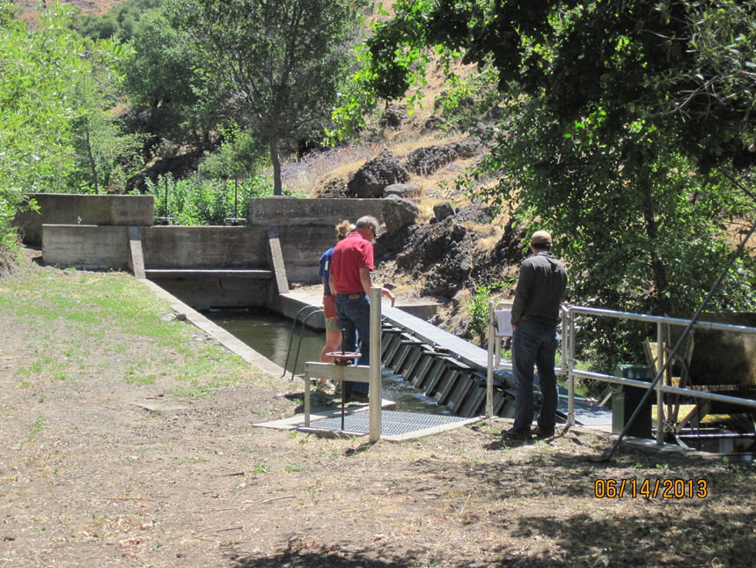
DCID screen and headgate

Slide 2
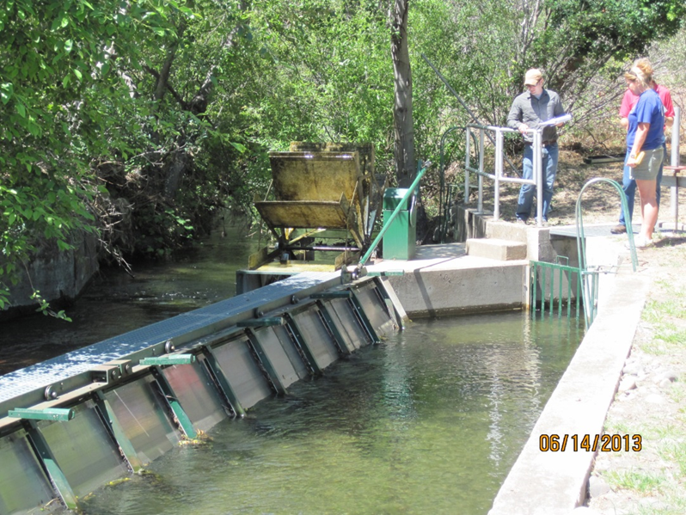
Bypass
entrance
DCID screen and bypass entrance

Slide 3
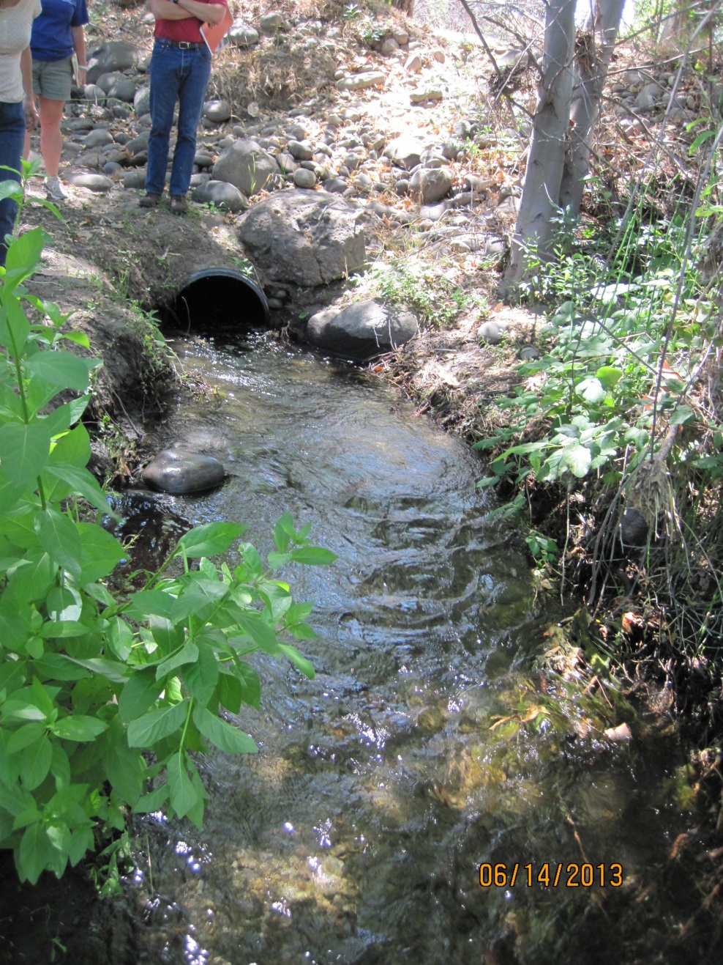
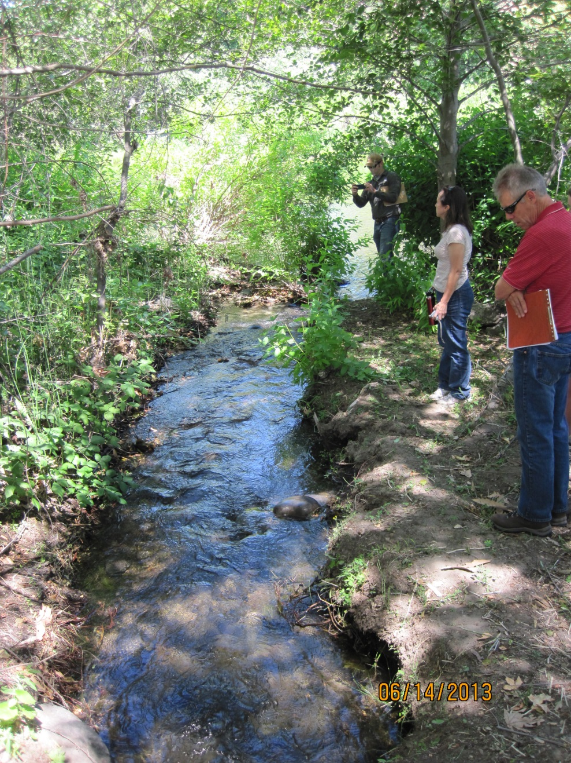
DCID bypass outlet
DCID bypass outlet to stream

Slide 4
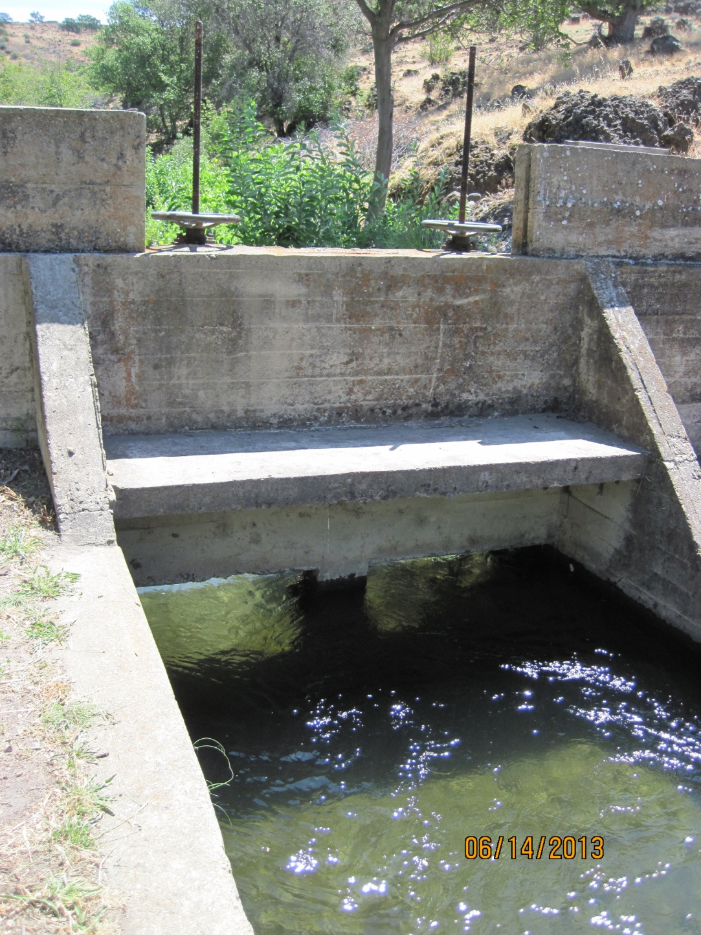
DCID headgate, downstream side

Slide 5
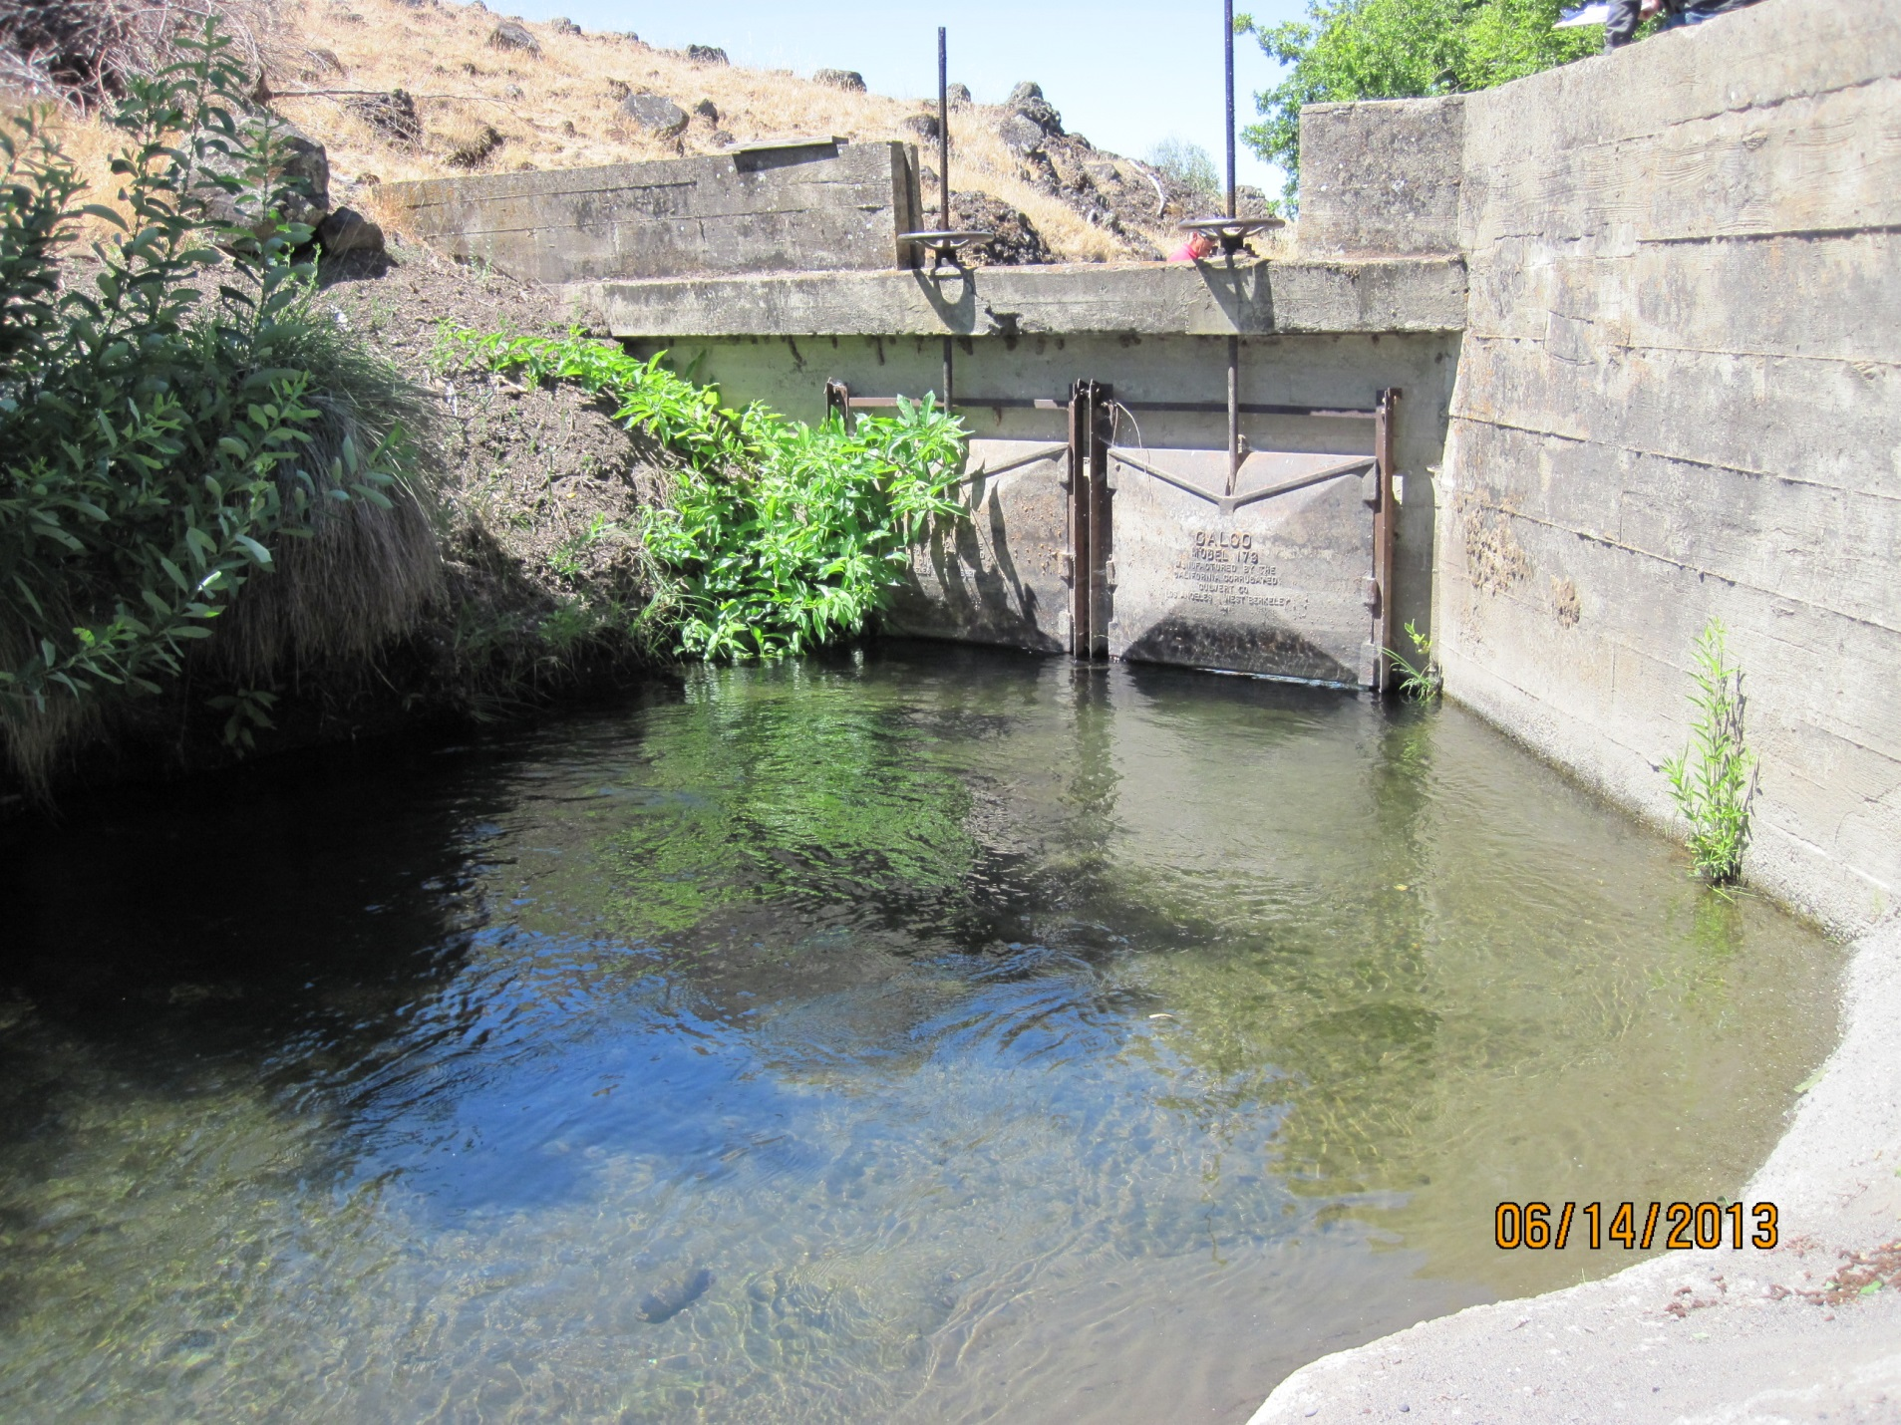
DCID headgate, upstream side

Slide 6
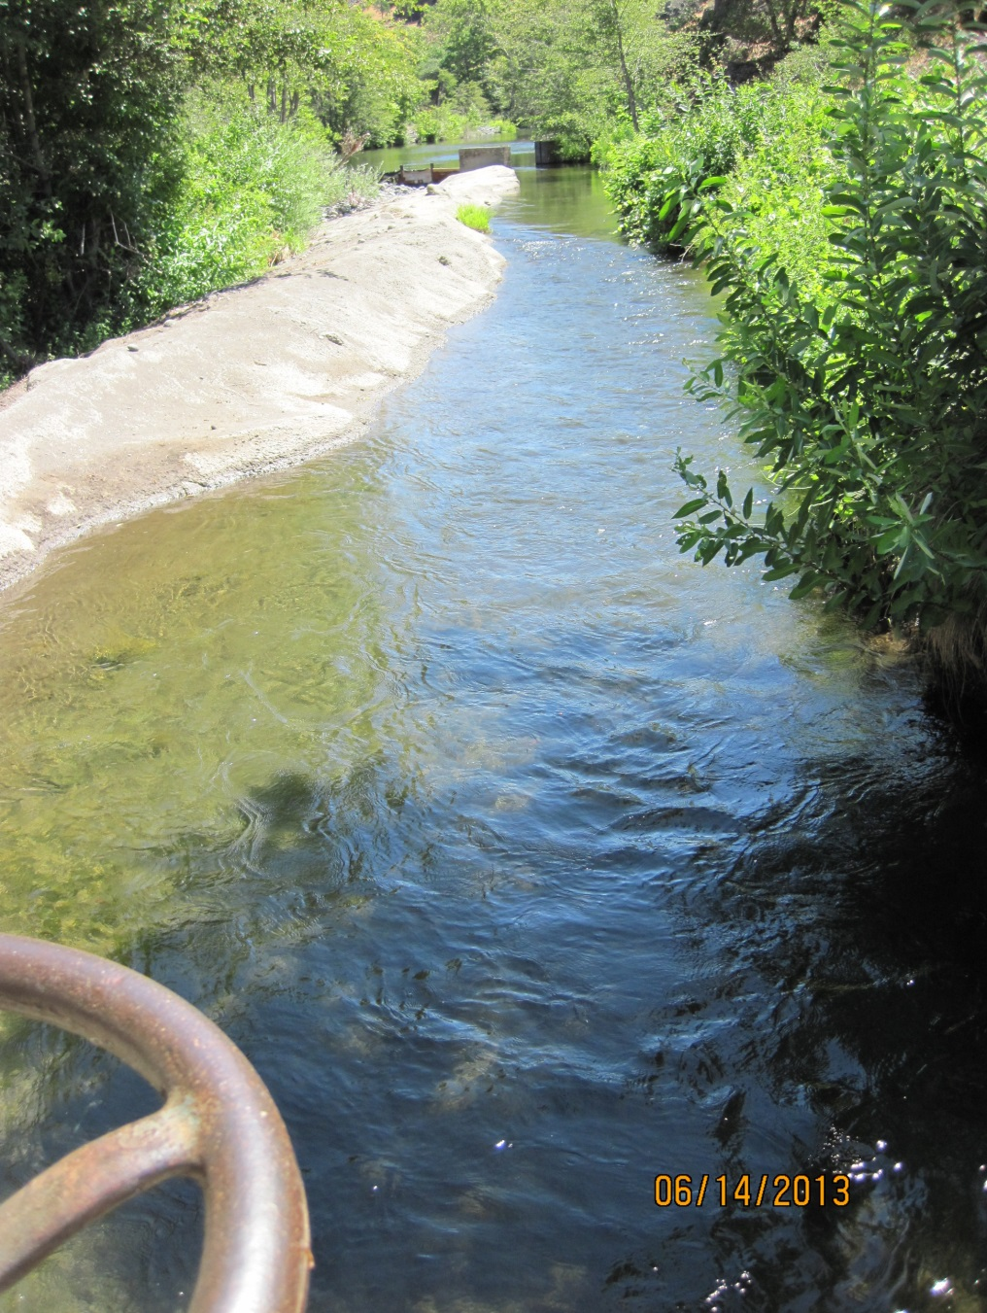
DCID ditch from stream to headgate

Slide 7
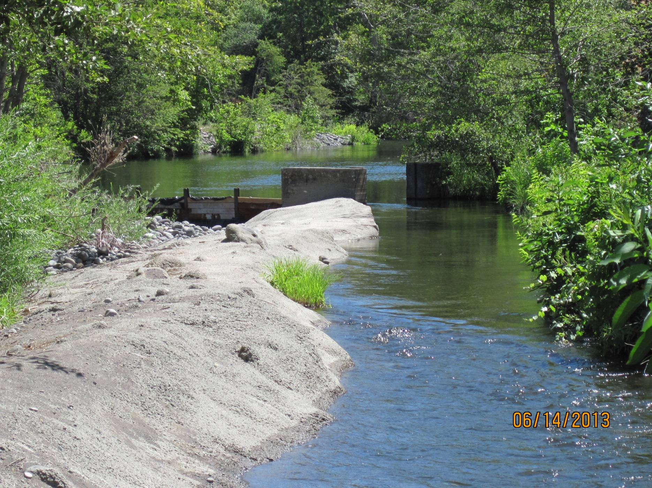
DCID ditch entrance and river left side of dam

Slide 8
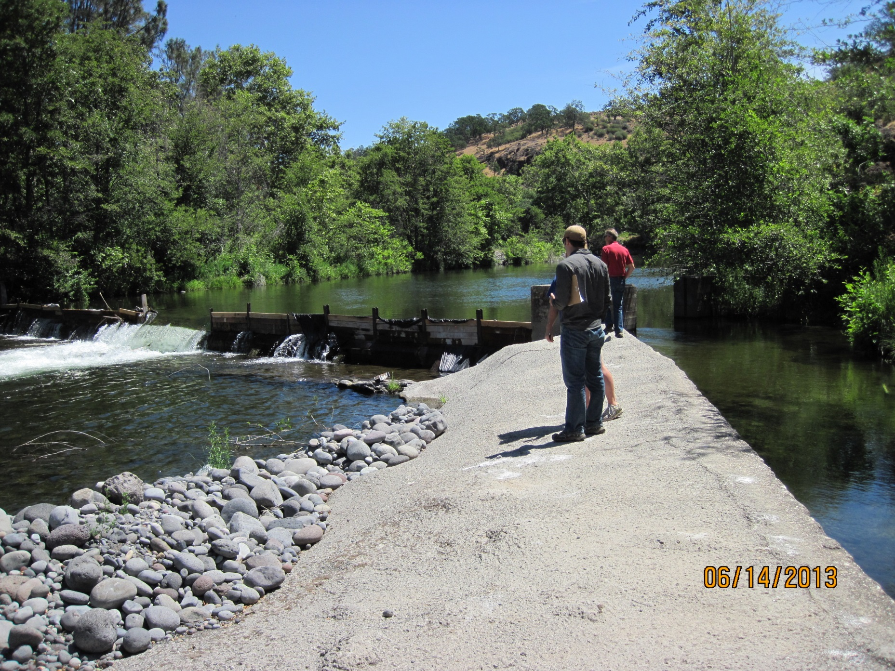
DCID dam and ditch

Slide 9
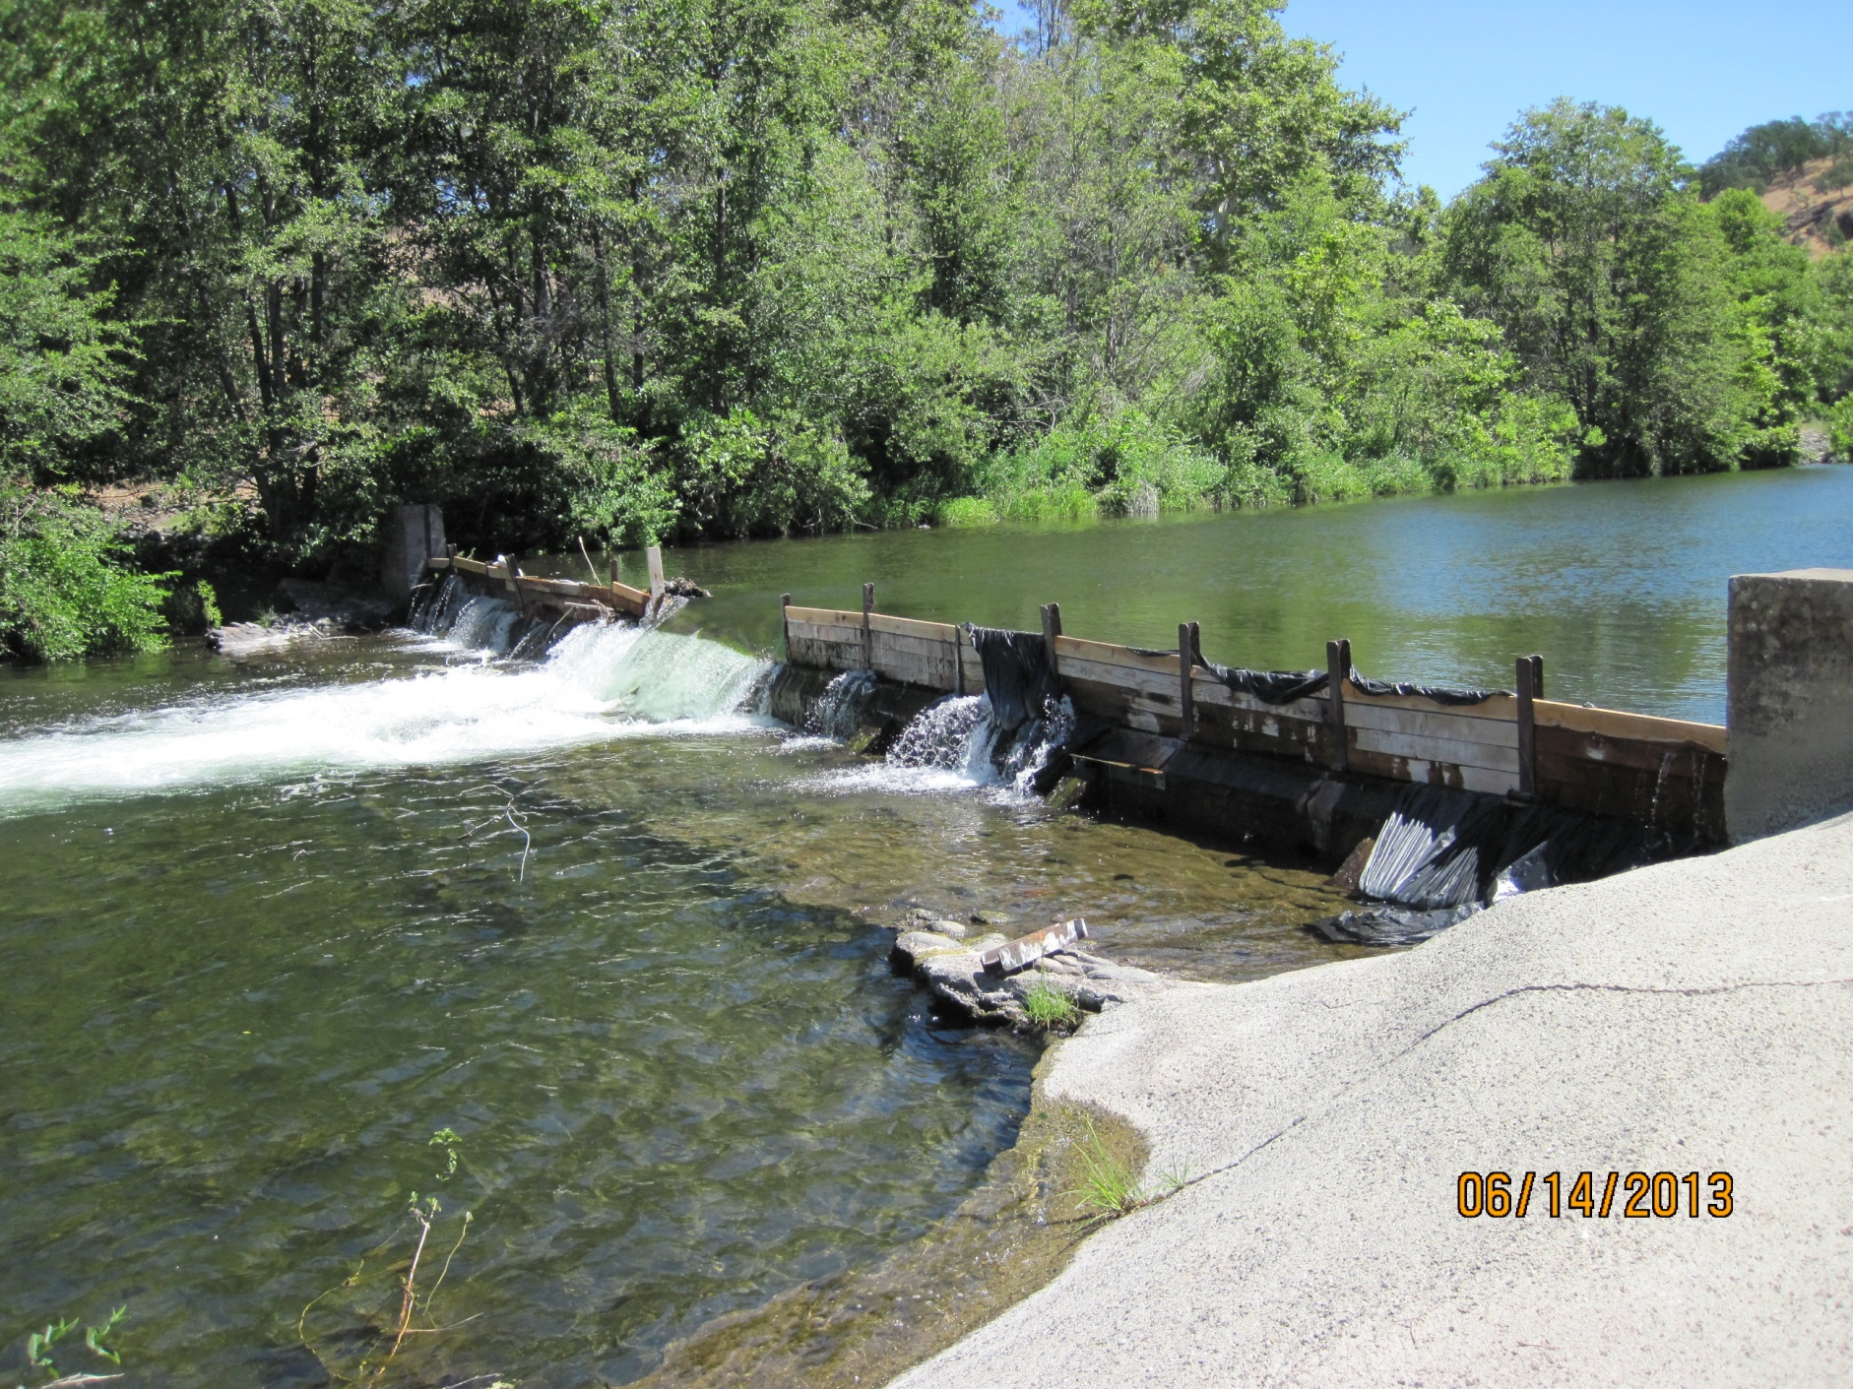
Dam apron
DCID dam

Slide 10
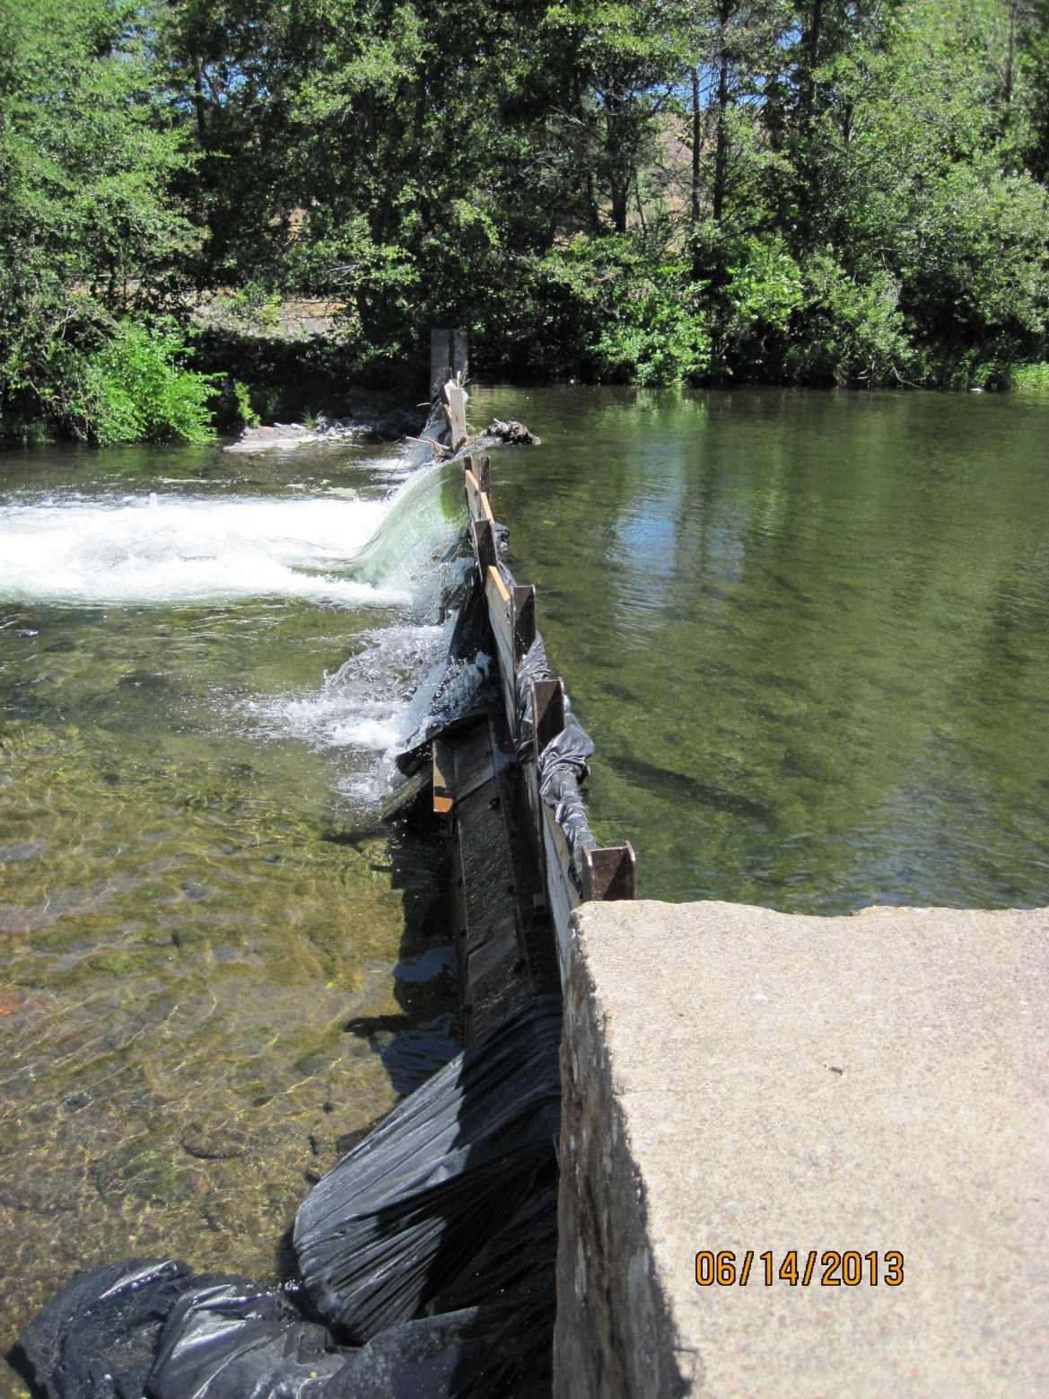
DCID dam

Slide 11
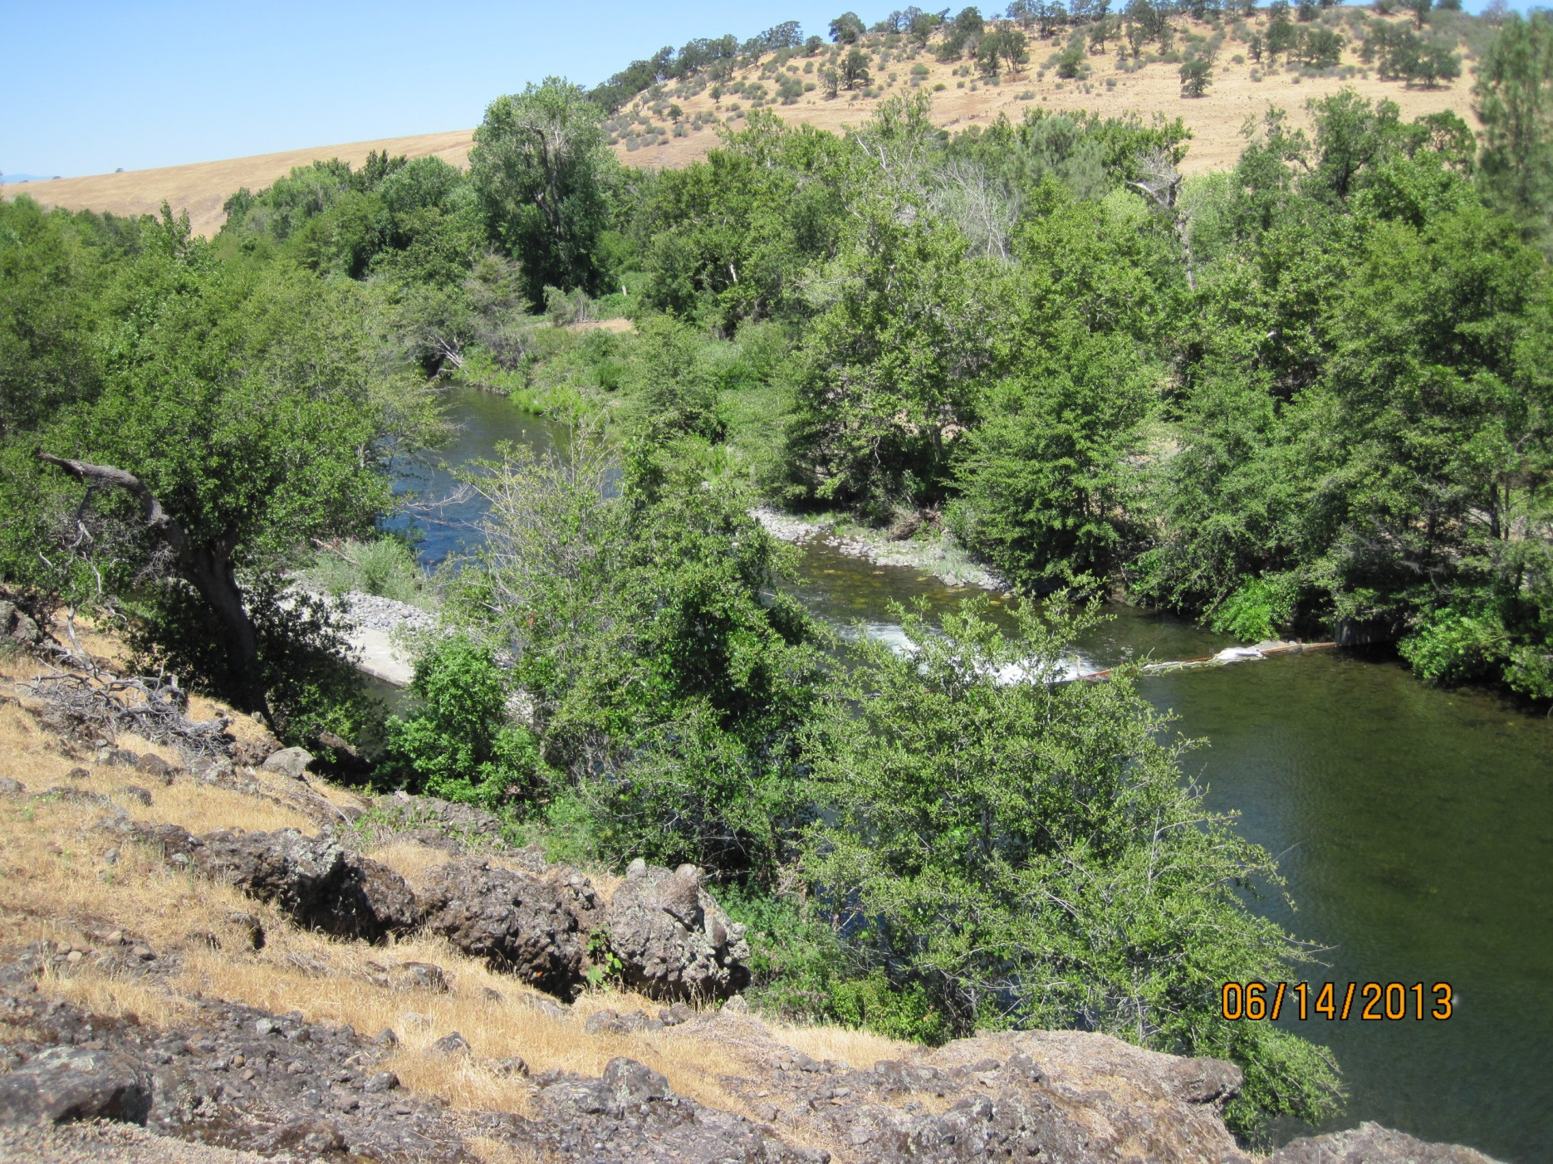
DCID dam from above, looking downstream

Slide 12
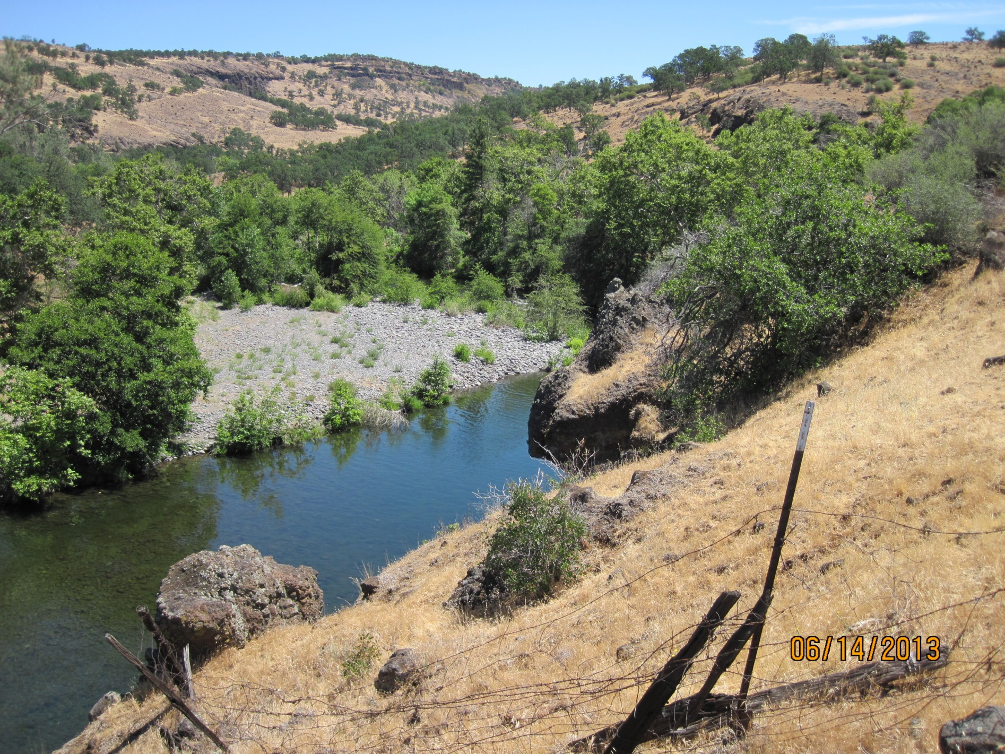
DCID, upstream of dam

