Slide 1

General Overview of GEPA Section 427
  Purpose: To ensure equitable access to, and participation in, Federally-assisted programs for all beneficiaries.
  Section 427 highlights, but is not limited to, six barriers that can impede equitable access or participation:
  Gender
  National origin
  Disability
  Race
  Color
  Age
An applicant must determine and define:
The participants and community to serve
The local circumstances
Barriers that may inhibit participation
Notes:
Screen ID: 01020_00
Audio Narration:
Let’s start by reviewing the GEPA Section 427 law. The General Education Provisions Act, or GEPA, Section 427 titled, Equity for Students, Teachers, and Other Program Beneficiaries, was enacted as part of the Improving America’s Schools Act of 1994. Its purpose is to ensure equitable access to, and participation in, Federally-assisted programs for all beneficiaries.
[Fade on text in orange banner] The six barriers highlighted in Section 427 are gender, race, color, national origin, disability, and age.
[Fade on bottom paragraph] An applicant must determine and define, at the outset and based on the design of their proposed grant project, the participants and community the project proposes to serve and local circumstances, what barriers may inhibit the full and effective participation of all who might benefit from the program.
Graphics Notes:
Production Notes:
User will select next to advance to next screen when ready.

Slide 2

GEPA Section 427 Standard Form Changes
Original Form
Updated Form
One overall general requirement
Flexibility to determine ad define the barriers to “equitable access” and “equitable participation”
Discretion in how to describe plans to address the identified barriers
Description may be provided in a separate narrative or in connection with related topics in the application
Applicants respond to four questions with specificity
Flexibility to determine and define the barriers to “equitable access” and “equitable participation”
A timeline for meeting targeted milestones for removing identified barriers
Notes:
Screen ID: 02030_00
Audio Narration:
The Section 427 standard form, created in 1995, consisted of one overall requirement allowing an applicant to define and determine its barriers. Each applicant had discretion with addressing barriers identified and either provided an overall general narrative or in connection with related topics in the application.
[Fade in text in right column] ED updated the Section 427 form by requiring responses to four questions. Each applicant still maintains flexibility in determining and defining barriers, but the questions prompt responses to be focused on equity and specific questions in addition to a timeline to meet targeted milestones for removing the identified barriers.
Graphics Notes:
Alt tag:
Production Notes:
User will select next to advance to next screen when ready.

Slide 3
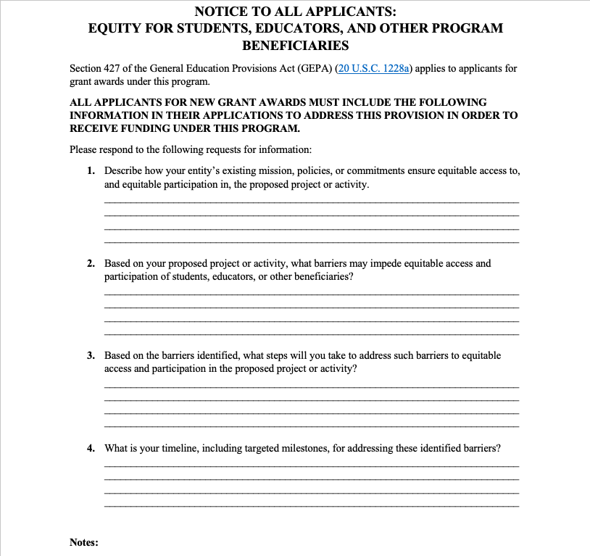
Updated GEPA Form Has Four Questions
Applicants must respond to each question on the standard form and submit the form with its grant application package or State plan.
For Grants.gov application submissions:
The updated form is integrated into Grants.gov and no longer needs to be uploaded as PDF.
The form is electronic and each text box response allows 4,000 characters.
An error message is received if a response is missing and the form can not be saved. (see next slide)
Notes:
Screen ID: 02040_00
Audio:
The Section 427 standard form is required to be completed and submitted with an applicant’s grant application package or State plan submission. Each text box allows 4,000 characters, so ensure if copying from another document that all content copied properly. Applicants that have already undertaken steps to address barriers must provide an explanation or description of the steps already taken in response to each question, as appropriate. Applicants that believe no barriers exist must provide an explanation or description to each question, as appropriate, which confirms this position and satisfies GEPA Section 427 requirement.
One-page instructions are included in the application package for how to complete GEPA Section 427 standard form. The Notes on the form also outline additional details necessary for completing the form. A copy of the form is included in the Job Aid found at the end of this course.
Select each icon to learn more.
Graphic Notes:
Alt tag: Section 427 standard form with the questions and notes. All text for this information is included in the job aid.
Production Notes:

Slide 4
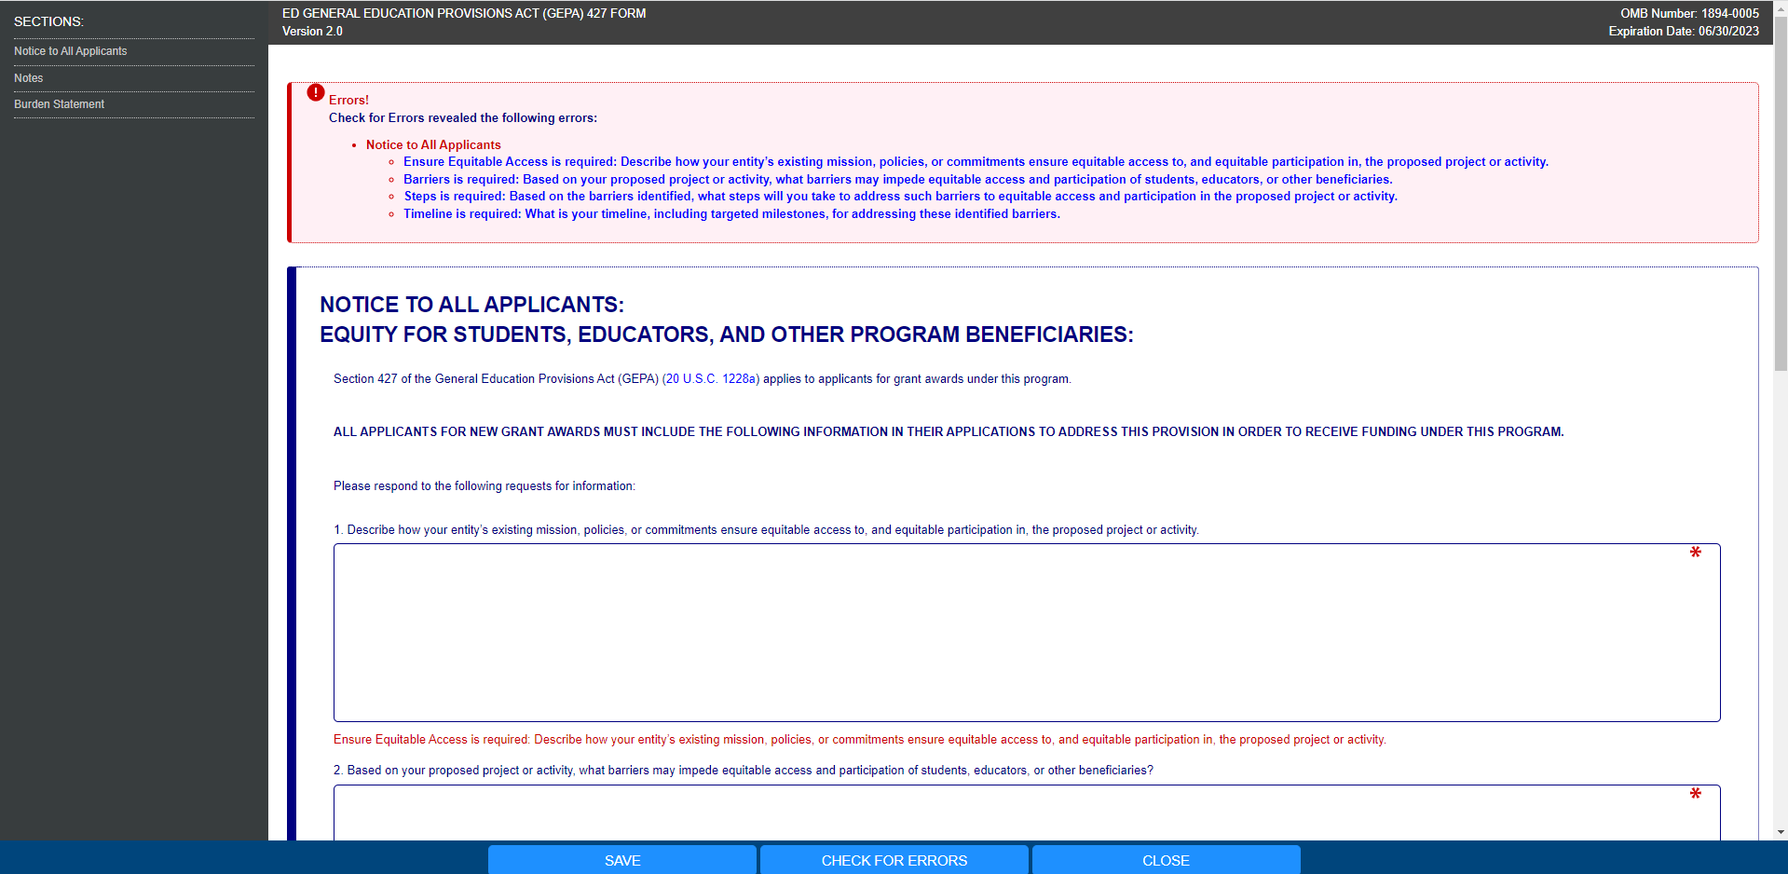
Sample Error Message

Slide 5
Grant Program Example
Grant Program Goal: To provide grants to alternative high schools, non-profit organizations, and combinations of those institutions to provide academics and other support services to prepare low-income, first-generation college students, and other underrepresented students for a college education.
ED Strong Interest In: Ensuring low-income students, first-generation college students, students who are English learners, students with disabilities, homeless students, students who are in foster care, and other disconnected students, receive the necessary support to assist them in successfully pursuing a college education.
The several slides that follow provide an example response to each question on the new Section 427 form from a fictitious organization applying for federal funds.

Slide 6
Question One – Response Example
Describe how your entity’s existing mission, policies, or commitments ensure equitable access to, and equitable participation in, the proposed project or activity.
Our organization has a contract with the city to operate a non-traditional high school in the local YMCA. As non-traditional, we will open earlier and remain open longer than a regular high and be open seven days a week to work with students living on their own, students that are homeless, and students expelled from a regular high school. One of the goals of our organization is to ensure homeless and other non-traditional students are able to obtain high school diplomas.

Slide 7
Question 2 – Response Example
Based on your proposed project or activity, what barriers may impede equitable access and participation of students, educators, or other beneficiaries?
Based on the population that is currently served our organization has identified homeless status or housing insecurity, pregnancy, and language as potential barriers.

Slide 8
Question 3 – Response Example
Based on the barriers identified, what steps will you take to address such barriers to equitable access and participation in the proposed project or activity?
We intend to offer core subjects of varying levels of math, reading, and science, several times throughout the day and evening in small group settings so that registered students are able to attend classes needed to graduate. Daily attendance will be required although not at any set time. Multi-lingual counselors will be on sight at various times to regularly engage with each student. A mobile health truck will be onsite bi-weekly to address health and safety issues.

Slide 9
Question 4 – Response Example
What is your timeline, including targeted milestones, for addressing these identified barriers?
Extensive outreach through posters and flyers posted at local community organizations and shops, support from the YMCA patrons, mobile health van team, and our counseling staff conducting daily foot patrols within a specific perimeter and in the hangout areas of targeted youth in order to share information and recruit targeted population.
The target population assigned through the system such as juvenile courts will also assist in the identification and recruitment of the target population.
Register five percent (50 students) of the target population (as documented by local standard statistical references), for core classes within 180 days of the opening of the school year.

Slide 10
GEPA Form Instructions
Applicants may identify any barriers that may impede equitable access and participation in the proposed project or activity, including, but not limited to, barriers based on economic disadvantage, gender, race, ethnicity, color, national origin, disability, age, language, migrant status, rural status, homeless status or housing insecurity, pregnancy, parenting, or caregiving status, and sexual orientation.
Applicants are not required to have mission statements or policies that align with equity in order to submit an application.
Applicants may have already included some or all this required information in the narrative sections of their applications or their State Plans. In responding to this requirement, for each question, applicants may provide a cross-reference to the section(s) and page number(s) in their applications or State Plans that includes the information responsive to that question on this form or may restate that information on this form.

Slide 11
GEPA Form Instructions continued
Applicants must respond to each question using the associated text box. Each text box allows approximately 4000 characters; therefore, if copying and pasting into the text box from another document be sure to check that everything copied.
Applicants should use the “check for errors” button before they save the form. Applicants will receive an error message if any response is missing and will not be able to submit the application due to the missing information.
Applicants that have already undertaken steps to address barriers must still provide an explanation and/or description of the steps already taken in each text box, as appropriate, to satisfy the GEPA Section 427 requirement.
Applicants that believe no barriers exist must still provide an explanation and/or description to each question to validate that perception, as appropriate, to satisfy the GEPA Section 427 requirement.

Slide 12
GEPA Section 427 Resources
PDF version of Section 427 form and instructions (add website link)
Computer-based training, Ensuring Equitable Opportunities Under the GEPA Section 427
GEPA Section 427 form Frequently Asked Questions (FAQs)
The Department of Education Equity Action Plan at ED.gov/equity
Comments or concerns regarding the status of your individual form may be addressed to the person listed in the FOR FURTHER INFORMATION CONTACT section in the competition Notice Inviting Applications.

