Slide 1

SAM.gov for Federal Assistance Applicants/Recipients
December 2022

Slide 2
Requirements
Applicant and grantee organizations – unique entity identifier (UEI) and sam.gov registration
Subrecipient organizations – UEI only
Individuals – not applicable unless a sole proprietorship or limited liability company
Registration and UEIs are free. Some legitimate businesses may offer to help with registration for a fee but it is not required. Watch out for scams that claim payment is required.

Slide 3
Possible Exemptions – Speak to your Grants Officer for More Details
National security, foreign policy or safety
(ii) Foreign (non-U.S.) organization, less than $25,000, outside the United States
(iii) Exigent circumstances (ex. system issues out of organization’s control) – must complete requirements within 30 days of the Federal award date.

Slide 4
2022 Transition from DUNS to UEI
Recent Developments
Previously, an identifier code known as DUNS was required. As of April 2022, a UEI is required instead.
  All organizations must have their entity (re)validated in SAM.gov, even those with an existing DUNS/UEI
  This validation process is backlogged
    particularly for those whose registration lapsed
    This can take up to 45 days to resolve
  Payments may be delayed without sam.gov registration
    Tracking efforts (submission of helpdesk tickets) is key
    The State Department does not manage these systems

Slide 5
NCAGE No Longer Required!
Previously, non-U.S. organizations were required to register for an NCAGE code before registering for sam.gov and the UEI.
As of November/December 2022, this is no longer required unless the organization also wants to bid on U.S. Department of Defense contracts.
Organizations can contact FSD to ask how to change their registration to not require NCAGE/CAGE if they don’t plan to apply for DOD grants.
If you have a notice of funding opportunity / Annual Program Statement posted, post an amendment to it to remove the NCAGE requirement.

Slide 6
Steps & Timeline for New Registrations (Foreign Organizations)
  Obtain an NCAGE code – NO LONGER REQUIRED!
  For help: NCAGE support team
  2) Create a login.gov account (instantaneous; but involves multi-factor authentication)
  For help: login.gov help center
  3) Begin sam.gov registration to validate entity and obtain UEI
  Up to 45 business days. Current average is 14.
  For help: Entity Validation Service (EVS) specialists - through a Federal Service Desk (FSD) ticket/incident but not by contacting FSD’s general team separately by phone or chat
  4) Continue sam.gov registration to complete it (not required for subrecipients)
  Takes up to 10 business days
  For help: Federal Service Desk (FSD) general team
If not completed within 90 days, the process restarts from Step 3; all registration info must be reentered and documents resubmitted.
  5) Send in entity admin access letter within 30 days of registration

Slide 7
Steps – tips for avoiding and addressing common hurdles
  Obtain an NCAGE code – NO LONGER REQUIRED!
  For help: NCAGE support team
  IF using an NCAGE, info (org name, address) used in sam.gov must match NCAGE info EXACTLY
    Do NCAGE before any sam.gov, as NCAGE has shorter character limit
    Contact NCAGE support team to update NCAGE info if needed
  If midway through the process and no longer want to use an NCAGE, update/submit ticket to ask how to do that
  2) Create a login.gov account (instantaneous; but involves multi-factor authentication)
    Have working devices (phone, tablet, computer) for multifactor authentication ready
    Know that creating this is not the same as completing sam.gov registration
    Use the same email address you previously used at sam.gov, if applicable, to automatically link info
    Use individual email address not group email or distro list
  For help: login.gov help center

Slide 8
Steps & Timeline for New Registrations (Foreign Organizations)
  3) Begin sam.gov registration to validate entity and obtain UEI
  - Up to 45 business days. Current average is 14.
  Only pick an exact match that shows up in the system for your organization, not a close match.
  Respond promptly (within 5 business days) to requests/emails
  Follow instructions carefully
  Check status in your sam.gov workspace and fsd.gov (tickets) daily
  Follow detailed requirements for acceptable documents
  Upload documents to sam.gov workspace, not the ticket
  Physical address not PO box
  Include several points of contact for your entity
  After 14 days you can use ticket to inquire about status
  Do not create multiple submissions/incidents/tickets -- this will slow things
  For help: Entity Validation Service (EVS) specialists - through a Federal Service Desk (FSD) ticket they create but not by contacting FSD’s general team separately by phone or chat)

Slide 9
Steps & Timeline for New Registrations (Foreign Organizations)
  4) Continue sam.gov registration to complete it (not required for subrecipients) -Takes up to 10 business days
  For help: Federal Service Desk (FSD) general team
If not completed within 90 days, the process restarts from Step 3; all registration info must be reentered and documents resubmitted.
Check sam.gov workspace and fsd.gov daily and respond promptly and carefully to any requests/instructions.
Add comments to existing ticket; Do not create multiple submissions/incidents/tickets.
  5) Send in entity admin access letter within 30 days of registration

Slide 10
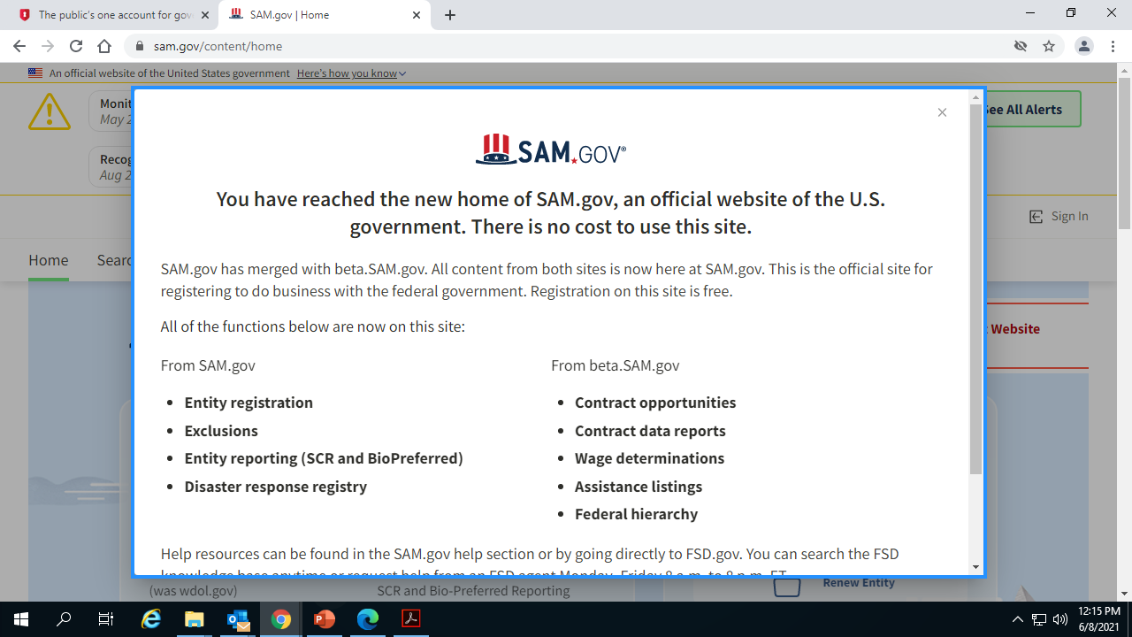
Step 1: SAM.gov landing page
Applicants must:
  Create a login.gov account - only need to do this once
  Enter an email addres

Slide 11
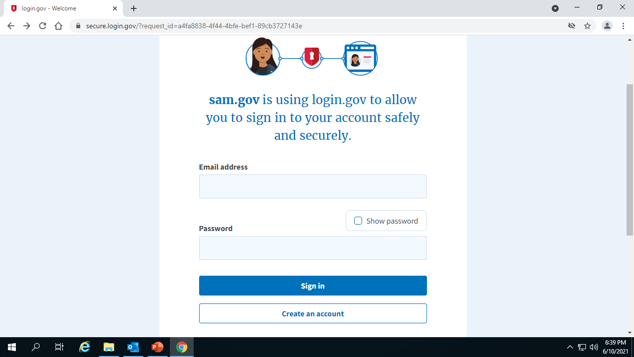
Step 1: Login.gov
Process
Getting a login is NOT the same as finishing your entity registration

Slide 12
Step 2: Login.gov
Process
https://login.gov/help/get-started/authentication-options/​
Choose a device (phone/tablet) on which apps can be installed​
Download and install an authentication app. Options include:​
  Android options: Google Authenticator, Authy, LastPass, 1Password
  iOS options: Google Authenticator, Authy, LastPass, 1Password
  Windows apps: 1Password, OTP Manager
  Mac apps: 1Password, OTP Manager
  Chrome extension: Authenticator
Sign in to login.gov https://secure.login.gov/
Select “Enable” next to “Authentication app”
Follow instructions to associate the authentication app and the account

Slide 13
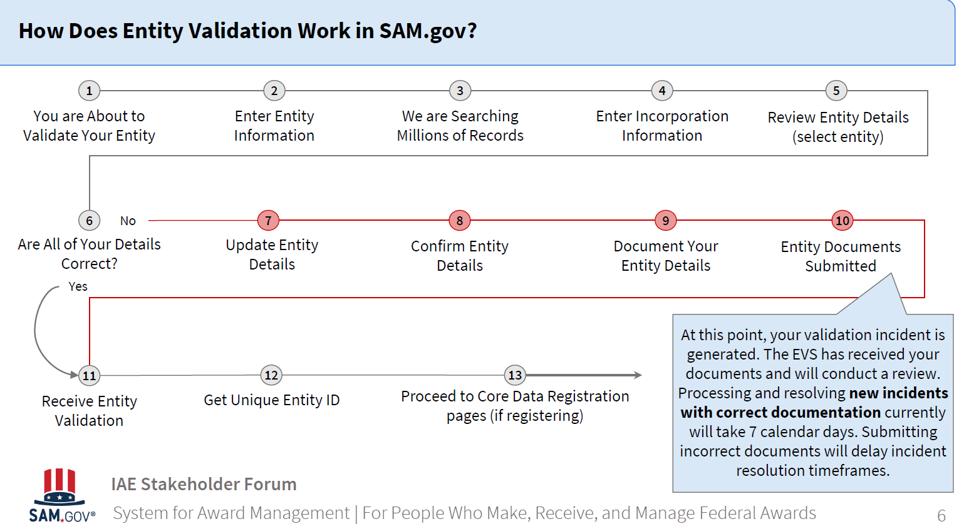

Slide 14
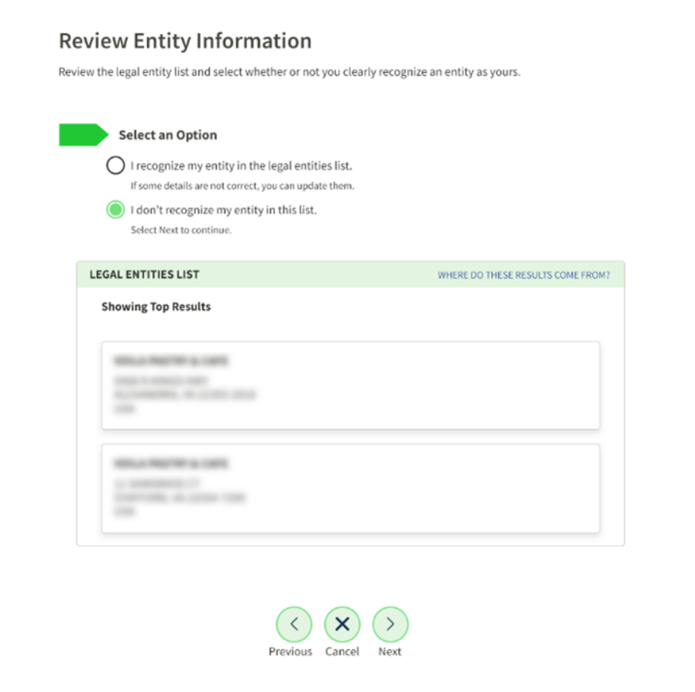
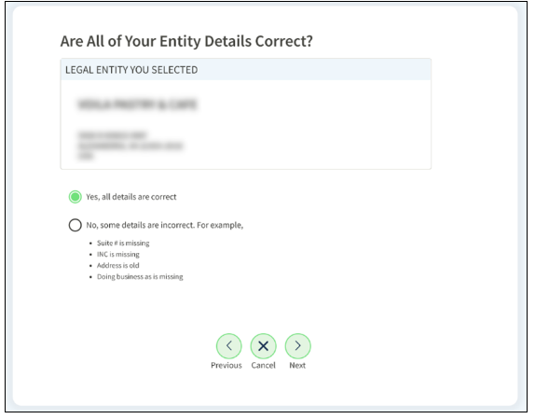
Reviewing Entity Details

Slide 15
Tips for Success and Troubleshooting – Step 3: Entity Validation
To validate your entity, sam.gov requires you upload documents that prove your name, physical address, etc.
If your documents contain other language(s), you must also include a full English language translation of that document.
The translator must certify their competency and the translation as complete and accurate. Certification < 30 days old.
At least one document that is less than five years old must contain both your correct legal business name and your correct physical address (Not a PO Box).
If you provide documentation that is not current (e.g., with an old entity name or address), you must also submit documentation of the change (e.g., transfer of business).
Explain discrepancies and provide backup.
If you have not heard anything back in more than 14 business days since you last replied/submitted documents, use FSD incident ticket to ask about the status.

Slide 16
Tips for Success and Troubleshooting – Step 3: Entity Validation
Additional Common Issues:
Not submitting correct, acceptable documents
Not responding to emails/requests promptly and ticket is closed
Not using ticket to describe your specific request or uploads
Logo on documents not same as name
Submitting docs that are too old or have mismatched documents or have no date on them at all
Translations not dated within 30 days of upload
Need to spell out the month in dates so difference between American and European formats of writing dates does not make meaning unclear. Note: Spelling it out doesn’t change translation
Scans are low quality or cut off
You attached your original application or typed document or screenshots of a form where you entered data on a website (but wasn't approved yet).

Slide 17
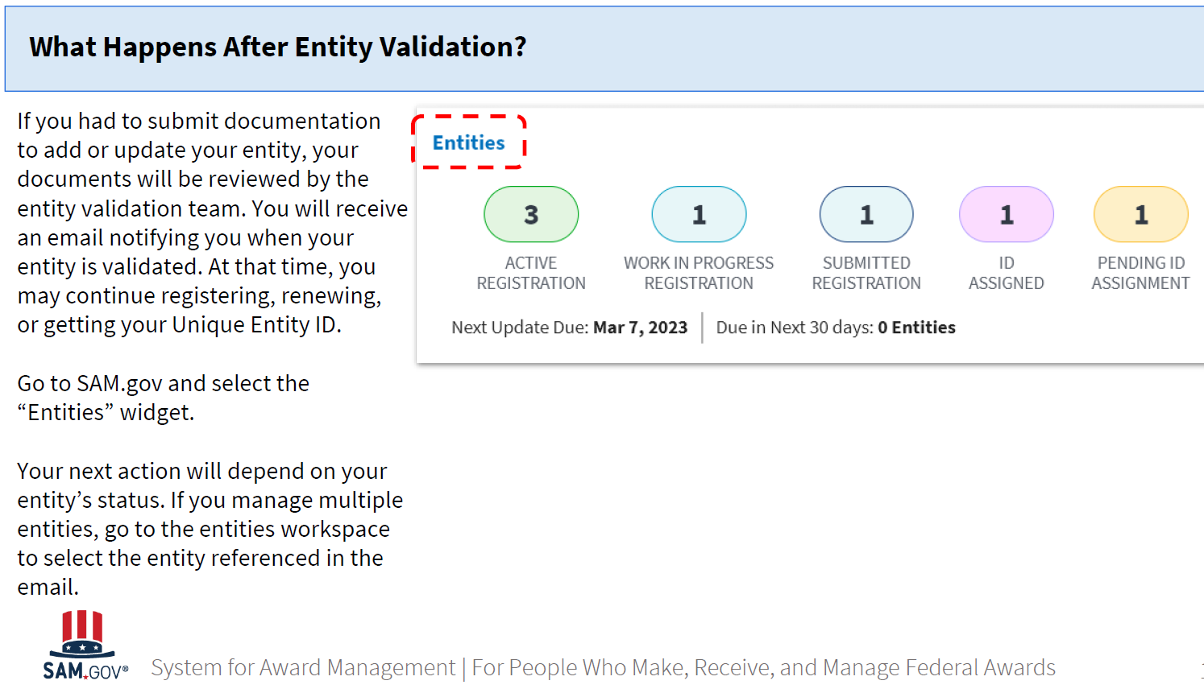
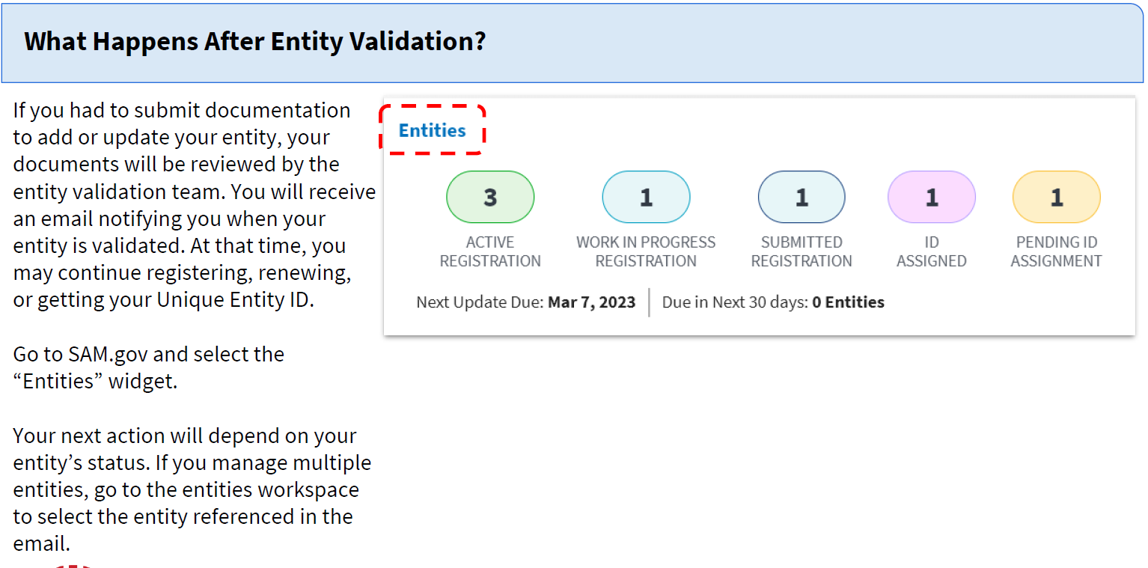

Slide 18
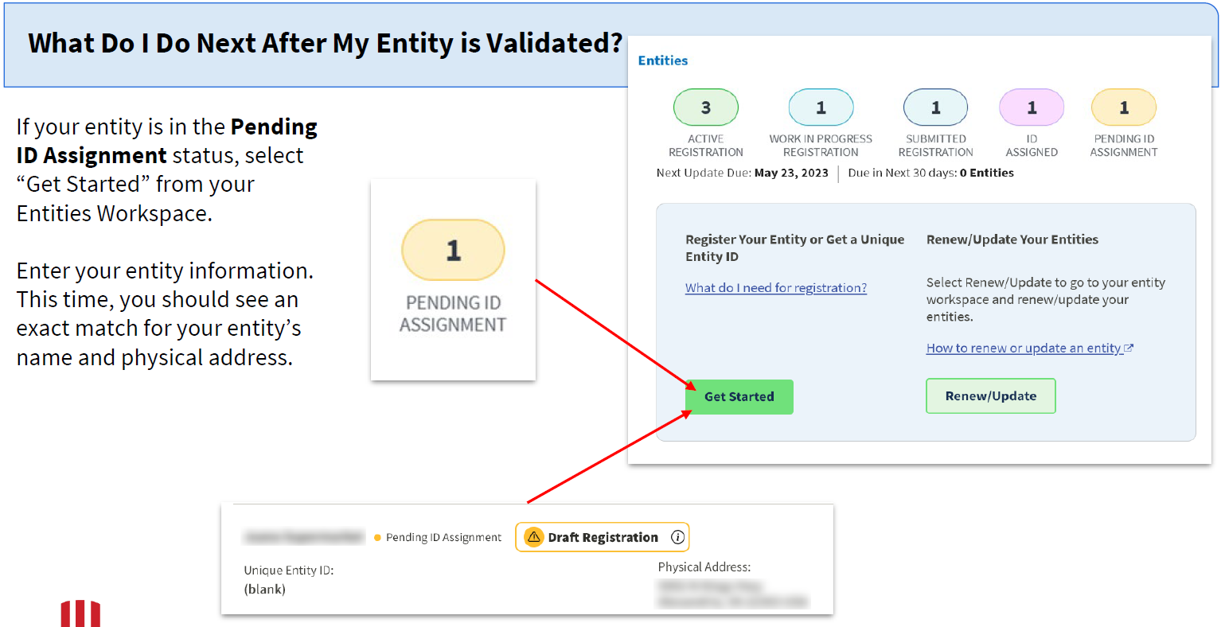

Slide 19
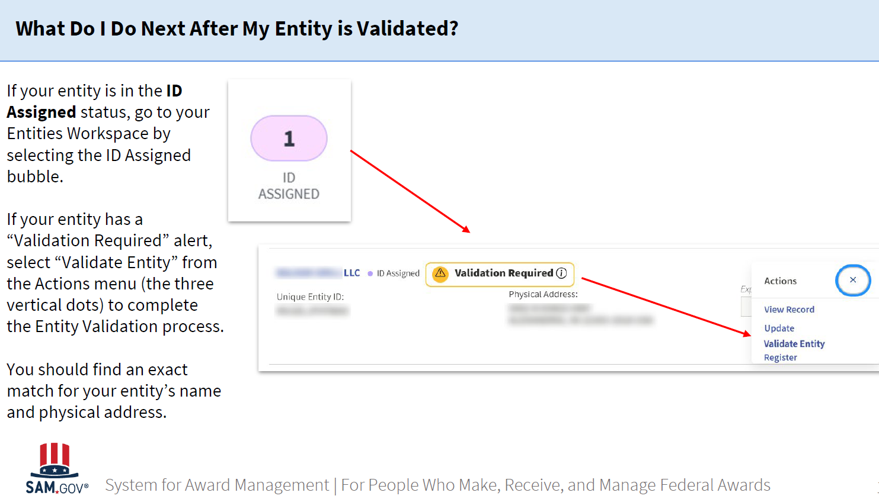

Slide 20
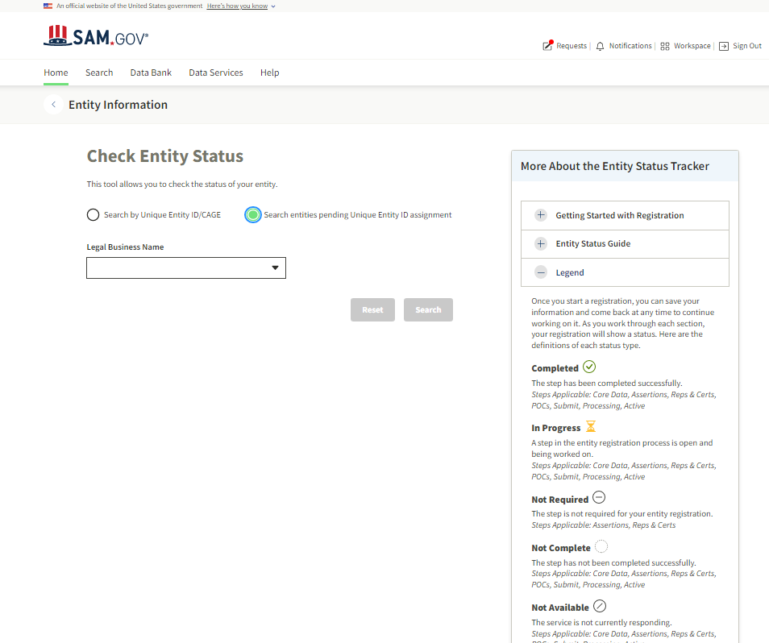
Another way to check status
Log in to SAM.gov.
Landing page will give option to search
By UEI ( see next page for this)
By name
If an organization has checked no public view, only those with .gov accounts or those within the organization will see the status

Slide 21
List of status in SAM.gov
Once you start a registration, it will be in the Work in Progress Registration status. You can save your information and come back later to continue working on it. Work in Progress Registrations are held in SAM.gov for up to 90 days. If you do not update or submit your Work in Progress Registration in that time, the system will remove it. As you work through each section, your registration will show a status for each of the following sections:
Validate Entity
Entity validation confirms that an entity exists and is unique. An entity validation service (EVS) independently verifies the uniqueness of an entity. This is required to get a Unique Entity ID. SAM.gov verifies that there is no existing registration for the legal business name and physical address as part of this validation process.
Get Unique Entity ID
The Unique Entity ID is a 12-character, alpha-numeric code that uniquely identifies entities in SAM.gov. Unique Entity IDs are issued by SAM.gov and are a part of an entity's record.
Core Data
Core data is mandatory for all registration types. It includes, but is not limited to, your Unique Entity ID, business name, your TIN, and your financial information.
Assertions
Assertions include, but are not limited to, data about the types of goods and services you provide, optional Electronic Data Interchange (EDI) and whether you wish to be included in the Disaster Response Registry.
Reps & Certs
Representations and Certifications (Reps & Certs) are a common set of representations and certifications required by federal statutes or regulations in accordance with the Federal Acquisition Regulation (FAR). You will be given a questionnaire to guide you through entering your Reps & Certs. This section is only completed by entities registering to compete for federal contracts.
POCs
Before your entity registration is complete, you will be asked to provide mandatory points of contact (POCs) and optional POCs. You must complete all mandatory POCs before you can submit the registration.
Submit
Once you enter all the information required, review it, and submit it, your registration enters the submitted status. While the average overall processing time is up to three business days, external reviews can take up to ten business days. You will be notified by email when all reviews are complete.
Processing
Your entity registration information is being processed at this stage. You will be notified by email when all reviews are complete. The Federal Service Desk cannot provide further information about your registration unless at least 10 business days have passed since you submitted your registration.
Active
Once your entity registration is successfully processed, it enters the active status. It will remain active for 365 days from the date you submitted it for processing, unless it is deactivated by your Entity Administrator.

Slide 22
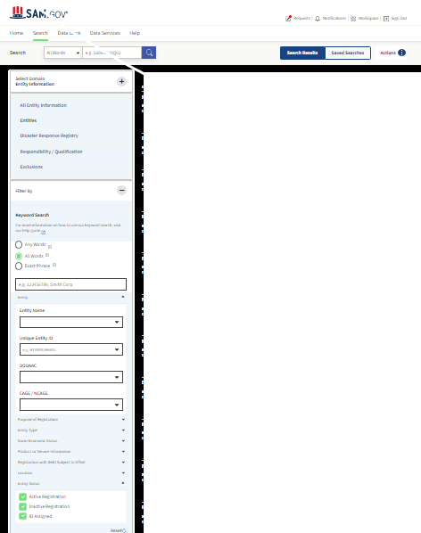
Full search page: See next page for statuses
Notes:
Advanced/full search screen – select all options (in green) to obtain full available search results.

Slide 23
Detailed when searching full status in SAM.gov
Once you start a registration, you can save your information and come back at any time to continue working on it. As you work through each section, your registration will show a status. Here are the definitions of each status type.
Completed
The step has been completed successfully.
Steps Applicable: Core Data, Assertions, Reps & Certs, POCs, Submit, Processing, Active
In Progress
A step in the entity registration process is open and being worked on.
Steps Applicable: Core Data, Assertions, Reps & Certs, POCs, Submit, Processing, Active
Not Required
The step is not required for your entity registration.
Steps Applicable: Assertions, Reps & Certs
Not Complete
The step has not been completed successfully.
Steps Applicable: Core Data, Assertions, Reps & Certs, POCs, Submit, Processing, Active
Not Available
The service is not currently responding.
Steps Applicable: Core Data, Assertions, Reps & Certs, POCs, Submit, Processing, Active
Invalid Data
Your information was either incomplete, or your registration may have failed TIN validation or CAGE validation.
Steps Applicable: Core Data, Active
Inactive
Your registration is expired. Please log into SAM to begin the update process.
Steps Applicable: Core Data, Assertions, Reps & Certs, POCs, Submit, Processing, Active
Restricted
Access to this entity registration is restricted. It cannot be displayed through the SAM Status Tracker.
Steps Applicable: Core Data, Assertions, Reps & Certs, POCs, Submit, Processing, Active

Slide 24
I have tried it all, now what?!
Write your embassy contact and include the following:
The Point of Contact (POC) Name
Organization name and address
Telephone number
The POC email address
Screenshot of your sam.gov workspace that shows your pending request(s).
CAGE/NCAGE
GSA SAM/FSD/EVS Incident ticket number:
Emails with SAM/FSD/EVA in one single PDF or Word document.
Brief explanation of issue
Ask your contact to escalate the ticket
  The recipient must FIRST submit a ticket
  The recipient must still log into their ticket every couple of dates and write a question or comment in it (ex. “Checking on the status.”) so it doesn’t get closed.
  The State Department does not have a help desk dedicated to these systems
  The State Department does not own these systems

Slide 25
Renewals of Existing Sam.gov Registrations

Slide 26
SAM.gov registration update / renewal
SAM.gov
SAM.gov registration must be updated yearly
  There is no fee
  NCAGE requires renewal only when info changes
Unique Entity Identifier (UEI) is assigned during SAM.gov registration

Slide 27
Steps to renew / update in SAM.gov
Access the SAM.gov Homepage.
Click the blue Log In (redirects to Login.gov)
Click Sign in and enter login.gov email and
Click Next to go to the SAM.gov Terms and Conditions
Click Accept to complete log in
Select Entity Registrations on the left
Click Existing Entity Registrations
Select the entity record to update
Click the Update button to begin renewal
Select parts to update. Click Next.
Continue through the remainder of registration
*Once submitted, further changes may not be made until the initial one is processed (or if validation failed)

Slide 28
Does getting a login.gov account impact an organization’s existing SAM.gov registration?
What will happen to my existing SAM.gov profile?
Nothing
  If the same email is used to create the login.gov profile, all records, data requests, and saved searches convey
  If a new email address is used, nothing happens to the SAM.gov profile but you will be unable to access it
What will happen to my Entity Registrations in SAM.gov?
There is no impact
  Entity registration data, exclusions data, data access requests, and roles convey
    Data in SAM.gov remains as is
    No entity data in SAM.gov is impacted by the login process
Obtaining a login account will not change SAM.gov info for grantees

Slide 29
SAM.gov/FSD Organization/
Entity
Templates
FSD templates for submitting letters to the FSD helpdesk so organizations can access their account in SAM.gov
Template 1 - Single Entity
  If used, must be notarized
Template 2 - Multiple Domestic Entities
Template 3 - International Entity (No US Banking Info) *
  NO need to notarize, self-certification is acceptable
* Most international entities will use template 3

Slide 30
What about that notarized letter?(for establishing / changing entity administrators)
If using Template 1, notarize
If using Template 3, a notary is NOT required
The person must have signatory authority to make commitments (President, CEO, or other authorized representative)
NOTE:
International entities are not required to enter banking info for Electronic Funds Transfer (EFT) on the Financial Information page of the entity registration
If the recipient uses a US financial institution, they may enter banking information for EFT

Slide 31
How is the letter sent to SAM.gov?
Scan the completed, signed letter
Submit a copy to the Federal Service Desk by creating a service ticket and attaching the scanned letter.
Use the following when submitting:
  System: System for Award Management (SAM)
  Issue Type: Other
  Business Type: (Choose the appropriate value for your entity)
  UEI: Enter the UEI number for your Entity
  Subject: Letter Designating Entity Administrator - New Registration
  Question: Please review the attached letter designating our Entity Administrator

Slide 32
Keep in mind
Things to Remember!
Organizations must renew registration every 12 months from date last certified
  Sooner, if information changes
The primary contact receives reminders 60, 30, and 15 days prior to expiration
  If an org does not renew, registration expires
Organizations must have an active SAM.gov registration to apply via Grants.gov or get paid
Active SAM.gov registrations get priority in tickets
Currently, renewals take up to 45 days

Slide 33
More about the Workspace
What if my organization not in my workspace (renewals)
This is likely because an entity administrator letter was not submitted within 30 days to approve you as an administrator for the organization.
Follow instructions on sam.gov website for submitting the letter.
What if I have multiple records in my workspace for a single entity / organization?
Put in a ticket with FSD to request that they merge the records. Explain which info is current.

Slide 34
Key Resources
Quick Start Guide for International Registrants
What documents can I use for entity validation? What are the requirements? – chart
Seven Common Reasons Documents are Rejected and How to Address
Search Frequently Asked Questions / Knowledge Base Articles

