Slide 1

MCC Annual Program Statement
Technical Areas 1 & 2
December 1, 2017
Online Conference

Slide 2
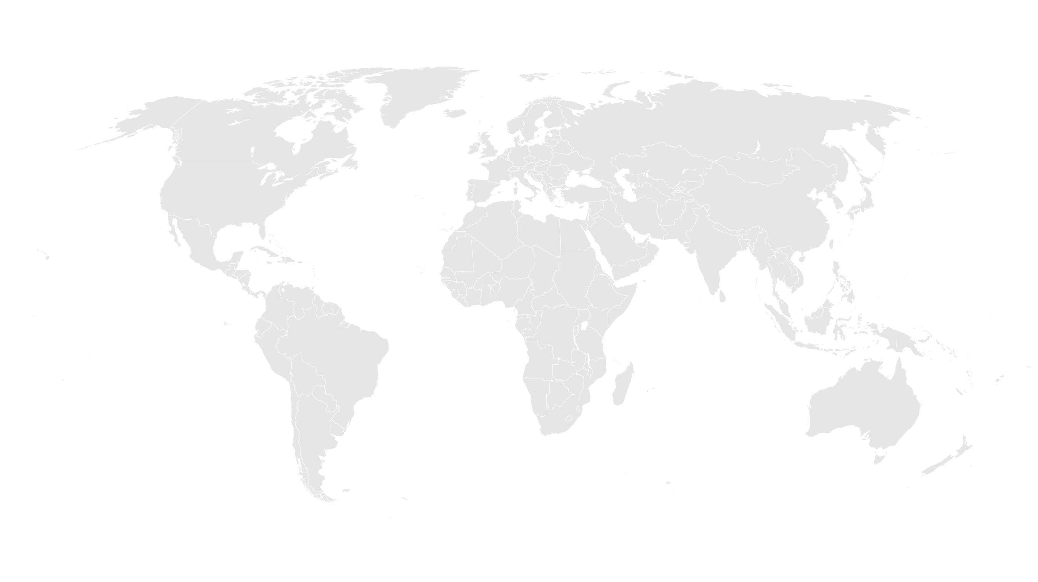
APS Conference Agenda
Introduction from Office of Strategic Partnerships
General Overview of Technical Area #1: Growth Diagnostics & Economic Policy Reform
General Overview of Technical Area #2: Urban Growth Analysis & Urban Management
APS Overview with MCC Contracts & Grants Management Team
Q&A

Slide 3
About MCC
A U.S. Government foreign assistance agency
fighting to end global poverty.
Created by the U.S. Congress in 2004, with bipartisan support, as a different approach to U.S. foreign assistance.
What’s different about MCC?
Notes:
What is MCC?
MCC is an innovative foreign aid agency leading the U.S. fight against global poverty.
We are a grant provider to countries committed to good governance, economic freedom and investment in their citizens.
MCC was created by the U.S. Congress in 2004 with strong bipartisan support. Our funding is appropriated by Congress for each fiscal year.
We were created to be a new, different approach to foreign assistance, taking best practices from every existing agency and applying those to MCC’s model.
We’ve already seen there are a number of different agencies working on foreign assistance. So what’s so different about MCC?
MCC is different from other development agencies.
We have a very focused mandate: To reduce poverty through economic growth.
Not reduce poverty through humanitarian assistance, or through food aid, or through disaster response, but specifically through economic growth.
We define this in a specific way: All of MCC’s programs are designed to raise incomes among their target populations, and to open up markets to increase private sector investment.
MCC, as its name implies, is structured like a corporation.
Like a private sector firm, we have a CEO and an senior management team of Vice Presidents and Managing Directors.
We are led by an interagency, public-private Board of Directors. The Board makes decisions regarding which countries to partner with, and it approves every country program before it begins.

Slide 4
MCC & Partnerships
MCC established the Office of Strategic Partnerships to provide a vision and strategy for MCC partnerships that align with agency goals. Building on MCC’s strong track record of leveraging partnerships to maximize and sustain its investments, OSP works to more fully incorporate partnerships in the agency’s work to increase the scope, impact, and sustainability of our poverty-fighting programs.
Learn more at: https://www.mcc.gov/work-with-us/partnerships
Notes:
Overview of OSP
APS is one of the ways OSP is advancing the agency’s capacity to engage and work with partners and support its mission.

Slide 5
Technical Area #1: Growth Diagnostics & Economic Policy Reform
The growth diagnostics partnership aims to connect our theoretical understanding of the growth process in developing countries to the practical details of identifying constraints to growth
Improved practice of growth diagnostics
Theoretical foundation of growth diagnostics
Theory of growth in developing countries
Guidance on how to analyze data
Prepared tools for analysis, e.g. STATA code
Identifying data sources
Examining country context to inform the analysis of constraints
  How should we think about the future of growth in developing countries?
  (e.g. structural transformation, agriculture, jobs, urbanization, etc.)
  What is the role of comparator countries in a growth diagnostic? How to apply this?
Identifying specific binding constraints to growth
  Which inputs to growth should be considered? Does the existing tree adequate capture these? (e.g. tacit knowhow, entrepreneurship, agglomeration externalities)
  Do the “four tests” need to be updated?
  Provide practical guidance on applying the tests to elements of the tree.
Identifying syndromes
  What issues might cut across the economy, giving rise to multiple constraints?
  How do constraints persist if they are so costly?
  Does the CA need to connect to a political economy and/or PFM analysis? How?

Slide 6
Technical Area #1: Growth Diagnostics & Economic Policy Reform
Example: sustainably addressing a roads constraint often requires improving a road maintenance agency's ability to maintain roads
  MCC seeks a partner to help us consider interventions and reforms that can build such capabilities in the public sector, as well as other areas of economic policy in developing countries
Partners will adapt or develop an approach for connecting binding constraints to interventions that can address root causes of constraints
The framework(s) developed should be able to address both the design as well as implementation challenges of such interventions
Potential partners will have the opportunity for publications and case studies stemming from MCC’s application of frameworks suggested or developed under this activity

Slide 7
Technical Area #2: Urban Growth Analysis & Urban Management
Partners
Partners who can give MCC access to the latest thought leadership, research, and practice on
  Analyzing the role of urban agglomeration in economic growth and the contribution of urbanization to poverty reduction
  The effects of urban land policy and its implementation in enabling economic growth and poverty reduction, and/or
  Design and implementation of policies, institutional practices and tools or systems to help government institutions better manage and monitor urbanization in order to more fully achieve its benefits
Leaders and influencers on urban matters, use of technology/new technology, proposals from consortia of more than one entity.

Slide 8
Technical Area #2: Urban Growth Analysis & Urban Management
Form of Partner Engagement
Partners would work with MCC to develop operational tools and methodologies for
  Addressing the urban agglomeration and growth dimensions of MCC’s growth diagnostics
  MCC root cause and problem analysis associated with urbanization or urban environments; and
  MCC due diligence and design of projects in urban or urbanizing contexts, with particular emphasis on the policy and institutional enabling environment for urban management and urban growth.
  Quantifying the benefits of urban land-oriented investments.

Slide 9
Technical Area #2: Urban Growth Analysis & Urban Management
Form of Partner Engagement
Partners would have the opportunity to influence the form of MCC’s engagement in urban environments and MCC’s analysis leading to investment choice and scope.
Partners would also have the opportunity to work with MCC (and be expected to work with MCC) to apply thought leadership and tools developed under the partnership to concrete, real-world cases among compact or threshold program eligible countries.

Slide 10
ANNUAL PROGRAM STATEMENT (APS)
No: 95332418N0002
Taylor Wolf,
AO
Nataliya Holl,
AS
Jacqueline Naranjo,
AO
PARTNERSHIPS with MCC Program
Posted on www.grants.gov on
November 9, 2017 for one year
Contracts and Grants Management Team

Slide 11
Highlights
Awards period of performance | The majority of awards’ period of performances will be one to three years, though some may be up to five years max
Anticipated Number of Awards and Eligibility | Multiple awards The APS is open to U.S. and non-U.S. private businesses, business and trade associations, foundations, U.S. and non-U.S. Non-Governmental Organizations (NGOs), international organizations, U.S. and non-U.S. colleges and universities, civic groups, regional organizations, etc.
Type of Awards Substantial involvement | Grants, Cooperative Agreements, and Fixed Amount Awards For Cooperative Agreements
Two-phase Competition | The competition will be conducted in two phases – Phase I -Concept Paper submission, open to everyone, and Phase II - Complete Application by MCC invitation only Collaboration, co-creation and feedback brainstorming sessions

Slide 12
Timeline and Key Dates
NOFO APS posted | November 9, 2017 for one year
First teleconference Questions for Review Window 1 Concept Papers due Window 1 | November 30, 2017 10.00 am EST December 4, 2017 2.00 pm EST November 9 - December 13, 2017 2.00 pm EST | Questions for Review Windows 2-7 are due 15 calendar days from the start date of each window at 2.00 pm EST
Review Window 2 Concept Papers due | December 14, 2017 through February 2, 2018 | Each Review Window will have a separate teleconference scheduled
Review Window 3 Concept Papers due | February 3, 2018 through March 30, 2018 | We might conduct separate teleconferences for each technical area
Review Window 4 Concept Papers due | March 31, 2018 through May 31, 2018
Review Window 5 Concept Papers due | June 1, 2018 through July 31, 2018
Review Window 6 Concept Papers due | August 1, 2018 through November 08, 2018

Slide 13
Cost Sharing/Matching and Leveraging Program Income
Cost Sharing/ Matching | 2-10% | 2 CFR 200.306 Cost Share refers to the resources a recipient contributes to the total cost of an agreement, the portion of project or program costs not borne by the U.S. Government. Cost-sharing includes cash and in-kind contributions. Must be allowable costs, auditable
Leveraging | 1:1 or higher | Leverage describes the quantifiable contributions presented in a variety of forms provided by resource partners to the program. Leverage is not intended to be binding or auditable
Program Income | Program activities generated amount | 2 CFR 200.80 Program Income is gross income earned by the non-Federal entity that is directly generated by a supported activity or earned as a result of the Federal award during the period of performance. Funds are to be returned to MCC on a quarterly basis via the International Treasury System

Slide 14
Question & Answer Session
All questions will be documented and released as an amendment to the APS package on grants.gov.
Please click the ‘raise hand’ icon to be recognized for a question, or you may type your question into the chat box.

Slide 15
Thank you for joining us today, we look forward to working with you!

