Slide 1

MCC Annual Program Statement
Technical Areas 3 & 4
November 30, 2017
Online Conference

Slide 2
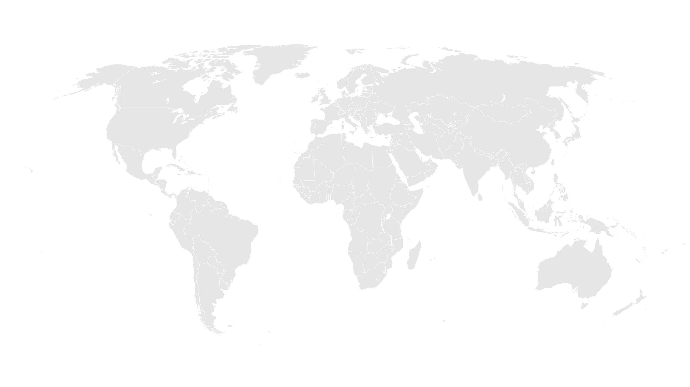
APS Conference Agenda
Introduction from Office of Strategic Partnerships
General Overview of Technical Area #4: Data Collaboratives for Local Impact Program
General Overview of Technical Area #3: Agribusiness in Niger
APS Overview with MCC Contracts & Grants Management Team
Q&A

Slide 3
About MCC
A U.S. Government foreign assistance agency
fighting to end global poverty.
Created by the U.S. Congress in 2004, with bipartisan support, as a different approach to U.S. foreign assistance.
What’s different about MCC?

Slide 4
MCC & Partnerships
MCC established the Office of Strategic Partnerships to provide a vision and strategy for MCC partnerships that align with agency goals. Building on MCC’s strong track record of leveraging partnerships to maximize and sustain its investments, OSP works to more fully incorporate partnerships in the agency’s work to increase the scope, impact, and sustainability of our poverty-fighting programs.
Learn more at: https://www.mcc.gov/work-with-us/partnerships

Slide 5



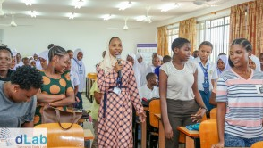
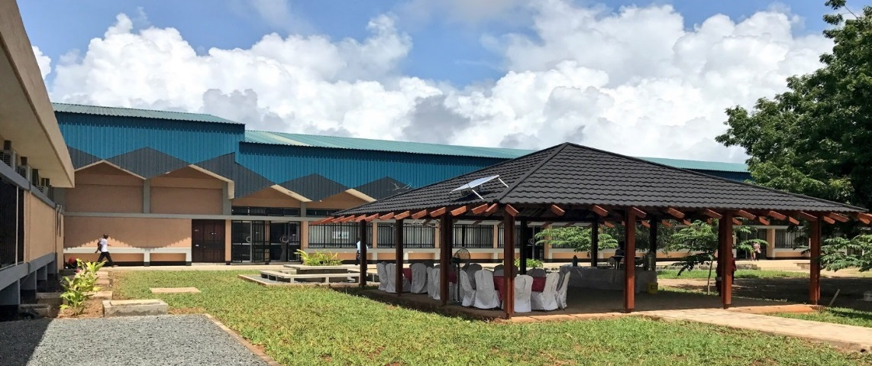
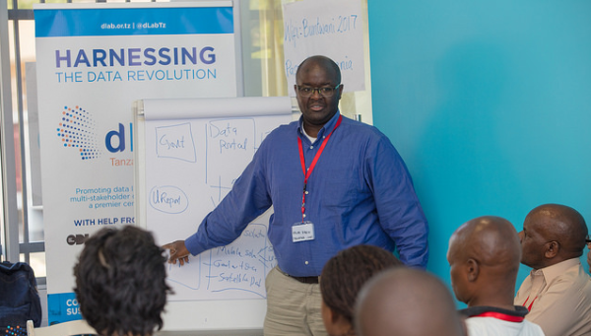
Technical Area #4: Data Collaboratives for Local Impact
TANZANIA, dLab Sustainability dlab.or.tz/ @dLabTz | COTE D’IVOIRE, Data Analytics Center
Operating since 2016, and providing data analytics training, data services, co-working and other resources for data-related collaborations. Based at the University of Dar Es Salam and soon an independent NGO. | A data science center that will analyze, visualize, and interpret data to help make better development decisions, initially to enhance education (MCC) and health (PEPFAR) programs. Designed to self-support through its services.
APS Need: Funding/in-kind donation partners for sustainability Data science / data training service delivery Building dLab staff data analytics & business skills Tanzania/Regional collaboration | APS Need: Co-investment, collaboration and thought partners in areas of data science, data use training, open data, data transparency, and data use innovation Youth engagement / Data fellows program
HIV/AIDS AND HEALTH – EDUCATION – GENDER EQUALITY – ECONOMIC GROWTH

Slide 6
Technical Area #3: Agribusiness in Niger
The Opportunity
Value Chain Partnerships
Input Supply Partnerships
MCC can offer: Organization and capacity building of smallholders, extension services; Infrastructure investments; Limited Grant Funding (in some cases)
Opportunity to integrate smallholders into key value chains including onion, rice, cowpea, peanut, moringa, vegetables, sesame, millet, diary and livestock, with support from MCC Niger Compact.
In some cases, MCC may be able to provide matching grant funding for processing or supply chain investments in compact areas that utilize a Nigerien partner.
Opportunity to implement sustainable models of input and equipment provision for smallholder farmers, whose demand for inputs will increase with MCC compact investments.
Particularly interested in innovative delivery mechanisms that address last mile distribution and integrated business models that target challenges faced by smallholders.

Slide 7
Technical Area #3: Agribusiness in Niger
Context
MCC’s 5 year, $437 million compact in Niger, approved in June 2016 and expected to begin implementation in January 2018, aims to increase agricultural/livestock productivity and facilitate market access for smallholder producers
Investments will include:
  ~5000 hectares of irrigation infrastructure in Konni and Dosso-Gaya;
  capacity building in production and marketing and other services to farmers;
  upgrade of 307 km of national and rural roads serving Dosso-Gaya;
  community-based infrastructure and natural resource management projects to increase agricultural productivity, resilience, and sales;
  livestock health services and market infrastructure development.

Slide 8
ANNUAL PROGRAM STATEMENT (APS)
No: 95332418N0002
Taylor Wolf,
AO
Nataliya Holl,
AS
Jacqueline Naranjo,
AO
PARTNERSHIPS with MCC Program
Posted on www.grants.gov on
November 9, 2017 for one year
Contracts and Management Team

Slide 9
Highlights
Awards period of performance | The majority of awards’ period of performances will be one to three years, though some may be up to five years max
Anticipated Number of Awards and Eligibility | Multiple awards The APS is open to U.S. and non-U.S. private businesses, business and trade associations, foundations, U.S. and non-U.S. Non-Governmental Organizations (NGOs), international organizations, U.S. and non-U.S. colleges and universities, civic groups, regional organizations, etc.
Type of Awards Substantial involvement | Grants, Cooperative Agreements, and Fixed Amount Awards For Cooperative Agreements
Two-phase Competition | The competition will be conducted in two phases – Phase I -Concept Paper submission, open to everyone, and Phase II - Complete Application by MCC invitation only Collaboration, co-creation and feedback brainstorming sessions

Slide 10
Timeline and Key Dates
NOFO APS posted | November 9, 2017 for one year
First teleconference Questions for Review Window 1 Concept Papers due Window 1 | November 30, 2017 10.00 am EST December 4, 2017 2.00 pm EST November 9 - December 13, 2017 2.00 pm EST | Questions for Review Windows 2-7 are due 15 calendar days from the start date of each window at 2.00 pm EST
Review Window 2 Concept Papers due | December 14, 2017 through February 2, 2018 | Each Review Window will have a separate teleconference scheduled
Review Window 3 Concept Papers due | February 3, 2018 through March 30, 2018 | We might conduct separate teleconferences for each technical area
Review Window 4 Concept Papers due | March 31, 2018 through May 31, 2018
Review Window 5 Concept Papers due | June 1, 2018 through July 31, 2018
Review Window 6 Concept Papers due | August 1, 2018 through November 08, 2018

Slide 11
Cost Sharing/Matching and Leveraging Program Income
Cost Sharing/ Matching | 2-10% | 2 CFR 200.306 Cost Share refers to the resources a recipient contributes to the total cost of an agreement, the portion of project or program costs not borne by the U.S. Government. Cost-sharing includes cash and in-kind contributions. Must be allowable costs, auditable
Leveraging | 1:1 or higher | Leverage describes the quantifiable contributions presented in a variety of forms provided by resource partners to the program. Leverage is not intended to be binding or auditable
Program Income | Program activities generated amount | 2 CFR 200.80 Program Income is gross income earned by the non-Federal entity that is directly generated by a supported activity or earned as a result of the Federal award during the period of performance. Funds are to be returned to MCC on a quarterly basis via the International Treasury System

Slide 12
Question & Answer Session
All questions will be documented and released as an amendment to the APS package on grants.gov.
Please click the ‘raise hand’ icon to be recognized for a question, or you may type your question into the chat box.

Slide 13
Thank you for joining us today, we look forward to working with you!

