Slide 1

MCC Annual Program Statement
Technical Areas 5 & 6
November 30, 2017
Online Conference

Slide 2
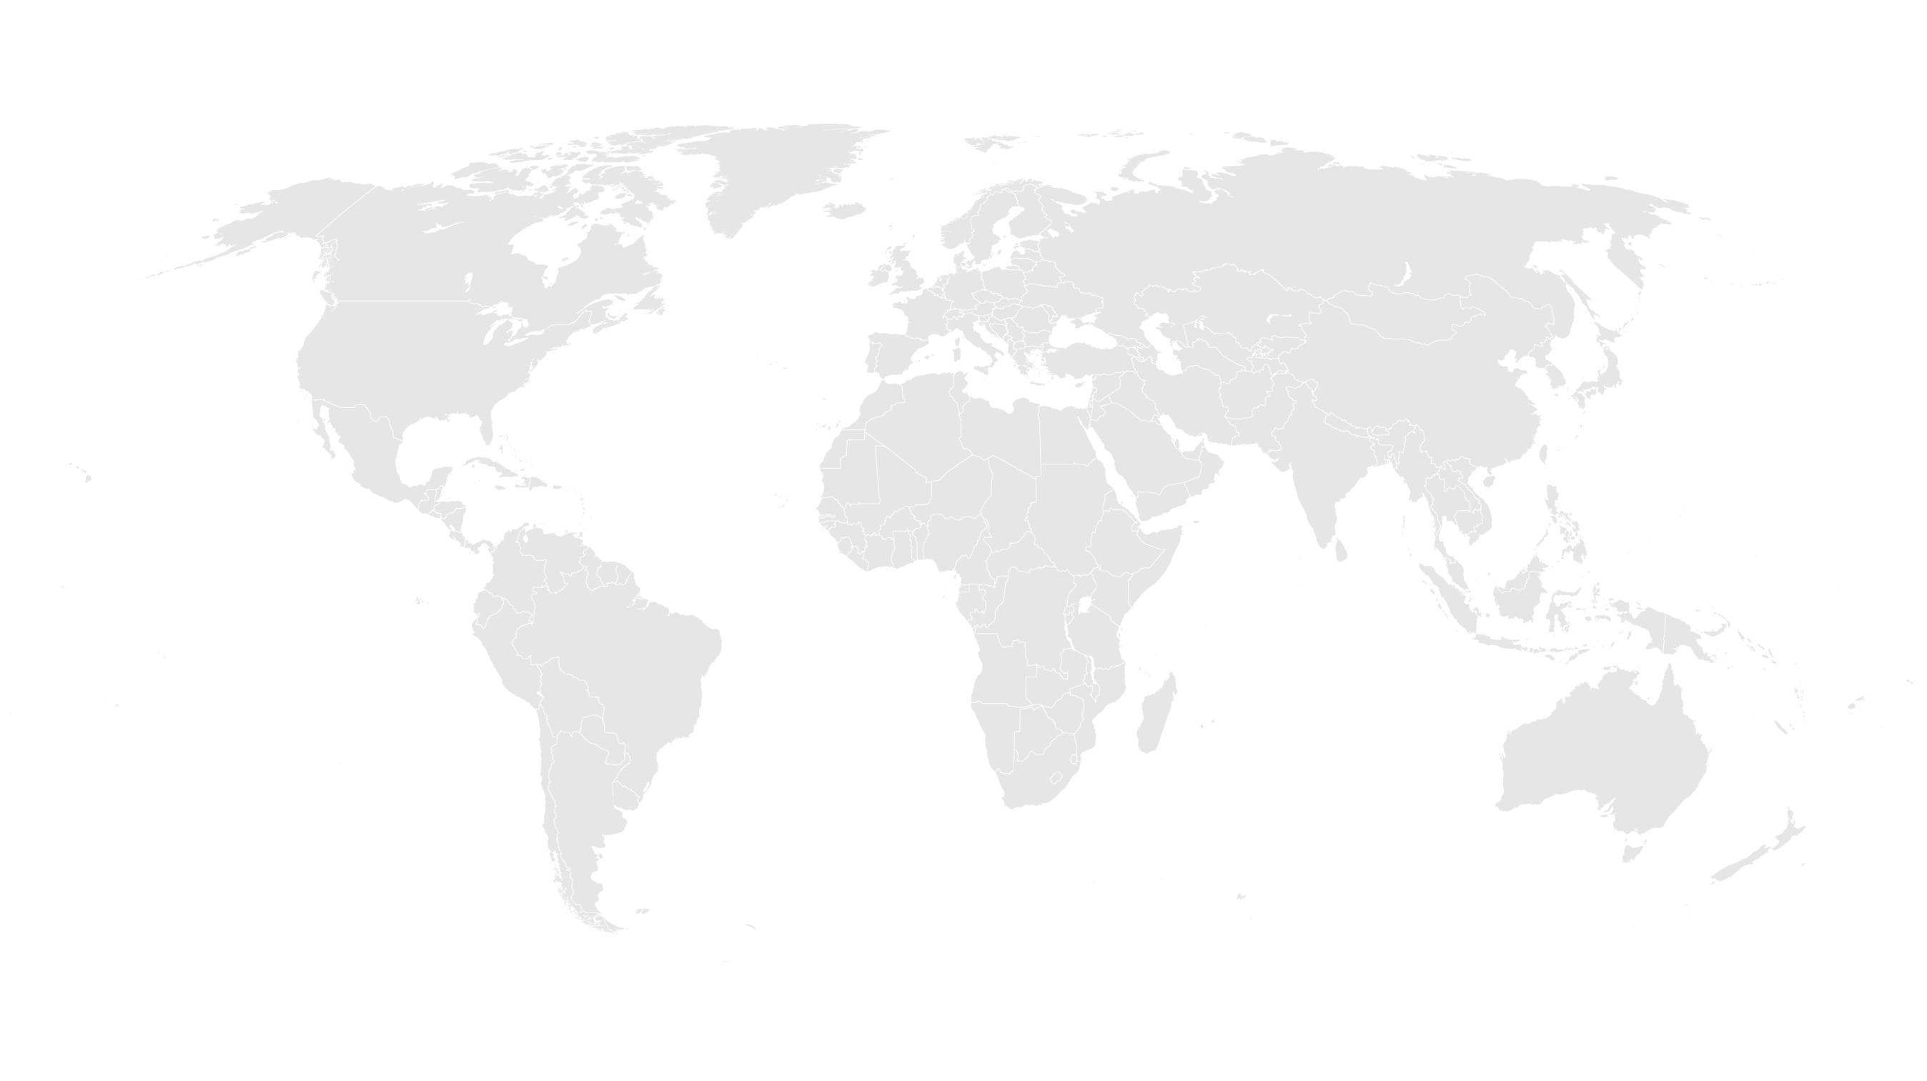
APS Conference Agenda
Introduction from Office of Strategic Partnerships
General Overview of Technical Area #5: High Frequency Monitoring Data
General Overview of Technical Area #6: Data Collection & Analysis in Sri Lanka
APS Overview with MCC Contracts & Grants Management Team
Q&A

Slide 3
About MCC
A U.S. Government foreign assistance agency
fighting to end global poverty.
Created by the U.S. Congress in 2004, with bipartisan support, as a different approach to U.S. foreign assistance.
What’s different about MCC?

Slide 4
MCC & Partnerships
MCC established the Office of Strategic Partnerships to provide a vision and strategy for MCC partnerships that align with agency goals. Building on MCC’s strong track record of leveraging partnerships to maximize and sustain its investments, OSP works to more fully incorporate partnerships in the agency’s work to increase the scope, impact, and sustainability of our poverty-fighting programs.
Learn more at: https://www.mcc.gov/work-with-us/partnerships

Slide 5
Technical Area #5: High Frequency Monitoring Data
Desired skills
Innovative, cost effective approaches to data collection for high frequency data, and/or innovative tools to:
  Inform investment decisions
  Monitor and improve program implementation
  Support rigorous project evaluations
Ideas in all sectors are welcome, with particular interest in:
Sectors
  Roads (traffic counts, origin destination, IRI, etc.)
  Energy (outages, technical/nontechnical losses, etc.)
  Water (non revenue water, supply, pressure, etc.)
  Uses of GIS (satellite imagery, cell phone data/apps, etc.)

Slide 6
Technical Area #6: Data Collection & Analysis in Sri Lanka
Desired skills
Innovative, cost effective approaches to data collection and analysis in
  Transportation, especially around congestion and public transit usage in key corridors in the Colombo Metro Region.
    Travel times, socioeconomic characteristics, origin destination, etc.
  Demand, availability and prices of land.
Transportation & Land
Sectors

Slide 7
ANNUAL PROGRAM STATEMENT (APS)
No: 95332418N0002
Taylor Wolf,
AO
Nataliya Holl,
AS
Jacqueline Naranjo,
AO
PARTNERSHIPS with MCC Program
Posted on www.grants.gov on
November 9, 2017 for one year
Contracts and Management Team

Slide 8
Highlights
Awards period of performance | The majority of awards’ period of performances will be one to three years, though some may be up to five years max
Anticipated Number of Awards and Eligibility | Multiple awards The APS is open to U.S. and non-U.S. private businesses, business and trade associations, foundations, U.S. and non-U.S. Non-Governmental Organizations (NGOs), international organizations, U.S. and non-U.S. colleges and universities, civic groups, regional organizations, etc.
Type of Awards Substantial involvement | Grants, Cooperative Agreements, and Fixed Amount Awards For Cooperative Agreements
Two-phase Competition | The competition will be conducted in two phases – Phase I -Concept Paper submission, open to everyone, and Phase II - Complete Application by MCC invitation only Collaboration, co-creation and feedback brainstorming sessions

Slide 9
Timeline and Key Dates
NOFO APS posted | November 9, 2017 for one year
First teleconference Questions for Review Window 1 Concept Papers due Window 1 | November 30, 2017 10.00 am EST December 4, 2017 2.00 pm EST November 9 - December 13, 2017 2.00 pm EST | Questions for Review Windows 2-7 are due 15 calendar days from the start date of each window at 2.00 pm EST
Review Window 2 Concept Papers due | December 14, 2017 through February 2, 2018 | Each Review Window will have a separate teleconference scheduled
Review Window 3 Concept Papers due | February 3, 2018 through March 30, 2018 | We might conduct separate teleconferences for each technical area
Review Window 4 Concept Papers due | March 31, 2018 through May 31, 2018
Review Window 5 Concept Papers due | June 1, 2018 through July 31, 2018
Review Window 6 Concept Papers due | August 1, 2018 through November 08, 2018

Slide 10
Cost Sharing/Matching and Leveraging Program Income
Cost Sharing/ Matching | 2-10% | 2 CFR 200.306 Cost Share refers to the resources a recipient contributes to the total cost of an agreement, the portion of project or program costs not borne by the U.S. Government. Cost-sharing includes cash and in-kind contributions. Must be allowable costs, auditable
Leveraging | 1:1 or higher | Leverage describes the quantifiable contributions presented in a variety of forms provided by resource partners to the program. Leverage is not intended to be binding or auditable
Program Income | Program activities generated amount | 2 CFR 200.80 Program Income is gross income earned by the non-Federal entity that is directly generated by a supported activity or earned as a result of the Federal award during the period of performance. Funds are to be returned to MCC on a quarterly basis via the International Treasury System

Slide 11
Question & Answer Session
All questions will be documented and released as an amendment to the APS package on grants.gov.
Please click the ‘raise hand’ icon to be recognized for a question, or you may type your question into the chat box.

Slide 12
Thank you for joining us today, we look forward to working with you!

