Slide 1
Attachment III
Water Conservation Activity
Pre-Application Conference
USAID/Jordan
November 18, 2015
Washington, DC

Slide 2
Objective
Provide a clear understanding of the WCA, background information, purpose, and lessons learned in this program area
Familiarize Applicants with the technical and cost requirements
Highlight important aspects in the application process
Questions and Answers

Slide 3
Agenda
14:00 | Welcome & Introduction Purpose of Conference & Remarks Rules of the Game
14:30 | Purpose of WCA & Lessons Learned Past work performance in this program area Technical Application Requirements
15:30 | Break
16:00 | Cost application requirements
16:30 | Application evaluation procedure
17:00 | Questions & Answers
18:00 | Concluding Remarks

Slide 4
WCA Goal
To conserve water; seek to save and/or conserve a minimum of 10-20 MCM of water during the five years of the activity.
Promote water saving goals by addressing three objectives:
  Water conserving technologies and behavior changes adopted
  Sustainable soil water storage and aquifer recharge improved
  Institutions strengthened to promote water saving technologies

Slide 5
Data Summary
Open to all qualified U.S. and non-U.S. organizations (See Section C of RFA) | Resulting in one award
Choice of Instrument | Cooperative Agreement
Estimated Period of Performance | 5 years from date of award
Total Estimated Amount (TEA) of Award | $30 million
Grants-approximately 30% of the TEA | $10 million
Cost Share (2 CFR 200.306) | 10%

Slide 6
Outline
Purpose of WCA: Water Conservation and Security
Outline: Lessons Learned in Past Projects
Program Description & Requirements

Slide 7
Umbrella IR: Accountable Sustainable Management of Water Resources Increased
IR 1: National Sustainable Water Supply System Improved
IR2: Water Conserved
IR3 Water Sector Governance Improved
IR4: Water Supply and Resources Protected
Comp 1: H2O Cons Technol & Behavior Change Adopted
1. Financial Sustainability of Water Sector Improved
1. Enforcement and Compliance Improved
1. Supply of Water Increased in Water Supply System
Comp 2: Sustainable Aquifer Recharge
2. Transparency and Accountability Improved
2. Management of Wastewater Improved
2. Management of Water Entities Improved
Comp 3: Institutions Strengthened to Promote Water Saving Technologies
3. Bilateral and Regional Agreements Supported and Promoted
Water Conservation Activity
Notes:
Here is the results framework for DO3W rooted in WRE. Read C1-3 from slide. Note that we link also to financial sustainability, protection of water supply and resources and regional cooperation.

Slide 8
Percentage of WCA Activities
NOTE: Pay particular attention to the suggested percentage of efforts for activities provided in Table 2, summarized as follows:
Component 1: Implementation of science and technology to enhance water availability (50-60%)
Component 2: Enhance aquifer recharge and soil water storage (10-20%)
Component 3: Institutional strengthening (20-30%).
Sum total of grants should not exceed $10 million

Slide 9
Water Conservation Project (WCP) WCP = WCA + DCA + Interagency Agreement (IAA)
Water Conservation Activity (WCA) starting in 2016
WCA Component Capacity Development
WCA Component Hydroponics & Technology (JV & Mafraq/Azraq Basins) | WCA Component Household Interventions | WCA Component Soil & Aquifer Water Storage
WCP Component Development Credit Authority (DCA): Access to Finance
IAA:
USAID & U.S. Forest Service
to assist the Badia Restoration Project

Slide 10
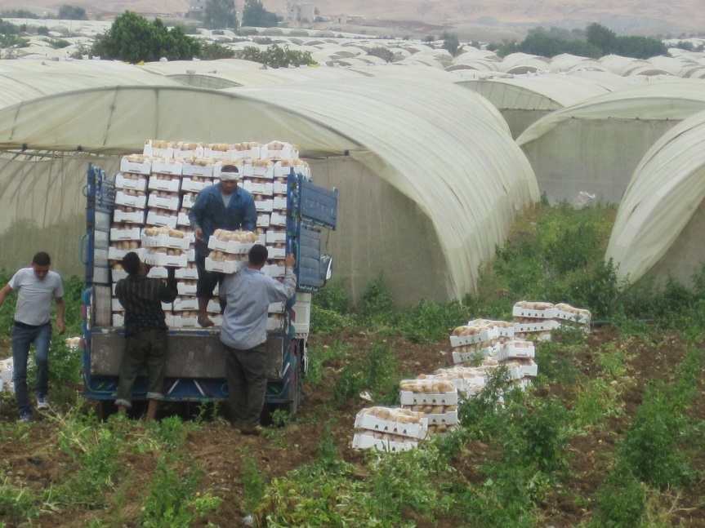
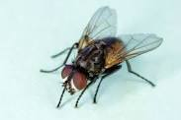
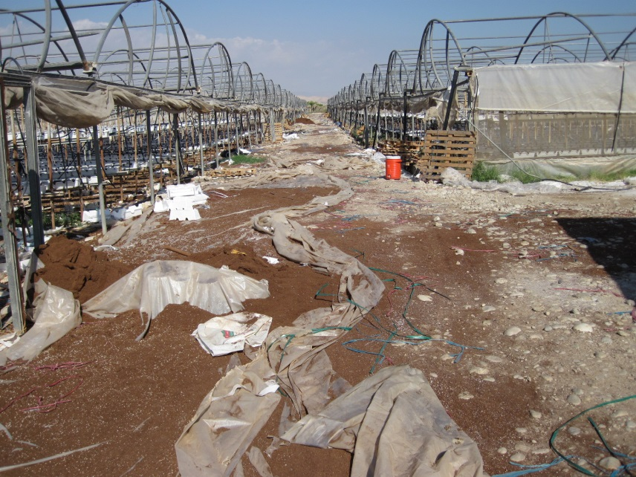
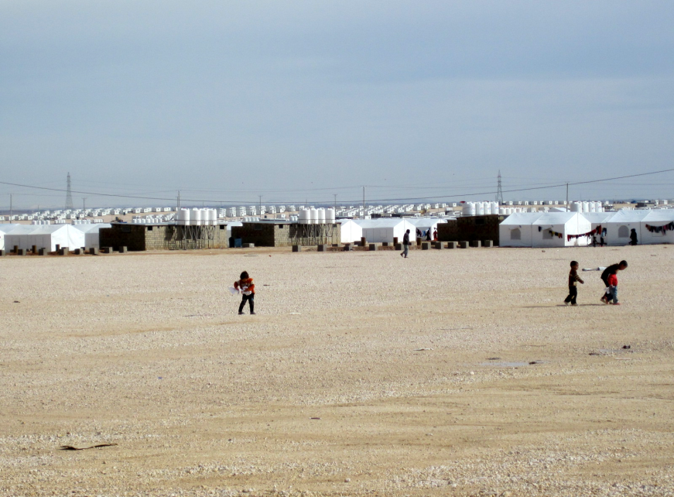
Problems
Notes:
Clockwise from top left, totally disorganized packing with Styrofoam crates and no cold chain; housefly outbreaks from untreated manure; plastic waste / herbicides / pesticides from greenhouses; and all in one – refugees, water scarcity; unemployed youth.

Slide 11
Institutional Support is Needed
Private Sector Value Chains
only for “crops that sell”
under a sub-contract & grown
to GlobalGAP specifications.
Vo-tech training
needed to expand
skills in CBOs & WUAs to fill new “desired” jobs.
WCA HH & AG H2O
CBOs & WUAs
Workforce
Education & Training
Research & Extension
NCARE and JVA
can be conveners
of events and WCA can “bring them along” by including them.
How to create an acceptable commercial mechanism to complement revolving loans under CBI?
Notes:
WCA touches CBOs/WUAs, with whom we have a 4 star rating because of the USAID Community Based Initiatives for Water Demand Management (CBIWDM), implemented by Mercy Corps, with CBOs and USAID Institutional Strengthening and Support Project (ISSP) work with WUAs.
Going counter-clockwise, there is plenty of research but not much extension in Jordan so it gets 2 stars.
Extension and Training (ET) -- there is plenty of higher education but not of the right kind that leads to jobs; however, very little vo-tech education so it gets 1 star. Unfortunately AG is not an interesting career choice for students. Parents don’t encourage them so this is where we need to focus on behavior change.
Little focus on the AG workforce (and GOJ has little interest in training the half million Egyptians in country) – so it also scores low.
Going clockwise now with the boxes starting in the upper left, our approach will need to start with the private sector, producing what sells.
Box 2 shows that we need to build vo-tech skills with proper salesmanship and messaging to sell this new kind of job to youth in the CBO/WUAs.
Bring NCARE and JVA along as partners.
Finally, we need to find a way to expand the pie of revolving loans to CBOs and JVAs.

Slide 12
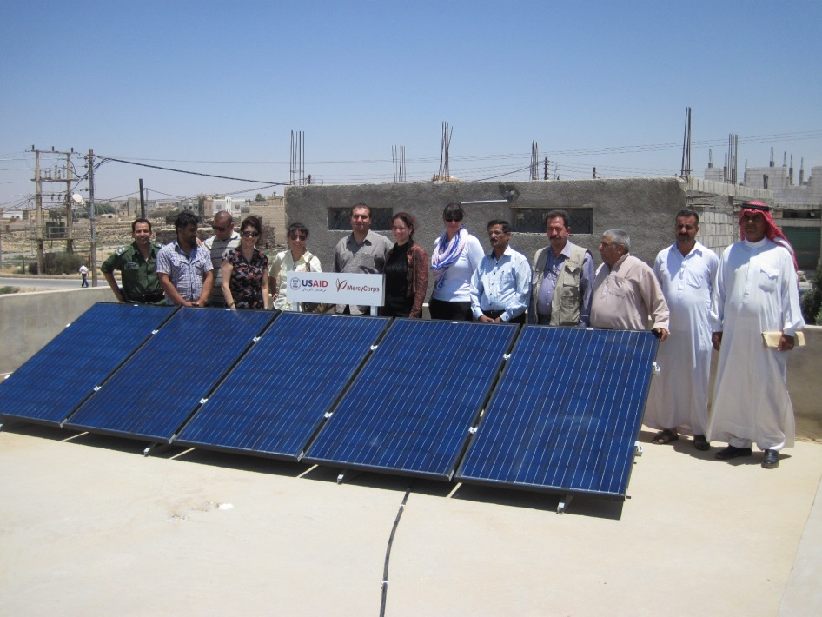
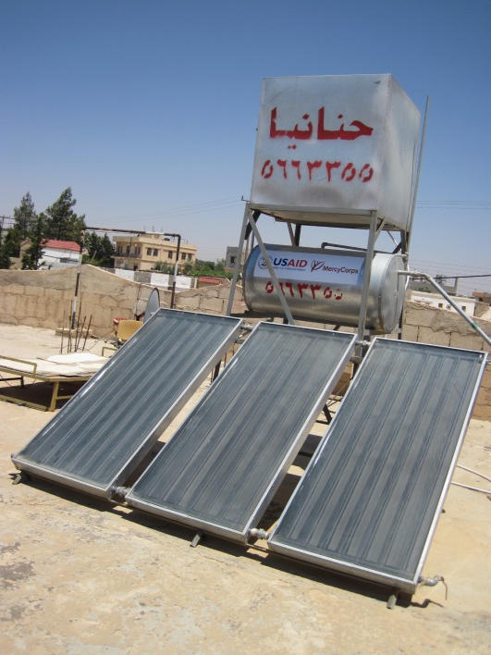
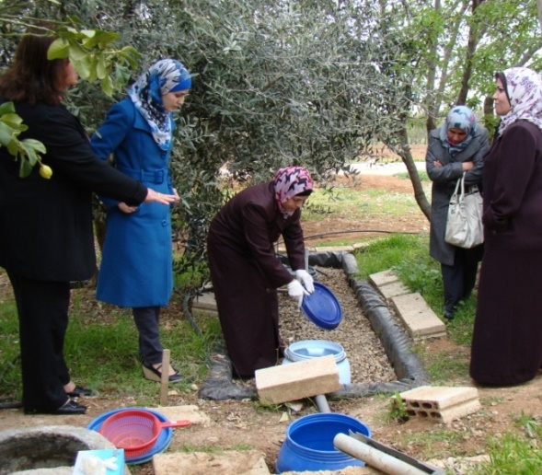
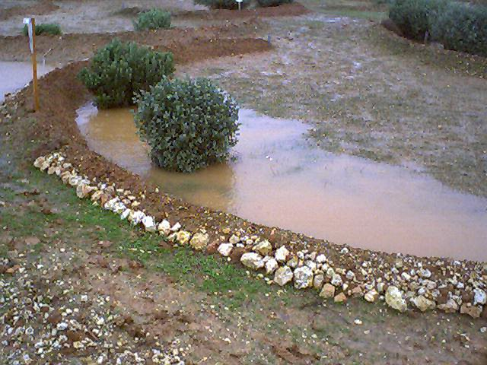
Build on
CBIWDM
Notes:
Building on CBIWDM, and perhaps partnering with USAID’ s Office of Economic Development and Energy (EDE), we could keep the solar powered heating and PV panels that feed into the grid because the PV technology is making gains for use in solar powered pumping and desalinization. Micro water harvesting, drip irrigation and grey water recycling, popular with women’s CBOs, can also continue.

Slide 13
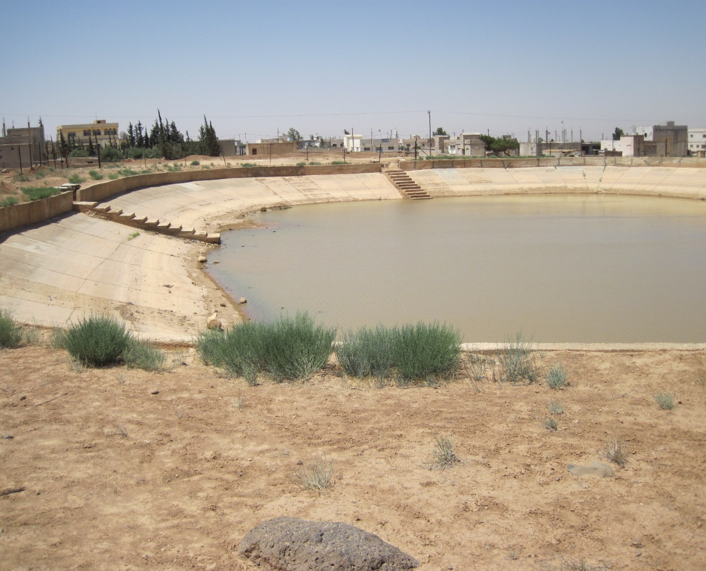
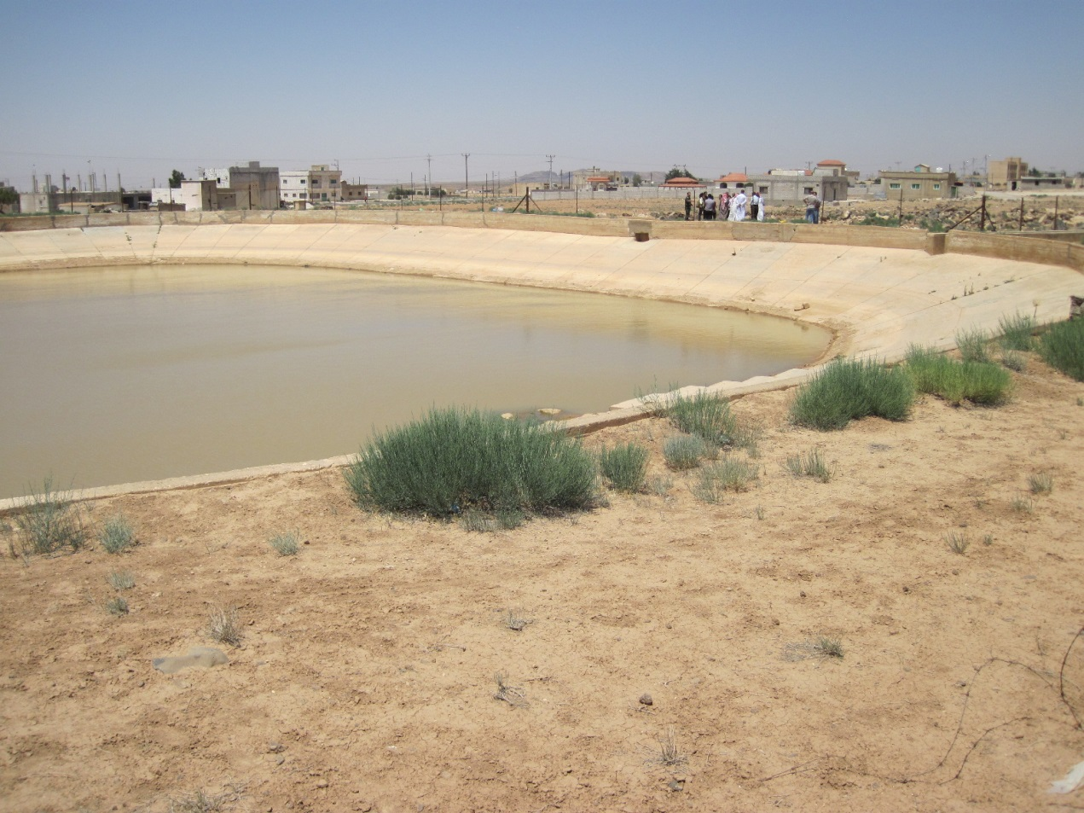
CBIWDM Community Grant
Roman Pond Rehab at Anaqeed al-Khair CBO
Notes:
One of the CBIWDM projects at Anaqeed Al-Khair, this is the kind of project that saves water. It is a community grant gifted to CBOs who were performing well with their revolving loans given to individual CBO members.

Slide 14
CBIWDM
Summary of loans
Grants given to CBOs:
Total number of grants | 193
Total amount of grants | USD 5,015,974
Loans given to beneficiaries:
Total number of loans given | 9196 | 1891
Total amount of loans given | USD 8,990,748
Waiting List PI (883)+ PII (381) | 1264
Repayment rate:
Repayment of 193 CBO grants > member loans | 94%
Notes:
Total number of CBO community grants in CBIWDM: 193 grants totaling almost $5 m. Total number of individual loans to members was 9196 totaling almost $9 m with 1264 people still on the waiting list. Considering both phases, overall repayment was 94% and the good thing is that these loans should go on in perpetuity, providing the communities can top the principle up from time to time to account for inflation and non-repayment.

Slide 15
CBIWDM
Summary of loans
Type of projects: | No. | USD
Cisterns & reservoirs | 4755 | 6,045,056
Residential network maint. | 1539 | 1,038,658
Water tanks only | 1349 | 467,909
Drip irrigation | 925 | 937,288
Grey Water | 137 | 123,870
Solar water heaters | 416 | 342,797
Other projects types | 75 | 35,169
SUM | 9196 | 8,990,747
Notes:
Cisterns, reservoirs, residential networks and drip kits were the most popular interventions.

Slide 16
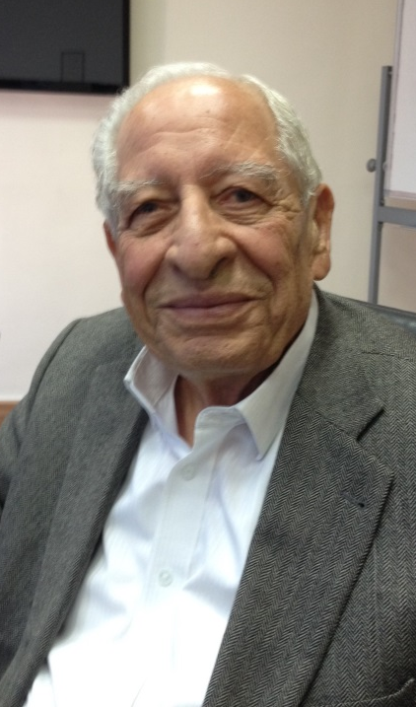

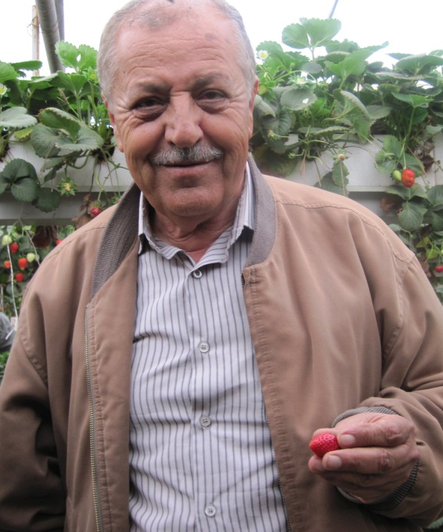
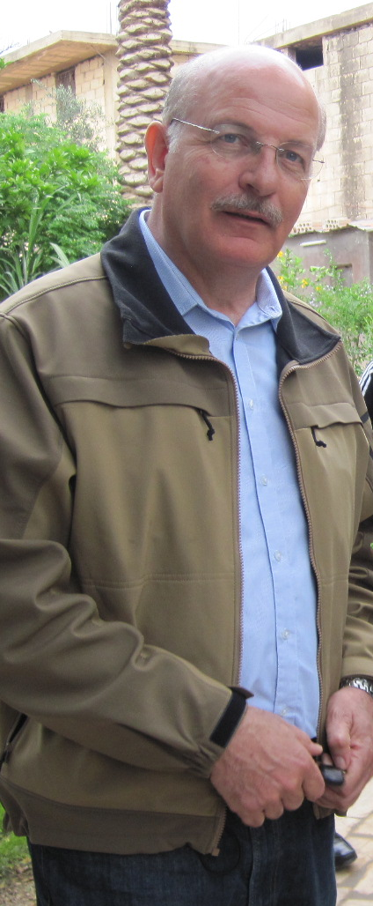
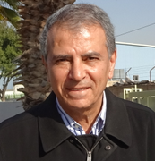
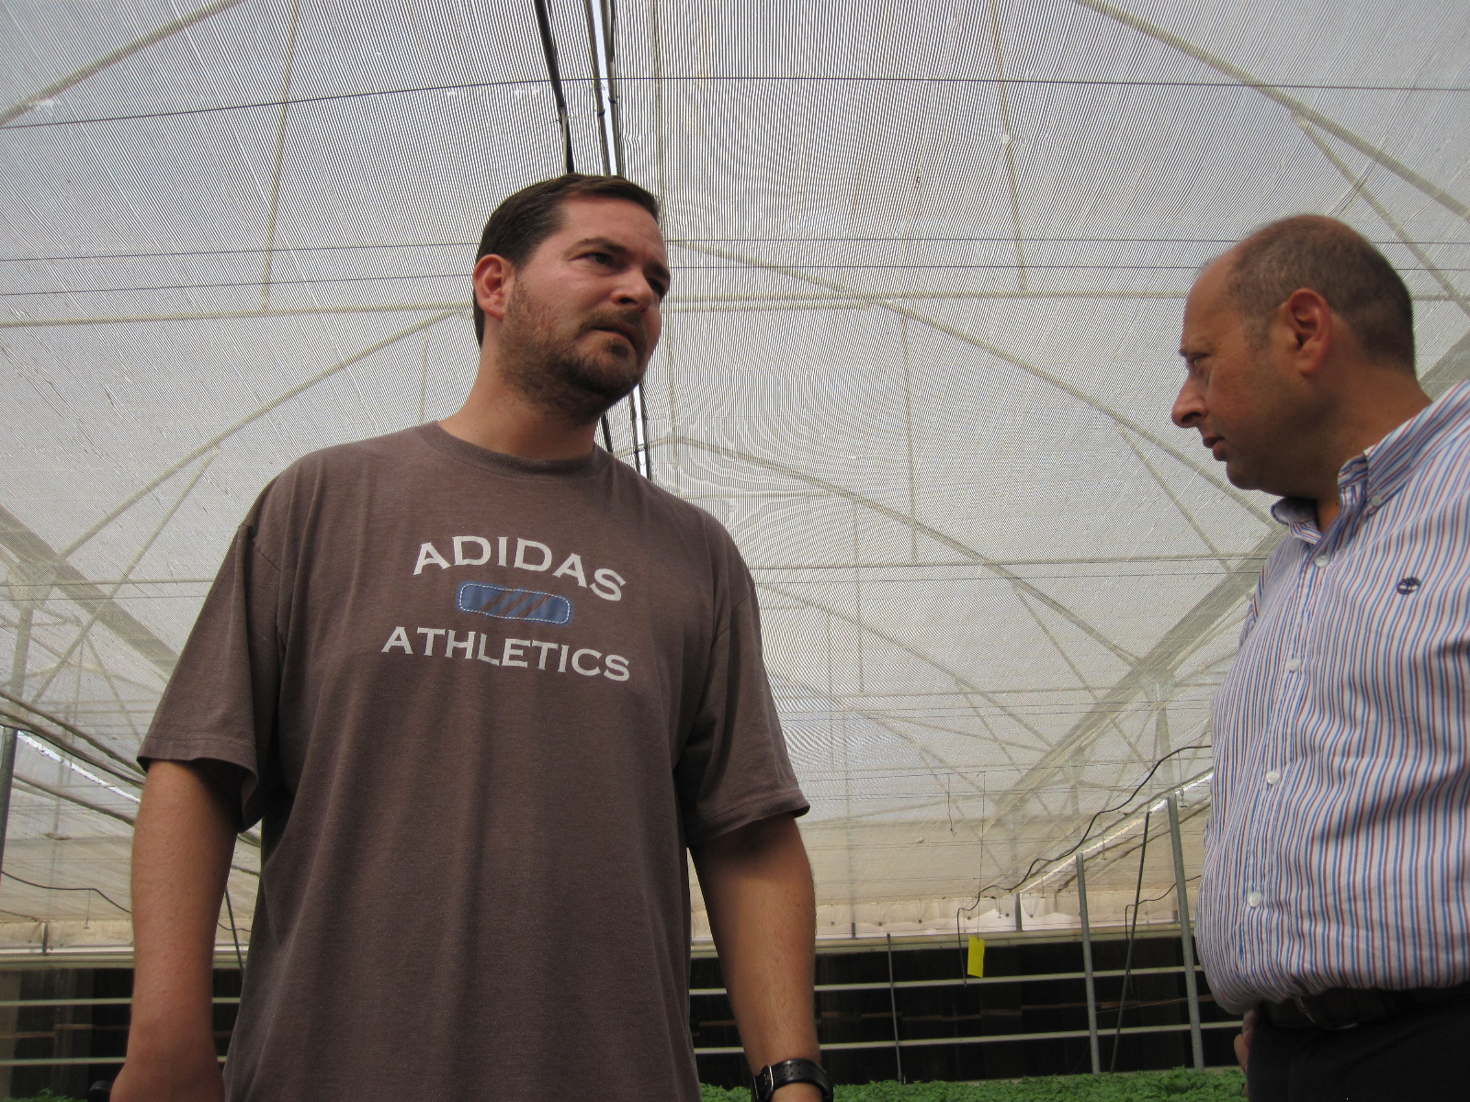
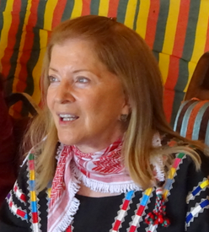
Partner with Experience
Notes:
We intend to reach out to some of the experienced private sector people with whom we have been talking over the past year, including clockwise from top left:
Husam Al-Nimer – hydroponic pioneer in Jordan, water harvesting;
Ahmad Omar, large strawberry exporter;
Khalil Abou Ghannem, the hydroponics and brackish water desal pioneer know as Mr Strawberry;
Mohamed Bateineh, American Chamber of Commerce and CEO, Agri-Jordan,
Sherifa El-Zein, Hashemite Fund for the Development of the Jordan Badia (HFDJB);
Sharrif Hajjar, CEO of Greener Farms growing basil for UK markets;
Zarif Al-Baradei, CEO of the National Drip Irrigation Company

Slide 17
Scale up
Hydroponics
Lettuce description | Open Field | Net House | Hydroponic
Lettuce average weight | 360 gram | 400 gram | 160 gram
Weight minus waste | 320 gram | 370 gram | 160 gram
Lettuce head/ha/year | 400,000 | 540,000 | 2,200,000
Grade A | 70% | 85% | 99%
Useful Grade A/ha/year | ~ 70 Ton | ~ 170 Ton | ~ 350 Ton
Cycles / harvest | 4-5 / 9 month | 6 / 12 month | 365 days
Water consumed (m3/ha) | 21,000 | 17,000 | 6,000 – 7,000
Fertilizers (%) | 100% | 120% | 65%
Pesticide (%) | 100% | 60% | 0 – 45%
Work/ha/year (days) | 425 | 510 | 1,000
Notes:
Profit-Agro produces, installs and troubleshoots hydroponics gear on a global basis. They used to operate under Netafim but are now branching out on their own. Let’s look at the performance of hydroponics compared to open field and net house production.
Twice as much clean useable production
A third of the water consumption
Half as much fertilizer and pest control inputs and
Double the labor days.

Slide 18

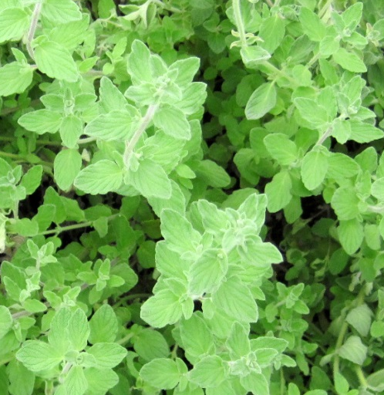
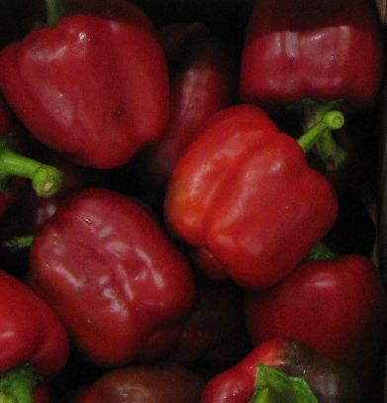
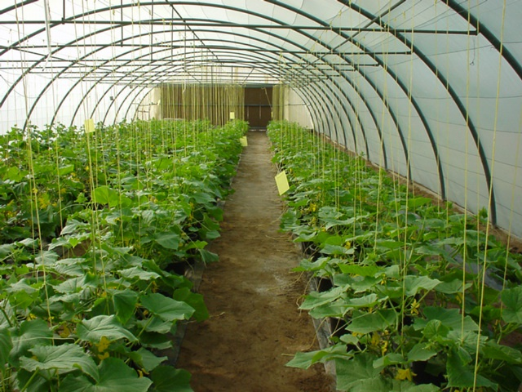
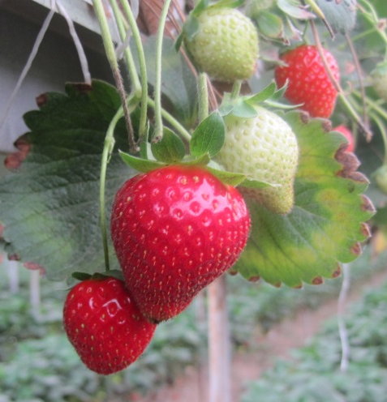
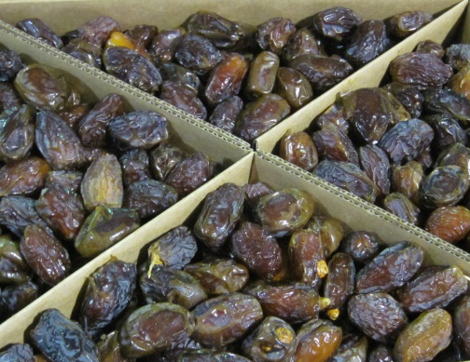
High value per m3 of water
Notes:
We seek to work with different categories of low water use crops such as, but not restricted to:
Fruits (grapes in the Highlands);
Spices (e.g. zatar in Beni Kenana, tarragon with Greener Farms);
Vegetables (red peppers with Agri-Jordan);
Strawberries (with Mr Strawberry);
Dates (leases with Zeid Kawar’s Dates of Jordan) and
Cucumbers, lettuce and many other vegetables with CBOs/WUAs in out-grower schemes with private sector partners.

Slide 19
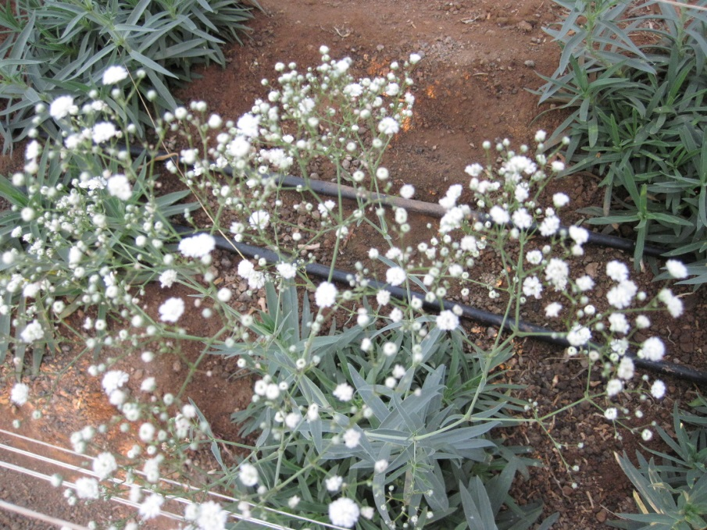
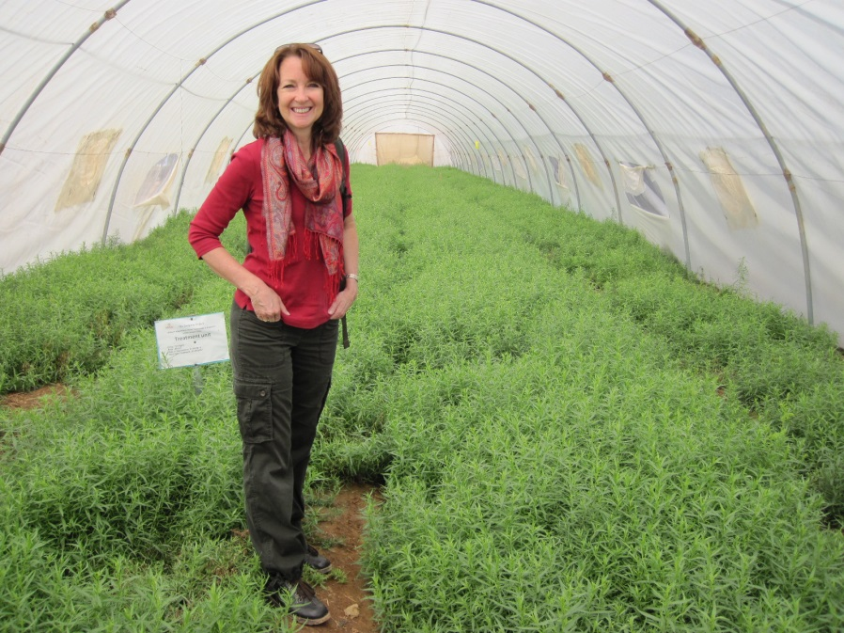
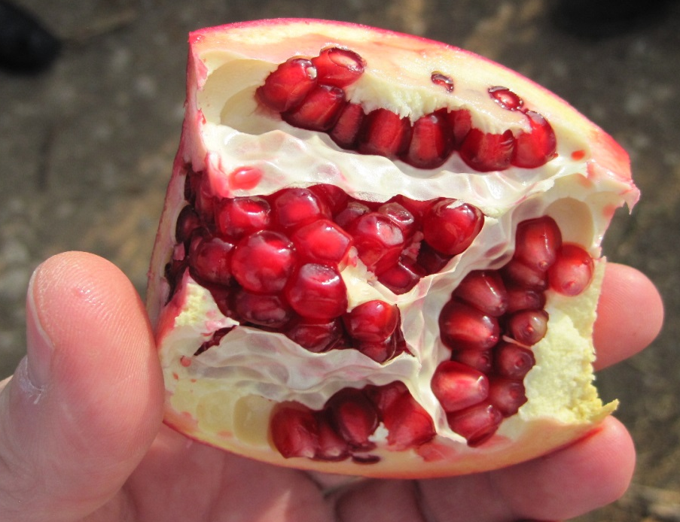
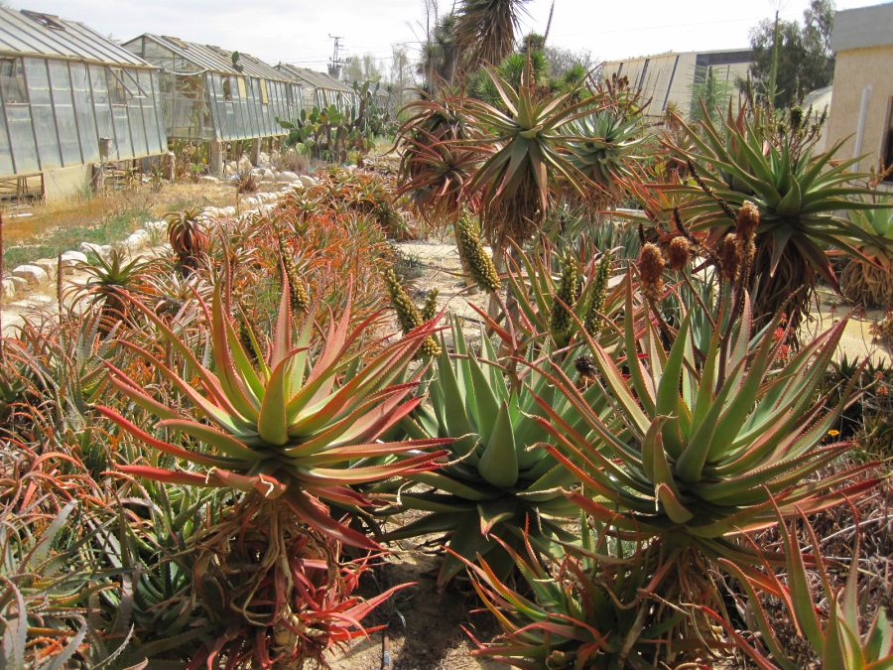
High value per m3 of water
Notes:
There are numerous other crops with high value: clockwise from top left (baby’s breath for florist’s bouquets); tarragon; Aloe vera (medicinal properties); and pomegranate (anti-oxidant).

Slide 20
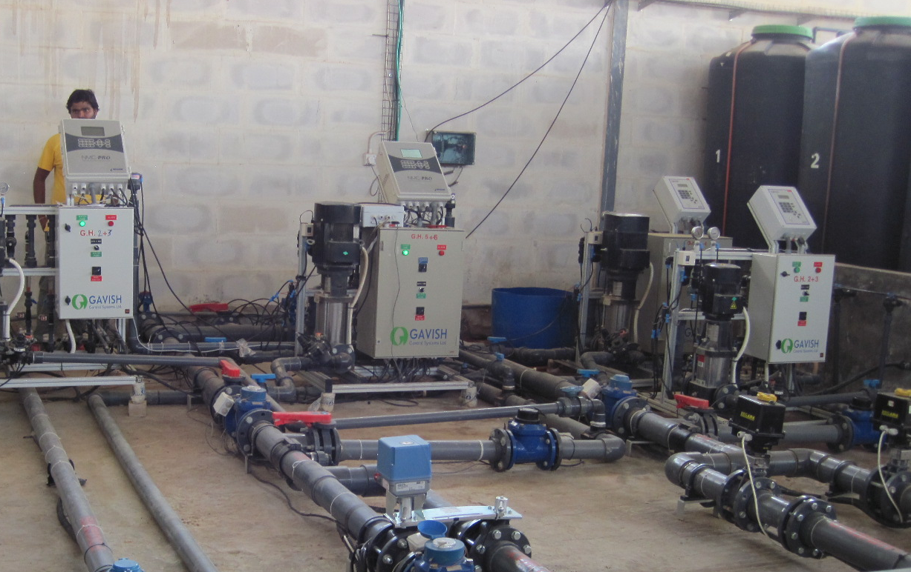
High tech nutrient mgmt/desalinization
Notes:
The high tech parts of the operation are likely to be associated with nutrient monitoring, mixing and desalinization but high tech also comes into the design of greenhouses and the material with which they are constructed to ensure strength and longevity.

Slide 21
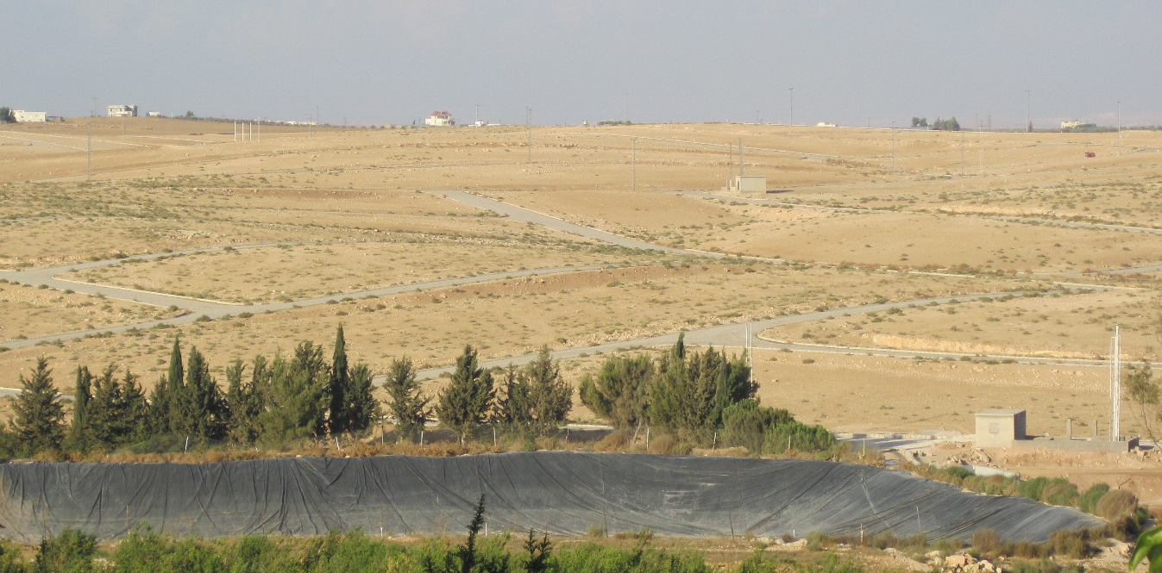
Highlands water
harvesting
Husam Al-Nimer Farms in Madaba
Notes:
Highland farmers are now finding it expensive to get water from wells and must store rainfall to supplement their limited amounts of groundwater. We propose to help these farmers to harvest and store rainwater run-off, while decreasing their groundwater pumping by converting to hydroponics.

Slide 22
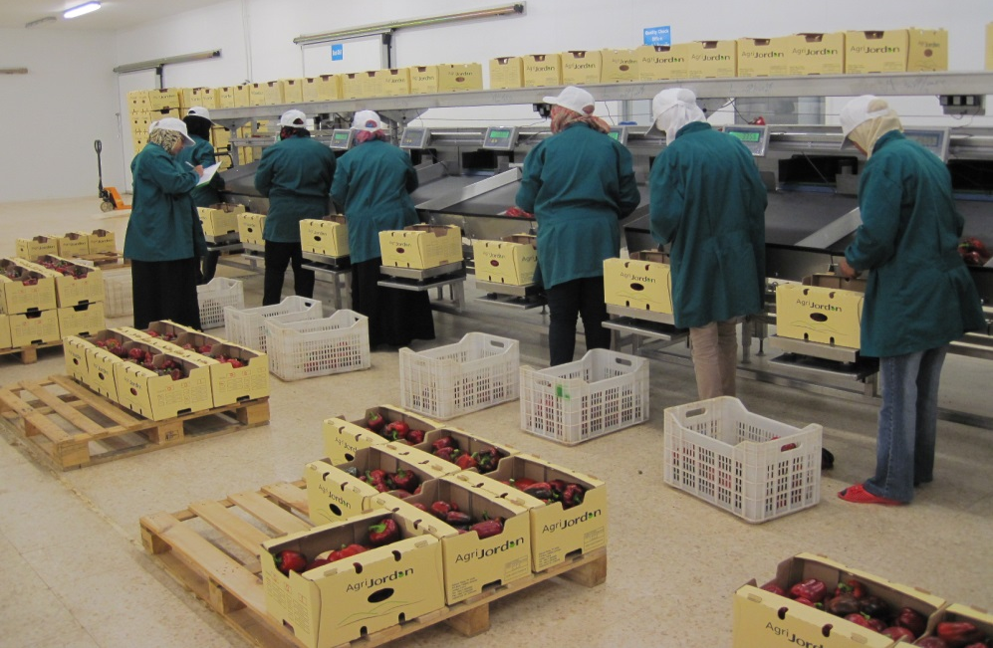
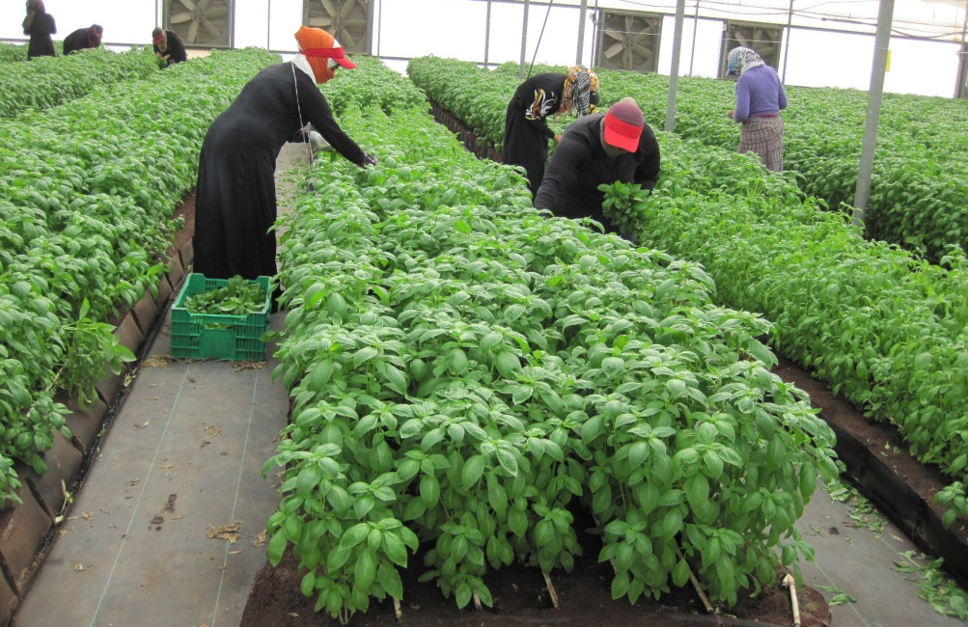
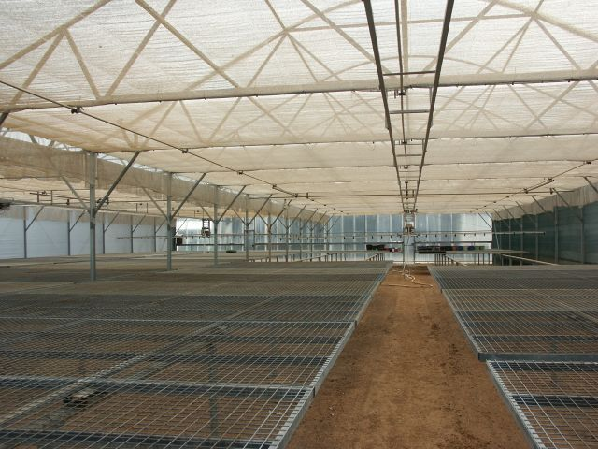
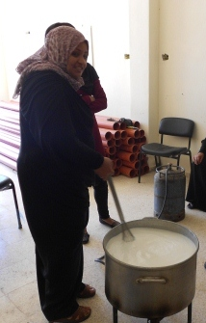
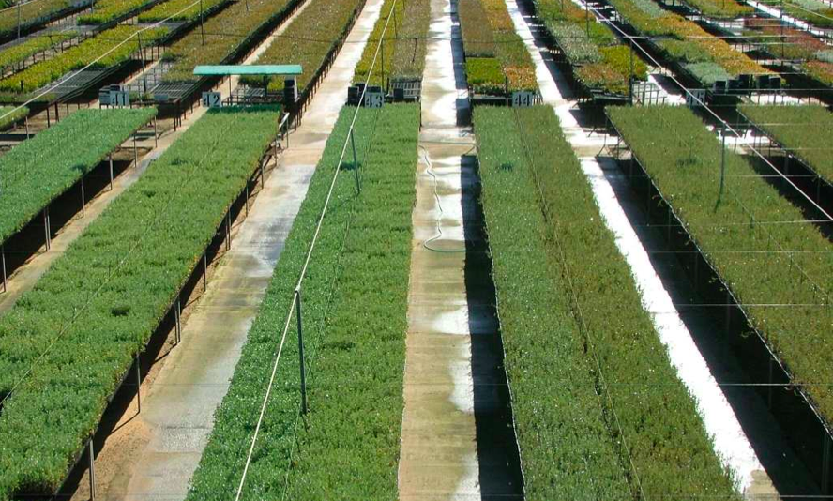
Women should be managers
Notes:
Women, almost exclusively, are hired for production lines: clockwise from top left at Agri-Jordan (peppers); Greener Farms (basil) and not pictured Zeid Kawar dates. Women could also dominate a potential high tech shrub seedling industry, shown here a picture from Australia of a nursery with 2.5 million seedlings. Women are already experts at handling and transforming milk from sheep and goats into differentiated products like laban, lebneh, yoghurt and cheese.

Slide 23
Seedlings for Range Rehab
Cone-tainers provide consistent quality seedlings.
Practical to handle and distribute to communities.
Easy to transplant.
Distribute cone-tainers to community nurseries and let the GOJ (MOA and BRP) supervise.
Requires workers i.e. jobs and revenue for the community if they take over the role of seedling production.
Notes:
USAID has a rep on the Technical Advisory Panel for the MoENV’s Badia Restoration Program (BRP). Their program calls for millions of fodder shrubs planted over many years. It is possible that GOJ will want to change their shrub production system to improve performance based on the USFS advice and recommendations. If not GOJ then we can work with CBOs, the Hashemite Fund for Development of the Jordan Badia (already working with USFS) and Rangeland Cooperatives (RLCs).

Slide 24
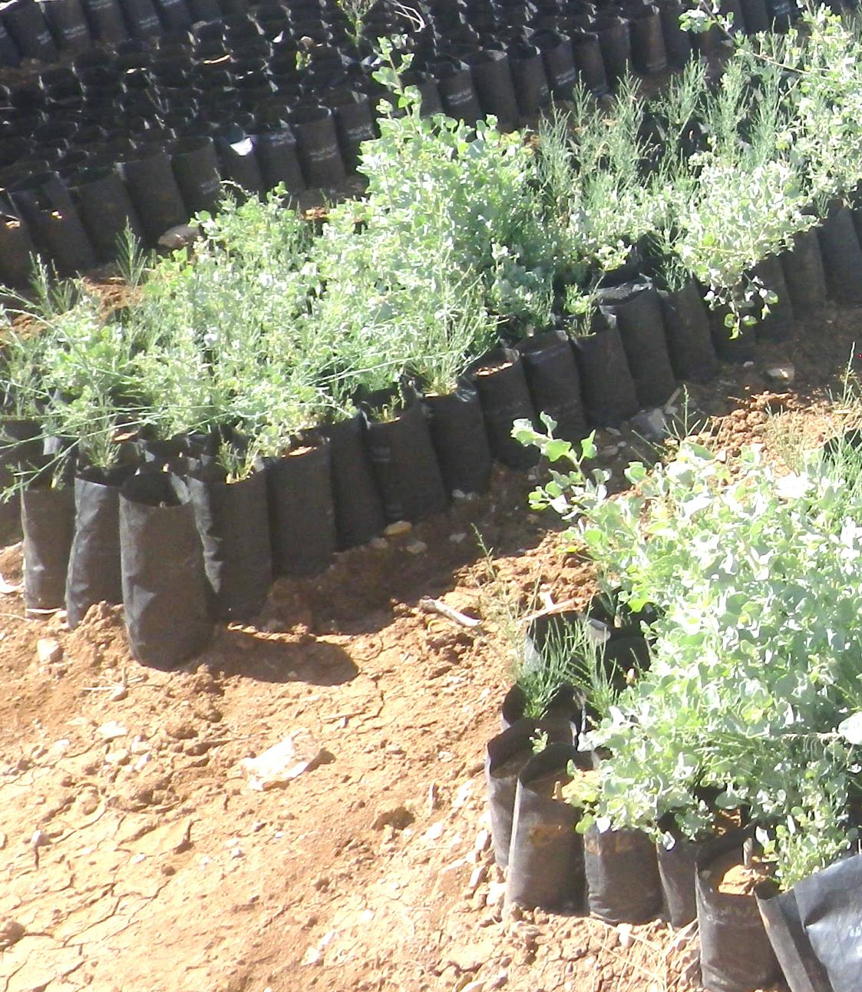
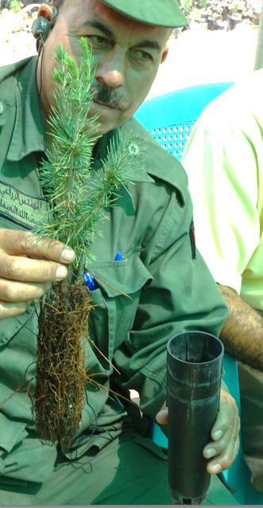
Reduce soil weight; improve root vigor!
Notes:
Compare the 1-2 kg sized bags of shrubs on the left with the cone-tainer on the right. This change alone, along with respecting the proper planting time and transplanting into contour furrows in the badia would vastly improve performance of this system. Combined with a feed source (hydroponic barley) and cut and carry Atriplex for feed block production it would be possible to avoid overgrazing of the new plantations.

Slide 25
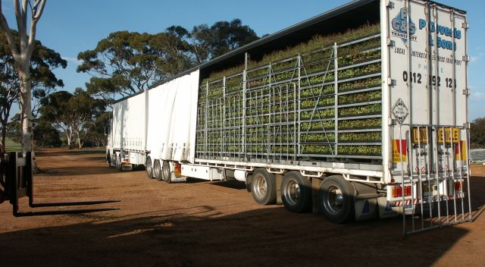
Transport cost is a big factor
Notes:
Clearly, stacking of the seedling trays and reducing the weight of soil in each container is critical to the transport system, as shown for a plug system in Australia.

Slide 26
Flatbed trucks needed for transportation
Example from Australia
Quantity of potting mix needed for propagation
Current System – 3,500 cubic metres or 350 truck loads
Australian plug system – 80 cubic metres or 8 truck loads.
Current system – 1,875 seedlings per truck = 933 trucks
Lightweight plugs in trays stacked 10 high = 20 trucks)
Notes:
This is the comparison of amount of soil needed and transport of seedlings to the field for traditional vs the Australian plug system. It will take 350 truck loads of soil to plant 1.75 m seedlings using the old system but only 8 trucks with the new system. It will take 933 trucks to transport shrubs produced from the old system vs. 20 trucks stacked ten layers high with the new system.

Slide 27
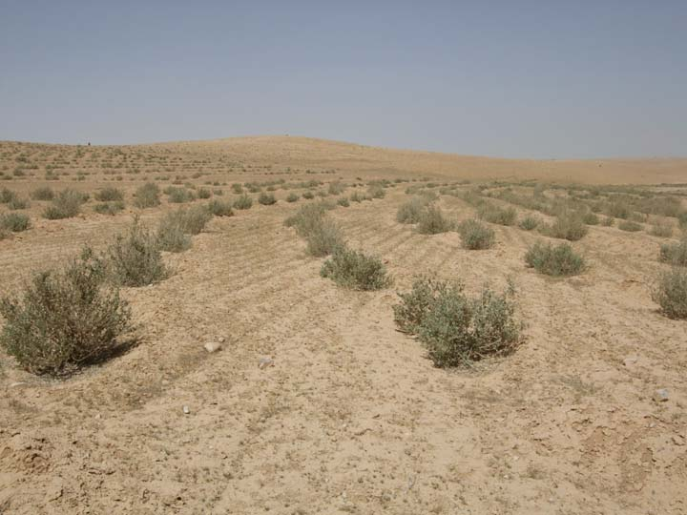
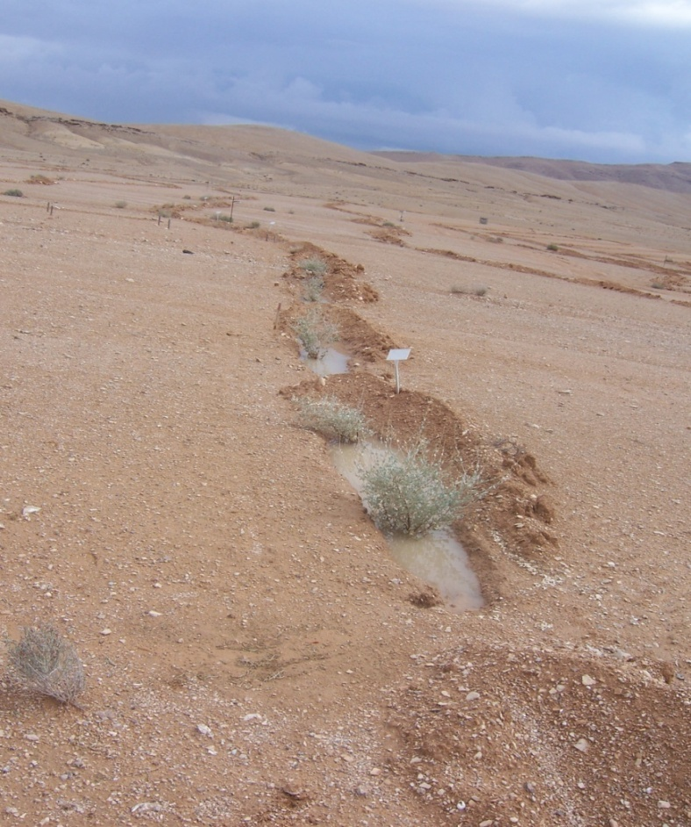
Correct technique is a must
OK
Not OK
Notes:
The success of rangeland revegetation is both technical and socioeconomic – in terms of control of grazing. It is clear in the picture on the right that run off is being intercepted and is used by the shrubs, resulting in a successful plantation as shown in the picture on the left. The diagram shows the mistake that is commonly made by pitting operators, preventing inflow to the furrow.
Only massive replantation schemes could change the characteristics of the hydrological cycle on this watershed. You might be interested to hear that UNICEF and UNHCR are interested in this kind of plantation around Azraq camp, irrigating them with TWW during the winter from our WWT package plants from Afghanistan. Refugees could begin a business making multi-nutritional feed blocks.

Slide 28
Summary
Conserve water in the JV, Highlands and Badia.
For households, carry on with the successful water-saving interventions with CBOs.
For agriculture: promote rainwater harvesting for water storage and hydroponic crops that maximize economic return / m3 of water.

Slide 29
Summary
Conserve water in the JV, Highlands and Badia
In the arable Highlands convince the farmers who use the most water, such as those cultivating olives, to convert to hydroponic production.
In the Badia, add hydroponic fodder production, feed blocks and milk processing to barley based feeding schemes as a quid pro quo to control grazing pressure on new plantations.
Notes:
Target the biggest users of water and give them options to change their behavior. In the Badia, develop re-vegetation techniques that will capture more water for aquifer recharge and shrub production. In the Badia, shrubs are ultimately more important for restoration of the hydrological cycle on watersheds than as a grazing resource but you have to take care of the Bedouin small ruminant feed needs in order to make it work. Grazing management is the biggest concern.

Slide 30
Example Indicators
# Plans: Annual Work, M&E, Communication & Outreach
# Water (m3) conserved from all interventions
# Commercialization and scale-up of hydroponics
# GOJ, NGO, CBO, RLC, WUA promotions of conservation
# Technologies, demonstrations, financing, provided
# Adoptions of new technologies for aquifer recharge
# Institutions strengthened for water-saving technologies
$ Increased access to finance
$ Micro and/or commercial financing available
# Commercialization of water-saving technologies
# Vo-Tech educational training
# Women and youth employed in water conservation

Slide 31
Water Conservation Project (WCP) WCP = WCA + DCA + Interagency Agreement (IAA)
Water Conservation Activity (WCA) starting in 2016
WCA Component Capacity Development
WCA Component Hydroponics & Technology (JV & Mafraq/Azraq Basins) | WCA Component Household Interventions | WCA Component Soil & Aquifer Water Storage
WCP Component Development Credit Authority (DCA): Access to Finance
IAA:
USAID & U.S. Forest Service
to assist the Badia Restoration Project

Slide 32
DCA Key Features
DCA offers a guarantee on non-sovereign debt capital
Typically a 50% guarantee on principal
Flexibility to guarantee foreign and/or local currency
Reporting online in a simple internet-based system
Guarantees typically paired with USAID Technical Assistance
Origination and utilization fees ensure partner commitment

Slide 33
DCA can be tailored to specific development contexts
USAID/Jordan
DCA Loan Guarantee (50%)
Large, exporting farmers converting to hydroponics
4
Export Markets
2
Financial Institution
1
4
Out-growers adopting hydroponics
3
USAID Project Technical Assistance
Notes:
Project description: A loan portfolio guarantee with a financial institution in which USAID will guarantee 50% of realized loss on loans made to farmers for adoption of hydroponic technologies. The guarantee could help banks provide loan terms that are more favorable for agribusinesses adopting water-saving technologies. Given the financial institutions’ perceived risk of working with farmers and the agriculture sector, it is unlikely that institutions will have appetite in the short-term for new agriculture loan products, but this could be explored for the medium-term, especially in conjunction with insurance products.
1. USAID/Jordan and DCA establish a 50% credit guarantee facility for hydroponics adopters to access finance from local financial institutions.
2. DCA provides a 50% guarantee on the loans to large and medium farmers. If farmers default, DCA pays 50% of the realized loss
3. USAID provides TA to farmers for hydroponic adoption/conversion
4. Out-growers sell their produce to large farmers, who on-sell all produce to fulfill contracts in export markets.

Slide 34
Technical Info
Prospective Applicants are encouraged to read the solicitation and specific requirements.
The applicants must provide a detailed technical application that demonstrates how it will creatively achieve the overall goal, program objectives and results.
Applicants should choose a set of interventions from the illustrative interventions to accomplish the desired results -- or -- propose alternative interventions and provide the rational for their selection.

Slide 35
Technical Info. Cont’d
Demonstrate the impact of the selected intervention on cross cutting issues to include gender and youth and, how the intervention insures long-term sustainability.
Do the proposed activities encourage interaction and synergies among the WCA components?

Slide 36
Application Info
The Application must be received by the closing date and time.
The application must strictly adhered to the page limitation.
Do not submit promotional literature and materials regarding the applicant.
Information not requested in the solicitation will not be reviewed.
Proposed activities must be within the scope of Program Description.

Slide 37
Substantial Involvement
Substantial Involvement: Consistent with ADS 303.3.11, USAID/Jordan will be substantially involved in the implementation of the Water Conservation Activity. Substantial involvement may be inclusive of:
Approval of the Recipient's Implementation Plans.
USAID will approve the Annual Budget; Activity Monitoring and Evaluation Plans; Annual Work Plans; Sustainability Plans; Branding and Marking Plan.
Approval of Specified Key Personnel.
Agency and Recipient Collaboration or Joint Participation.

Slide 38
Geographic Code
The authorized geographic code for procurement of goods and services under this WCA award is 937 (http://www.usaid.gov/sites/default/files/documents/1876/310.pdf). Code 937 is defined as the United States, the cooperating/recipient country, and developing countries other than advanced developing countries, and excluding prohibited source. Procurement of agricultural commodities and related products, motor vehicles and pharmaceuticals is subject to the limitations in 22 CRF 228.19 and may require a waiver.

Slide 39
Cost Share & Program Income
Cost Share: USAID has established that a cost share of at least 10% is required for the recipient of the award and is subject to 2 CFR 200.306 (http://www.ecfr.gov/cgi-bin/text-idx?tpl=/ecfrbrowse/Title02/2cfr200_main_02.tpl)
Program Income: Any program income generated under the award may be added to the Federal award by the Federal agency and the non-Federal entity. The program income must be used for the purpose and under the conditions of the Federal Award in accordance with 2 CFR 200.307 (e)(2).

Slide 40
Application Submission
Application Submission Procedures : (Carefully Review the submission instructions)
Adhere to electronic submission requirement and the stipulated font size and document numbering
Submit Cost/Business Application separately from the Technical Application.
Submit via E-mail to: bdiah@usaid.gov with a copy to Wdaas@usaid.gov, by the stipulated due date
E-mail Subject Line: [Name of the Organization, USAID/Jordan WCA NOFO No. 278-16-000002, Cost Application, Part 1 of 2".
Each email should not exceed 20 MB.

Slide 41
Technical Application Format
Cover Page (not included in the page limit)
Acronyms (not included in the page limit)
Table of Contents (not included in the page limit)
Executive Summary
Technical Approach
Key Personnel (Three Key Personnel)
Overall activity Management Plan and Integration of Cross-Cutting Themes
Experience in implementing projects in the Middle East Region
Any tables, graphs, photos, etc.

Slide 42
        Application Annexes
Annexes (No Page Limit):
Resumes/Curriculum Vitae for Key Personnel
Position descriptions & signed letters of commitment
Partner Letters of Commitment
Branding Strategy and Marking Plan
Past Performance Short Forms
Activity Monitoring and Evaluation Plan
Charts - management structure, matrixes demonstrating staff skills, and organizational chart(s)

Slide 43
Review and Selection Process
A Selection Committee (SC) comprised of USAID employees shall review the applications according to the criteria described below. The merit review factors are presented in descending order of importance.
After evaluation of applications, USAID expects to select the apparent successful Applicant. USAID reserves the right to conduct oral presentation to better select the winning application. USAID may also award without discussions with the apparent successful Applicant.

Slide 44
Technical Review Criteria
The technical applications will be reviewed in accordance with the review criteria set forth in Section E of the RFA , summarized below:
Technical approach
Key Personnel
Overall Activity Management Plan and Integration of Cross-Cutting Themes
Experience in Implementing Activities in the Middle East Region

Slide 45
Cost Submission
The cost/business application should contain the budget categories consistent with SF-424A presented in the following format:
  Cover Page
  Standard Forms (SF 424 Forms)
  Budget
  Budget Narrative
  Valid DUNS and active System for Award Management (SAM)
  Certification, Assurances, Statements and Other Required Forms
  Funding Restrictions

Slide 46
Additional Requirements
SF 424 Package – Link provided in the RFA.
Certifications and Representations - Link provided in RFA.
Summary Budget and Detailed Budget in Excel:
Must have an accompanying detailed budget narrative and justification that provides in detail the total program amount for implementation of the program your organization is proposing. The budget narrative should provide information regarding the basis of estimate for each line item, including reference to sources used to substantiate the cost estimate (e.g. organization's policy, payroll document, and vendor quotes, etc.).

Slide 47
Salaries & Fringe
Direct salaries: Propose salaries in accordance with the Applicant's personnel policies. State the amounts of time, such as months and percent of time that shall be expended by each position, their base pay rate verification documentation.
Fringe Benefits: Provide supporting documents, i.e., approved fringe benefit or provide a detailed breakdown comprised of all items of fringe benefits.

Slide 48
Travel & Transportation
The Application will clearly indicate the # of trips, domestic and international,# of days per trip, and the estimated costs; specify the purpose of travel, the origin and destination for each proposed trip, duration and # of individuals traveling and the position held by the travelers. Estimated travel and transportation costs, including airfare and per diem.

Slide 49
Equipment and Supplies
Equipment: The Applicant must itemize the equipment i.e. vehicle, capital equipment and briefly justify the need for the items to be purchased as they apply to the Activity. Provide the basis for the cost estimates per item, e.g., pro forma invoice, published price lists, etc.
Supplies: The Applicant must itemize the materials and supplies and briefly justify the need for the items to be purchased as they apply to the Activity.

Slide 50
Construction & Contractual
Construction: The construction proposed under the RFA will strictly fall under the agency limitations. See ADS 303.3.30.
Contractual: Grants/Sub-Awards: The Applicant's budget shall include a breakdown of all costs for each sub-awards and identify the proposed Sub-awardees. The lump sum must be consistent with the detailed Sub-awardees’ budgets.

Slide 51
ODC & NICRA
Other Direct Costs: Identify other costs and briefly justify the need for each cost item proposed relative to the WCA activities. Include the basis for cost estimates, e.g., market rate, vendor quotes, pro-forma invoice, etc.
NICRA the Applicant should submit the most current
NICRA. In the absence of a NICRA, USAID's
regulations allow partners who have not had a
NICRA the option of electing a 10% deminimus rate.
See 2 CFR 200.414
http://www.gpo.gov/fdsys/pkg/CFR-2014-title2-
vol1/pdf/CFR-2014-title2-vol1- sec200-414.pdf

Slide 52
Cost Evaluation
Technical merit review are significantly more
important than cost. While Cost is less important
than technical, the cost application of the
apparently successful technical application will be evaluated for credibility, completeness and for:
Allowability of Costs (2 CFR 200.403)
Reasonable Costs (2 CFR 200.404)
Allocable Costs (2 CFR 200.405)
Demonstration of management capability to meet a responsibility determination.

Slide 53
Authority
The authority is found in the Foreign Affairs Act and the applicable sections of 2 CFR 700 and 2 CFR 200 – Uniform Administrative Requirements, Cost Principles, and Audit Requirements for Federal Awards. USAID applies some of these regulations to non-U.S. non-governmental organizations through ADS Chapter 303 and the Standard Provisions for Non-U.S. Non-governmental Organizations.
Authority to obligate the U.S. Government: the Agreement Officer is the only individual who may legally commit the U.S. Government to the expenditure of public funds.

Slide 54
Questions and Answers
Review questions received from prospective Applicants
Address questions from the floor

Slide 55
Next Steps
Pre-Application Conference | 18 Nov 2015
Anticipated Response/Amendment | 2 Dec 2015
Closing Date | 28 Dec 2015
Closing Time | 4:30 p.m. Jordan time
Evaluation & Negotiation | 3 Jan 2016 to 15 Feb 2016
Anticipated Award Date | 1 Mar 2016
Post award orientation | TBD

Slide 56
Thanks
APPRECIATION
On behalf of United States Agency for International Development Mission to Jordan, we wish to sincerely thank you for your interest in WCA and for participating in the Pre-Application Conference. We hope you found the exercise useful and beneficial.
We look forward to receiving innovative and outstanding application packages that will successfully address the objectives of WCA. Thank you and best regards.

Slide 57
DISCLAIMER:
Participation in the Pre Application Conference does not constitute an award commitment nor does it change the RFA in anyway. A formal amendment to the RFA incorporating the pre application conference information will be published on www.grants.gov.
Please note: Each prospective Applicant is responsible for travel and associated costs to and from the conference venue. The Government will not commit to such costs.

